Slide 1
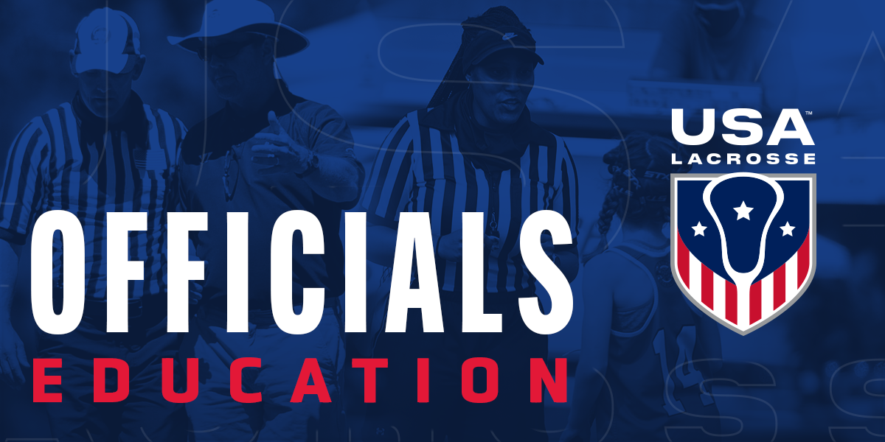
MENS THREE-PERSON MECHANICS
MENS OFFICIALS DEVELOPMENT | 2023 SEASON
Notes:
MENS THREE-PERSON MECHANICS
This presentation will take 90-120m as it is designed.
Please check the presentation prior to using for video compatibility
There have been some codec issues with newer versions of windows.
Please update your .mp4 codecs on your host computer

Slide 2
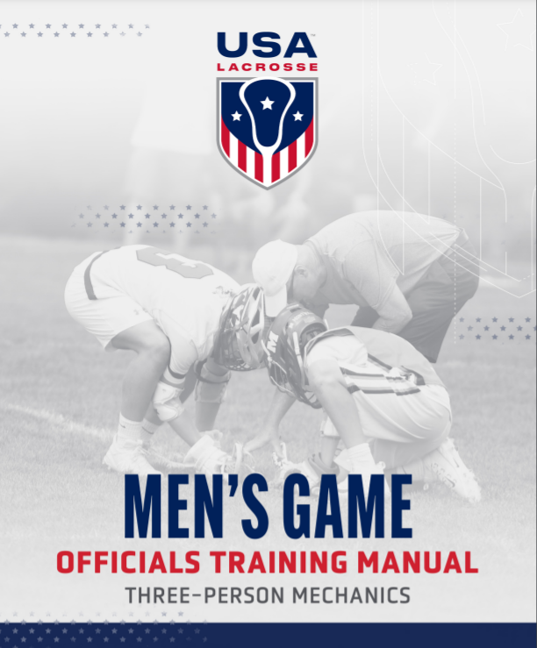
WHAT ARE MECHANICS?
OUR GUIDING PRINCIPALS
Me·chan·ics /məˈkaniks/
noun: mechanics; plural noun: mechanics
The way in which something is done or operated;
The practicalities or details of something.
  "The mechanics of lacrosse officiating"
  How we move with purpose and signal for clarity
2
Notes:
WHAT ARE MECHANICS?
Mechanics are simply the way we move on the field
It’s a team effort
The goal is clarity for all involved to understand our actions and communications

Slide 3
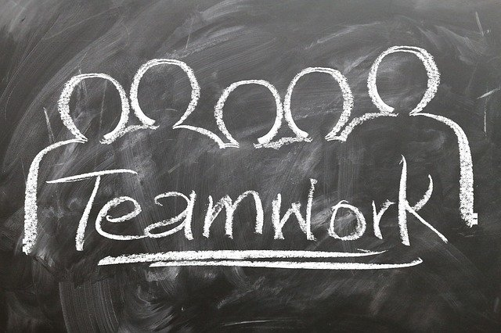
THE MISSION OF OUR MECHANICS
Position
Be in the be spot to see and make the call
Consistency
Make the same calls during the entire game
Fairness
Rules and game knowledge to promote a fair outcome
Safety
Priority #1 in today’s game. Make the calls
Notes:
THE MISSION OF OUR MECHANICS
Mechanics put officials in the best position to make the necessary calls to keep the game safe and fair by using methods that are easily applied in a consistent manner.
Position – The best spot to be in for most game situations. Hustling to your next spot is one of the best ways to show the clinicians that you are focused on the game and giving your maximum effort.
Consistency – Endeavor to make the same calls on each half of the field from the first whistle till the last. Communication with your partner is essential to crew consistency for an entire game.
Fairness – Your technical foul knowledge and game awareness factor heavily in a fair game. Address issues that unfairly give a team an advantage.
Safety – Priority number one for all officials in every game. Make the necessary safety calls when you see them.

Slide 4
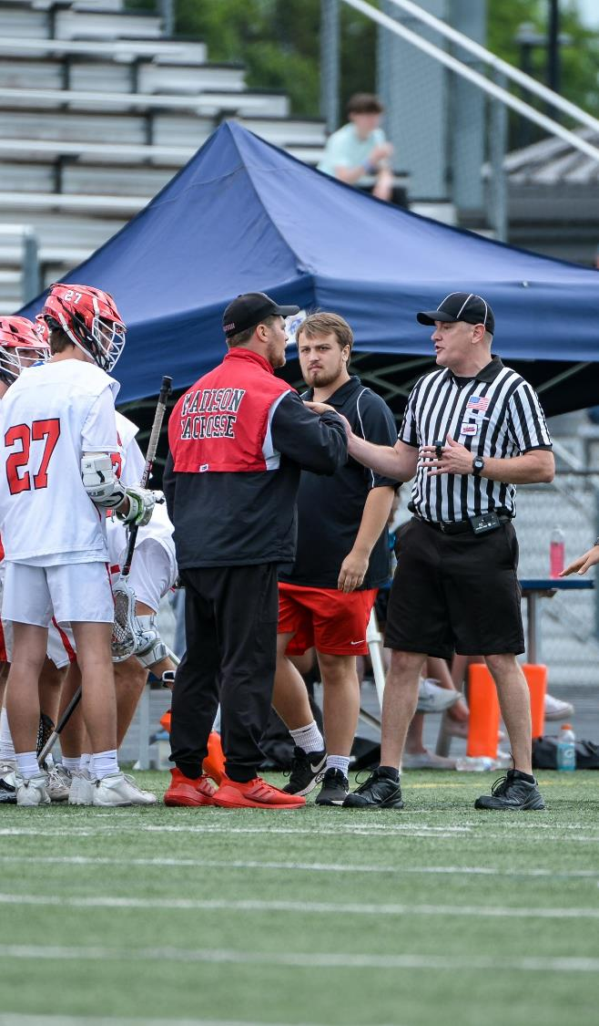
WHY CLEAR MECHANICS ARE IMPORTANT
COMMUNICATION IS KEY
Three basic things all coaches need to know…
  What's the call ?
  Who is getting the ball ?
  Where will the ball start ?
Notes:
WHY CLEAR MECHANICS ARE IMPORTANT
Mechanics are officials’ main form of communication to:
Players
Coaches
Fans.
We need to be clear, concise and consistent.
When officials use clear, concise and consistent mechanics coaches know what is happening and is one less thing they will get uneasy about.
Communication is your first line of defense.

Slide 5
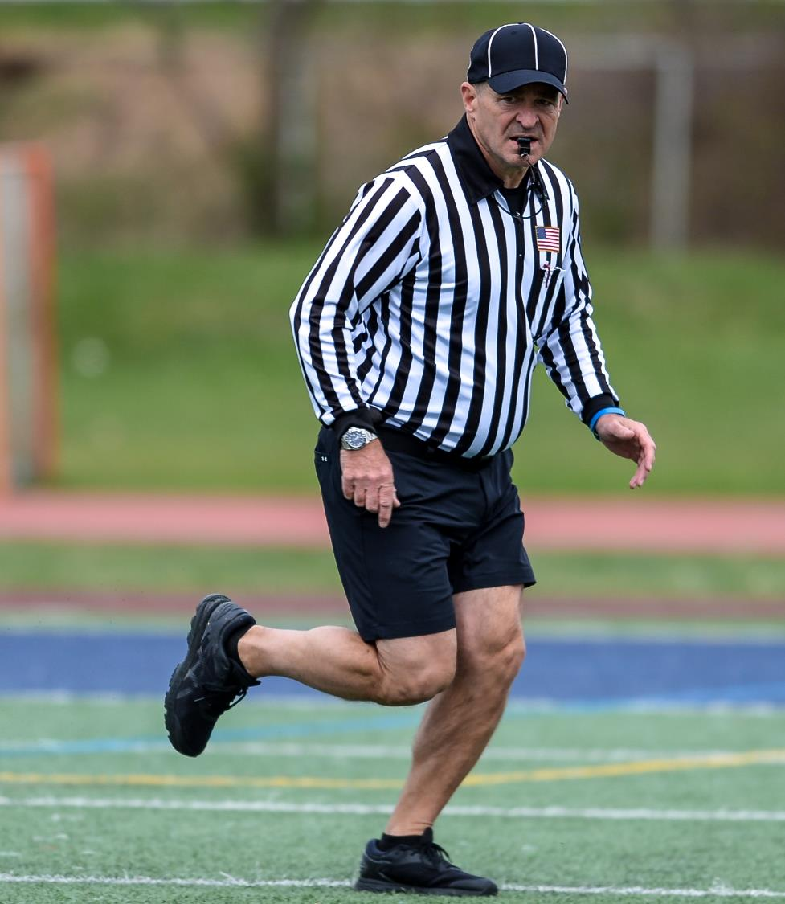
KEY CONSIDERATIONS
OPERATE WITHIN YOURSELF
Know your physical ability
Anticipate the play
Put yourself in the best position to make the best decision
Can you get in better shape?
Notes:
KEY CONSIDERATIONS
Your success will be determined by understanding what you bring to the table
Are you in shape?
Are you older or younger?
Are you a good communicator?

Slide 6
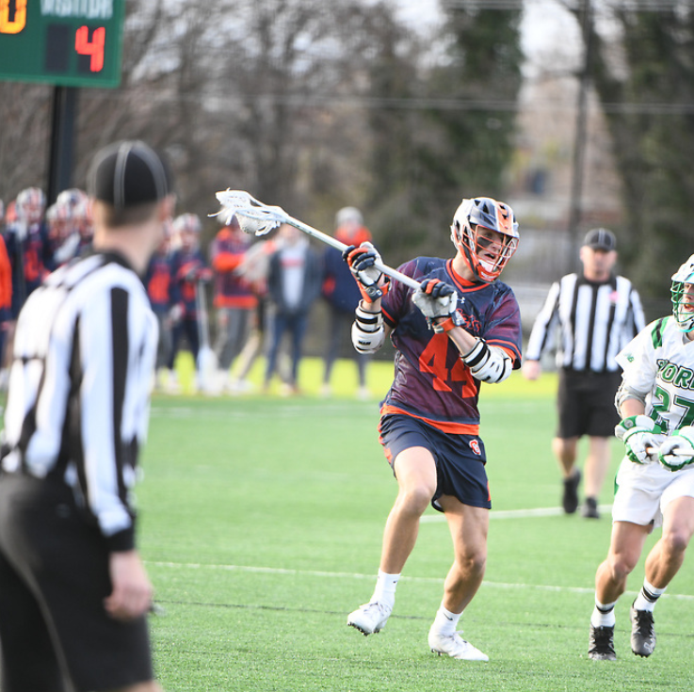
POSITIONING
RIGHT PLACE AT THE RIGHT TIME
  Where’s the ball?
  Am I “on-ball” or “off-ball”?
  Where could the ball go next?
  Where are my partners?
  Can I see all the players?
Notes:
POSITIONING
Ball Location – This will determine how close you are to the play, the crease or the midline
On and Off Ball – Lead and Single generally. When do we transition from “on-ball” to “off-ball”?
Anticipation – Over and back, shots
Partners – Does my single have GLE covered if I go to the endline as Lead?
Vision – Am I “inside” of the play getting “light-housed” or am I “yo-yo-ing” in and out as needed?

Slide 7
PRE-GAME MECHANICS
Coaches
Table Staff, Game Clock & Penalties
Captains coin toss
Face Off Players
Pre-game team line up, in-home on the field
Time outs and between quarters
Notes:
PRE-GAME MECHANICS
You establish your credibility when you take care if your pre-game duties
Your interactions with the various game stakeholders will determine your level of success during the game
Don’t minimize this part of the game

Slide 8
PREPARATION WITH TABLE STAFF
Penalty Clock and Scorekeeper
Prefer to use the game clock for penalties.
Know who we will be communicating penalties to.
Ask the penalty statistician to acknowledge our signals.
Go over the conditions for a penalty to release.
Penalties released AFTER possession on a face off.
Penalties usually released after a goal by the man up team.
Non releasable penalty situations
Review “early” release procedures.
Double horn next dead ball
Know the time remaining
Get it right
Notes:
PREPARATION WITH TABLE
The home team must provide the official timer and the official scorekeeper.
Identify who will perform each role.
Do they have experience?
If they are inexperienced go over their roles and responsibilities
Use the game clock for releasing penalties.
What to do if there is a problem:
Note who has the ball, where the ball is, and what the problem is
Sound a double horn at the next dead ball
The Head Referee will come to the table to sort out the problem while the Umpire keeps his eyes on the field.

Slide 9
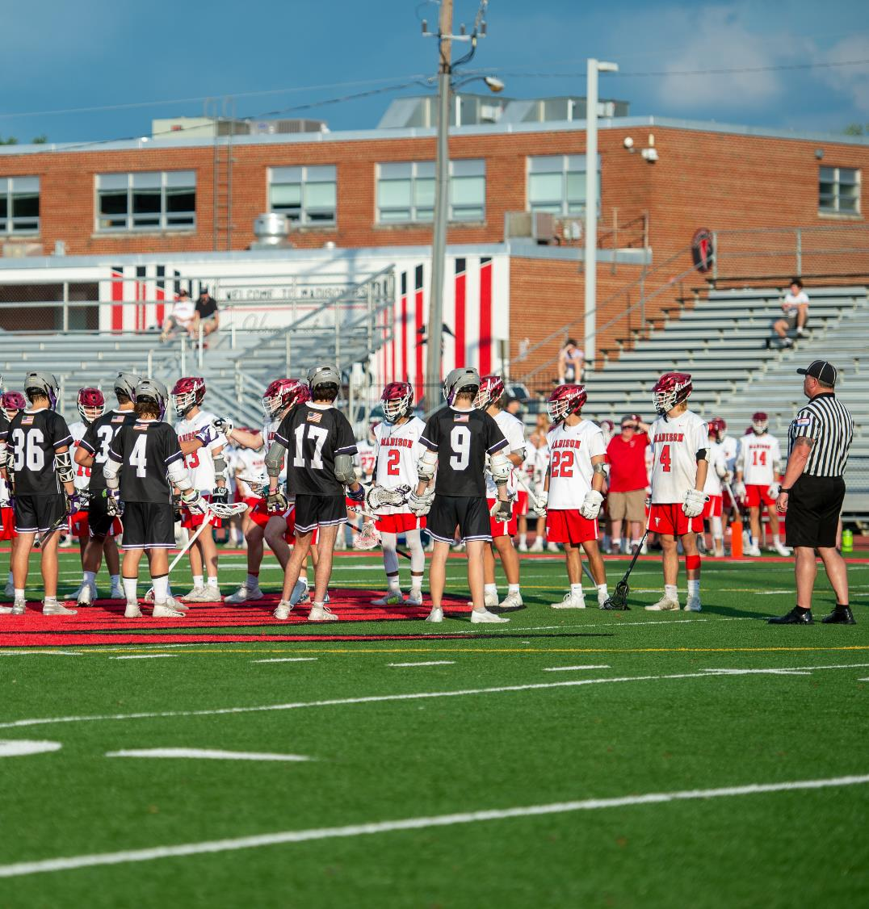
PLAYER PREGAME LINE UP
EVERYONE IS WATCHING
Proper Setup
Goalie’s left shoulder to goal they are defending
Defense, Midfield, Attack after Goalie
Faceoff player should be on midline
5 yards apart set by Umpire and Field Judge
Notes:
PLAYER PREGAME LINE UP
Referee has the game ball and stands at midfield across from the Umpire & Field Judge
Teams line up with their left shoulder to the goal they are defending.
The Referees should escort or guide the players to their line up positions avoiding teams from crossing through one another.
The Head referee introduces the Officials to the players and possibly a brief comment about sportsmanship and wishes all a good game.
R tells the goalkeepers to cross and shake hands, and then the same for the rest.
R becomes the faceoff official.
The Umpire becomes the helper/left official, placing one arm in the air until the field is set.
Th Field Judge becomes the Right official
Note: The line up is not the time to check player equipment. Make yourself available before the game for equipment checks

Slide 10
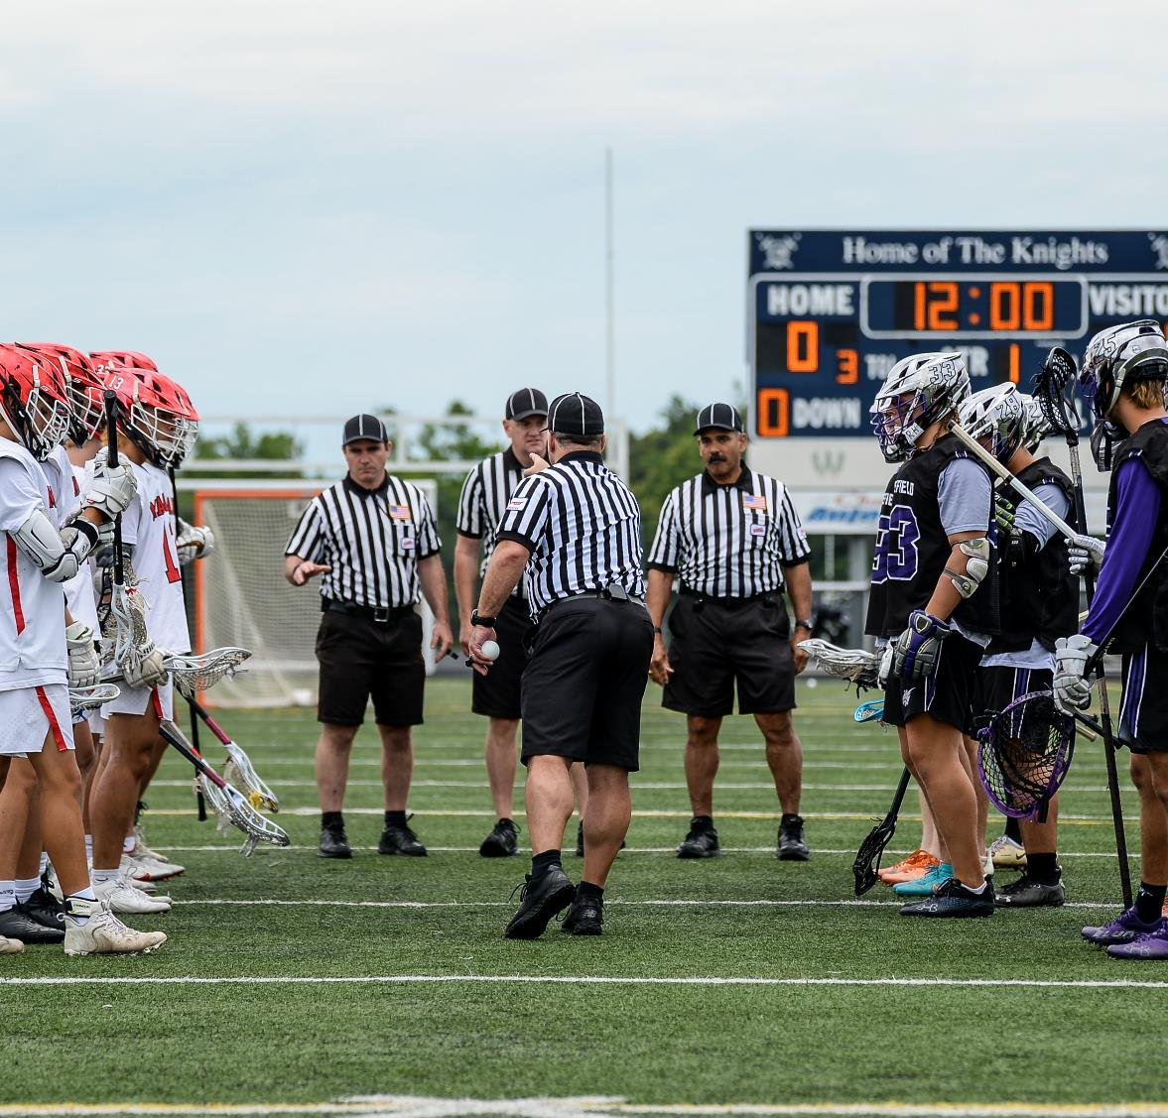
PLAYER PREGAME MESSAGING
FINAL CHANCE TO SET THE TONE
Messaging
Keep it short
Know what you are going to say
Ask the player to Respect the Game!
Sportsmanship
“Questions are OK, Comments are not!”
Goalie’s Cross
Gentlemen, introduce yourselves
Notes:
PLAYER PREGAME MESSAGING
This is unique to every Referee
Style is a key element
Establish you own style and practice your message

Slide 11
PRE-FACEOFF
F
L
R
Notes:
PRE-FACEOFF
Count players to make sure you have the correct number including those in penalty area
Check wings for shenanigans prior to faceoff
Make visual contact with all partners
Watch for “gamesmanship” with FO players
Make “small talk” and get the FO players on your team
For many FOGOs, they only care about this part of the game

Slide 12
FACE OFF OFFICIAL’S RESPONSIBILITIES
THE SINGLE-SIDE OFFICIAL CONDUCTS THE FACEOFFS
Makes sure both players are in a legal set-up position
Backs out diagonally to be clear of the players paths.
Watches player facing for early movement and other violations.
Knows where the far side wing players are before you put the ball down.
Restarts play after all violations
Notes:
FACE OFF OFFICIAL’S RESPONSIBILITIES
Control your environment
Stand over ball until you get the “ready” signal from your partner
Set the standard from the first faceoff

Slide 13
FACEOFF OFFICIAL’S MECHANICS
PLAYER AND STICK POSITIONING
May physically adjust the players’ positioning (including crosses).
Gives “Set” command with his hand on or near the ball or crosses.
Backs away and sounds the whistle while concentrating on the faceoff players’ actions, moving with the play as necessary.
Avoid "Swistles“ & change cadence
Get away from the players before blowing your whistle.
Know where the far side wing players are lined up and get out of their way coming into the play.
Notes:
FACEOFF OFFICIAL’S MECHANICS
Each officials has their own style
Some like to be close when blowing the whistle
Some like to be further away
KNOW where the wingmen are on single side

Slide 14
FACEOFF “HELPER”RESPONSIBILITIES
FACEOFF "HELPER" IS IN THE LEAD LEFT POSITION
Assists with face-off set up
Backs out diagonally
Responsible for left goal
Watches for early movement and violations
Can stop play and call violations
Watches for early release from restraining ling
Locks players behind restraining line on violations
Notes:
FACE OFF “HELPER”RESPONSIBILITIES
Assists Faceoff Officials with legal setup-Verbally
Backs out diagonally to bench side before faceoff
Has the left goal responsibility
Watches the player facing for early movement and other violations
Can stop play and call violations
Watches for early release from restraining line
Locks players behind the restraining line on Violations

Slide 15
FACEOFF WING OFFICIAL’S RESPONSIBILITIES
THE WING OFFICIAL IS IN THE LEAD RIGHT POSITION
Responsible for watching wings and all other players
Aware of players lined up next to each other for possible interference violations
Keeps all other players behind the restraining line
Watches for early release from restraining line
Locks players behind restraining line on violations
Notes:
FACEOFF WING OFFICIAL’S RESPONSIBILITIES
Responsible for watching the wings and all other players on the field.
Pay special attention to players lined up next to each other for possible interference violations
Makes sure all other players are behind the restraining line
Watches for early release from restraining line
Locks players behind the restraining line on Violations

Slide 16
FACEOFF WHISTLE
s
L
R
Notes:
FACEOFF WHISTLE
What are focused on at the whistle?

Slide 17
FACEOFF- BALL GOES LEFT
ANIMATED
S
S
L
L
R
T
Notes:
FACEOFF- BALL GOES LEFT
Discuss proper mechanics

Slide 18
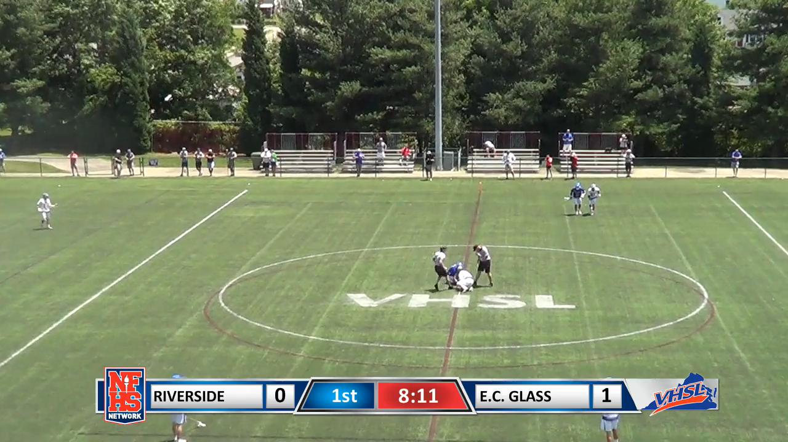
FACEOFF VIDEO - BALL GOES LEFT
Notes:
FACEOFF- BALL GOES LEFT
Video Example

Slide 19
FACEOFF- BALL GOES RIGHT
ANIMATED
Notes:
FACEOFF- BALL GOES RIGHT
Discuss proper mechanics

Slide 20
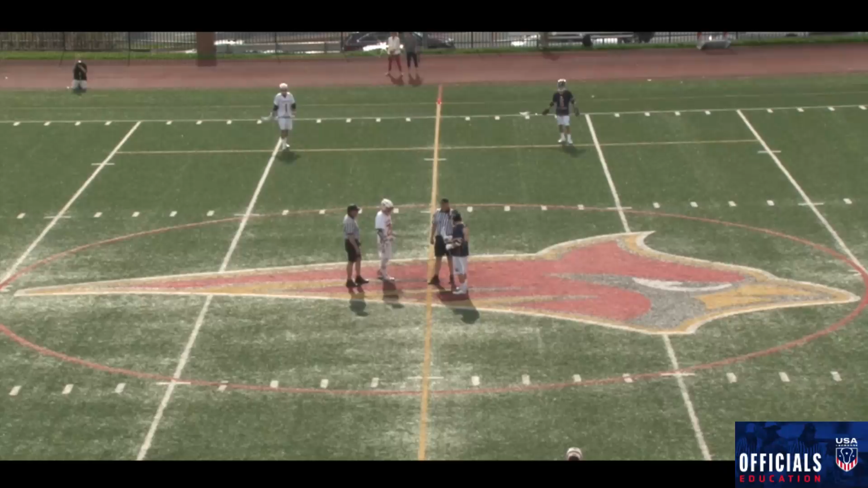
FACEOFF VIDEO – BALL GOES RIGHT
Notes:
FACEOFF VIDEO – BALL GOES RIGHT

Slide 21
FACEOFF VIOLATIONS
Pre-whistle – stand the players up without a whistle, signal/state the violation.
Post-whistle – blow the whistle immediately, and signal/state the violation.
Single Side Official handles all restarts
Restart from spot of violation
Lead Left and Lead Right make sure boxes are locked (no release) and delays restarts if necessary
Notes:
FACEOFF VIOLATIONS
Pre-whistle
Wing violations
Post-whistle
When is the faceoff over and the foul is NOT a faceoff violation?
Consider saying “ball is loose” or “faceoff over”

Slide 22
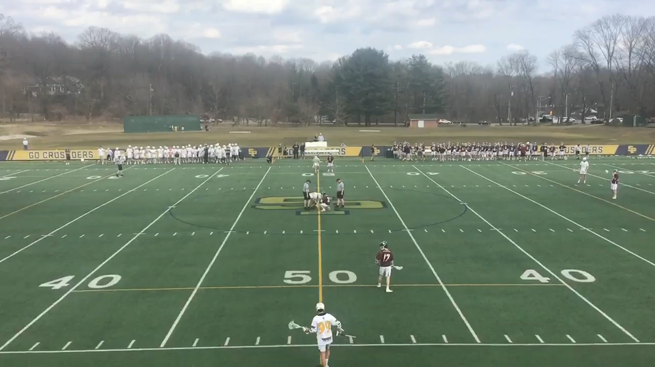
VIOLATION & RESTART
Notes:
VIOLATION & RESTART
Video Example

Slide 23
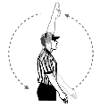
FACEOFF POSSESSION & PLAY
POSSESSION
Takes 20 and 10 sec counts
S
L
T
Notes:
FACEOFF POSSESSION & PLAY
When a player gains possession of the ball and make a lacrosse move (don’t blow this too early)
the ON official first will wind his arm backward and yell “Possession!”
The other officials will echo his partner’s call by winding their arms backward and yell “Possession!”
Once possession is established the Single Side takes the 20 and/or 10 counts.
If a loose ball crosses the restraining line the official closest will wind his arm backwards and yell “Play” with other officials echoing the call and signal.

Slide 24
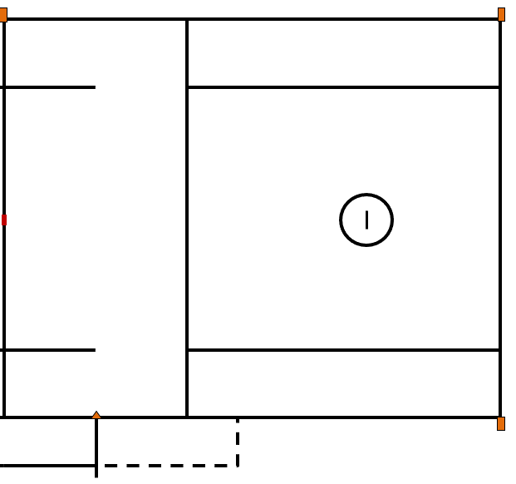
PRIMARY RESPONSIBILITIES
Lead
    Goal & Crease
    End line
Single
    Shooter
    Sideline
    Counts
    1st Offsides Count
Trail
    Shooter
    Sideline
    Opposite goal
    Over and back
    2nd Offsides Count
S
L
T
Notes:
Lead Official:
Goal is primary responsibility
Roughly one step above or below GLE and covers the end line on contested plays
Single Official:
Primary responsibility is the action in front of the crease
Also watches for late hits after a shot
Responsible for far sideline and all transition counts
Positioned 3-5 yards above GLE and moves toward GLE when the Lead official covers the end line
Trail Official:
Watches the shooter for late hits after a shot
Watches the high crease area
Watches for contested substitutions
Covers the far goal on a long outlet pass
Positioned near end of wingline

Slide 25
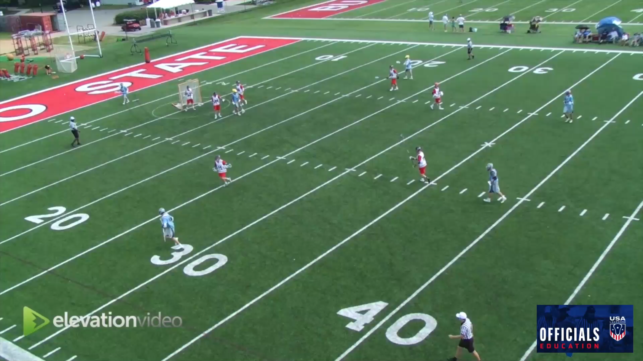
SETTLED SITUATIONS
Notes:
SETTLED SITUATIONS
ON Official
The “On” official is generally responsible for calling fouls committed against the player in possession
He also calls offensive fouls such as warding and withholding the ball from play.
The “On” official usually has a narrow focus on the player with possession and the surrounding 5 yards.
OFF Official(s)
The OFF official without ball coverage is focusing attention on the area in front of the crease and on cutters.
The “Off” official is generally looking for fouls such as late hits, illegal offensive screens, interference, and crease violations, which tend to occur away from the ball.
All officials must pay constant attention to their positioning.
They should keep their eyes on the field & avoid turning their backs to the goal and the play.
If there is any doubt who is the ON or OFF official, communicate verbally or by pointing.

Slide 26
ON & OFF BALL RESPONSIBILITIES
Notes:
ON & OFF BALL RESPONSIBILITIES
Animation covers areas as ball moves

Slide 27
LINE RESPONSIBILITIES
T
S
L
Notes:
LINE RESPONSIBILITIES
Out of bounds
Some restarts

Slide 28
GOAL SCORED & ENSUING FACEOFF
L
F
R
T
T
S
S
L
L
Notes:
GOAL SCORED & ENSUING FACEOFF
Animated proper procedure for goal scored coverage and faceoff

Slide 29
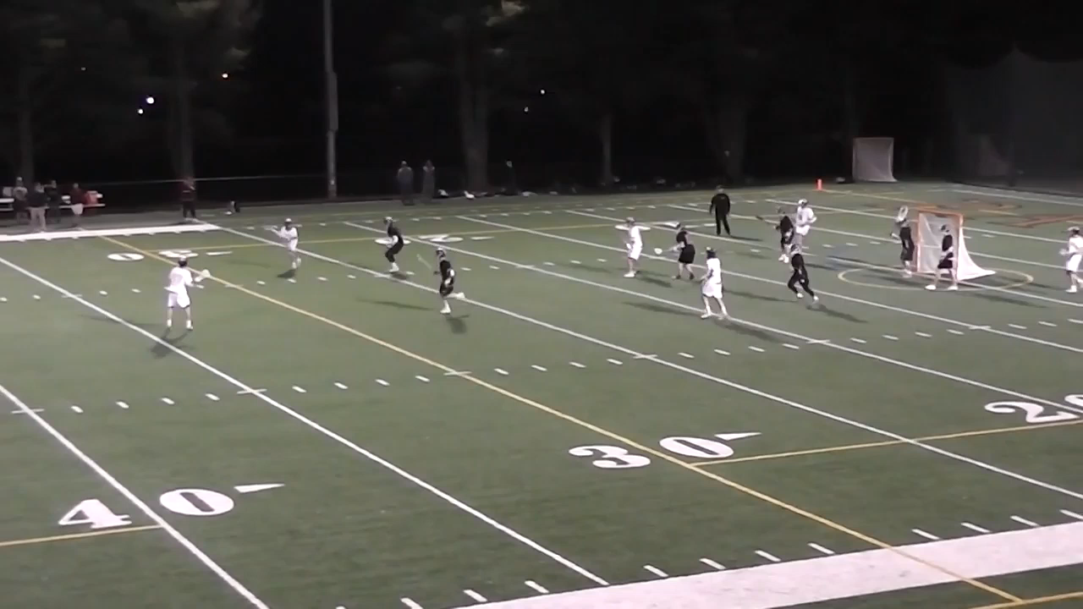
GOAL SCORED VIDEO EXAMPLE
Notes:
GOAL SCORED VIDEO EXAMPLE
The Grey Area is the diagonal line separating the officials’ areas of focus.
The on or off official changes depending on where the ball is.
When a player carries the ball from your "on area to the gray area you should stay with that player in the grey area, until he is clearly into your partners on area.
Avoid having 2 official watching the ball carrier in the grey area.
Discuss this in pre-game.

Slide 30
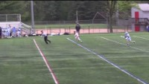
OVER AND BACK
Notes:
OVER AND BACK
The trail official is responsible for Over and Back
If an OAB is called, the trail official stops play, and the single officials restarts play

Slide 31
SETTLED PLAY – WHO IS RESTARTING?
T
S
L
Notes:
SETTLED PLAY – WHO IS RESTARTING?
Which line was crossed?
Where is everyone going?
Walk through these scenarios

Slide 32
DEEP RESTARTS ACROSS FIELD
S
Single
Stand OFF the field at the cone. Let the ball pass you, begin your 10s count and follow ball to box
L
T
New Lead
Be 2 lines ahead of ball. Begin to transition to GLE as ball crosses restraining line
New Trail
Stay with or just behind ball as it moves up field. As ball crosse midfield, pause and check offsides, then move into position.
Notes:
DEEP RESTARTS ACROSS THE FIELD
Discuss ready relay from Lead to Single to Trail
Discuss signaling for single to let trail know when player is on field
Discuss wide triangle

Slide 33
RESTARTS AT SUBSTITUTION BOX
BALL ON DEFENSIVE SIDE
S
Remember to make sure ball is in 5y from sideline when within the box area.
L
T
Notes:
RESTARTS AT SUBSTITUTION BOX
BALL ON DEFENSIVE SIDE

Slide 34
RESTARTS AT SUBSTITUTION BOX
BALL ON OFFENSIVE SIDE
Lead & Singe already in position if ball already cleared
S
L
Remember to make sure ball is in 5y from sideline when within the box area.
T
Notes:
RESTARTS AT SUBSTITUTION BOX
BALL ON OFFENSIVE SIDE

Slide 35
ENDLINE RESTART AFTER SHOT
BALL TO DEFENSE - ANIMATED
S
T
L
Notes:
ENDLINE RESTART AFTER SHOT
Single hustles to cone
New Trail blows whistle as soon as player is ready (d not wait for partners)
New Lead hustles to midfield and then to far restraining line

Slide 36
FAST BREAK TO OPPOSITE END
ANIMATED
S
T
L
Notes:
New Lead Official:
Sprint to cover your goal. Allow your partner to pick up the offside
Has the 10-second count when ball crosses midfield
Note: You may need to keep your eyes on the shooter if your Trail official is not yet in position.
New Trail Official:
Has the 4-second crease count and 20-second clearing count
Make sure all additional action has ceased and then hustle to your position
Count forward when determining offside
Note: Do not leave your partner hanging. Hustle to your next position and tell your partner. It is a one-person game during a fast break until the Trail gets into position.
“The game moves fast, so slow it down. That was something my supervisors consistently said to me: Slow it down and let the game come to you.”
– Mike Liner, NCAAF

Slide 37
PENALTY RELAYS
Inform your partners and the players
Get to open space, facing the table, at the wing/midfield intersection
Take a breath
Be aware of Pace, Tone, Volume: Slow, Calm Relaxed
CNOTe
When and Why the “E”
Notes:
PENALTY RELAYS
Discussion about relay to partners, then table

Slide 38
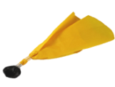
PENALTY RELAYS
ANIMATED
Relay
S
L
T
C-NOTE
Notes:
PENALTY RELAYS
Animated replay
Discuss getting field ready while penalty ir reported

Slide 39
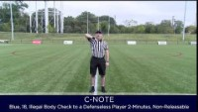
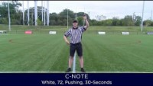
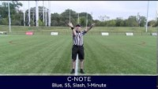
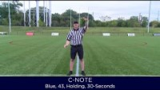
PENALTY RELAYS
VIDEO SAMPLES
Notes:
PENALTY RELAYS
Watch Videos
1 Click for each after each is done
Have participants practice

Slide 40
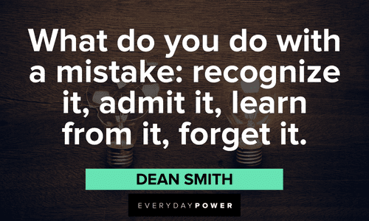
CORRECTING MISTAKES BY OFFICIALS
YOU WILL MAKE THEM
Mistakes are inevitable
How you handle them will determine your future as an official
Admitting your mistake is the first step
HOW you “admit” the mistake is a key part
  Are you self-deprecating?
  Are you angry and defensive?
  Do you ignore your mistakes?
Know and practice YOUR process!
Notes:
CORRECTING MISTAKES BY OFFICIALS
You WILL make mistakes, we ALL do
Acknowledge the mistake (pointing the wrong direction, error in penalty enforcement)
Allow both coaches an opportunity to understand what the correct call
Allow the teams to have the correct players on the field for the situation
Only restart play when both coaches acknowledge they have the correct players on the field for the situation and let everyone know where play will be starting.

Slide 41
END OF GAME
Have end of game exit strategy.
Sign the scorebook.
You job ends when we leave the immediate playing facility.
Leave the field together.
Acknowledging the coaches is ok.
Notes:
END OF GAME
Game management
It's recommended to have an end of game exit strategy.
Some areas require an official to sign the scorebook.
The official's responsibilities end when we leave the immediate playing facility, NFHS Rule 2, Sect. 6, Art.1.
The bench side official can approve the score and pick up any gear from the table area then meet the far side official to professionally exit the playing field.
Acknowledging the coaches with a wave is ok. It is not required to shake hands with coaches or players.

Slide 42
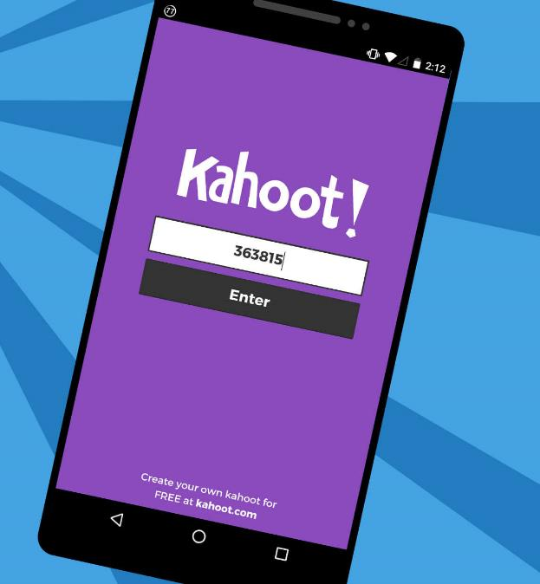
KAHOOT!
GAME-STYLE LEARNING
Kahoot! is a digital learning platform that uses quiz-style games to help students learn by making the information engaging in a fun way.
As one of the biggest names in quiz-based learning, it's impressive that Kahoot! still offers a free-to-use platform, which makes it highly accessible for teachers and students alike. It's also a helpful tool for a hybrid class that uses both digital and classroom-based learning.
The cloud-based service will work on most devices via a web browser. That means this is accessible for students in class or at home using laptops, tablets and smartphones.
Notes:
KAHOOT (You need to be connected to the internet to Play Kahoot!)
Practice this before the class starts
Open the link and have it sitting in a browser window waiting
No app or login is required

Slide 43

KAHOOT INSTRUCTIONS
PLAYERS
On your smartphone, tablet or laptop, go to www.kahoot.it
Wait for the instructor to give you the Game Pin
Enter your first name and last initial ONLY
INSTRUCTORS
A Kahoot account can keep track of results, otherwise, you can play without an account
https://create.kahoot.it/auth/login
Create a free BASIC account (up to 50 users) or paid PRO account (up to 100 users)
Click on the link below
Game will open in an internet browser window
USA Lacrosse Officials Development Program - THREE PERSON MECHANICS
Notes:
You need to be connected to the internet to Play Kahoot!

Slide 44
THANK YOU TO THE MEMBERS OF THE
2023 MENS OFFICIAL’S EDUCATION DEVELOPMENT TEAM
Notes:
THANK YOU TO THE MEMBERS OF THE
2023 MENS OFFICIAL’S EDUCATION DEVELOPMENT TEAM

