Slide 1
RULE 4-PART 2 – THE FACEOFF
MENS OFFICIALS DEVELOPMENT | 2023 SEASON
Notes:
Trainer Instructions:
MATERIALS NEEDED
Projector or TV to present
Computer w/Presentation
Copies of Student Notes (can send ahead via PDF)
Copy of Instructor Notes
Time: 30-60 Minute Lesson

Slide 2
THE FACEOFF
HOW CAN WE HELP OURSELVES AS OFFICIALS?
Define our expectations
It is all about communication
Quick but not fast
2
Notes:
THE FACEOFF
One of the key and most controversial parts of any game
YOU set the tone
Don’t underestimate the game effect of a well-done faceoff protocol

Slide 3
DEFINING EXPECTATIONS
PRE-GAME FACEOFF MEETING
You should meet with coaches and faceoff players prior to each game
At a minimum, spend a few minutes at the first faceoff with the players.
PRESENTATION TITLE HERE
Class Discussion Questions
3
Notes:
DEFINING EXPECTATIONS
This is your chance to set the tone BEFORE the game starts
Relationships with faceoff players should be a PARTNERSHIP
CLASS DISCUSSION
As a class review what you would talk about with the coaches and face-off players prior to the game in a meeting, or at minimum prior to the game face-off

Slide 4
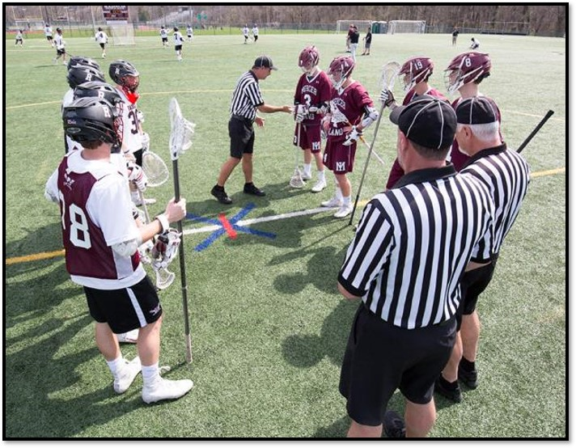
PRE-GAME FACEOFF MEETING PROCEDURE
SOLVE PROBLEMS BEFORE THEY HAPPEN
Immediately after the captains have left
  Invite all faceoff players to the center
  Invite the coaches as well
  Know your message
  Answer questions
  Check sticks if asked
Pregame this with your crew
Class Discussion Questions
4
Notes:
PRE-GAME FACEOFF MEETING PROCEDURE
Is this necessary?
Do you do it always?
What about late in the season. Does it still matter?

Slide 5
DISCUSSION ITEMS FOR FACEOFF PLAYERS
Be ready for “Down” position
Stick heads: “Top to Stop”
Out of Neutral Zone
Parallel but not touching line
Hands touching ground & wrapped around stick
No leaning stick head
No body parts on the ground
1
2
3
4
5
6
7
5
Notes:
DISCUSSION ITEMS FOR FACEOFF PLAYERS
Be ready when asked to assume the “Down” position
Line the head of the sticks up from the “Top to Stop”
Stay out of the neutral zone
Sticks parallel to the line but not touching the line
Hands on the ground
Sticks cannot be leaning
No body parts on the ground
The motorcycle grip is no longer allowed
Players must play the ball
Hands off the plastic, no tape on the head of the stick
Contrasting color on the shaft of the stick
If there is a question regarding the faceoff, ask at the next faceoff. Get out there ASAP!
From these points, select the items you feel need to be addressed for your game

Slide 6
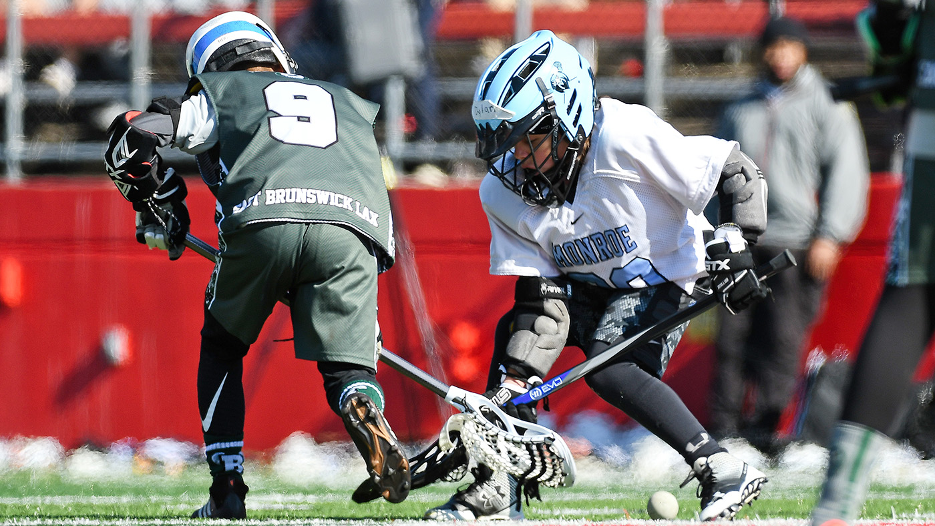
NO PREGAME MEETING
YOUTH & TOURNAMENT GAMES
Let’s be honest, sometimes we can’t have the pregame conference due to time. With youth and tournament games using running time, starting on the hour and ALWAYS behind schedule, we can’t always follow all the steps…so what should we do?
At the first faceoff, have a quick conversation defining your expectations on how you want to conduct the faceoff.
What do you want from the players?
What are the main points you want to address for the faceoff to be conducted smoothly.
6
Notes:
NO PREGAME MEETING
Some situations just don’t allow for a formal meeting
You should still establish that protocol to minimize violations
Have a short version
Introduce yourself
Consider shaking hands and building consensus for a clean faceoff game

Slide 7
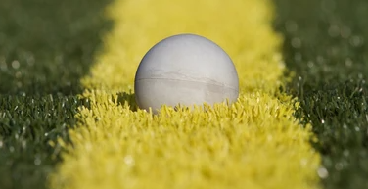
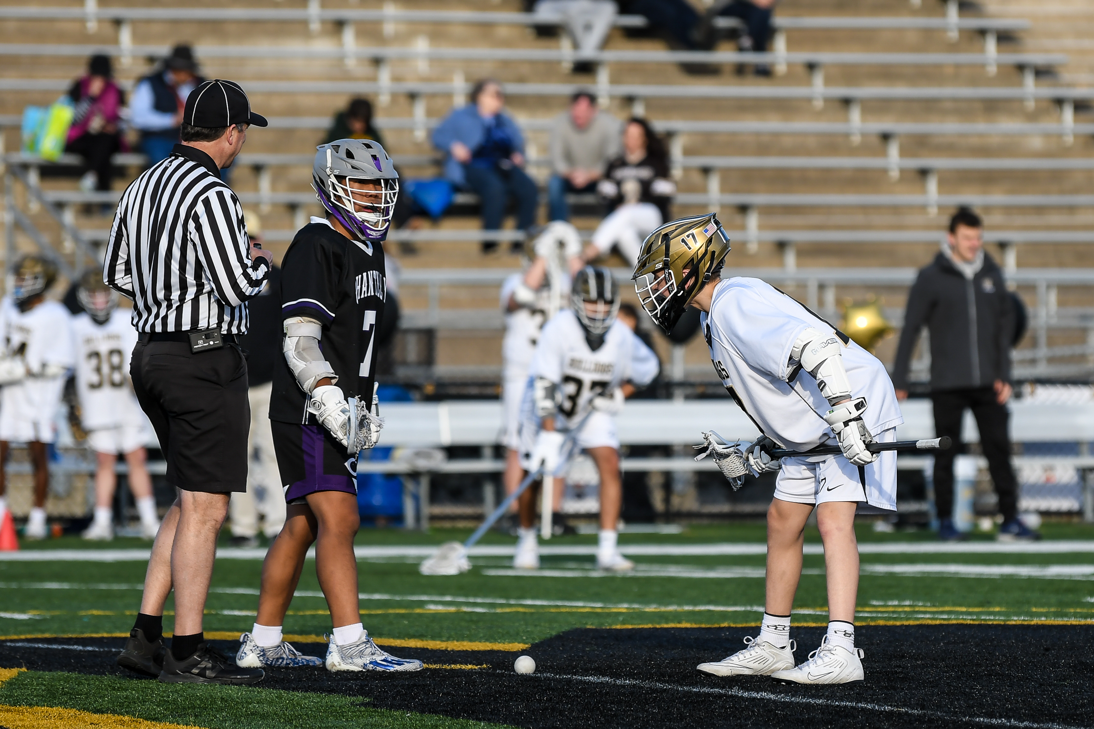
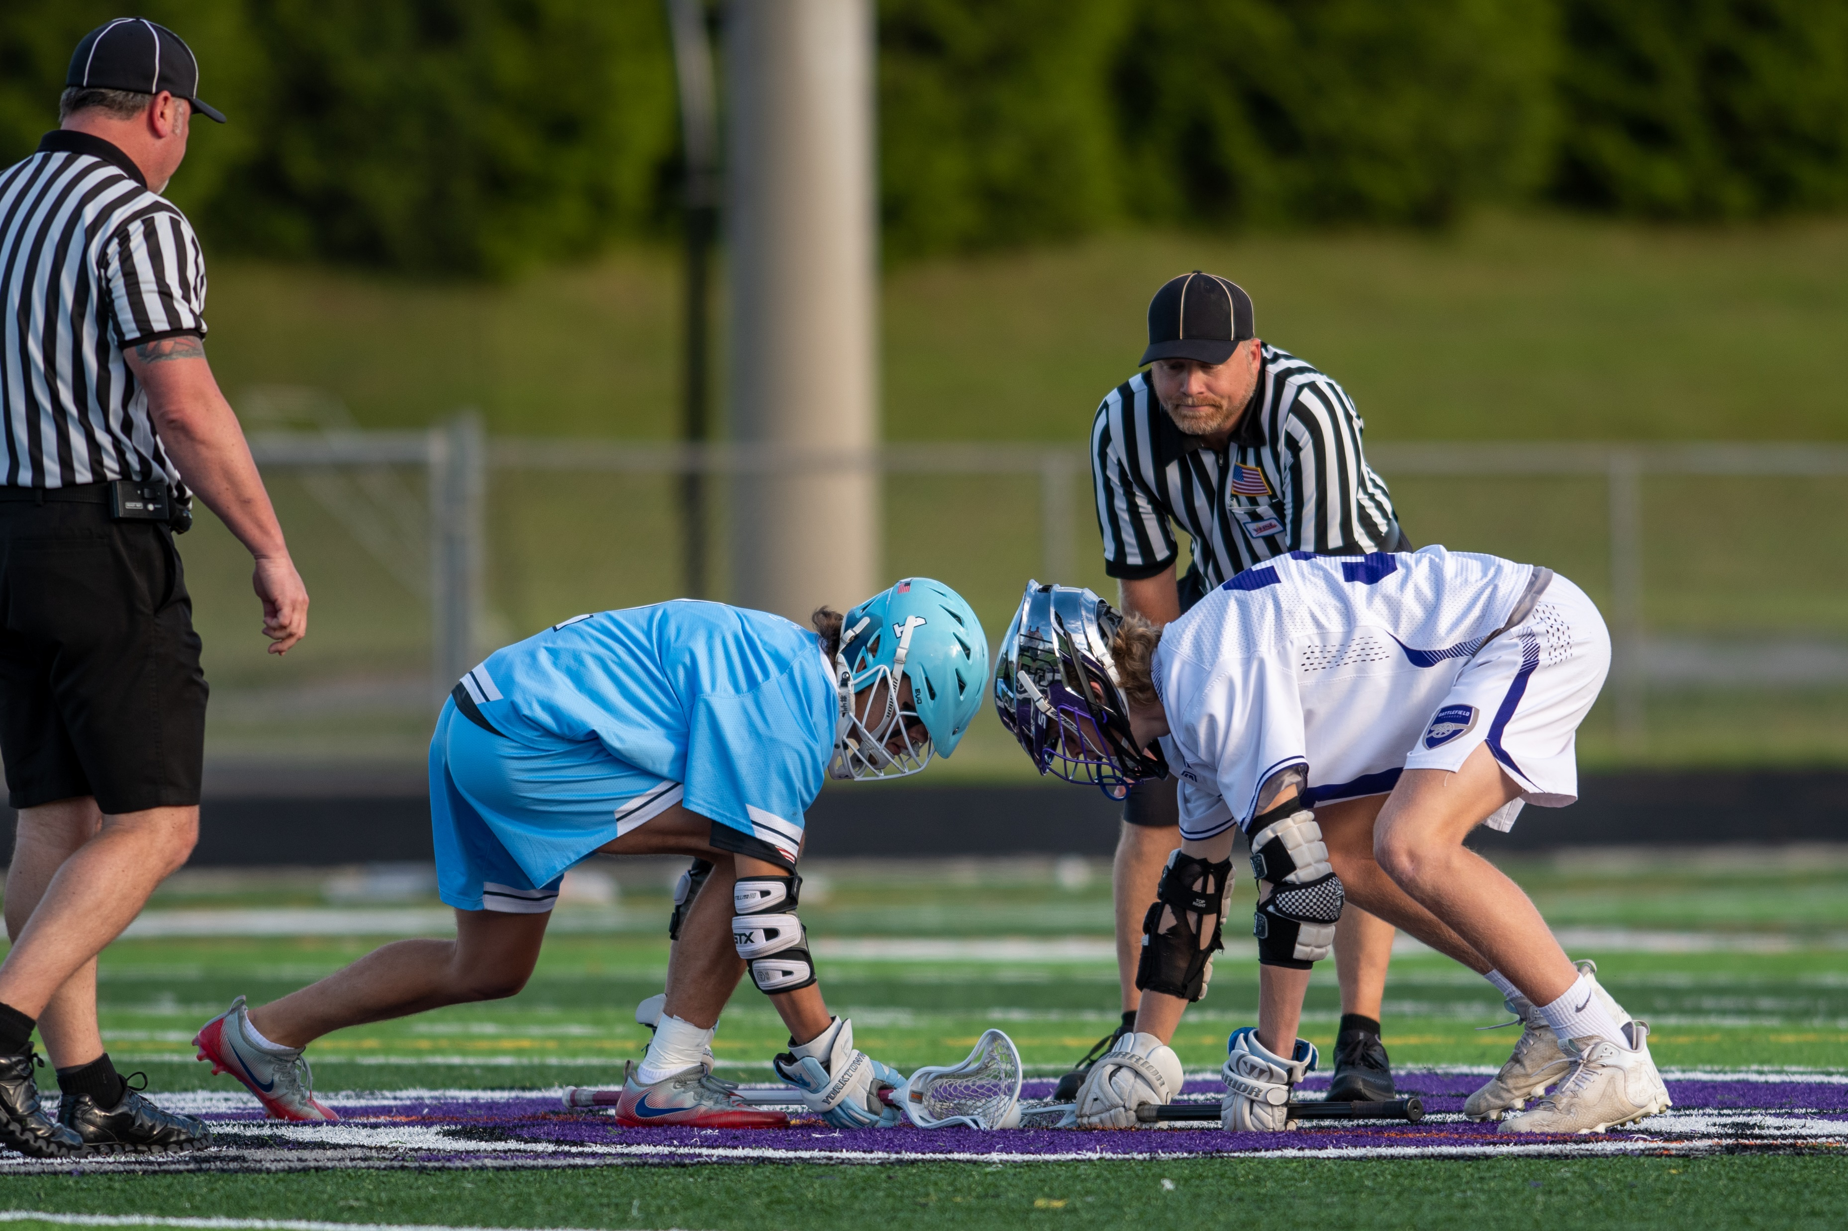
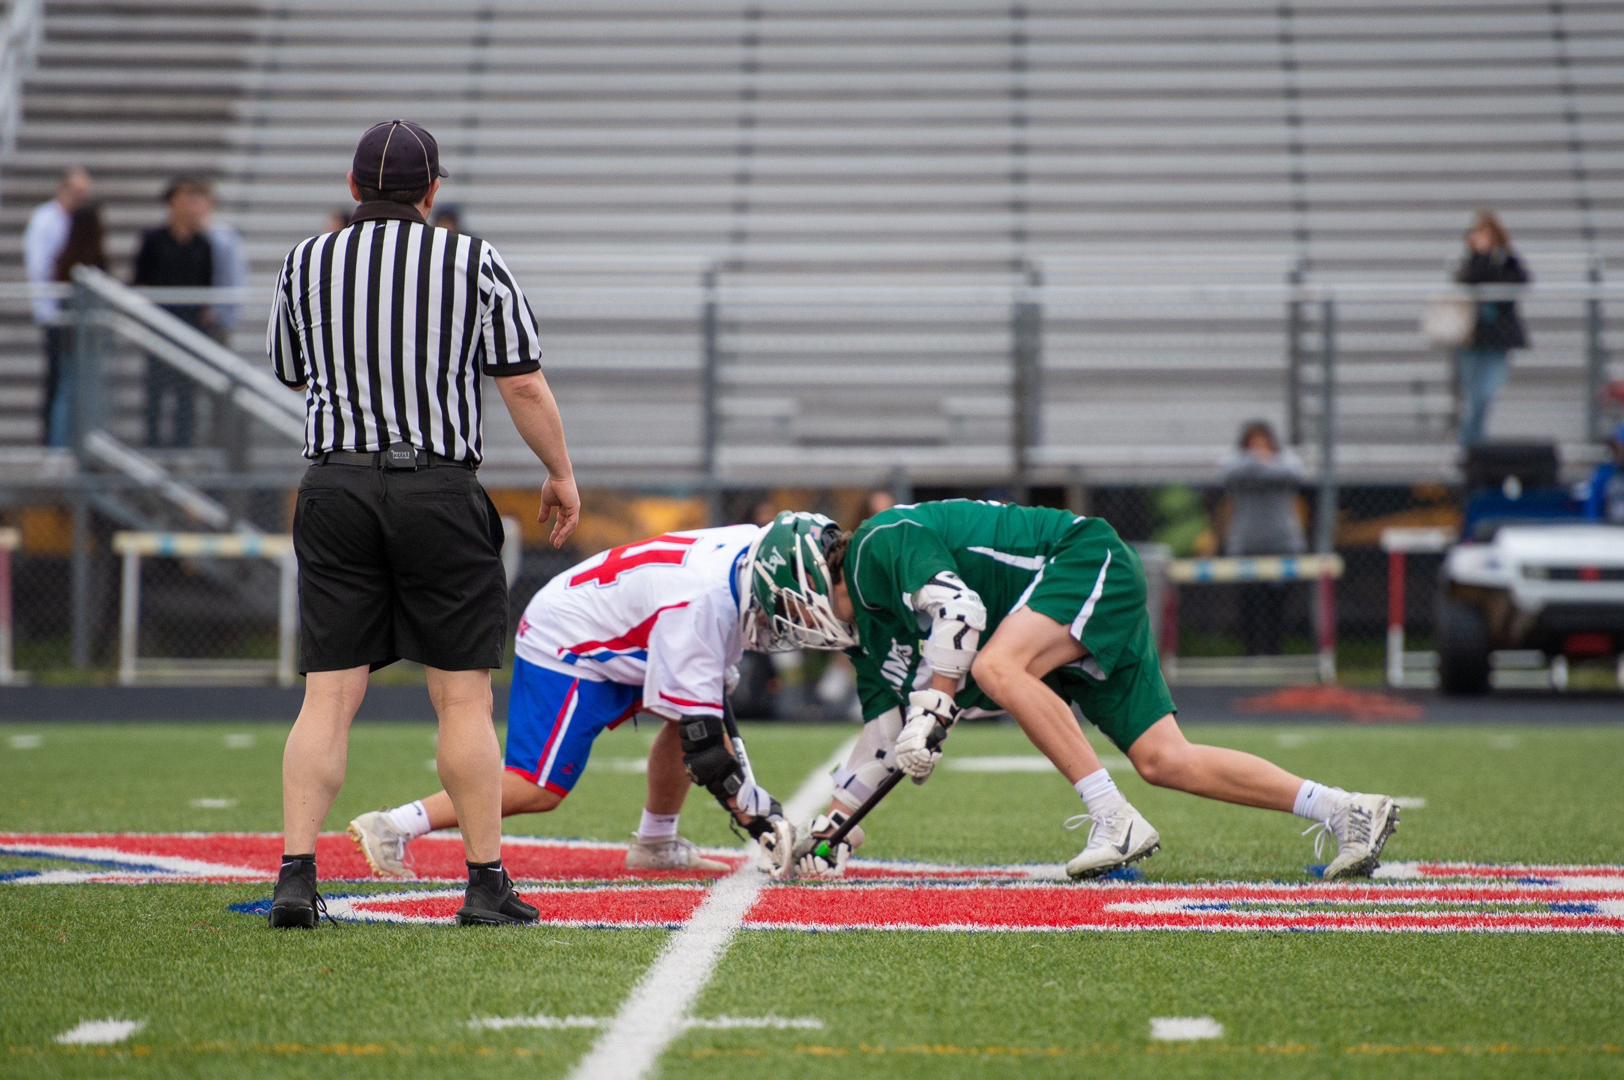
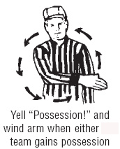

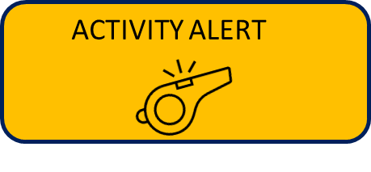
CONDUCTING THE FACEOFF
CONSISTENCY IS KEY
Ball
Down
Set
Whistle
On Possession, ALL Officials Wind!
MAKE CORRECTIONS HERE
7
Notes:
CONDUCT THE FACEOFF
Place the ball at the point of the faceoff first.
Down
May move players if needed
Say “Set”
Back away and whistle
It is legal to clamp the ball but must be moved, raked or directed immediately, within one step.
ACTIVITY: have participants work in teams and set up face offs, have each team self-assess their teammates

Slide 8
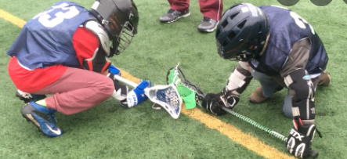
LEGAL FACEOFFS
QUICK VISUAL CHECKS
Hands on Shaft
not plastic
Fingers wrapped around shaft & touching the ground
Sticks parallel to line and vertical
Sticks up to, but not touching line
8
Notes:
LEGAL FACEOFFS – VISUAL CHECK
Hands around shaft, not touching the plastic
All fingers touching the ground
Hands off the head of the stick
Stick parallel to the centerline
Heads of the stick vertical
No tape on head of stick
Sticks up to but not touching the line
Note: The ball is placed down first which indicates the faceoff position.
Note: Motorcycle grip is no longer allowed. The hand closer to the head of the stick must be in a palm up position. Contrasting color on the shaft of the stick (via tape or a shaft color. The head and a bare shaft cannot be the same color)

Slide 9
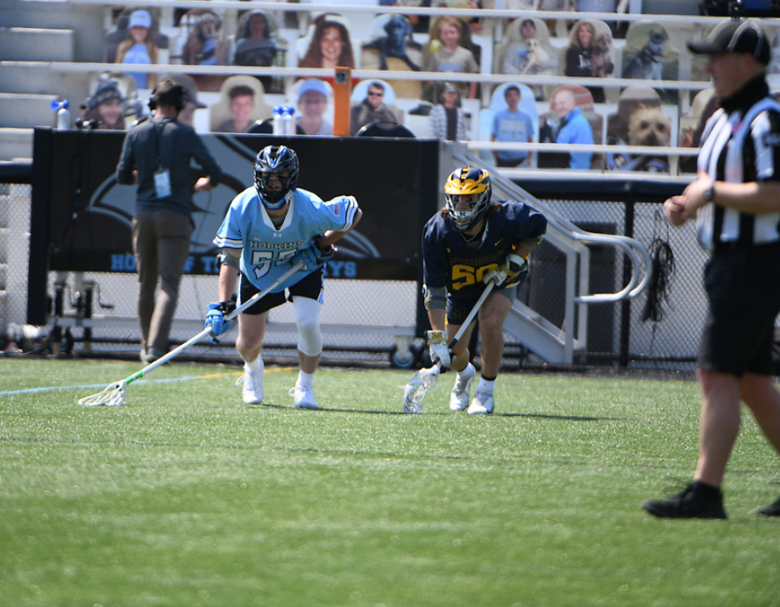
WING PLAYERS
DON’T FORGET ABOUT THEM
Wing players can only check the faceoff players stick until the faceoff has ended
If they check the faceoff players battling for the ball
  Unnecessary Roughness flag thrown
  Penalty at least 2 minutes full time
9
Notes:
WING PLAYERS
Don’t sleep on these players
Lots of cheap shots can happen here
Sometimes a challenge to watch, especially 2-man
Preventative officiating can solve problems
DISCUSSION QUESTION
When does the faceoff end?

Slide 10
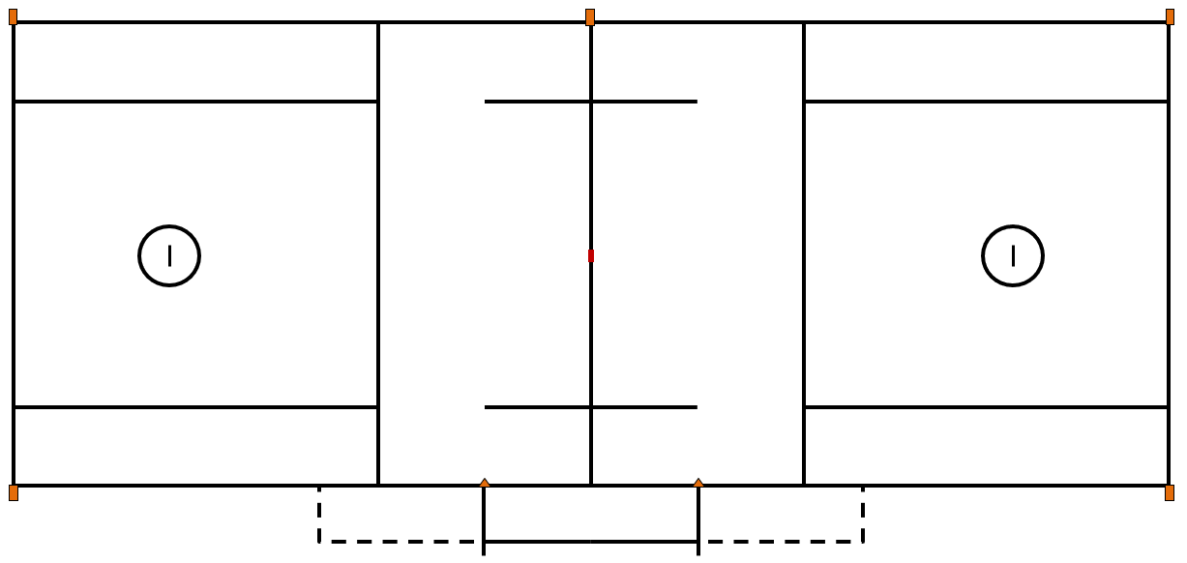

PLAYERS IN PENALTY AREA DURING A FACEOFF
KNOW THE PROTOCOLS FOR RELEASE
The wing must be left open
If penalty time has expired and possession has been signaled on the faceoff, player in the box is released.
If penalty time has expired but no possession has been signaled, the player must remain in the box until the official’s signal possession
w
w
B
B
Class Discussion Questions
w
10
Notes:
PLAYERS IN PENALTY AREA DURING A FACEOFF
Make sure EVERYONE know the situation before the faceoff
Partners
Table staff
Coaches
CLASS DISCUSSION
If the player comes out before possession, what violation is called?
How is it adjudicated?
Does the near wing have to be left open for release?

Slide 11
LOOSE BALL, TECHNICAL FOUL DURING A FACEOFF
WHAT DO WE DO WITH THE PLAYERS BEHIND THE RESTRAINING LINES?
11
Notes:
LOOSE BALL TECHNICAL FOUL DUIRNG A FACEOFF
Play will be restarted with the players who were behind the restraining line remaining behind lines.
Do you hold up play to put them back?
Do the offensive players have to wait to com out of the box until the whistle?

Slide 12
WHEN DO WE SIMPLY START OVER?
WE DON’T ALWAYS GET A CLEAN FACEOFF
Ball goes out of bounds in midfield and officials don’t know who last touched the ball
An inadvertent whistle before the ball crosses the restraining line
An injury occurs in the midfield area
Simultaneous fouls of equal duration occur while the ball is loose
Official calls timeout before a team gains possession
Ball gets stuck in a uniform or equipment other than a crosse
12
Notes:
WHEN DO WE SIMPLY START OVER?
Sometimes, too many things happen and we need to start over
The goal is to make it fair
Do we put time back on the clock? (No)
Do we allow subs?

Slide 13
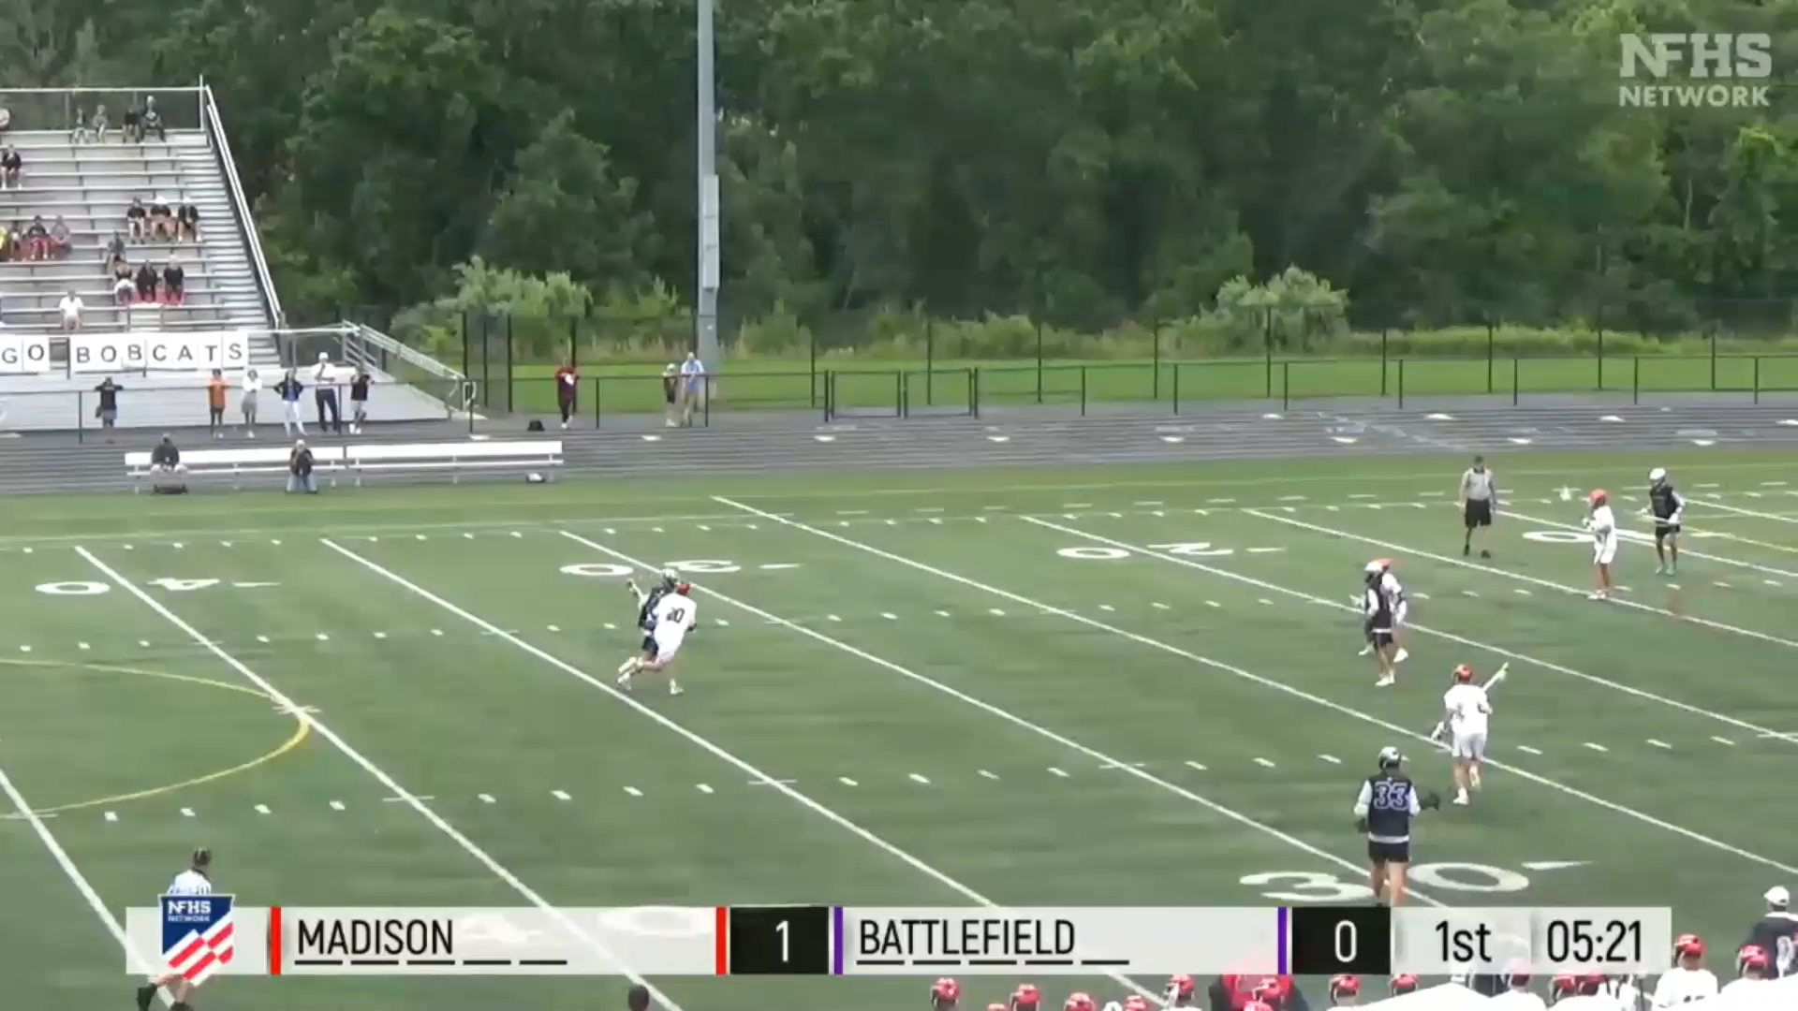
FACEOFF AFTER GOALS
WHAT IT LOOKS LIKE WHEN DONE CORRECTLY
When a goal is scored and the ball has been retrieved, HUSTLE to the faceoff spot
Write down the scores and such prior to the faceoff near midfield
Lead official blows whistle WHEN goal is scored, runs to crease and signals.
Single-side official enter goal area to watch for post-goal issues while lead gets ball.
Trail official has already backed-out, keeping his eye on the field and monitoring the sub area
Faceoff officials arrives, sets the ball, 18 seconds after the goal is scored
Class Discussion Questions
13
Notes:
FACEOFF AFTER GOALS
Video example of a faceoff after a goal
The faceoff was conducted within 30s of the gal being scored
CLASS DISCUSSION
What other good habit did you notice from this crew?
Anything you would do differently?

Slide 14
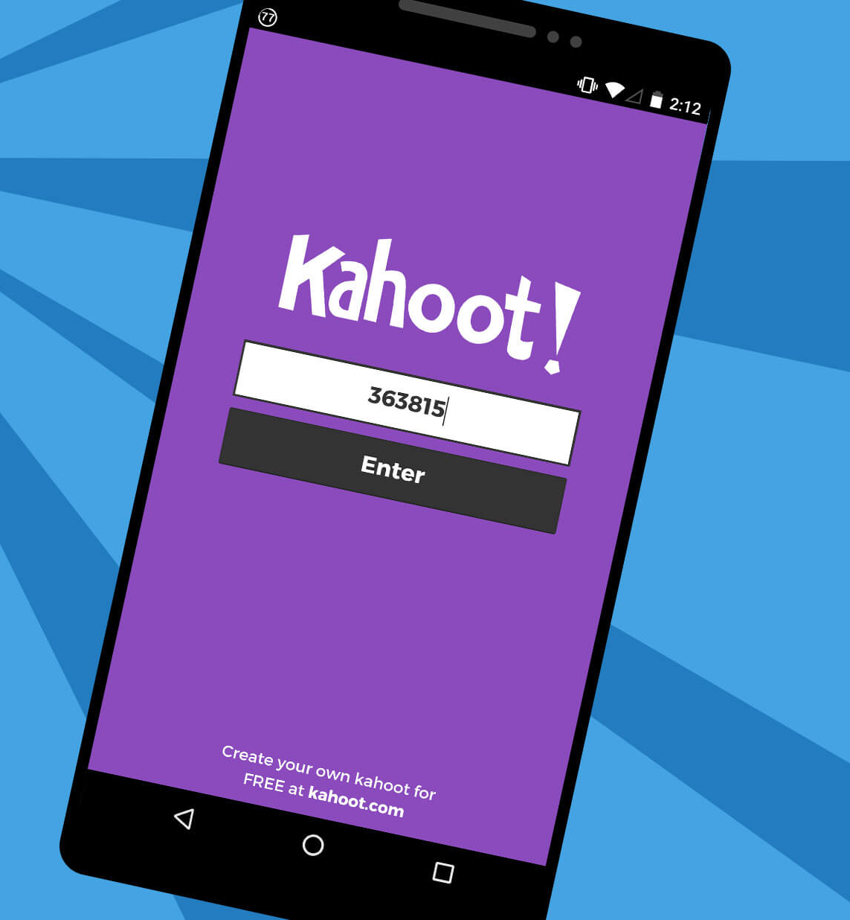
KAHOOT!
GAME-STYLE LEARNING
Kahoot! is a digital learning platform that uses quiz-style games to help students learn by making the information engaging in a fun way.
As one of the biggest names in quiz-based learning, it's impressive that Kahoot! still offers a free-to-use platform, which makes it highly accessible for teachers and students alike. It's also a helpful tool for a hybrid class that uses both digital and classroom-based learning.
The cloud-based service will work on most devices via a web browser. That means this is accessible for students in class or at home using laptops, tablets and smartphones.
Notes:
KAHOOT (You need to be connected to the internet to Play Kahoot!)
Practice this before the class starts
Open the link and have it sitting in a browser window waiting
No app or login is required

Slide 15

KAHOOT INSTRUCTIONS
PLAYERS
On your smartphone, tablet or laptop, go to www.kahoot.it
Wait for the instructor to give you the Game Pin
Enter your first name and last initial ONLY
INSTRUCTORS
A Kahoot account can keep track of results, otherwise, you can play without an account
https://create.kahoot.it/auth/login
Create a free BASIC account (up to 50 users) or paid PRO account (up to 100 users)
Click on the link below
Game will open in an internet browser window
USA Lacrosse Officials Development Program - FACEOFFS
Notes:
You need to be connected to the internet to Play Kahoot!

Slide 16
THANK YOU TO THE MEMBERS OF THE
2023 MENS OFFICIAL’S EDUCATION DEVELOPMENT TEAM

