Slide 1

RULE 4 – PART 1 - FLOW OF THE GAME
MENS OFFICIALS DEVELOPMENT | 2023 SEASON
Notes:
Trainer Instructions
Time: 60-90m
MATERIALS NEEDED
Projector or TV to present
Computer w/Presentation
Copies of Student Notes (can send ahead via PDF)
Copy of Instructor Notes

Slide 2

RULE 4 OVERVIEW
A LOT TO COVER
Rule 4 is very comprehensive and covers a large amount of information
The best way to learn is simply to study the rulebook and watch games
We are going to break this down for you
This presentation will focus on FLOW OF THE GAME
How to keep the game moving!
2
Notes:
OVERVIEW
Rule 4 is very comprehensive and covers a lot
Reading and studying the rulebook is the way to learn

Slide 3
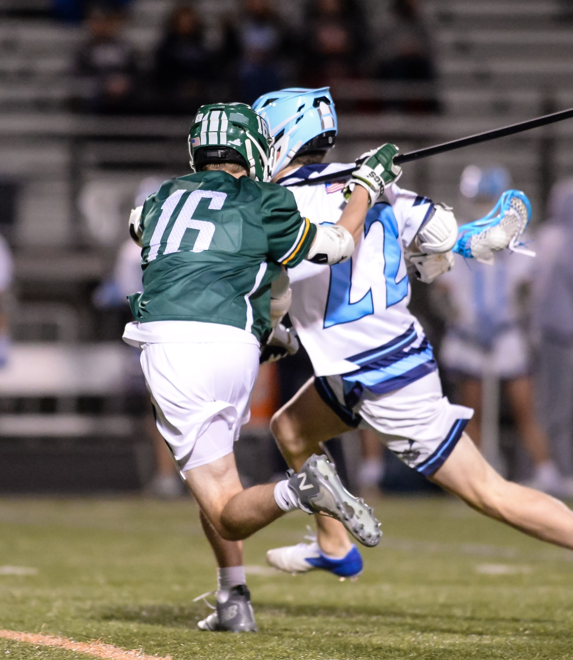
FLOW OF THE GAME
WHY IS IT IMPORTANT?
FLOW refers to the feel of the game for everyone involved
  Speed of the game
  Score of the game
  Length of the game
Is the game taking too long?
Does it seem slow?
Is it entertaining?
Are the players having fun?
You have more control than you think!
3
Notes:
FLOW OF THE GAME
This section will review areas of the game that as an official you will help facilitate the flow of the game.
Knowing the keys to your role as a member of the third team on the field, managing face-offs and other starts and restarts are crucial to the flow of the game.

Slide 4
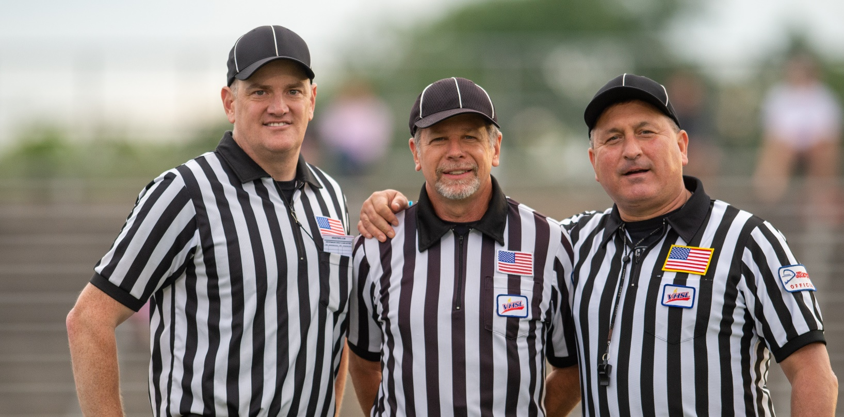
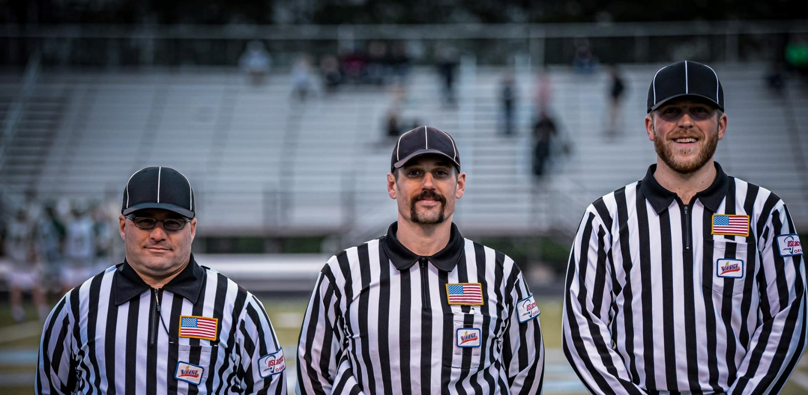
THIRD TEAM ON THE FIELD
GETTING ON THE SAME PAGE
The PREGAME is our primary method of creating consistency
For many high school games, we have little time to pregame on game day.
Some advance communication between crewmates is necessary for a successful game
Consider pregame emails, text messages or phone calls.
Cover the important details at the game
4
Notes:
THIRD TEAM ON THE FIELD
Review with the class why a solid pregame is needed to ensure success.
Each official must be aware of:
Positioning and your actions.
The positions and actions of your partners.
Make individual/crew adjustments when necessary.
Being supportive of the other members of the crew.
Communicating effectively with your team members as a group and individually.

Slide 5
GOALS FOR EVERY CREW IN EVERY GAME
Consistency
Rules and Mechanics Knowledge
Teamwork and Trust
Communication
CLASS DISCUSSION - HOW DO THESE GOALS AFFECT THE FLOW OF THE GAME?
₅
Notes:
GOALS FOR EVERY CREW IN EVERY GAME
Consistency
As a crew
At both ends of the field
Acknowledge when you "kick" a call to your partners
Rules & Mechanics Knowledge
Dedication to knowing the rules and mechanics for the level you are working
ABS – Always Be Studying
Teamwork & Trust
Willingness to work as a team and trust your partners
Don't go fishing unless it is absolutely necessary!
Communication
Do you understand each other’s verbal and non-verbal signals
CLASS DISCUSSION - HOW DO THESE GOALS AFFECT THE FLOW OF THE GAME?
The closer you get to these goals, the less time you take to get the job done
We don’t have the luxury of working in crews like football

Slide 6
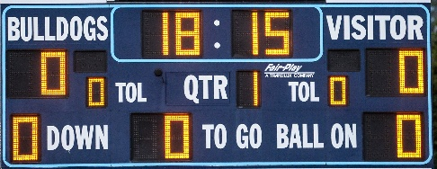
HIGH SCHOOL GAME LENGTH
Situation | Time | No Hustle Game | Hustle Game
Quarters | 48 | 1 Hour and 10 Minutes Of Required Time to Complete
Timeouts | 8
Half + Breaks | 14
Goal to Faceoff | 18 | @ 45 sec = 13.5 min | @ 12 sec = 3.6 min | @ 12 sec = 3.6 min
Penalty Admin | 7 | @ 120 sec = 14 min | @ 30 sec = 3.5 min | @ 30 sec = 3.5 min
Restarts | ~15 | @ 10 sec = 2.5 min | @ 5 sec = 1 min | @ 5 sec = 1 min
 |  | 30 minutes | 8.1 minutes | 8.1 minutes
 |  | 1:40 | 1 Hour and 18 min | 1:18
HUSTLE VERSUS NO HUSTLE
There are required time lengths in every game that we can’t control
There are controllable aspects to every game
This largely is controlled by the game officials
HUSTLE vs. NO HUSTLE!
DID YOU KNOW
At the international level, officials must track the time from goal scored to the next faceoff.
Do you know why?
6
Notes:
HIGH SCHOOL GAME LENGTH
Big effort over the last 20 years to “speed up the game”
A quick game is a generally a safe game
A quick game is generally a focused game
Time is lost largely on faceoffs and penalty enforcement
Old Quote
“Idle hands…”
Do your job, but do it expeditiously
Male it fun with your crew to hustle
Use private “buzzwords” to tell each other to pick up the pace
DID YOU KNOW ANSWER
International games are running clock
Officials hustle can make a big difference in a close game

Slide 7
PREGAME RESPONSIBILITIES
SET THE TONE
MEET AND CERTIFY COACHES
CAPTAINS/COIN TOSS
SUBSTITUTION COACHES-SET EXPECTATIONS
MEET TABLE PERSONNEL-REVIEW RESPONSIBILITIES
READY THE FIELD FOR PLAY
LINE-UP
1
2
3
4
5
6
7
Notes:
PREGAME RESPONSIBILITIES
A solid pregame is needed to ensure success
Each official must be aware of:
Positioning and your actions.
The positions and actions of your partners.
Make individual/crew adjustments when necessary.
Being supportive of the other members of the crew.
Communicating effectively with your team members as a group and individually.

Slide 8
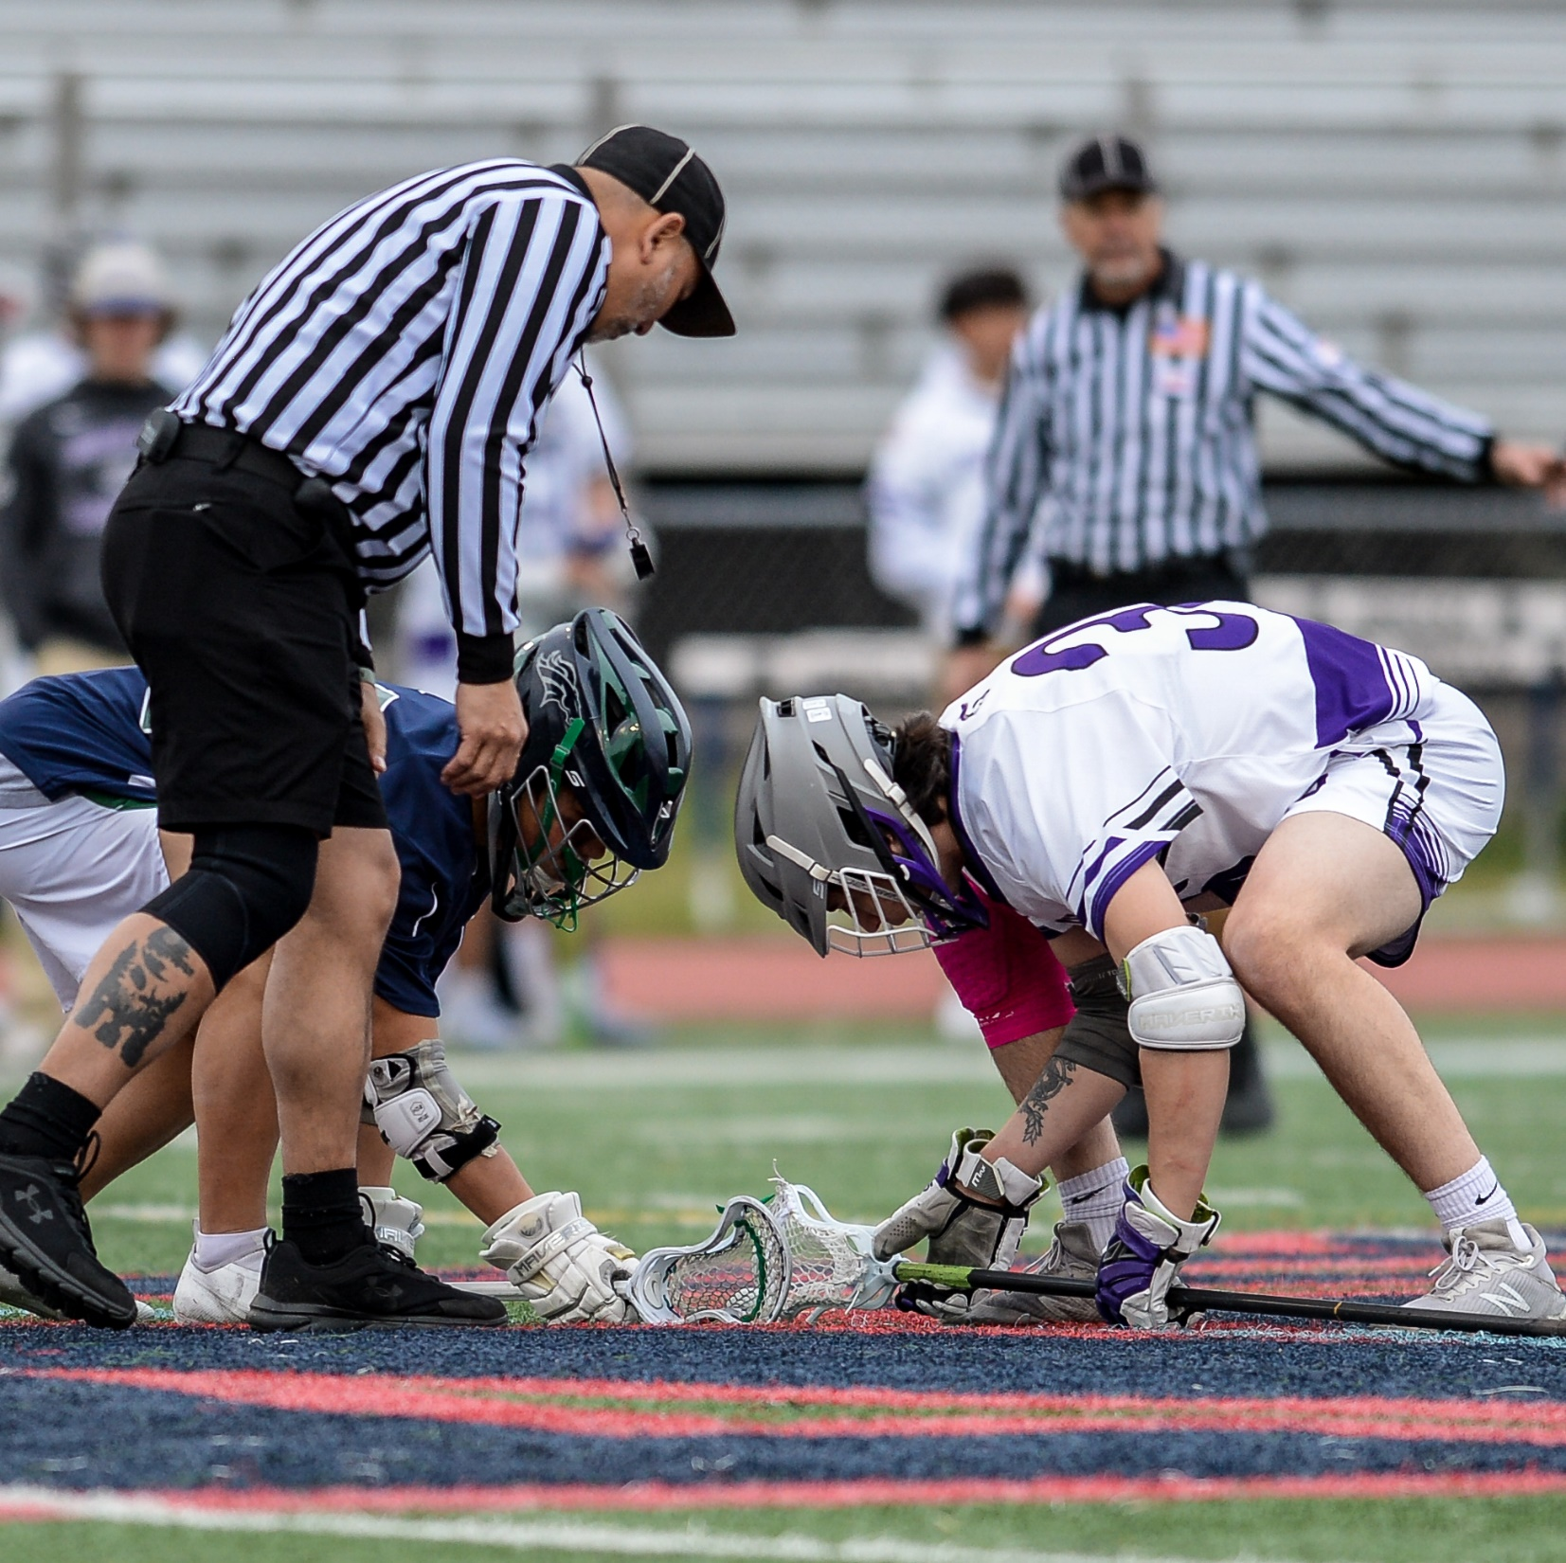
FACEOFFS & RESTARTS
MANAGING THE TEMPO OF THE GAME
This section dives deeper into your role as the official in administrating the face-off
How your teamwork and communication can help keep the game flowing
8
Notes:
FACEOFFS & RESTARTS
This section dives deeper into your role as the official in administrating the face-off
How your teamwork and communication can help keep the game flowing

Slide 9
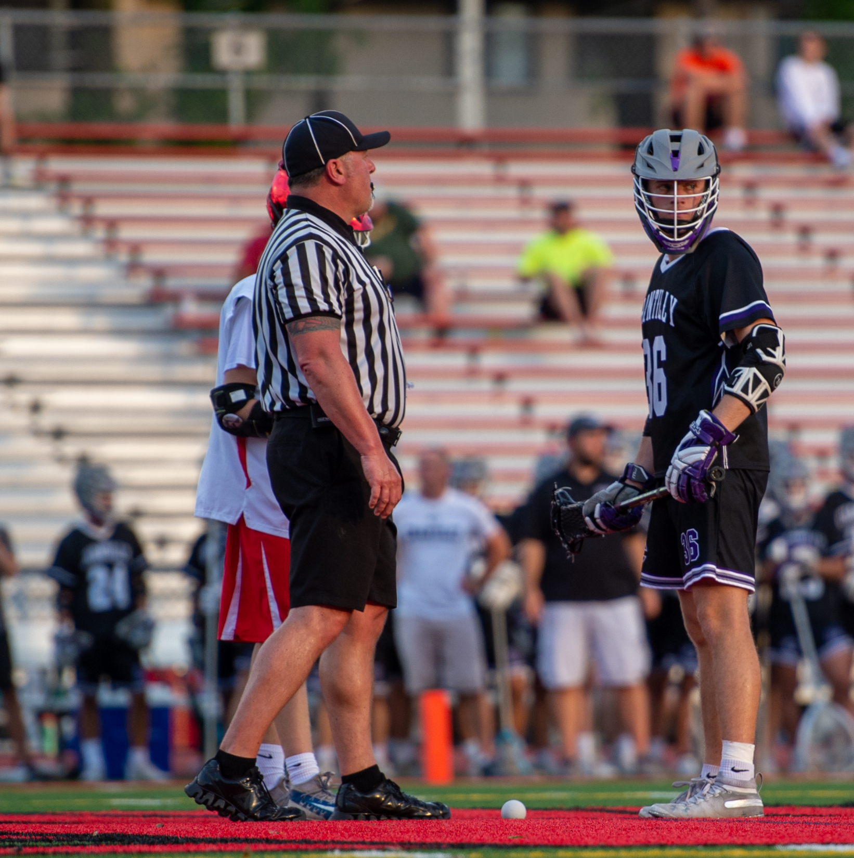
FACEOFFS
WHERE THE FLOW BEGINS
Pre-Game Faceoff Meeting
  Set your expectations
  Talk about speed of setup
  Enlist the faceoff men as partners
Opening faceoff sets the tone
  Take your time and be legal
  Call violations and explain them
  Get the restart quickly
9
Notes:
FACEOFF
The pre-game faceoff meeting is key to flow
If not possible such as during youth games, discuss at first face-off
Come down together, don’t delay
Don’t throw the ball away on a violation

Slide 10
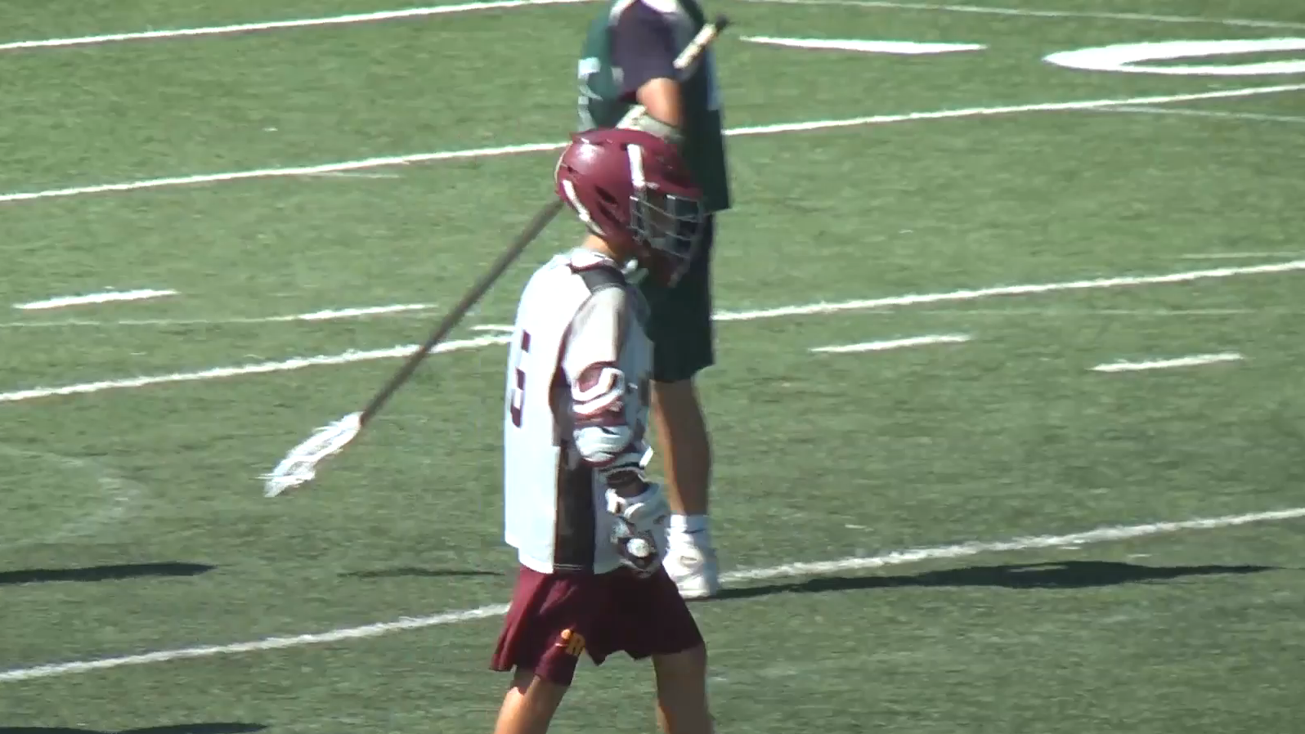
FACEOFF SETUP EXAMPLE
IS THIS A GOOD SETUP?
Class Discussion
Questions
10
Notes:
FACOFF – SETUP TOO LONG
Discussion:
How does the timing of this face off set up effect the flow of the game?
What do you see in this clip that is no longer legal for a face off in our current rules?

Slide 11
AFTER A GOAL, BEFORE NEXT FACEOFF
THE REAL TIME-SAVER
Signal the goal and retrieve the ball, wherever it is.
Jog back to center… Do Not WALK
Dead ball officiating is important
Record the score when in position for the faceoff
Non-faceoff official signals when field is ready for play
11
Notes:
AFTER THE GOALS, BEFORE NEXT FACEOFF
In tow-man mechanics, a ball toss of more than 15 yards that is too short or a high toss and the ball bounces over the trial officials head.
Now we are chasing the ball or referees that are lazy and yell for one of the players to go after the ball.
ALL THIS TAKES TIME!
If the distance is too long, move toward one another to shorten the distance.
Remember how soon do we want to start the next F/O?

Slide 12
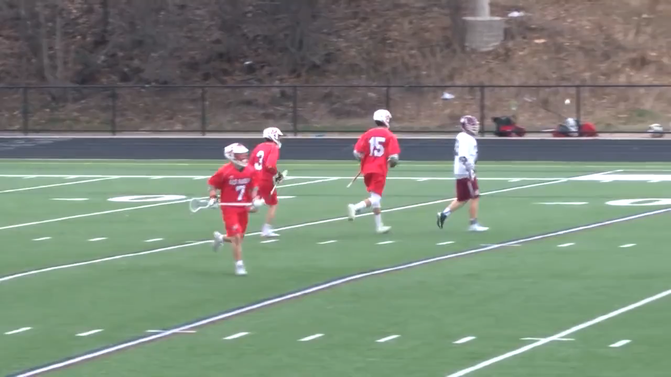
NO HUSTLE AFTER A GOAL
THE REAL TIME-WASTER
Class Discussion
Questions
12
Notes:
NO HUSTLE AFTER GOAL
Following a goal, you are not on a break. Hustle back to center and be ready for the face off before the players are. Players and teams should never be waiting for you to get back and set up to start play.

Slide 13
RESTARTS AFTER FOULS
MAKE THE CALL & START THE PLAY
Be efficient between fouls and restarts
Start play as soon as possible, but not before everyone is ready
Before starting play ensure the following has been done:
Any penalty has been reported to the table
All flags have been picked up
All Referees are ready to restart
The Goalie knows where the ball will be restarted
PARTNERS SHOULD BE SETTING THE FIELD FOR PLAY
13
Notes:
RESTARTS AFTER FOULS
Step away from players and receive/report foul
Clearly communicate to the table using the CNOTE penalty reporting protocol.
Don't forget to use your timer after reporting the foul as per mechanics.
This provides accountability for you and the other teams to be ready quickly along with keeping the game moving.

Slide 14
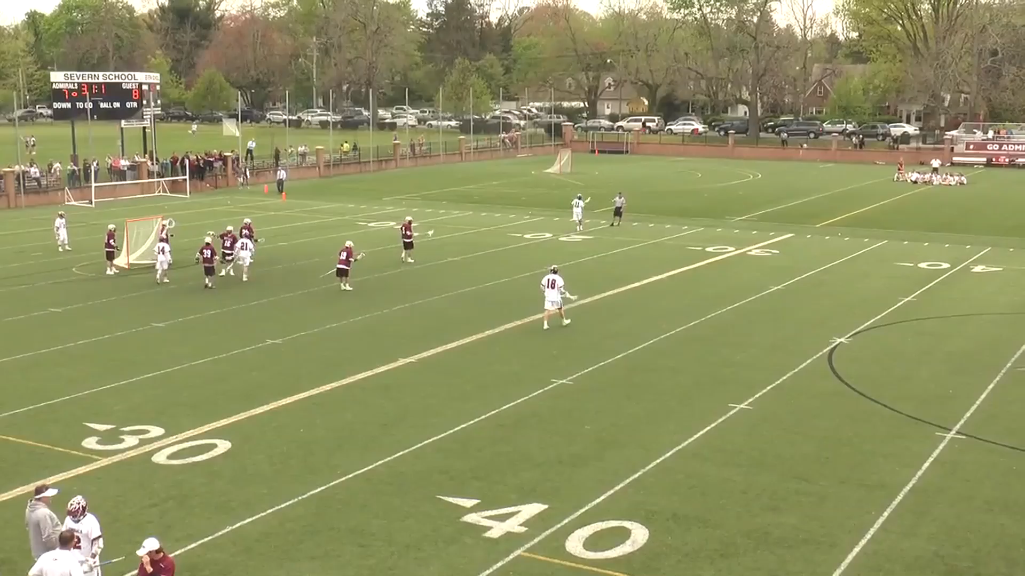
VIDEO - PROPER RESTART AFTER FOUL
THREE MAN MECHANICS
14
Notes:
VIDEO – PROPER RESTART AFTER FLAG
Ball starts in far alley
Lead and single have field ready to play
Trail finished reporting foul, looks, points and play starts
Lead heads to the crease since ball is wide

Slide 15
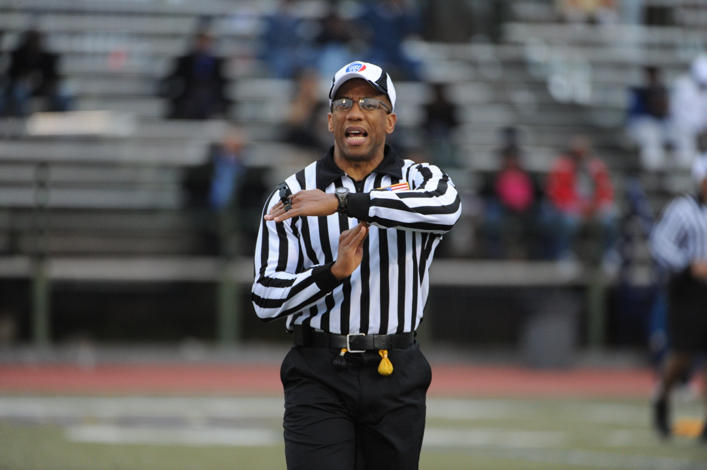
WHAT ARE YOU DOING?
WHILE YOUR PARTNER IS RELAYING THE FOUL
I really hope my partner is getting the field ready.
Class Discussion
Questions
15
Notes:
WHAT ARE YOU DOING?
Your partner is up near the box relaying the foul to the scorer’s table, what do you do?
Often, we see crews doing nothing to get the field ready for play when the penalty is being delivered to the bench area.
Whether two or three person crew, get the field ready for play.
Tell the team that is man up to move the ball to where it will be put into play.
Advise the goalie and the defense where the ball is and which player (number) has the ball.
Even assist with retrieval of your partner’s flag if possible.
By doing this when the official doing the penalty enforcement is done, play is ready to start without any unnecessary delay.
All of this saves TIME!

Slide 16
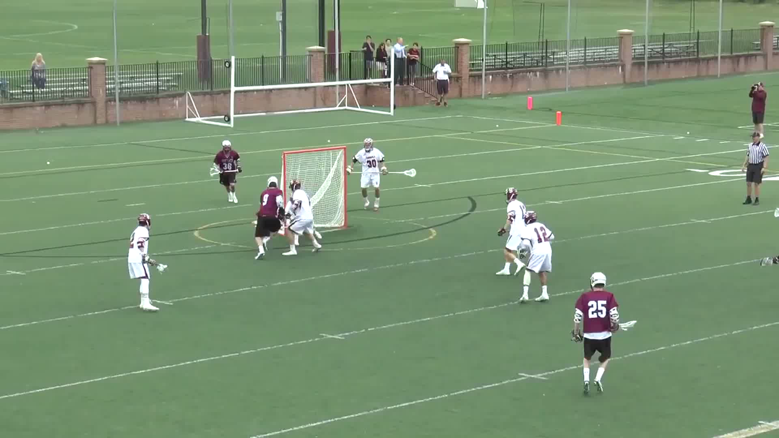
VIDEO - QUICK RESTART HUSTLE
THREE MAN MECHANICS
16
Notes:
VIDEO – QUICK RESTART HUSTLE
First, what was the call?
Play-On Possession Interference w/goalie, FREE CLEAR
Lead (now new Trail) makes call, grabs ball and hustles to the midline
Tosses ball to player at midfield and restarts play within 15-seconds

Slide 17
OUT OF BOUNDS RESTARTS
A KEY TO GAME FLOW
No running restarts from out of bounds
Start 5 yards on the field when in front of the table area
Must give the goalie 5 seconds to return to their crease
Offensive players must be more than 5 yards from the ball carrier
Defensive players do not need to be more than 5 yards away, but..
Can be penalized if they do not create a 5-yard separation
Timeouts along endline start inside box
17
Notes:
OUT OF BOUNDS RESTARTS:
Coaches want a quick whistle because no team wants their opponent to get set on defense.
Referees want quick restarts because they keep the game flowing.
No one wants an unclean restart.
At lower levels (youth), maybe an issue with not enough balls on end line that will slow down the game.
What can you do?
Pocket a ball and when it occurs you simply take the ball out of your pocket and give to the player.
Quick fix and keeps the game going.

Slide 18
IN-BOUNDS RESTARTS
SOME SLIGHT DIFFERENCES
Quick restarts allowed from in-bounds
Must give the goalie 5 seconds to return to their crease
Offensive players must be more than 5 yards from the ball carrier
Defensive players do not need to be more than 5 yards away, but..
Can be penalized if they do not create a 5-yard separation
Play-On fouls should restart quickly
Offensive restarts must be outside of box in alley if play stopped in box
18
Notes:
IN-BOUNDS RESTARTS:
Coaches want a quick whistle because no team wants their opponent to get set on defense.
Referees want quick restarts because they keep the game flowing.
No one wants an unclean restart.
Don’t force yourself into a Delay of Game (5y rule) penalty by starting too fast

Slide 19
QUICK RESTARTS
OFFENSE 5Y AWAY
DEFENSE 5Y AWAY OR…
CLEAR PATH TO GOAL
MAKE THE CALL
A CLOSER LOOK
The following requirements need to met for a quick restart
If not, a flag-down or turnover could occur
19
Notes:
QUICK RESTARTS
A defensive player plays the ball handler on a restart without granting the players 5 yards
Must give the offensive player a clear path to the goal
A 5-yard differential must be attained before the defensive player can engage
If the defensive player is or moves away from a direct path to goal and the offensive player runs at him, no foul will occur
Don’t split hairS…recognize the situation

Slide 20
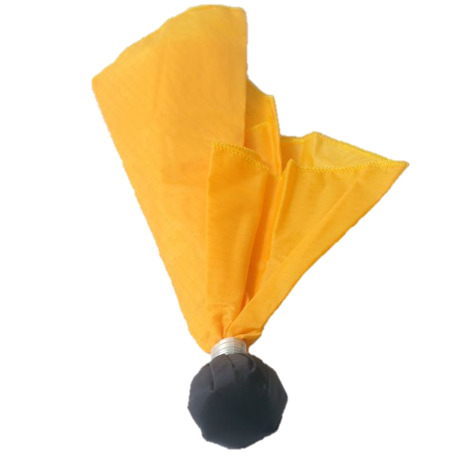
BAD RESTARTS FROM ENDLINE
KEY
OFFENSE
DEFENSE
ANIMATED 2-PERSON MECHANICS
S
Bad
G
L
D
O
Notes:
BAD RESTARTS FROM ENDLINE (Next slide shows good example)
Situation (describe and ask what SHOULD happen)
Shot taken and chased by both offense (red) and defense Blue), ball awarded to offense (red)
D1 is within 5y when O1 is ready to play
What needs to happen for this play to start without a flag?
Where should LEAD (L) official go as whistle is blown?
What is TRAIL (T) official watching in this case?

Slide 21
GOOD RESTARTS FROM ENDLINE
KEY
OFFENSE
DEFENSE
ANIMATED 2-PERSON MECHANICS
T
Good!
L
Notes:
GOOD RESTARTS FROM ENDLINE
Situation (describe and ask what SHOULD happen)
Shot taken and chased by both offense (red) and defense Blue), ball awarded to offense (red)
D1 is within 5y when O1 is ready to play
What needs to happen for this play to start without a flag?
Where should LEAD (L) official go as whistle is blown?
What is TRAIL (T) official watching in this case?

Slide 22
RESTARTS FROM MIDLINE
KEY
OFFENSE
DEFENSE
ANIMATED 2-PERSON MECHANICS
When trouble happens most.
  Over & Back
  Restart after a faceoff violations
L
O
D
G
T
Notes:
RESTARTS FROM MIDLINE
DON’T say “give him 5” to the defense
This is coaching
When do you throw the flag if he does not separate?
Is simply running with the player a foul?
Do we communicate they are NOT 5y in any way?

Slide 23
BAD RESTARTS FROM MIDLINE
KEY
OFFENSE
DEFENSE
ANIMATED 2-PERSON MECHANICS
When does this happen?
  Faceoff violations
  Shutoff in a man-down situation
  Take-away defender
BAD!!
L
T
Notes:
BAD RESTARTS FROM MIDLINE
Blow the ball in
See what happens
If the defender doesn’t separate, throw the flag
Remember – The offensive player cannot run into him on purpose if he is trying to move out of the way
Don’ start TOO fast and “create a penalty”

Slide 24
GOOD RESTARTS FROM MIDLINE
ANIMATED 2-PERSON MECHANICS
When does this happen?
  Faceoff violations
  Shutoff in a man-down situation
  Take-away defender
GOOD
L
O
D
G
D
T
O
Notes:
GOOD RESTARTS FROM MIDLINE
It is counter-intuitive for a player to move out of the way.
They will likely back off and the play
Good teams will use the “slide, rotate, recover” concept and have the defenders rotate
In most vases, this will happen while other subs are happening, and the team is not yet ready to play
Good teas will push this and look for the 2 on 1

Slide 25
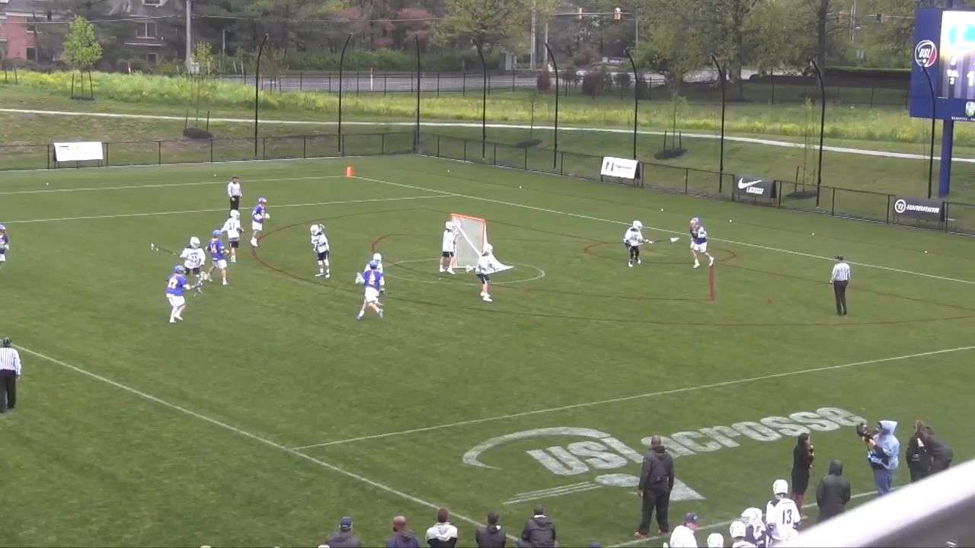
GOOD RESTART FROM SIDELINE
One small mechanics problem is that the single should be straddling the cone at this point since the ball has not yet crossed midfield.
Player does a good job of pausing to show the official he is ready.
Notes:
GOOD RESTARTS FROM SIDELINE
This is a great example of a quick restart that is legal.
Player gets the ball, pauses to show the official he is ready and gets a quick whistle from the single
This does not need to be a situation where the single gets to the cone and lets the new trail blow it in.
If he is ready, blow it in.
Talk to the player as he is getting the ball saying “come in and stop”

Slide 26
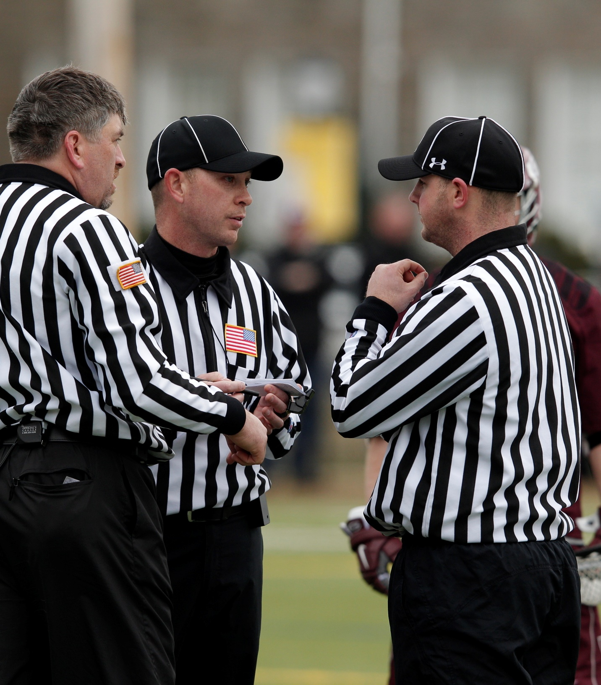
Ball is coming in side-left with you, got it?
TIMEOUTS & RESTARTS
A CHANCE TO GET ON THE SAME PAGE
Anticipate when a TO will be requested
  Last 2m of half
  Close game
  Possession saver
  Man-down kill and double-team
    Out of bounds in transition
    If we start talking about stalling
  Overtime Faceoff (this is key!)
Trail official needs to expect this! Pregame this point
Where's the restart?
How many TO remain
Tell the coaches
Notes:
RESTART AFTER TIMEOUT
Move with a purpose and encourage others to restart the steady tempo as well.
If you are a slacker official, you will be an irritant.
Sluggish/lazy officials contribute to a feeling of annoyance among coaches, players and fans.
You can “advance the flow” with a conscious effort.

Slide 27
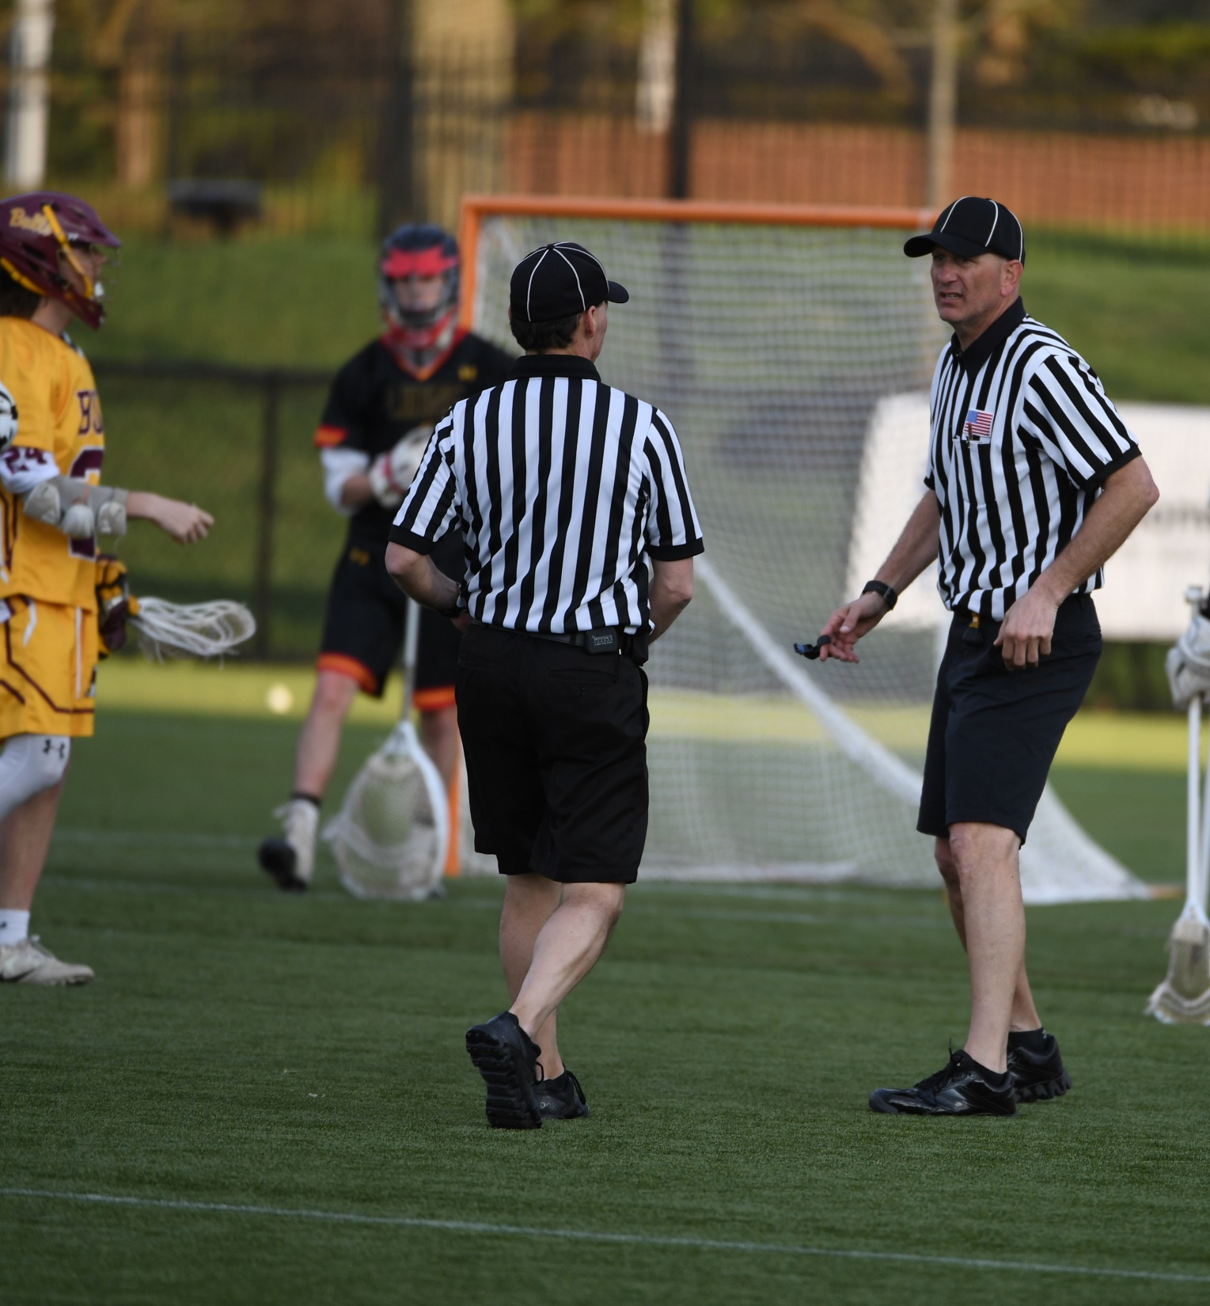
OFFICIALS TIMEOUTS
WHEN CLARIFICATION IS NEEDED
Know the situation...
  Crease call (goal or no goal?)
  Two Penalty Flags Thrown
  A foul in which a player will be "locked" in
  Issues at the Scorer’s Table/Time Issues
Report to coaches the results
"Who's watching the players"?
  3rd official
  Conference should never be all 3 officials
  If 2-man, open-up your field of view to see the players
Class Discussion
Questions
Be quick but don't hurry, take the time necessary to get it correct.
Notes:
OFFICIAL’S TIMEOUTS
In-game communication is key to preventing these, but…
Sometimes they are necessary
This is more common with new officials, that’s OK!
Our goal is to get the call, CORRECT!
Remember to stop the clock for RINNING-TIME games!
CLASS DISCUSSION
What other situations ca cause an officials timeouts?

Slide 28
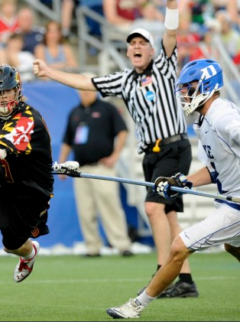
STALLING
GET IT IN – KEEP IT IN
When and where...
  Usually start behind the goal
Recognize the situation/level of play
  Usually not celled in lopsided games
Bottom line, is the offense attacking the goal?
  What does that mean?
  Shots?
  Dodges and re-dodges
Last two minutes of the game with a 4-goal or less differential
Class Discussion
Questions
Notes:
STALLING
One of the toughest calls in the game
College got a shot clock to get rid of it
High Schools will probably never have the shot clock due to cost
When the situation seems apparent (score is close end of Q3), TALK ABOUT IT!
What’s the tolerance? (60s, 90s, 120s)
There is no rule on the timing, but you MUST talk about it and watch the clock.
CLASS DISCUSSION
How will we signal stalling?
Hand over heart
Hands on belt
Others?

Slide 29
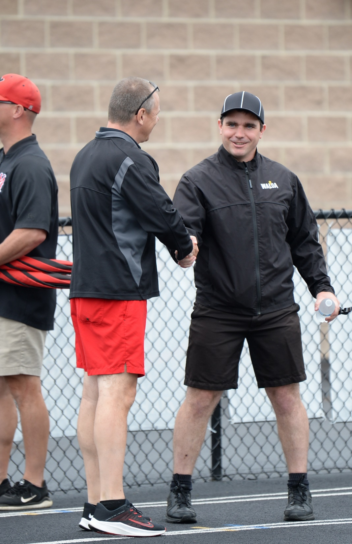
ALWAYS BE PROFESSIONAL
DEMEANOR AND COMMUNICATION
This lesson was about Flow of the Game
Professionalism from the first whistle keeps everyone focus on their job (playing, coaching, officiating)
Respect will come when you approach the game the way the coaches do.
We may not make the "Big" bucks officiating but, we are still getting paid for the job. WORK HARD...Hustle!
We, as officials must approach every game, regardless of level, as the most important game at that time.
It IS the most important game for the coaches and athletes, it must also be for us!
If you make a mistake, ADMIT IT & OWN IT!
Notes:
ALWAYS BE PROFESSIONAL
Professionalism is the one ting that you can always do well regardless of age, physical ability or talent
If you are not a professional, why are you here?
Treat the vocation of officiating with respect it deserves and it will be very good to you.

Slide 30
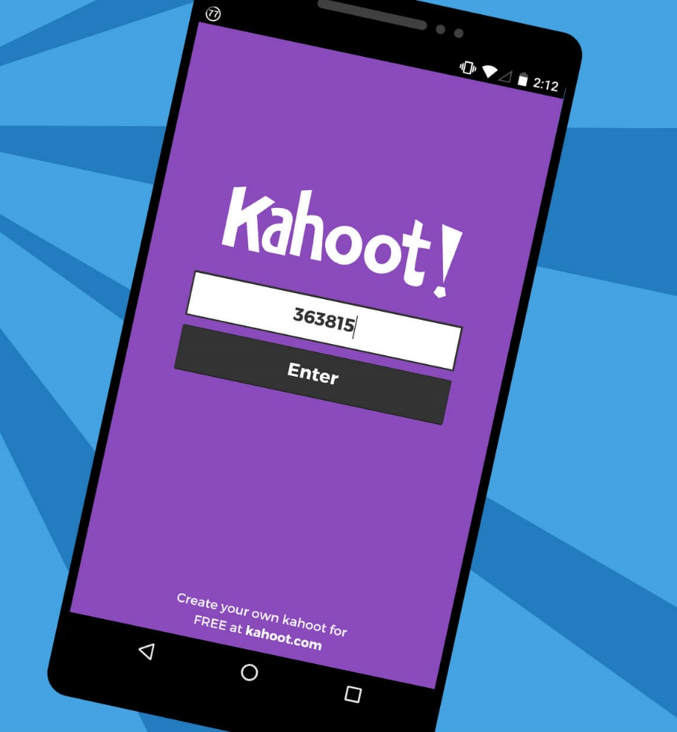
KAHOOT!
GAME-STYLE LEARNING
Kahoot! is a digital learning platform that uses quiz-style games to help students learn by making the information engaging in a fun way.
As one of the biggest names in quiz-based learning, it's impressive that Kahoot! still offers a free-to-use platform, which makes it highly accessible for teachers and students alike. It's also a helpful tool for a hybrid class that uses both digital and classroom-based learning.
The cloud-based service will work on most devices via a web browser. That means this is accessible for students in class or at home using laptops, tablets and smartphones.
Notes:
KAHOOT (You need to be connected to the internet to Play Kahoot!)
Practice this before the class starts
Open the link and have it sitting in a browser window waiting
No app or login is required

Slide 31

KAHOOT INSTRUCTIONS
PLAYERS
On your smartphone, tablet or laptop, go to www.kahoot.it
Wait for the instructor to give you the Game Pin
Enter your first name and last initial ONLY
INSTRUCTORS
A Kahoot account can keep track of results, otherwise, you can play without an account
https://create.kahoot.it/auth/login
Create a free BASIC account (up to 50 users) or paid PRO account (up to 100 users)
Click on the link below
Game will open in an internet browser window
USA Lacrosse Officials Development Program - Rule 4 - Part 1 - FLOW OF THE GAME
Notes:
You need to be connected to the internet to Play Kahoot!

Slide 32
THANK YOU TO THE MEMBERS OF THE
2023 MENS OFFICIAL’S EDUCATION DEVELOPMENT TEAM

