Slide 1
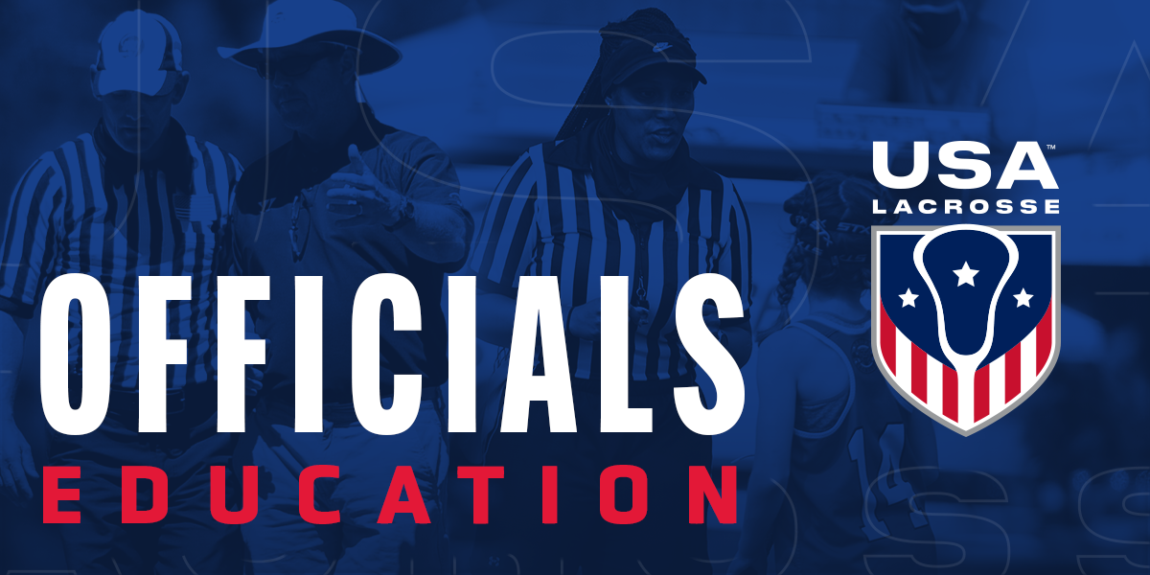
RULE 4 – PART 3 - THE GOAL AREA
MENS OFFICIALS DEVELOPMENT | 2023 SEASON
Notes:
RULE 4 – PART 3 - THE GOAL AREA
The presentation takes a deeper look at the goal as it pertains to Rule 4
30-60m

Slide 2
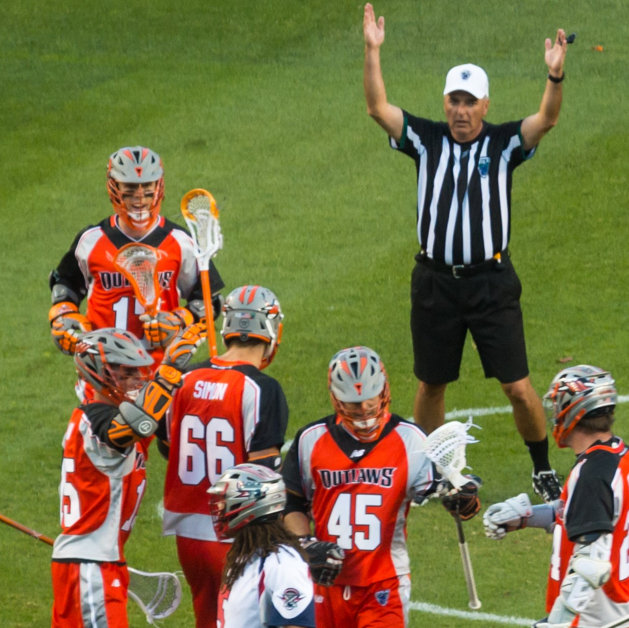
RULE 4 – THE GOAL AREA
WHERE THE ACTION OCCURS!
Most important area of the field
It is always the primary responsibility of at least one official
How we handle calls in this area will set the “temperature” of the game
2
Notes:
RULE 4 – THE GOAL AREA
Goals determine wins and losses
This is a critical area on the field and you need to be fully prepared to officiate the goal area well

Slide 3
THE GOAL CREASE
KNOW WHAT TO EXPECT
Officials Responsibilities Settled Situations
The Goalie
Play around the Crease
Teams Change Goals at the end of each Quarter!
PRESENTATION TITLE HERE
3
Notes:
THE GOAL CREASE
9’ radius
Goalie’s domain to perform his functions
Only the goalie has full goal-crease privileges
Rules have changes and ONLY the goalie can legally stop shots

Slide 4
AREAS OF RESPONSIBILITY
TRUST YOUR PARTNER TO COVER HIS AREA
Lead
  Goal
  End Line
Single
  Shooter
  Goal
Trail
  Substitutions
  Over and Back
  Shooter
S
T
L
Notes:
AREAS OF RESPONSIBILITY
Lead Official:
Goal is primary responsibility
Positioned roughly a step or two above or below GLE
Covers the end line on contested plays’
Single Official:
Watches the shooter for late hits
Moves toward the goal if the Lead official moves to the end line
Can assist with crease violations on a tight play
Trail Official:
Watches for contested substitutions
Makes the over and back call if necessary
Covers the far goal
Note: The pre-game should be clear on each responsibility, but the most important is that the Trail official watches the shooter on every shot.

Slide 5
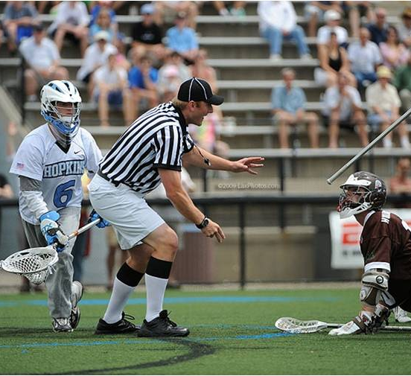
GOAL CREASE PRIVILEGES
KNOW THE RULES – MAKE THE CALLS
Goalkeeper has privileges and protections within the goal-crease IF…
He maintains continuous contact using at least one foot with the interior of the goal crease.
Non-goalkeepers DO NOT have goal-crease previleges
5
Notes:
GOAL CREASE PRIVILEGES
A properly equipped goalkeeper has the following privileges and protections within the goal-crease, so long as he maintains continuous contact using at least one foot with the interior of the goal crease:
A goalkeeper may stop the ball in any manner with his crosse or body while in the crease area.
He may block or bat the ball away with his hand, but he may not catch the ball with his hand.
No opposing player may make contact with the goalkeeper or the portion of his crosse that is within the goal crease area, regardless of whether the goalkeeper has the ball in possession.
When the goalkeeper is in the crease, any portion of the goalkeeper’s crosse extended outside the crease, is subject to being stick checked, except when the ball is in his crosse.
A goalkeeper or any player on the goalkeeper’s team may receive a pass while in the crease.
While in possession of the ball, no opposing player shall make contact with the goalkeeper or his crosse.
Other players do not have the same protections as goalkeepers.
Opposing players can check non-goalkeepers when they have the ball and are located in the crease but may not enter the crease

Slide 6
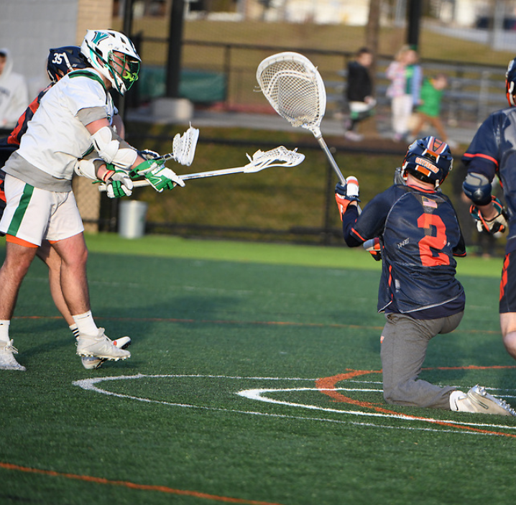
GOAL CREASE PROHIBITIONS
KNOW THE RULES – MAKE THE CALLS
The movement of players into and out of the goal-crease area is restricted
Offensive players have certain restrictions on play around the crease
Only a properly-equipped goalkeeper may play with the intent to stop a shot
6
Notes:
GOAL CREASE PROHIBITIONS
No offensive player may enter the crease at any time.
Offensive players can reach their stick into the crease to collect a loose ball but must not make contact with the goalkeeper or the goalkeeper’s crosse.
A goalkeeper or a defender may not exceed four seconds with possession of the ball in their crease.
No defensive player, other than a properly equipped goalkeeper, can enter their crease with the perceived intent on blocking a shot or acting as a goalkeeper.
Defensive players are allowed to be in or pass through the crease to but never to block a shot.
Officials will stop play as soon as they notice the situation except if a ball is already in flight on a shot.
If a shot is in flight, it shall be allowed to come to its natural conclusion before stopping play.
A violation will result in a technical foul for a conduct foul when a defensive player that violates this rule.
A subsequent violation is a personal foul that results in an unsportsmanlike conduct penalty

Slide 7
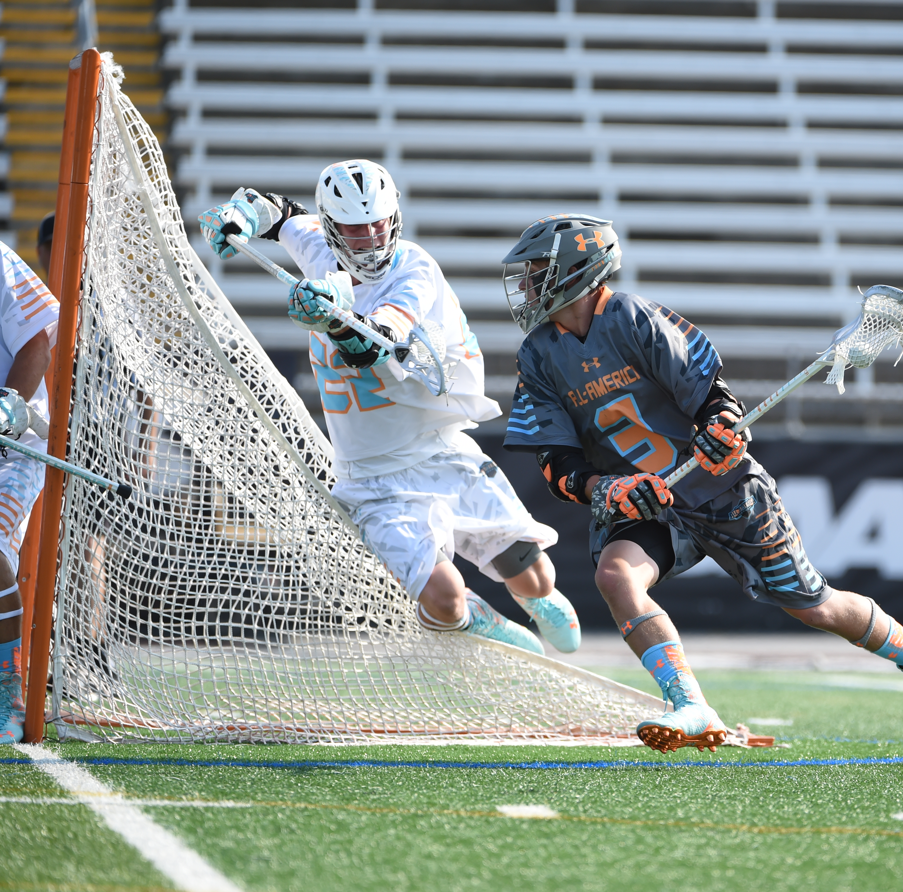
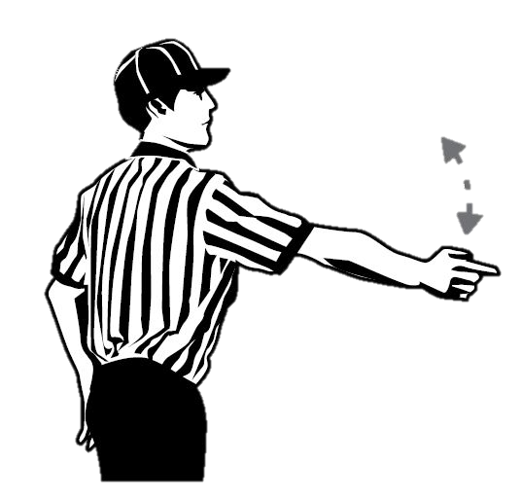
CREASE VIOLATIONS
BIG CALLS THAT SHOULD BE MADE BIG
Confidence is the key to making a crease violation call
Don’t hesitate and make a strong, decisive call that everyone can hear
Know the dive rules
7
Notes:
CREASE VIOLATIONS
Offense cannot physically touch the crease (crosse does not count, may reach in to play a loose ball)
Offense cannot touch the goal (with body or crosse)
Offense may not dive into the crease

Slide 8
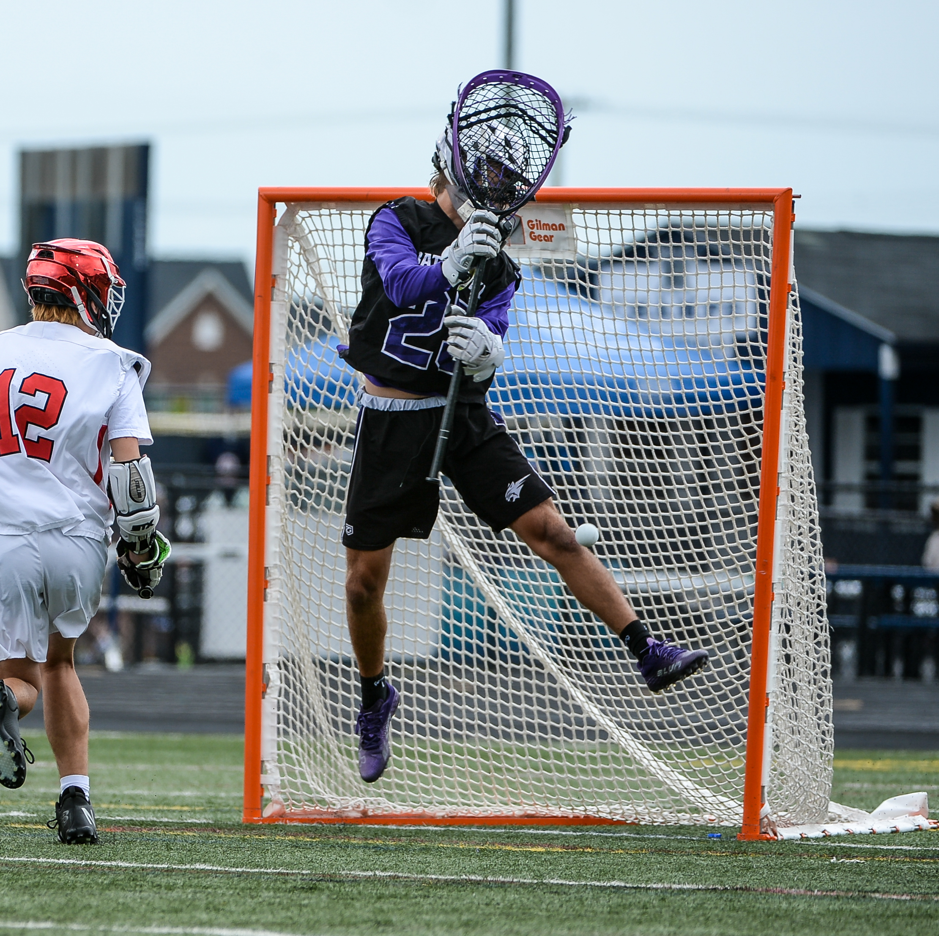

GOALKEEPER INTERFERENCE
GIVE THE GOALIE A CHANCE TO DO HIS JOB
Possession interference is rare in today’s game
Most goalie interference calls occur during loose ball situations
Know the rules about the goalie’s stick being in or out of the crease when the ball is loose.
Class Discussion Questions
PRESENTATION TITLE HERE
8
Notes:
GOALKEEPER INTERFERENCE
Offense cannot touch the goalkeeper’s body or crosse while the goalkeeper and his crosse is inside the crease
A goalie’s crosse may be checked if outside of the cylinder and the ball is loose
A covered ball by the goalie’s stick outside the crease is NOT considered possession
Discussion item:
Why is goalkeeper interference a play-on when he has possession and not a flag down?
This is a rare technical foul with possession that does not result in a flag on the offending team. Think of it as any offensive violation with the crease or the goalkeeper always turns the ball over to the defense. The “play-on” allows the defensive team an opportunity to preserve a fast break opportunity, and if they are unable to capitalize due to a bad pass or losing the ball they still retain the ball due to the violation.

Slide 9
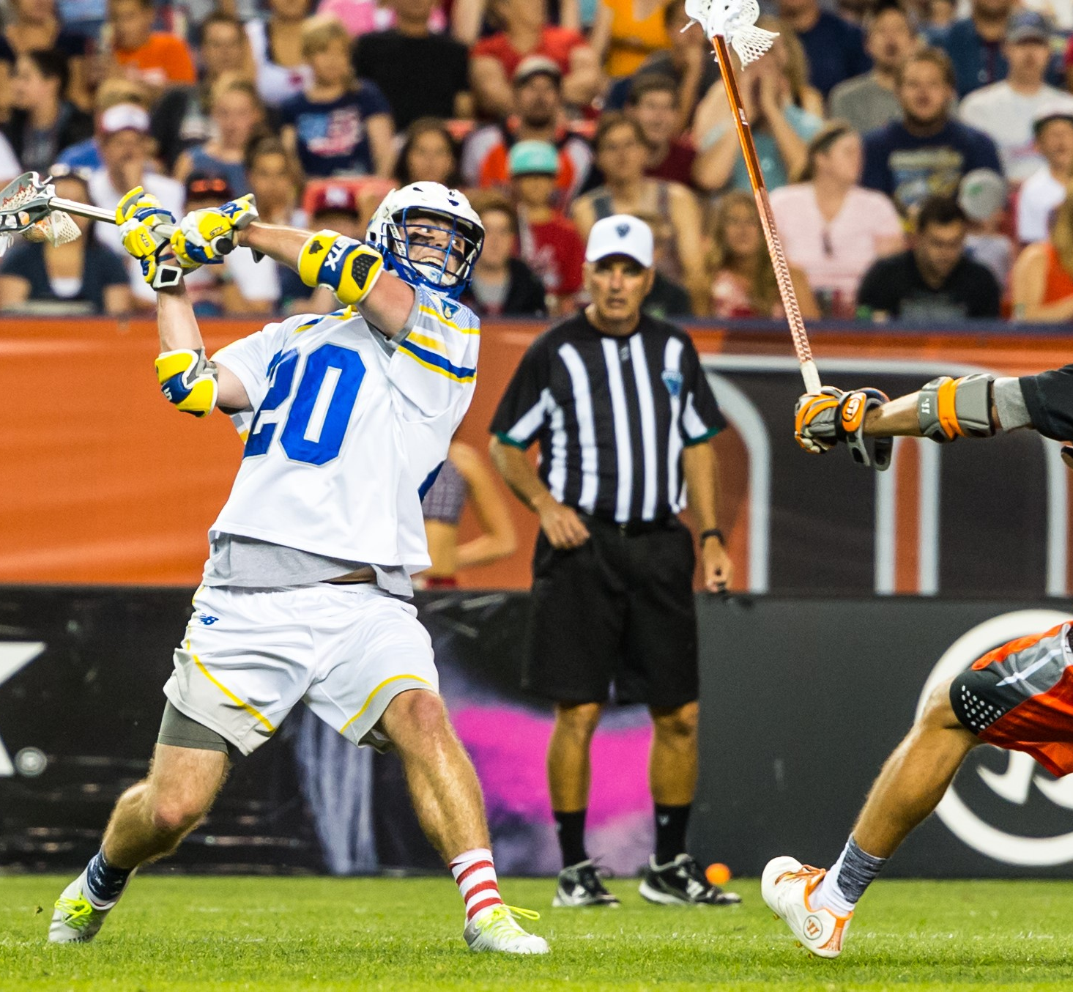
SCORING
KNOW THE RULES
A goal is scored when:
Loose ball passes from the front entirely over the goal line.
A goal will be allowed if the shot was released before the end of the period.
Class Discussion Questions
9
Notes:
SCORING
Discussion item:
How can the ball be propelled into the Goal?
Shot
Kicked
Batted
Deflected

Slide 10
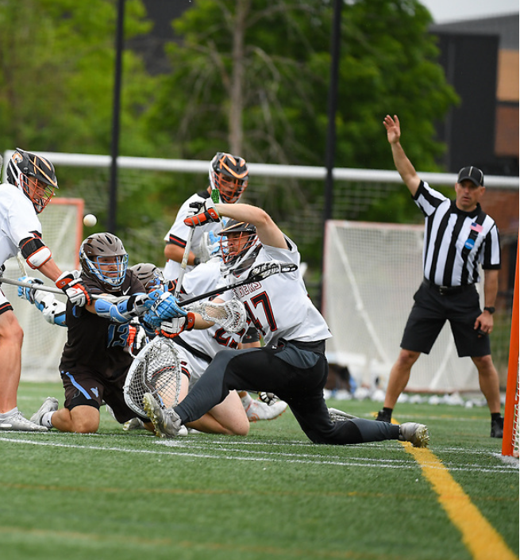
GOAL NOT SCORED
END OF PERIOD
A goal is NOT scored when:
The horn has sounded to end the period before a shot has been released
The horn has sounded after the shot has been taken but the ball is touched by an offensive player after the horn has sounded
10
Notes:
GOAL NOT SCORED
Under the following circumstances a goal will not count!
A shot is released AFTER the end of the period
A shot is released BEFORE the end of the period but one of the following incidents occurs after the end of the period
The ball makes contact with any member of the attacking team or his equipment
The ball is touched by any player of either team other than the defending goalkeeper after hitting the goalkeeper or his equipment, goal posts or crossbar

Slide 11
GOAL NOT SCORED
FOULS
Attacking team foul
Scorer’s crosse is found illegal
Contact is made with the goalie, goalpost or goal net
11
Notes:
GOAL NOT SCORED
A player from the attacking team commits a foul.
The goal scorer’s crosse is found to be illegal before the restart of play.
After one of the officials has sounded the whistle for any reason.

Slide 12
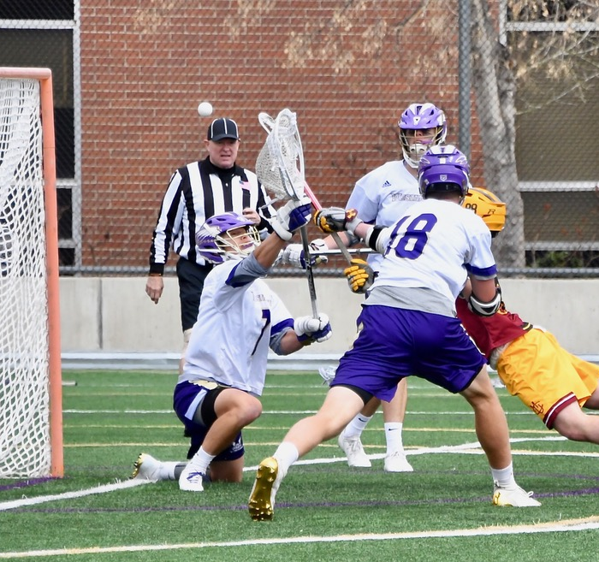
GOAL NOT SCORED
DIVE PLAYS
Diving is NOT the same at all levels.
Under NFHS rules, a player may NOT, under any circumstances land in the crease after a diving shot and have the goal count
If a player is contacted illegally, a goal cannot count, and the penalty shall be assessed.
If a player is contacted legally, it shall be a turnover
Class Discussion Questions
12
Notes:
GOAL NOT SCORED – DIVE PLAYS
An attacking player, in possession of the ball and outside the crease, dives or jumps (becomes airborne of his own volition), prior to, during, or after the release of the shot and lands in the crease.
An attacking player may legally score a goal and touch the crease area, provided the ball enters the goal before the contact with the crease, and his feet are grounded before, during, and after a shot.
CLASS DISCUSSION:
Discuss the difference between a dive and a grounded shot
Discuss lead/single responsibilities for feet and push calls.

Slide 13
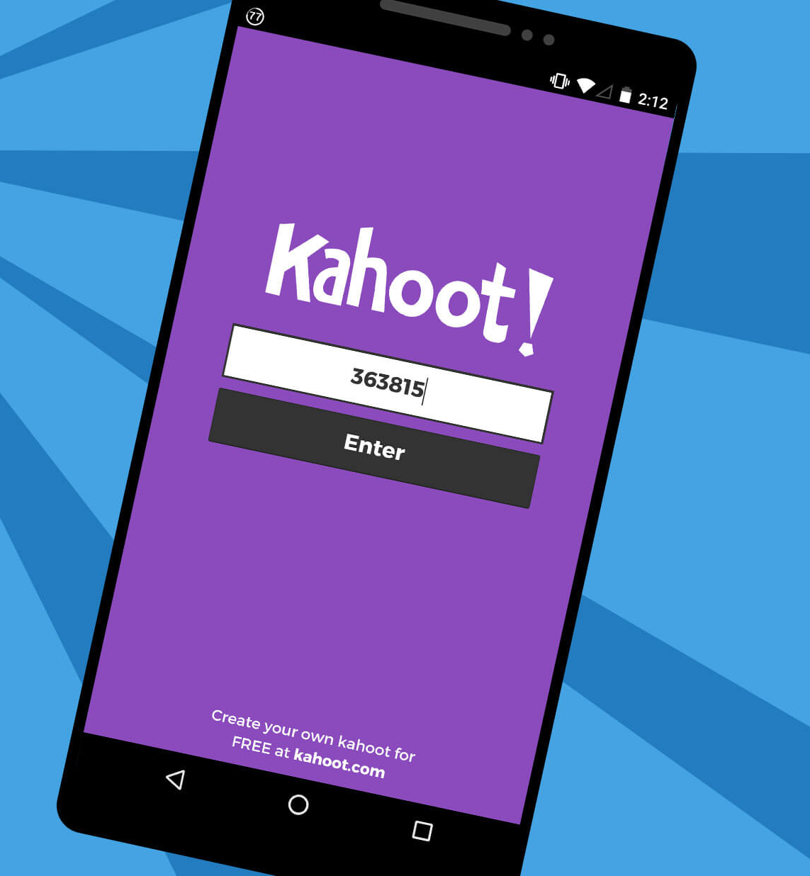
KAHOOT!
GAME-STYLE LEARNING
Kahoot! is a digital learning platform that uses quiz-style games to help students learn by making the information engaging in a fun way.
As one of the biggest names in quiz-based learning, it's impressive that Kahoot! still offers a free-to-use platform, which makes it highly accessible for teachers and students alike. It's also a helpful tool for a hybrid class that uses both digital and classroom-based learning.
The cloud-based service will work on most devices via a web browser. That means this is accessible for students in class or at home using laptops, tablets and smartphones.
Notes:
KAHOOT (You need to be connected to the internet to Play Kahoot!)
Practice this before the class starts
Open the link and have it sitting in a browser window waiting
No app or login is required

Slide 14

KAHOOT INSTRUCTIONS
PLAYERS
On your smartphone, tablet or laptop, go to www.kahoot.it
Wait for the instructor to give you the Game Pin
Enter your first name and last initial ONLY
INSTRUCTORS
A Kahoot account can keep track of results, otherwise, you can play without an account
https://create.kahoot.it/auth/login
Create a free BASIC account (up to 50 users) or paid PRO account (up to 100 users)
Click on the link below
Game will open in an internet browser window
USA Lacrosse Officials Development Program – RULE 4 – PART 3 – THE GOAL AREA
Notes:
You need to be connected to the internet to Play Kahoot!

Slide 15
THANK YOU TO THE MEMBERS OF THE
2023 MENS OFFICIAL’S EDUCATION DEVELOPMENT TEAM
Notes:
THANK YOU TO THE MEMBERS OF THE
2023 MENS OFFICIAL’S EDUCATION DEVELOPMENT TEAM

