Slide 1
PERSONAL FOULS – RULE 5
MENS OFFICIALS DEVELOPMENT | 2023 SEASON
Notes:
Trainer Instructions:
MATERIALS NEEDED
Projector or TV to present
“Rule 5” PowerPoint presentation (this one)
Copies of Student Notes (can send ahead via PDF)
Copy of Instructor Notes
Pool Noodles
Lacrosse Stick(s)

Slide 2
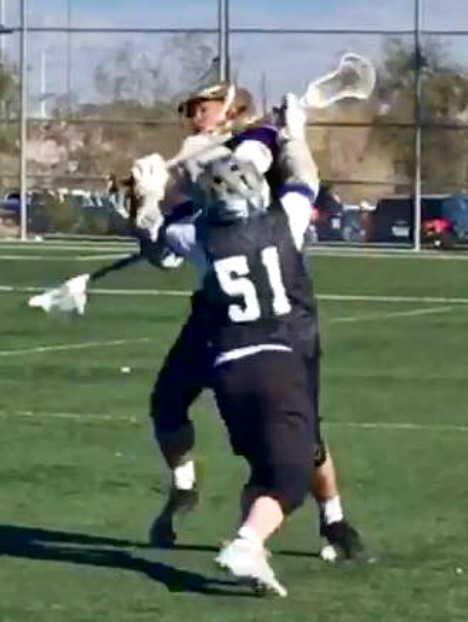
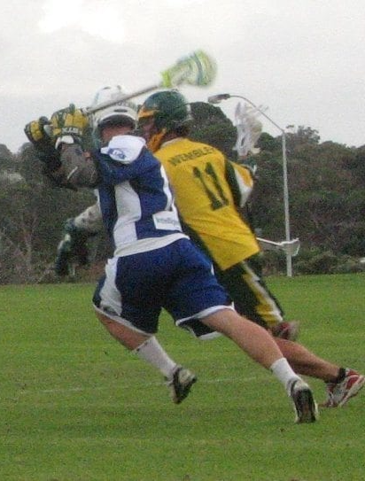
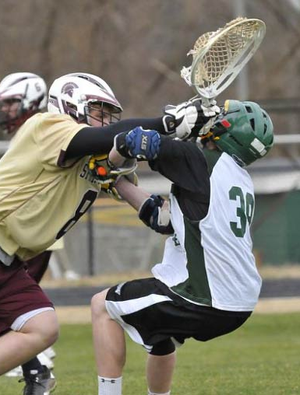
PERSONAL FOULS
Notes:
PERSONAL FOULS
Title Slide

Slide 3
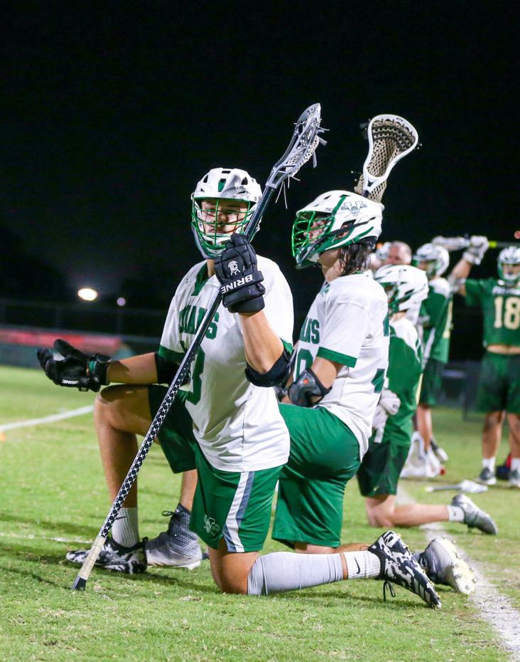
WHAT DOES THE RULEBOOK SAY?
Rule 5: Section 1
“Personal fouls are those of a serious nature: illegal body checking, slashing, cross checking, tripping, unnecessary roughness, unsportsmanlike conduct, checks involving the head/neck, and the use of illegal crosse and or illegal equipment.”
Notes:
WHAT DOES THE RULEBOOK SAY?
Know the rules!
Understand the “spirit” of the rule
When in doubt, make the FAIR call!

Slide 4
3 TYPES OF PERSONAL FOULS
Illegal Contact
Illegal Conduct
Illegal Equipment
CONTROL OF THE GAME
SAFETY OF THE GAME
CREW
CREDIBILITY
Notes:
3 TYPES OF PERSONAL FOULS
Illegal Contact are SAFETY Fouls.
Illegal Conduct includes Coaches and Players Behaviors
Illegal Equipment includes the stick and all mandatory required Equipment.
How you handle these areas, determines your…
Control of the game
Safety of the game
Crew credibility
The following slides takes a deeper dive into these....

Slide 5
WHAT ARE THE PERSONAL FOULS?
Crosscheck
Illegal Body Check
Checks involving Head/Neck
Body check a Defenseless player
Slashing
Tripping
Unnecessary Roughness
SAFETY
Notes:
WHAT ARE THE PERSONAL FOULS
SAFETY
Some fouls happen in the natural course of the game
Some fouls CAN be avoided and should be penalized severely

Slide 6
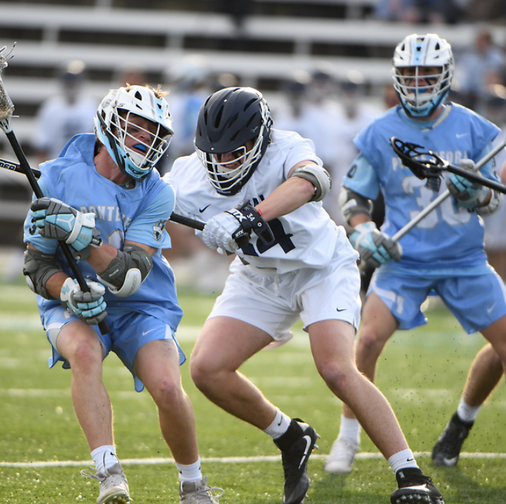
CROSSCHECK
Part of the crosse between the hands
Thrusting
Holding arms extended
Look for separation and a DEFINITIVE thrusting motion
Notes:
CROSSCHECK
A player may not check his opponent with his crosse in a crosse check position.
A check with that part of the handle of the cross that is between the players hands, either by THRUSTING away from the body OR by holding it EXTENDED from the body.
This rule has changed to allow PUSHING with the handle
DEMONSTRATION
Have volunteers cross check, 1st show a regular 1-minute cross check foul, then show multi minute crosscheck to the head/neck area.
This is very important to distinguish legal versus illegal

Slide 7
CROSSCHECK VIDEO
Notes:
CROSSECHECK EXAMPLE
1,2 or 3 minute?
Was this overly aggressive
Was this targeting?
Was it to the head?
This should be called as a 1-minute crosscheck

Slide 8
ILLEGAL BODY CHECK
More than 5-yards from loose ball
From the rear or below the waist
Player on the ground
Can still be 1-Minute
Notes:
ILLEGAL BODYCHECK
Body checking an opponent who is not in possession of the ball OR within 5 yards of a loose ball.
Body Checking an opponent from the rear or at or below the waist.
Body checking of an opponent who has any part of his body other than his feet on the ground.
Clarify the difference between this rule and the defenseless player rule.
Penalty duration is usually 1 minute releasable, however could be more depending on the severity.
NOTE:
If a player who is about to be body checked turns his back, jumps or moves in such a manner to make what started to be a legal check appear illegal, no foul is committed by the player applying the body check.

Slide 9
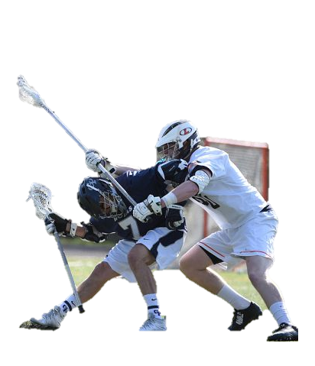
CHECKS INVOLVING THE HEAD/NECK
CHECKS INVOLVING THE HEAD/NECK
Cross check
Uncontrolled slash
Spearing
Legal then Follow through to head/neck
TARGETING
ALWAYS
2 or 3
MINUTE
Notes:
CHECKS INVOLVING THE HEAD/NECK
A player shall not initiate contact to an opponent's head or neck with a CROSS-CHECK or with any part of his body (head, elbow, shoulder, etc.).
Any follow through that contacts the head or neck shall also be considered a violation of this rule.
A player may not initiate an EXCESSIVE, violent or uncontrolled SLASH to the head/neck.
A player, including an offensive player in possession of the ball, shall not block an opponent with his head or initiate contact with the head (known as SPEARING).
A player shall not initiate a BODY CHECK legally that SLIDES UP into or follows through to an opponent's head or neck.
These are always 2 or 3 minutes, non releasable at the official's discretion. An excessively violent violation may result in an ejection.

Slide 10
CHECK TO HEAD/NECK AREA VIDEO
Notes:
CHECK TO HEAD/NECK AREA EXAMPLE
Check to head/neck – easy call, right?
But what will you call?
Does “driving” him into the ground matter?
Does the fact that he heled him up matter?
This should be a 2-minute, NR, IBC to the head/neck area.
Could be more if not his first offense in the game.

Slide 11
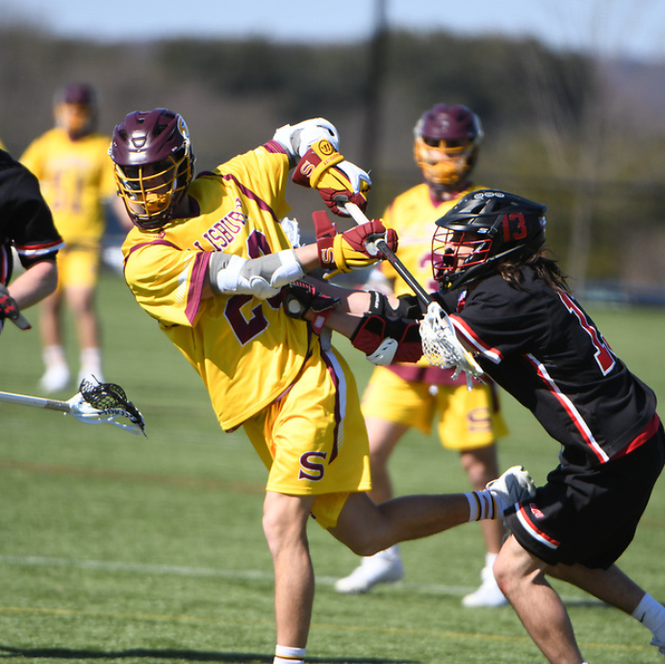
DEFENSELESS PLAYER
Blind side with & without possession
Head down on loose ball
MUST be a 2-Minute or 3-Minute Penalty
You CANNOT “bring this down” to a 1-minute if you use the words “to the head”
Notes:
DEFENSELESS PLAYER
A player shall not body check a player in a DEFENSELESS POSITION.
This includes but not limited to
Body checking a player from his "blind side“
Body checking a player who has his head down in an attempt to play a loose ball
Body checking a player whose head is turned away to receive a pass, even if that player turns toward the contact immediately before the body check.
PENALTY- These are ALWAYS 2 or 3 minutes, non releasable at the official’s discretion.
An excessively violent violation may result in an ejection.

Slide 12
DEFENSELESS PLAYER VIDEO
Notes:
DEFENSELESS PLAYER
Body checking a player from his "blind side“
Even the announcer got it
We CANNOT miss these!!
Could be targeting
What’s the call? Ask someone to standup and show the signals.
This should be a 3m and ejection!

Slide 13
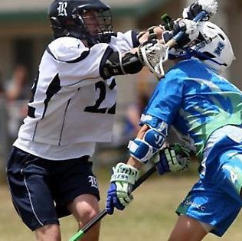
TARGETING
Blind side with & without possession.
Head down on loose ball
MUST be a 3-minute, non-releasable foul
Should be discussed as a crew
Notes:
TARGETING
A player shall not initiate TARGETING that intentionally takes aim at the HEAD/NECK of an opponent for the purposes of making violent contact
This could include SPEARING
These are usually “ANGRY” fouls
Can almost always be predicted (not prevented) based on tone and temperature of the game

Slide 14
TARGETING VIDEO
Notes:
TARGETING EXAMPLES
What’s the call?
Should be targeting, 3m and ejection!

Slide 15
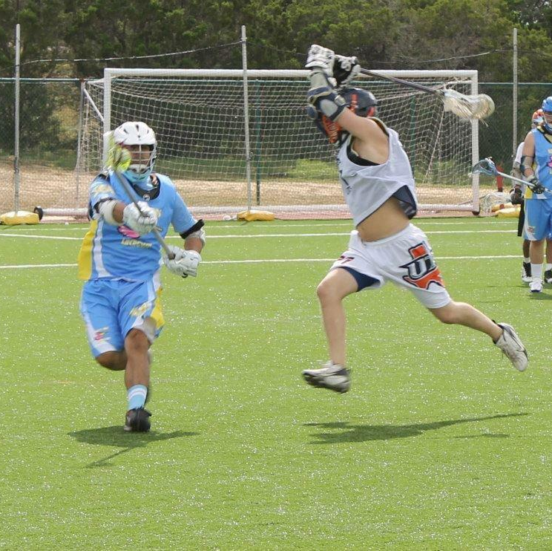
SLASHING
Swinging with viciousness or reckless abandon
Striking an opponent in the head, back, leg
ACTIVITY ALERT
Pool Noodle Demo!
Notes:
SLASHING
Swinging a crosse at an opponents cross or body with deliberate viciousness or reckless abandon, regardless of whether the opponents cross or body is struck.
Striking an opponent in an attempt to dislodge the ball from his cross UNLESS the player in possession, in an attempts to protect his cross, uses some part of his body other than his head or neck to ward off the thrust of the defensive players crosse and, as a result, the defensive players cross strikes some part of the attacking players body, other than the head or neck.
Striking an opponent in any part of the body with the cross (including its end cap, except when done by a player in the act of passing, shooting, or attempting to scoop the ball.
In all instances, the players gloved hand shall be considered part of the cross, except when in contact with a line marking.
Exercise
Have 2 volunteers with swimming noodles to replace the stick shaft, to show legal actions and slashes.
This is really key for new officials so you find that balance and don’t over or under call the youth game.

Slide 16
SLASHING VIDEO
Notes:
SLASHING
Everyday Slash by Defenseman
Easy call to make
Right in front of the official
Should learn to expect these as attackman come to GLE and defender gets desperate

Slide 17
SLASHING VIDEO
Notes:
SLASHING
Trail Slash by Attackman
This is a CONTROL call you cannot ignore
Was it bad, NO!
Could it start a problem, YES!
These are the calls that help you maintain control of a game

Slide 18
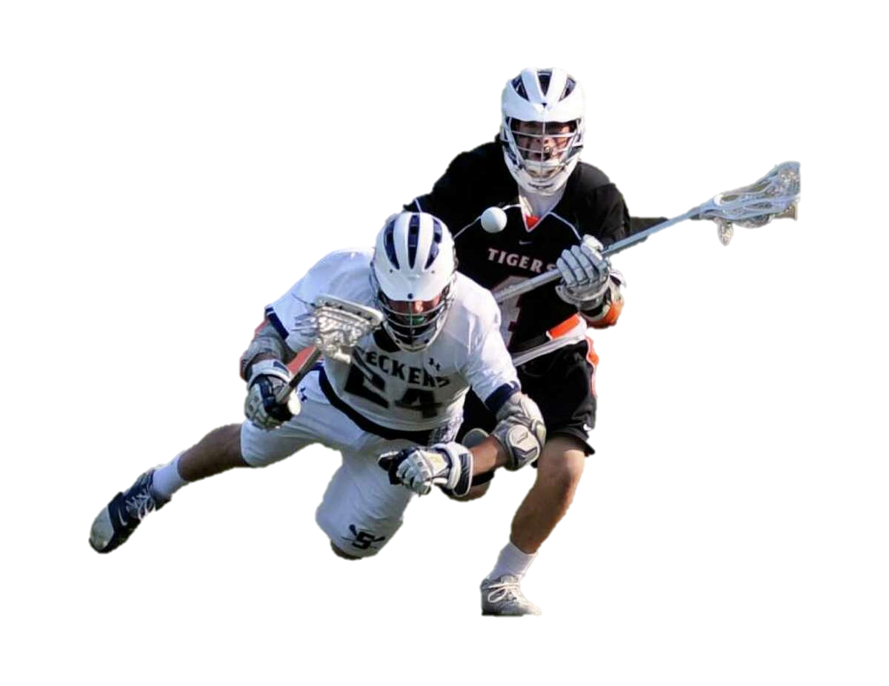
TRIPPING
Obstructing below the waist with POSITIVE PRIMARY action.
Doesn’t have to be intentional, most are not!
Usually happens after a missed check and the follow-through
Also happens when feet get tangled
Would he have gone down without “help”?
Notes:
TRIPPING
A player shall not trip an opponent with any part of his body or his cross.
Tripping is obstructing an opponent at or below the waist with the cross, hands, arms, feet or legs by any POSITIVE PRIMARY ACTION if the obstructing player is on his feet or by any secondary action when the obstructing player is not on his feet.
Tripping is obvious when it happens, although the actual cause may NOT be.
Being at the right angle to see the players is key to getting this one right.
When a player LEGALLY checks the cross of an opponent and the result is to cause the opponent to trip over his own crosse, no foul is committed.

Slide 19
TRIPPING VIDEO
Notes:
Tripping
These can be tough…why?
Because we are never really sure HOW the player went down?
Was it the feet, the stick or on his own?
The bottom line is the player went down with help
He would not have gone down on his own.

Slide 20
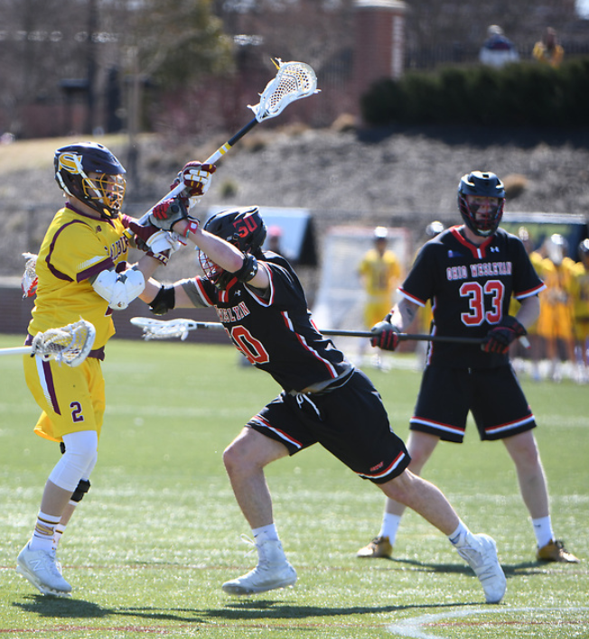
UNNECESSARY ROUGHNESS
Excessively violent holding and pushing infractions
Defensive player violent contact with screening opponent
Avoidable deliberate violent contact
Punching blows
Notes:
An excessively violent infraction of the rules against holding and pushing.
Deliberate and excessive violent contact made by a defensive player against an offensive player who has established a screening position, aka "running through a pick".
It is not a penalty if the defensive player, while playing his opponent unknowingly collides into a legal pick.
Any avoidable act on behalf of a player that is deliberate and excessively violent, whether it be with the body or crosse. This may include a legal body check.
A check delivered with the gloved hand or hands may not be delivered with a punching blow.

Slide 21
UNNECESSARY ROUGHNESS – LATE HIT VIDEO
Notes:
UNNECESSARY ROUGHNESS – LATE HIT
This is the most common UNR
Trail always has the shooter as should be looking for this
Could the defender have stopped?
Was he making a point?
What else do you call?
Make this call! OR REGRET IT LATER!

Slide 22
UNNECESSARY ROUGHNESS – RUNNING THROUGH A PICK
Notes:
UNNECESSARY ROUGHNESS – RUNNING THROUGH A PICK
This is one of the less common UNR calls and it can surprise us.
Don’t look past the pick before it happens
Its also tough because you MUST judge intent
Look for the extension of the arms
Look for the head turn to see the picker
Make this call!

Slide 23
ILLEGAL CONDUCT
Unsportsmanlike Conduct
Remember the ladder
Possession
30-Second Conduct
1-Minute USC
Ejection
Fighting
Automatic Ejection
3-Minute Penalty (in-home)
Notes:
ILLEGAL CONDUCT
No player, substitute, non-playing member of a squad coach or anyone officially connected with a team shall:
Enter into an argument with an official as to any decision
Use threatening, profane or obscene language or gestures
Bait or call undue attention to oneself
Any other act considered unsportsmanlike
Deliberately use his hands to play the ball or grab an opponents crosse with the open hand or fingers on a face off.
Items above are 1-3 min non-releasable penalties in all cases.
RELEASABLE 1-3 min USC penalties include:
Throwing a crosse at the ball, a player or game personnel
A coach who is on the field and obstructs play
Repeatedly commit the same technical foul (jumping on a faceoff purposely to go shutoff and go 1v1)
As a player deliberately fail to return immediately to the field after leaving the field while legally in the game
As a substitute, deliberately fail to comply with the rules for entering the field of play.

Slide 24
COACH BEHAVIOR
Use the Ladder!!
Do not Ignore the Head Coach
Answer a question, not a statement
“Coach…
it’s over”
Be
honest
Notes:
COACH BEHAVIOR
Allow the Coach to express his feelings and ask a question.
ANSWER IT!, but be brief and factual when answering questions.
Be careful to not reply to a statement.
USE THE LADDER IF NEEDED
Conduct foul, take away the ball.
Conduct fouls while the opponent has possession, 30 seconds served by the In-home player.
Unsportsmanlike Conduct, 1 minute non-releasable.
A second USC is an ejection of the coach, BUT, only a 1-minute penalty to be served by the in-home

Slide 25
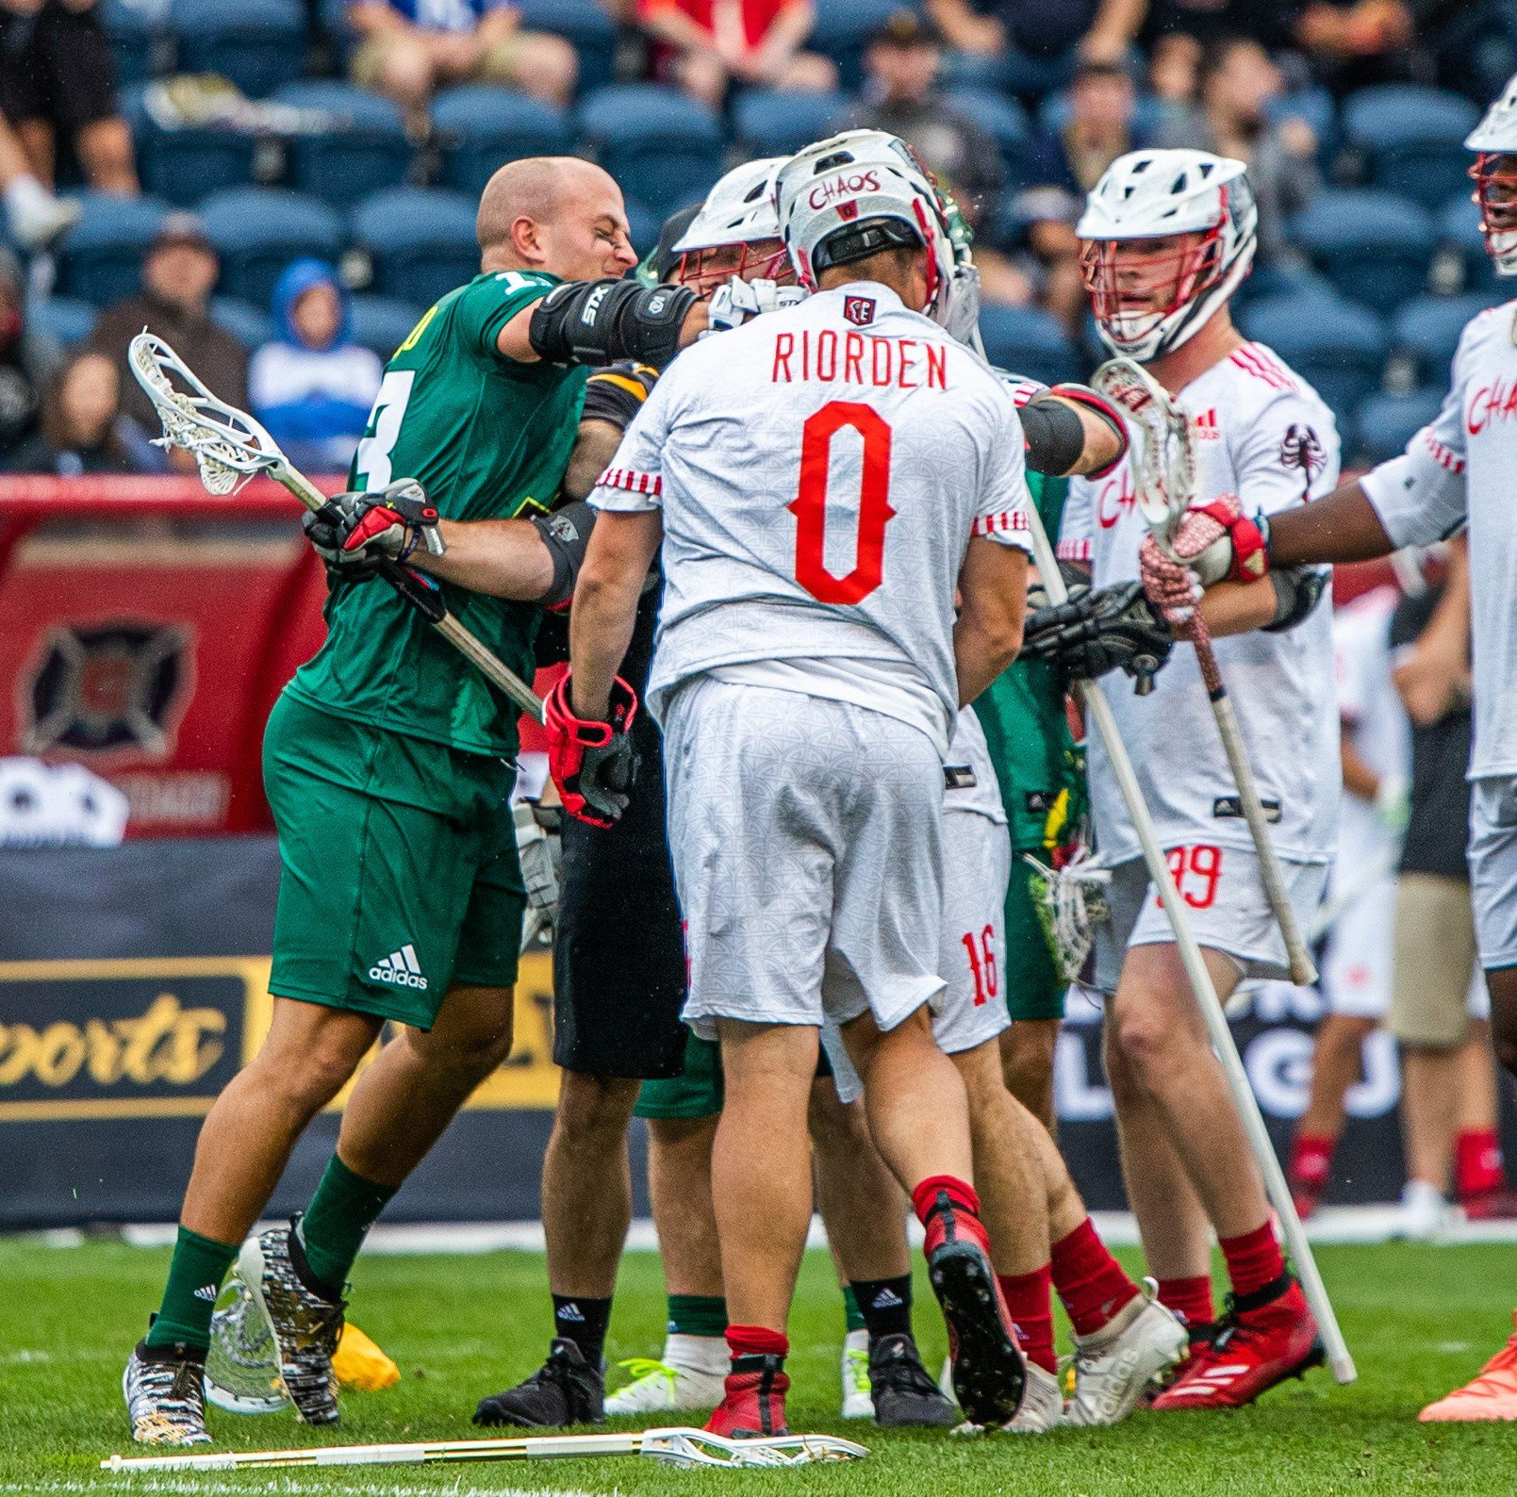
PLAYER BEHAVIOR
Control Player to Player Interactions
Trash-talking
Language
Teammates
Opponents
You!
Race and Gender
Class Discussion Questions
Notes:
PLAYER BEHAVIOR
YOU set the tone for this early
What you allow, will CONTINUE
What you stop, will STOP!
CLASS DISCUSSION
Trash-talk – What is OK? What is not? What are YOUR triggers?
Racial slur – How do you handle? This is a tough one!
Comments to Officials – What is your “line in the sand”? Should it be the same for all?

Slide 26
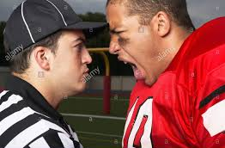
TEAM BEHAVIOR
ALL WARNINGS ARE TEAM WARNINGS
CAPTAINS CAN HELP DEFUSE SITUATIONS
Notes:
TEAM BEHAVIOR
When the behavior issues are wide-spread and non-specific, use the captains!
Individual discussions
BOTH team’s captains and relay the message
When the behavior is beyond the captains (such as fans, sideline, etc.) and involves BOTH teams, bring the coaches together
Discuss issues and what needs to change
No discussion or blaming
Consider the Game Manager if this has spilled into the fans

Slide 27
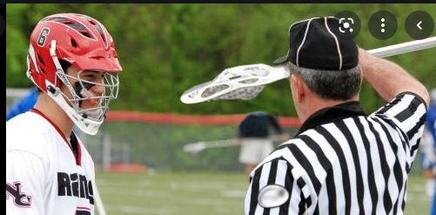
OTHER PERSONAL FOULS
Illegal Crosse & Equipment
Gloves must completely cover the hands
Note: Mouthpiece violation is technical foul
Certain Illegal Behavior:
Grabbing ball or opponent crosse in face off
Notes:
OTHER PERSONAL FOULS
Gloves – How do we handle small holes versus palms cut out?
What if he “swats” the ball during a faceoff?
DISCUSSION QUESTION:
What’s the signal for illegal touch?

Slide 28
PENALTY ENFORCEMENT
1, 2 OR 3 MINUTES​
AFTER END IF PERIODS
RELEASABLE/ NON-RELEASABLE
FOULING OUT
EJECTIONS​​
Notes:
PENALTY ENFORCEMENT
SEVERITY MATTERS:
1, 2 or 3 Minutes depending on the rule and official's judgement of the severity and perceived intent of the personal foul.
General Guide:
1 Minute, releasable, for fouls occurring during the normal course of play, These may include non-releasable unsportsmanlike conduct.
2 or 3 Minutes, possible non releasable, for flagrant or excessive unnecessary roughness or unsportsmanlike conduct.
3 Minutes, non-releasable and possible ejection, for flagrant unsportsmanlike conduct or intentionally targeting; and fighting is an automatic ejection.
5 minutes of personal fouls disqualifies the player different than ejection.
Ejection fouls for deliberately striking or attempting to strike anyone, or leaving the bench are during an altercation; a SECOND USC foul or any action deemed by the officials to be flagrant misconduct.
DISCUSSION QUESTION:
What does FLAGRANT actually mean on the field?
Discuss various examples

Slide 29
PREVENTING PERSONAL FOULS
Pre-game communication with Captains.
It's ok to ask questions.
It's not ok to yell and scream.
In game Communication with Players
It's ok to explain to players what they did wrong, so they don't do it again.
Notes:
PREVENTING PERSONAL FOULS
Discussion Questions
Should we talk to players during the game?
Can we talk the off the “ledge”?
Can we PREVENTATIVELY OFFICIATE?
What does that mean?
Give examples
When is it too much? When are we coaching?

Slide 30
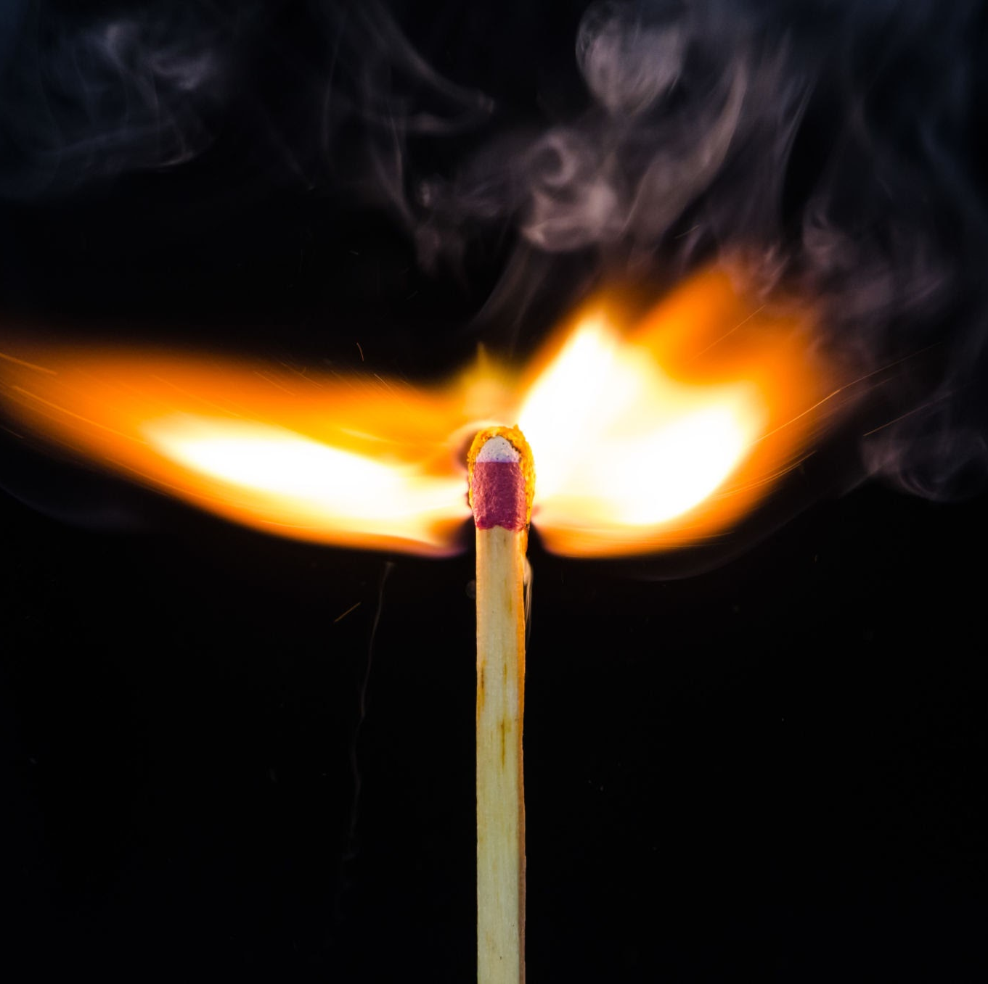
BE AWARE OF “FLASH POINTS”
After Goals!
Around the Crease!
Stoppages of Play!
Player Movement!
Substitution!
After a BIG HIT!
Notes:
FLASH POINTS
Discussion Questions
Why are we surprised by these?
Do we know the game of lacrosse or are new to it?
Study the game by watching film
Learn to EXPECT the UNEXPECTED and be surprised when it does NOT happen!

Slide 31
SITUATIONAL AWARENESS
Feel the momentum shift!
Big Long Loose ball scrums!
Those first 5 minutes!
After Big Hits!
The Crowd Goes Wild!
Near the Lines!
Notes:
SITUATIONAL AWARNESS
Discussion Questions
Describe a time when you felt things change
What led to the shift?
How did you handle?
What could you do better?

Slide 32
YOU MAKE THE CALL - 1
Notes:
You need to be connected to the internet for these to play…
SLASHING

Slide 33
YOU MAKE THE CALL - 2
Notes:
You need to be connected to the internet for these to play…
Legal Body Check

Slide 34
YOU MAKE THE CALL - 3
Notes:
You need to be connected to the internet for these to play…
TARGETING

Slide 35
YOU MAKE THE CALL - 4
Notes:
You need to be connected to the internet for these to play…
TRIPPING

Slide 36
YOU MAKE THE CALL - 5
Notes:
You need to be connected to the internet for these to play…
CHECK TO THE HEAD & NECK AREA

Slide 37
YOU MAKE THE CALL – 6
Notes:
This is the last one! Kahoot is next!
You need to be connected to the internet for these to play…
ILLEGAL BODY CHECK

Slide 38
KAHOOT!
GAME-STYLE LEARNING
Kahoot! is a digital learning platform that uses quiz-style games to help students learn by making the information engaging in a fun way.
As one of the biggest names in quiz-based learning, it's impressive that Kahoot! still offers a free-to-use platform, which makes it highly accessible for teachers and students alike. It's also a helpful tool for a hybrid class that uses both digital and classroom-based learning.
The cloud-based service will work on most devices via a web browser. That means this is accessible for students in class or at home using laptops, tablets and smartphones.
Notes:
KAHOOT (You need to be connected to the internet to Play Kahoot!)
Practice this before the class starts
Open the link and have it sitting in a browser window waiting
No app or login is required

Slide 39
KAHOOT INSTRUCTIONS
PLAYERS
On your smartphone, tablet or laptop, go to www.kahoot.it
Wait for the instructor to give you the Game Pin
Enter your first name and last initial ONLY
INSTRUCTORS
A Kahoot account can keep track of results, otherwise, you can play without an account
https://create.kahoot.it/auth/login
Create a free BASIC account (up to 50 users) or paid PRO account (up to 100 users)
Click on the link below
Game will open in an internet browser window
USA Lacrosse Officials Development Program - PERSONAL FOULS : RULE 5
Notes:
You need to be connected to the internet to Play Kahoot!

Slide 40
THANK YOU TO THE MEMBERS OF THE
2023 MENS OFFICIAL’S EDUCATION DEVELOPMENT TEAM

