Slide 1

RULE 7 – PENALTY ENFORCEMENT
MENS OFFICIALS DEVELOPMENT | 2023 SEASON
Notes:
RULE 7 – PENALTY ENFORCEMENT
30-60m
Lots of practice in this unit
Consider videotaping each student with their own phone so they can have as playback

Slide 2
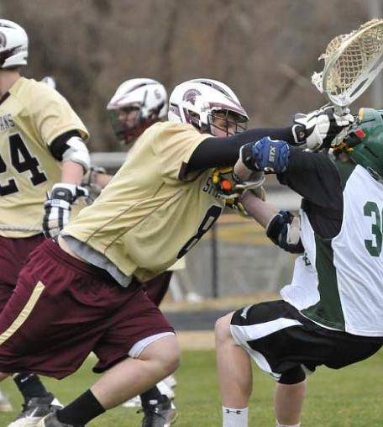
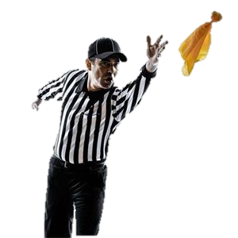
PENALTY ENFORCEMENT
YOU SEE IT…NOW WHAT?
First, recognize the situation
Second, make the call!
If you hesitate, that’s OK. This will come with experience
Talk to your partners if you are not sure to get the call right
Put the ball back in play and move on!
2
Notes:
PENALTY ENFORCEMENT
Biggest challenge for new officials
Don’t be afraid to throw the flag
If you make a mistake, it can be corrected
NOT throwing the flag questions your judgement

Slide 3
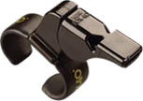
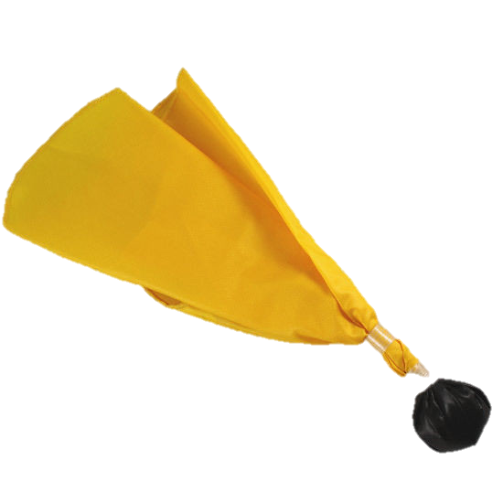
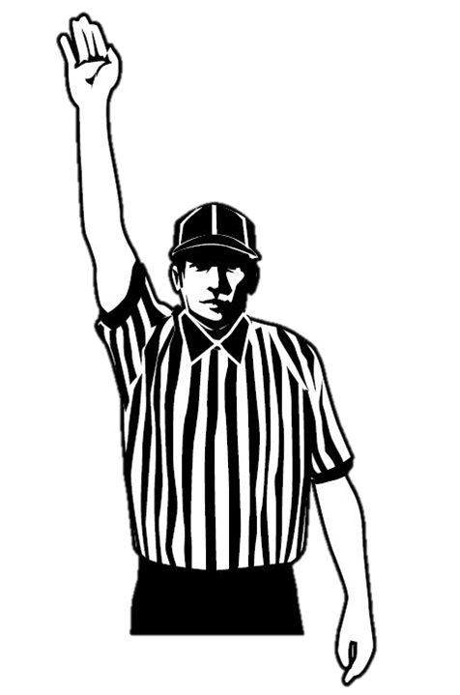
RECOGNIZE THE SITUATION
Foul Occurs
Loose Ball
Team In Possession Fouls
Team Not In Possession Fouls
Personal
Personal
Technical
Technical
Technical
Personal
Class Discussion Questions
3
Notes:
RECOGNIZE THE SITUATION
The Offended Team is the team who was fouled
The Offending Team is the team that fouled
Team A is the team in possession while reading the rulebook
Team B is the team not in possession while reading the rulebook
Class Discussion
How long should a play-on last for?
The play-on varies by level, but generally look for a quick advantage. Kill the play if no immediate advantage

Slide 4
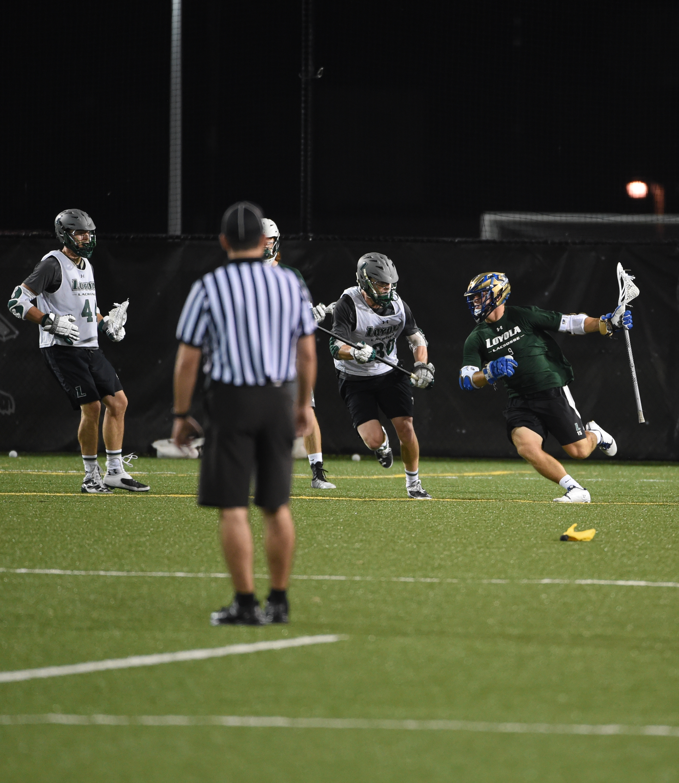
FLAG DOWN-SLOW WHISTLE
FDSW
FDSW is used when a team is possession is fouled
If you see a foul:
  Throw the flag high
  Yell “Flag Down”
  Remember the number!
Know the rules of when to stop the play
  GOODIES
Class Discussion Questions
4
Notes:
FLAG DOWN-SLOW WHISTLE
For a foul by Team B when Team A is in possession (other than most goalie interference and crease violation fouls)
Yell “Flag down!” and throw your flag without blowing your whistle.
Team A will then be allowed a chance to complete the scoring opportunity.
When to end a Flag Down
Slow Whistle in NFHS using GOODIES
Explained in detail on next slide
Class Discussion
What would be a typical offensive violation that would result in the end of a FDSW?
A ward or illegal offensive screen during the free scoring opportunity are the most likely violations.

Slide 5
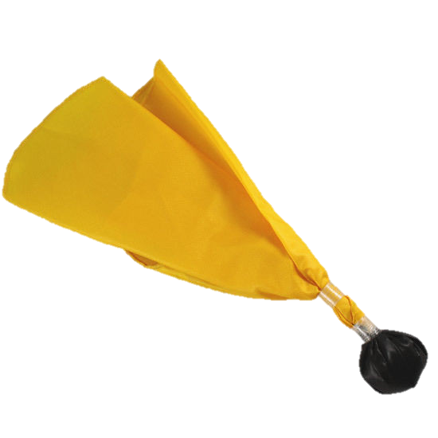
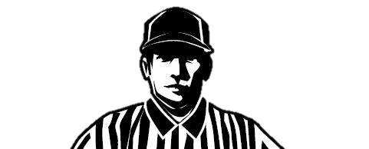
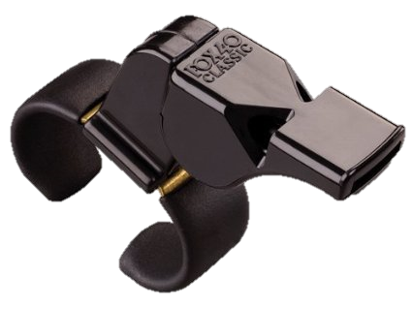
WHAT IS GOODIES?
AN ACRONYM TO HELP YOU REMEMBER
Goal
Offense commits foul
Out of Bounds
Defense gains possession
Injury stoppage
End of period/equipment loss
Second foul by defense
5
Notes:
WHAT IS GOODIES?
When to stop play on a flag-down slow-whistle
Discuss an “imminent scoring play” during second flag by defense

Slide 6
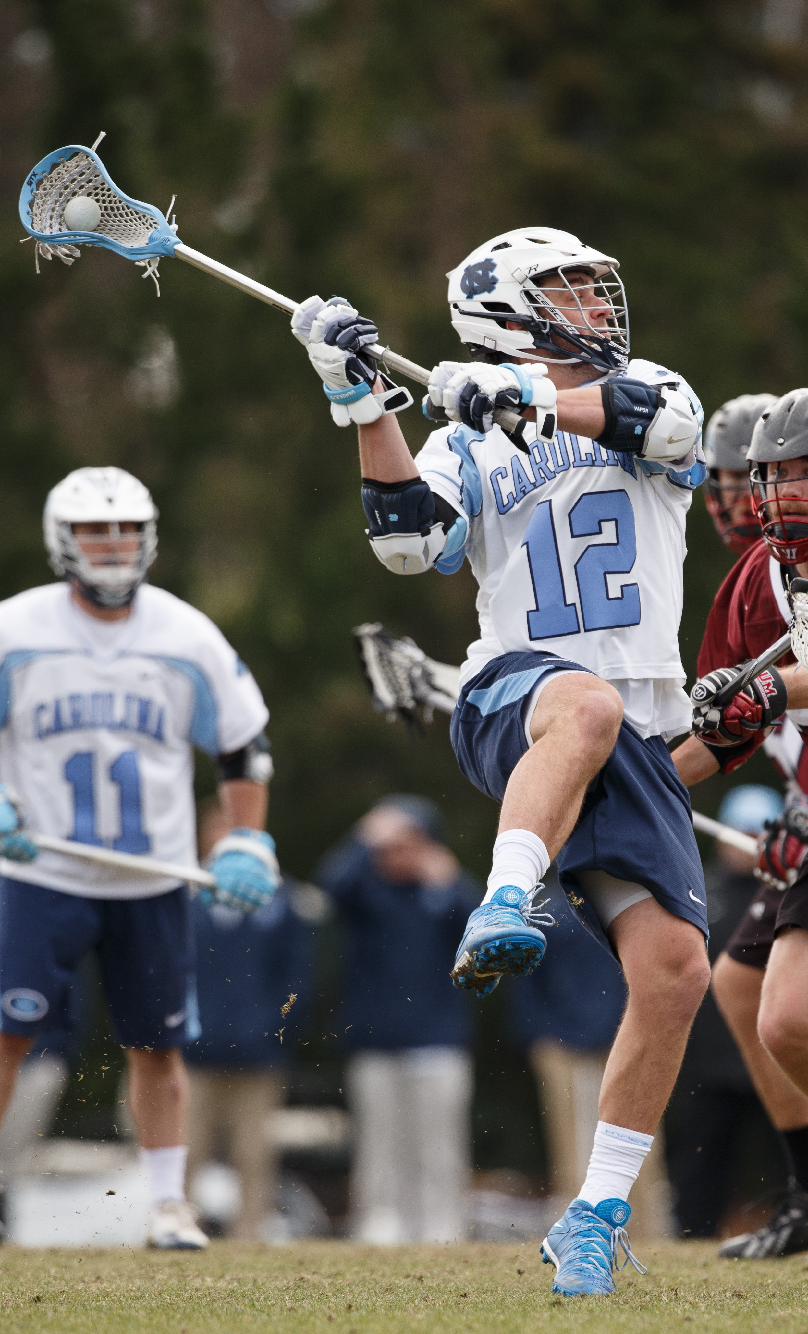
FLAG DOWN, SLOW WHISTLE STEPS
“Flag Down”
+
GOODIES
Class Discussion Questions
Scoring Opportunity
6
Notes:
FLAG DOWN, SLOW WHISTLE STEPS
Make certain you yell “flag down” while throwing your flag. This serves three purposes:
If you have trouble getting the flag out (sometimes they get stuck) everyone still knows a penalty was called. Keep repeating “flag down” until you can throw your flag
Your partner(s) will know that you threw a flag even if they don’t see your flag come out, and will be able to stop play at the right time according to the rules
The players will know you threw the flag. This prevents potential retaliation by the offended player who might assume you did not throw your flag
Echo your partner’s “flag down” call.
You do not throw your flag if your partner throws theirs, but you should always echo their verbal “flag down” so the entire field knows the call
Dead Ball Time
DO NOT lose sight of the players during the time immediately after your whistle.
Keep officiating and if you have to step in to prevent players from doing something foolish you should do so.
Class Discussion
Why is it important to echo your partner’s flag down call?
So that the players and coaches who may be further away from the on ball action understand that a flag has been thrown. This also tells your partner that you know a flag is down and will recognize when to properly end play.

Slide 7
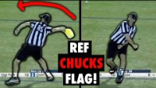
FLAG TOSS
GO BIG OR GO HOME!
7
Notes:
FLAG TOSS
Fun video of how NOT to do it!

Slide 8
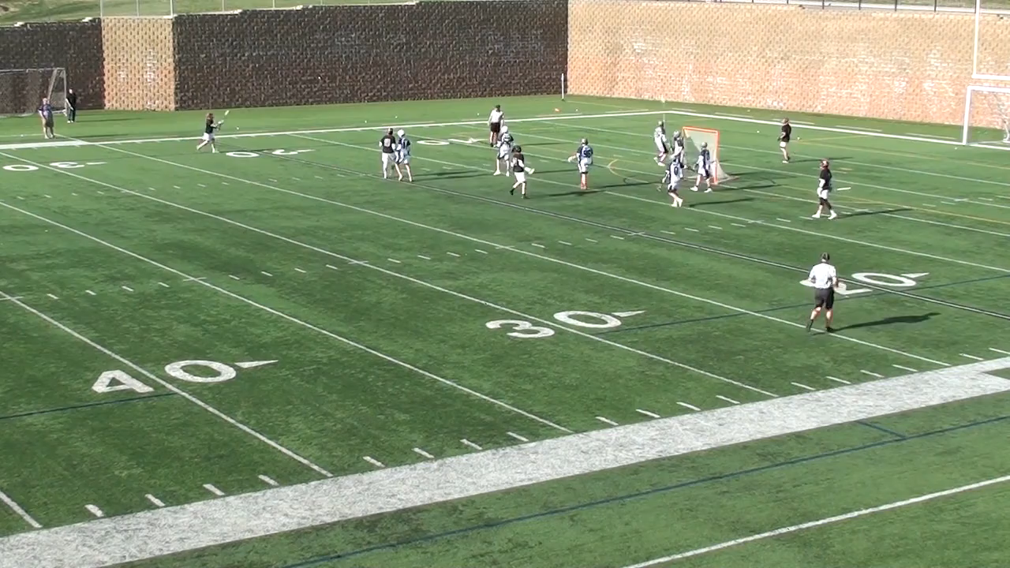
FLAG TOSS
LET’S TRY THIS AGAIN
8
Notes:
FLAG TOSS – THE CORRECT WAY
Fun video of how NOT to do it!
Big flag tosses are encouraged but do it right!

Slide 9
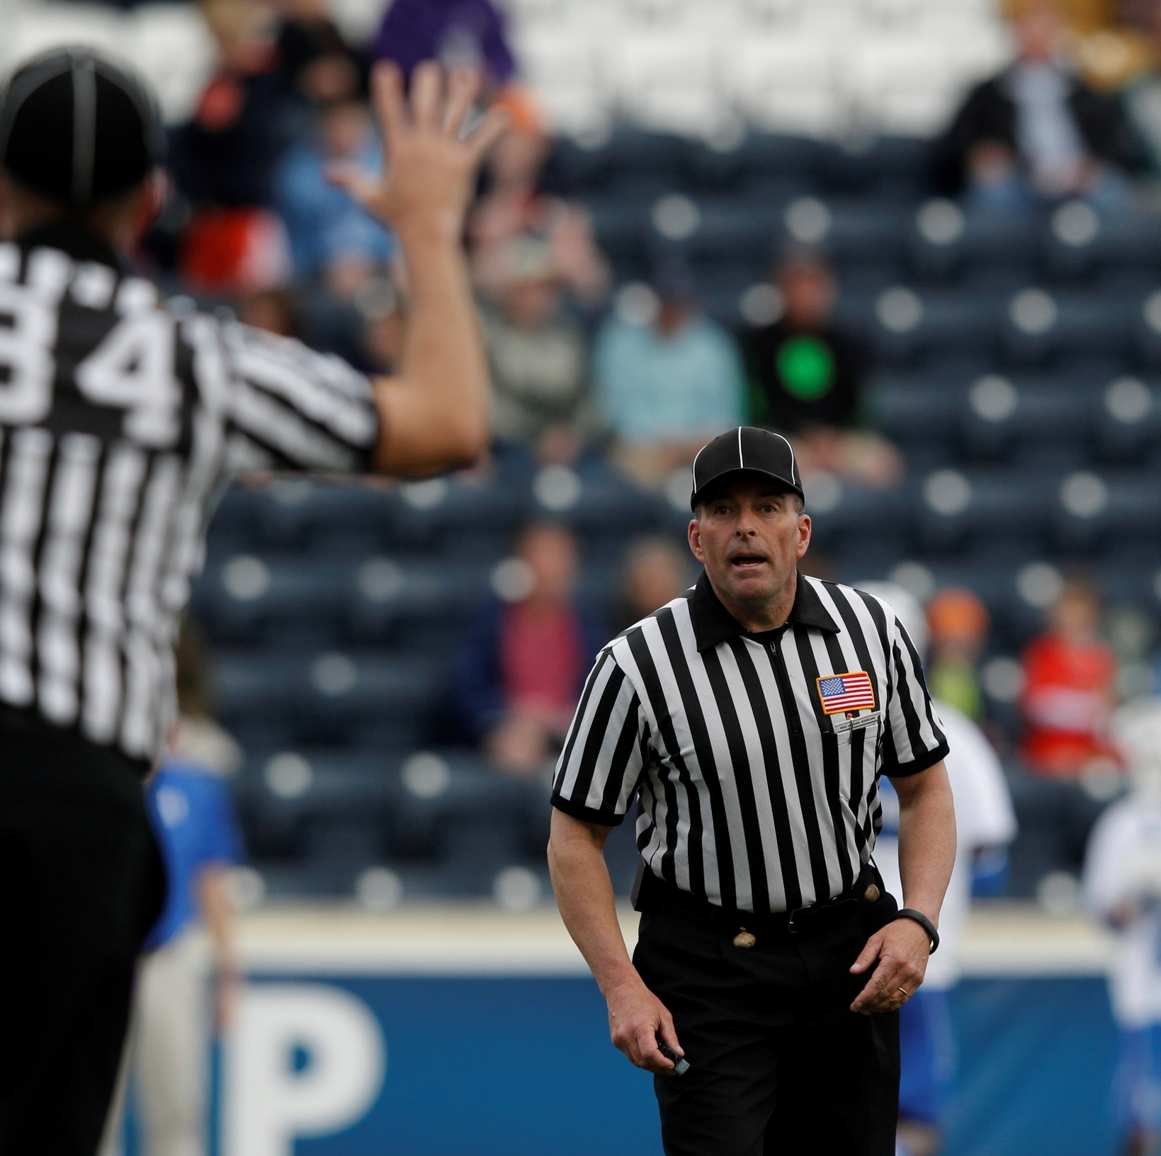
RELAY AND REPORT
1st
Partner(s)
Field
2nd
Table
Coaches
3rd
Goalkeeper
Others as necessary
Class Discussion Questions
Notes:
RELAY AND REPORT
Check for flags from your partner.
If there are multiple flags, you may need to conference to determine if you have two flags for the same foul or flags for two different fouls.
Position yourself promptly but not “hurriedly” in open space:
Face the table
2-person (Trail official)
3-person (Closest official to bench, usually the Trail)
Should be at intersection of wingline and midline or closer
Make sure the table’s view to you is unobstructed
Stand up straight with your feet set
Signal the penalty while pausing after each "word."
Don't turn away from the table until table fully understands the situation
Class Discussion
Why is it important for the goalkeeper to know what the penalty is and how long?
It is good to communicate with the goalkeepers of both teams so they understand the situation and can communicate to the defense. You should also tell the goalkeeper where the ball will be restarted so it is not a surprise.

Slide 10
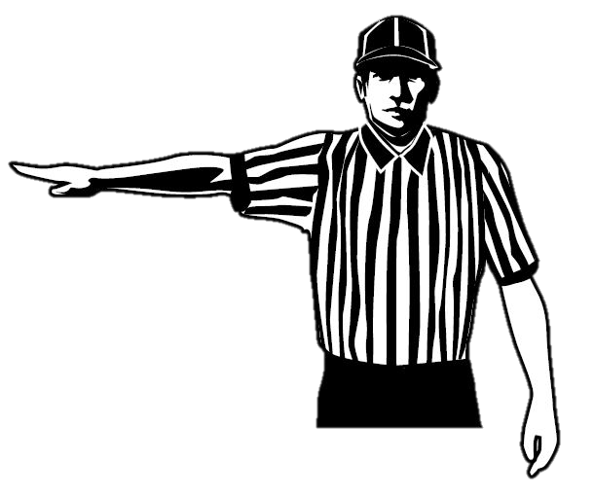
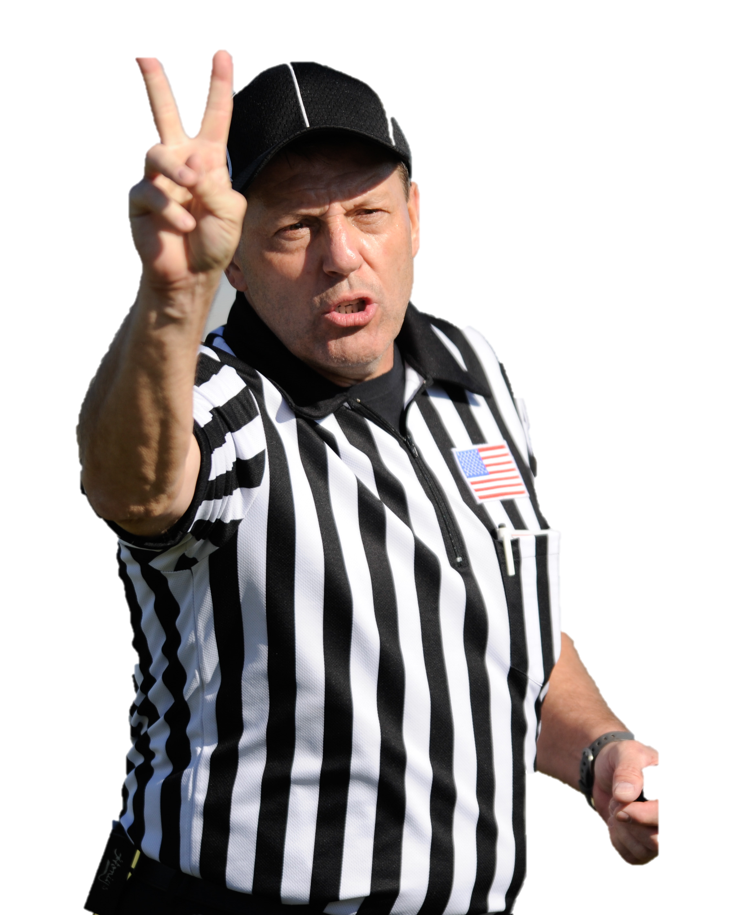
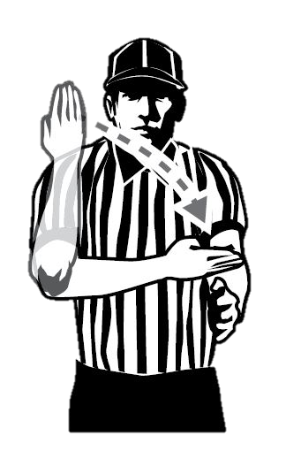
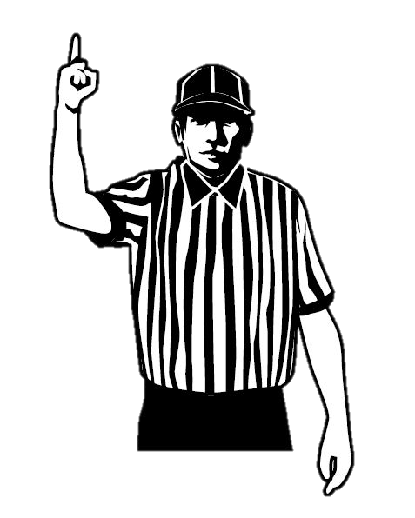
REPORT PENALTIES (C-NOTE)
Blue
Two
Slashing
1-minute
Class Discussion Questions
C
N
O
T
Explanation is optional, use when needed:
“Dead ball foul, Team A ball at Center X”
Notes:
REPORT PENALTIES (C-NOTE)
Announce the following information to the table:
Color of the offending player’s uniform (point to bench)
Number of the player (optional signal numbers)
Offense/Foul the player committed (give signal)
Time to be served (give “T” signal if 30 second technical foul)
Explanation (optional)
Quickly explain who has possession and where the ball will restart
“Blue ball, free clear at Center X”
“Red ball, side-left, outside the box”
Timer on after the report
Teams have twenty-seconds to get the right players on the field
Use the timer after the report!
Keep the dead-ball time to a minimum by signaling “timer on” and turning your twenty-second timer on.
This encourages both teams to be ready in time for the restart, and prevents extended dead ball time.
Class Discussion
Your partner is relaying the penalty to the table. What should you be doing?
You should be setting the field, which includes putting the ball where the restart will be
Informing the goalkeeper where the ball is and what the penalty is and for how long.
Count the man-up/man-down units to make sure the correct number of players is on the field.
This saves time and keeps the game moving.

Slide 11
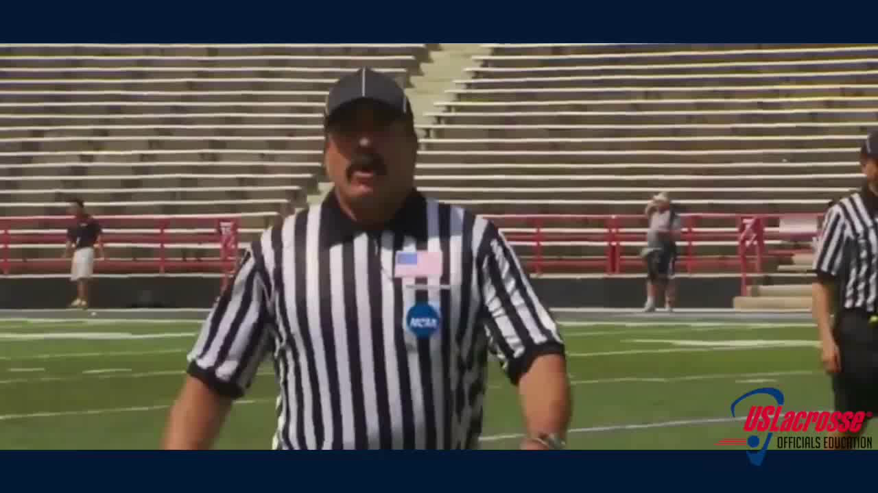

PROPER PENALTY REPORTING
WATCH THE BEST DO IT CORRECTLY
Notes:
REPORT PENALTIES WITH C-NOTE EXAMPLE
Watch top NCAA lacrosse officials report penalties.
Each report is played twice so you can see how C-NOTE is used.
When reporting to the table it is recommended you only say it once.
In the second part of this video LAREDO Head Clinician Sean Murphy explains why tone is important when reporting and how to better tell a story so everyone understands the situation. (deliver the story in a neutral tone)
C-NOTE: Color, Number, Offense, Time, Explanation if needed
Note: Freeze your feet and BE BIG when reporting penalties to the table area. It looks cleaner.

Slide 12
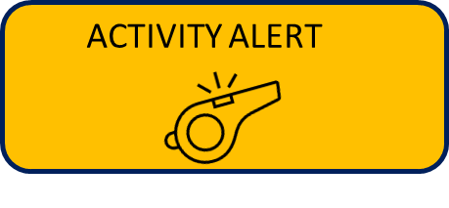

PENALTY REPORTING PRACTICE
Throw the flag
Report a penalty
Personal fouls
Technical fouls
Yell “Flag Down”
PRACTICE TIME
Give your phone to a neighbor and have them videotape you reporting fouls.
12
Notes:
FLAG DOWN, SLOW WHISTLE PRACTICE
Activity: Have each participant take turns practicing throwing the flag and going through the steps to report fouls.
Videotape w/participants OWN phone so he can have to refer back to.

Slide 13
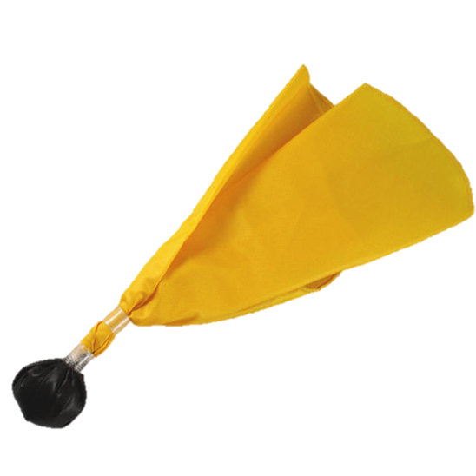
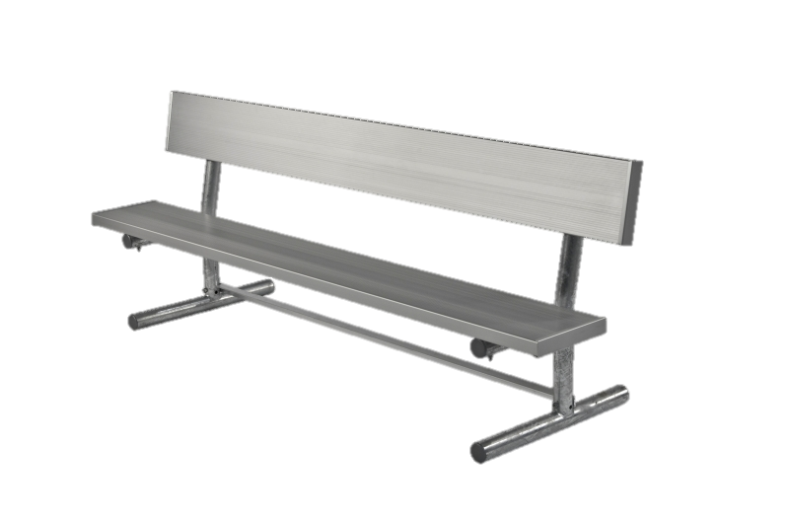
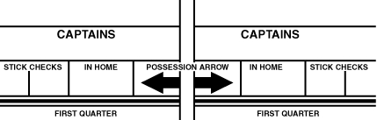
WHEN TO USE THE IN-HOME
?
?
No Number and/or Coach
Class Discussion Questions
2
14
Notes:
WHEN TO USE THE IN-HOME
In-home: starting attack player. (scorebooks aren't used much anymore)
Get the number of the in-home from the head coach during the coaches certification.
Write this on your scorecard for easy reference
If a penalty is called against a team when no definite player is involved (not a simple offside) or when the penalty is against someone other than a player in the game (coaches/bench penalties), the official shall assess the penalty time against the in-home.
Class Discussion
Who is responsible for writing down the in-home on the scorecard?
Each official on the crew should have that information on their scorecards.
What if the first listed attackman is already serving a penalty?
Use the next player listed in the scorebook.

Slide 14
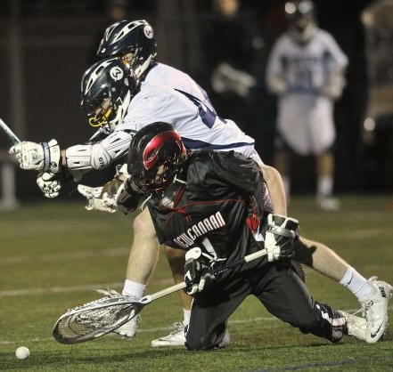
PLAY-ON
KEEP THEM SHORT
Play-On!
Class Discussion Questions
Notes:
PLAY-ON
Loose ball technical fouls by either team result in a “play-on” if the offended team has an opportunity to pick up the ball and maintain their advantage
If no clear opportunity for offending team to gain possession – blow the whistle and award possession
Class Discussion
Do you have to put your hand in the air when calling play-on?
Yes, the visual signal is critical so that even if the teams do not hear you they can see you.
This is also important for your partner to see.

Slide 15
PLAY-ON PROCESS
Team B commits loose ball technical
“Play-On”
Team A Does Not Gain Possession
Team A Gains Possession
Stop play
Signal penalty
Push
Award Possession
“Red Ball”
Eyes on any extra action
Play-Off!
Notes:
PLAY-ON PROCESS
North/South vs. East/West play-on
The play-on is designed to allow the offended team to maintain their advantage.
This typically involves the team being able to push the ball up field in transition
With a north/south play-on (the player is going towards one end line or the other) the official may be able to hold the whistle a little longer as there is a greater chance for the player to create a fast break
With an east/west play on (the player going towards one sideline or the other) the official may want to whistle play dead as the options for the player moving the ball up field are more limited
Play-on’s near a boundary line should be killed quickly. Even if the player picks up the ball, if they are immediately pressured and forced out of bounds that player never had an opportunity to utilize the advantage they received from the play-on.
Class Activity
Practice the correct play-on steps.
Have every official stand and go through each step.

Slide 16
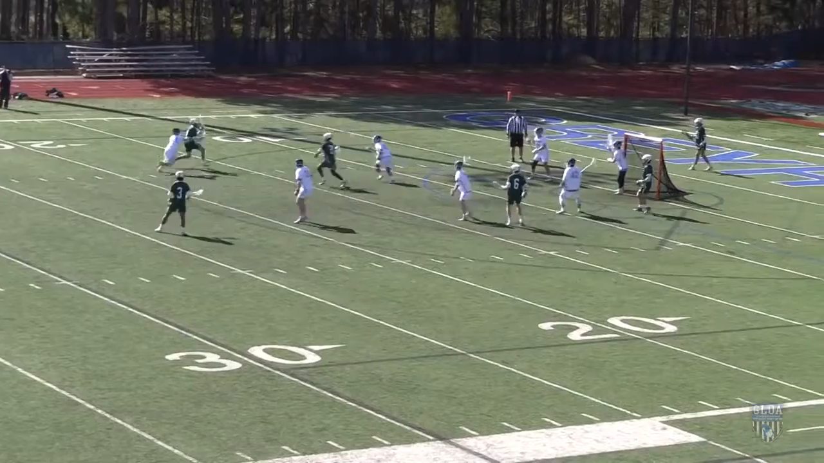

PLAY-ON VIDEO
LOOSE BALL INTERFERENCE
Notes:
PLAY-ON VIDEO
LOOSE BALL INTERFERENCE

Slide 17
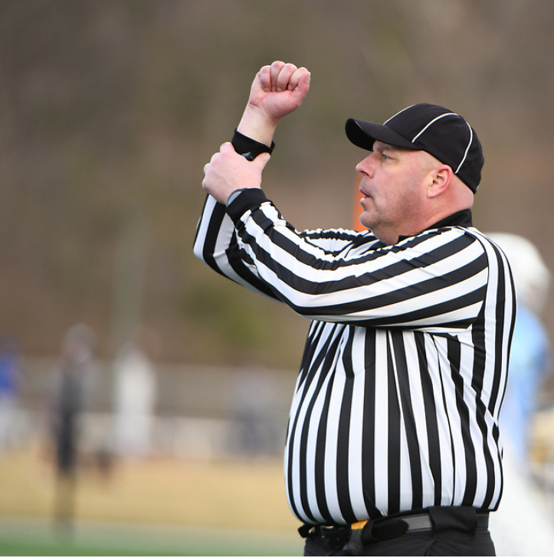
TECHNICAL FOUL DRILL
DEMONSTRATE THE SIGNALS
Push w/Possession
Holding
Offside
Illegal Procedure
Conduct Foul
Interference
Notes:
TECHNICAL FOUL DRILL
Class Activity
Groups of 2 for classes of 12 or more
Work through each foul using C-NOTE on play-on, whistle scenarios

Slide 18
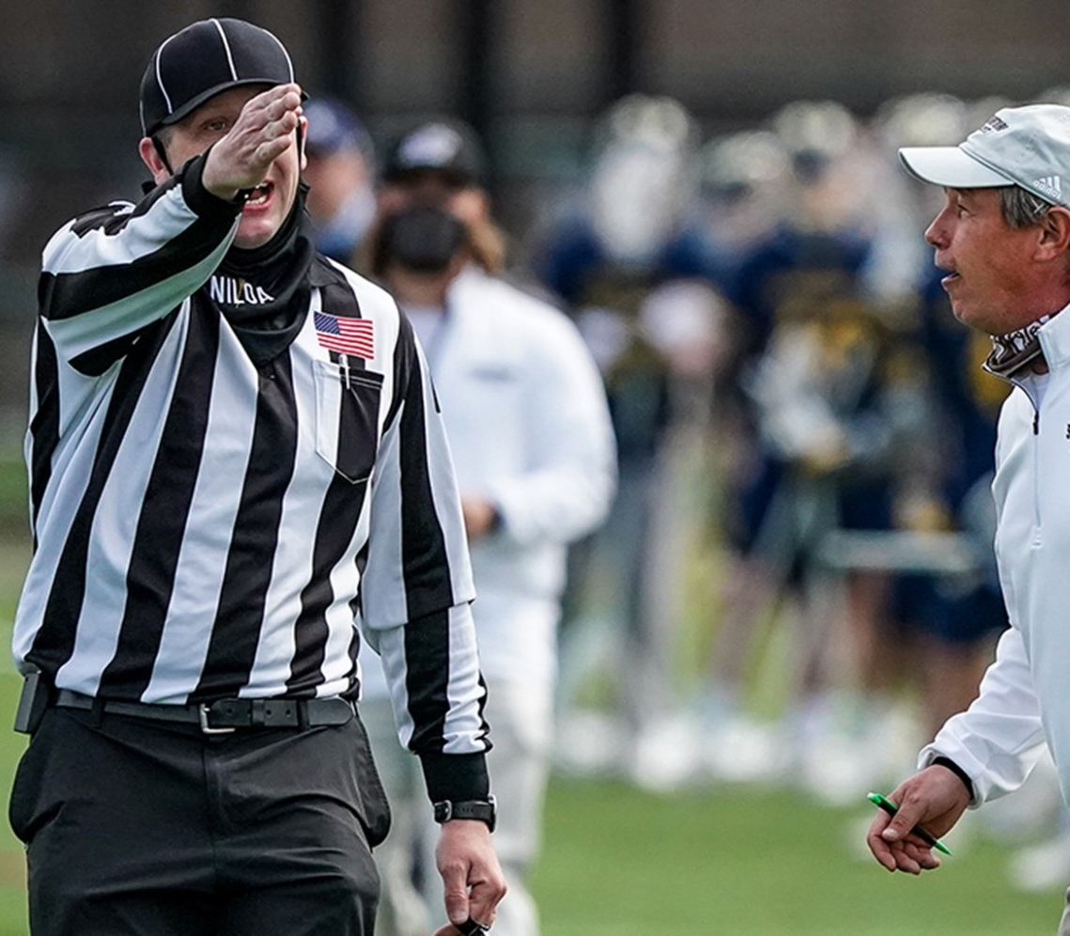
CORRECTION OF ERRORS
WE ALL MAKE MISTAKES
Take Your Time
  Clock stops when you blow whistle
Understand the Mistake
  What happened?
Inform Everyone of Error AND Correction
Give teams time to sub personnel
  Do not advantage a team by restarting too fast.

Slide 19
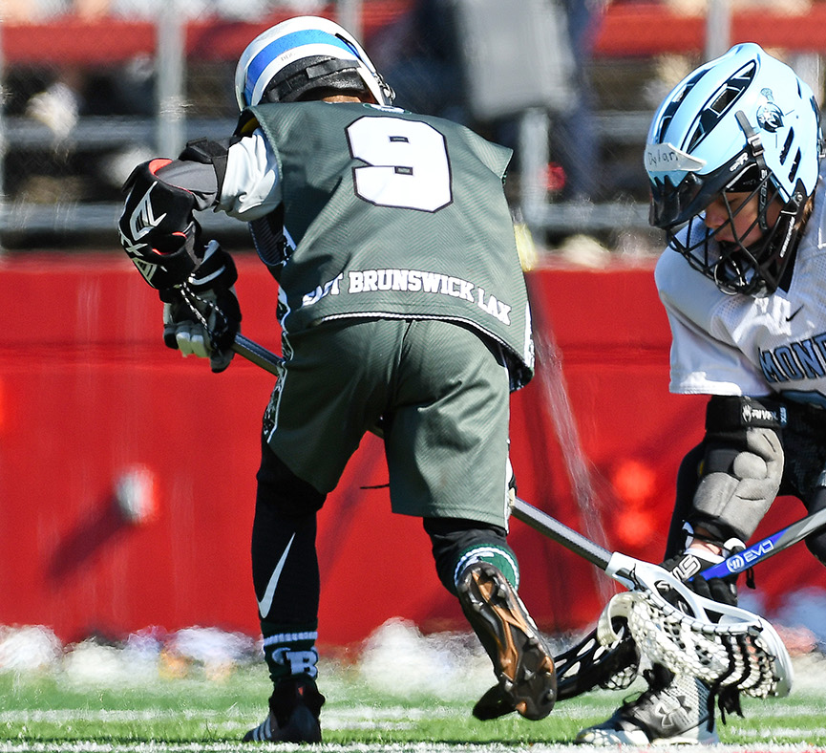
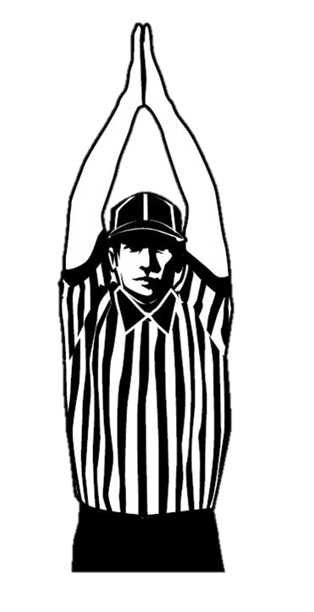
2023 RULES CHANGES
YOUTH RULES ONLY
Starting 2023 Youth all fouls served full time
Rationale
    Increases the impact of penalties called, ensuring commitment to safe and legal play
    Eases penalty administration for officials and table personnel.
Notes:
2023 RULES CHANGES – YOUTH ONLY
Discuss that simultaneous fouls are a non-issue under this rule.

Slide 20
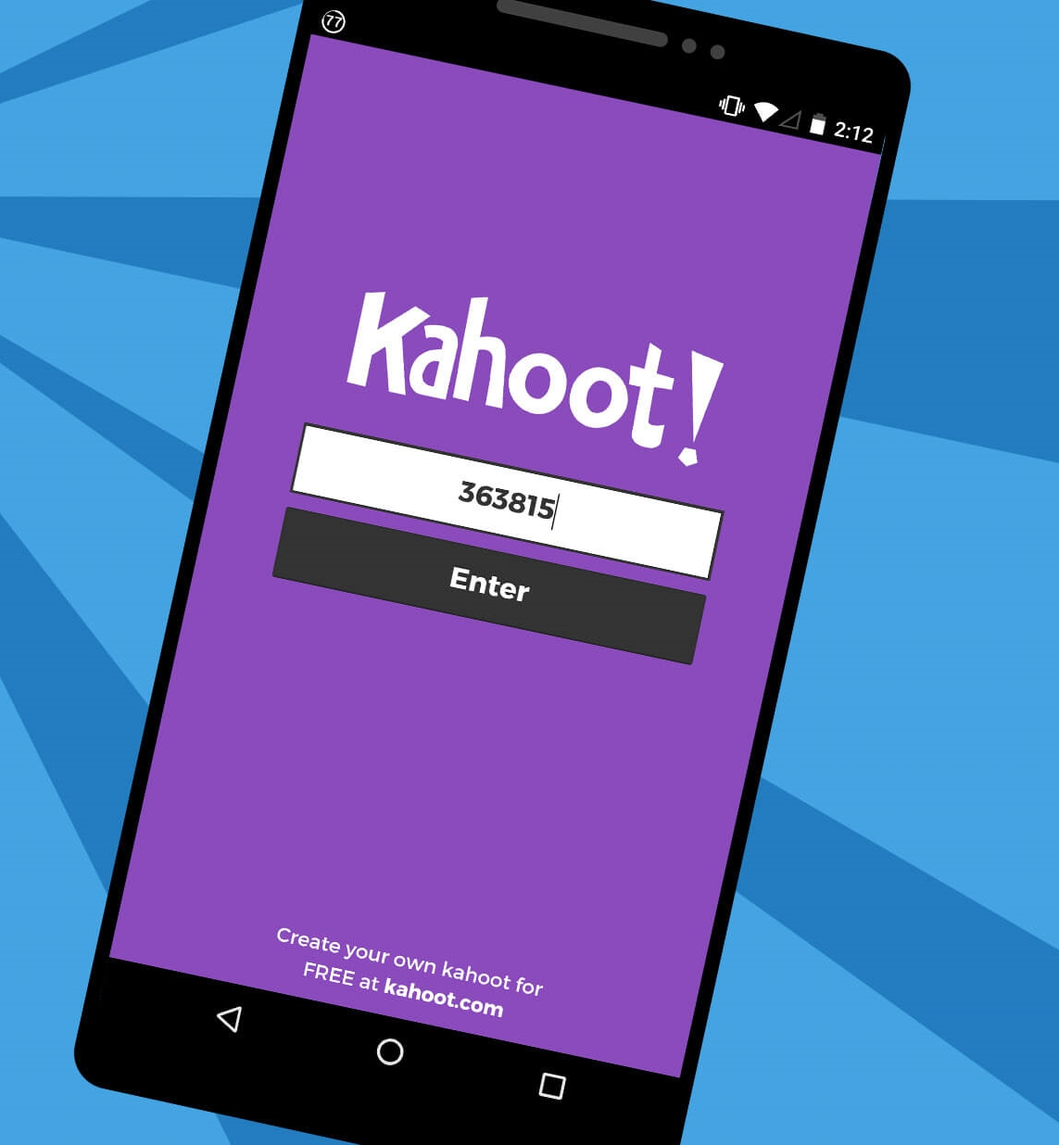
KAHOOT!
GAME-STYLE LEARNING
Kahoot! is a digital learning platform that uses quiz-style games to help students learn by making the information engaging in a fun way.
As one of the biggest names in quiz-based learning, it's impressive that Kahoot! still offers a free-to-use platform, which makes it highly accessible for teachers and students alike. It's also a helpful tool for a hybrid class that uses both digital and classroom-based learning.
The cloud-based service will work on most devices via a web browser. That means this is accessible for students in class or at home using laptops, tablets and smartphones.
Notes:
KAHOOT (You need to be connected to the internet to Play Kahoot!)
Practice this before the class starts
Open the link and have it sitting in a browser window waiting
No app or login is required

Slide 21

KAHOOT INSTRUCTIONS
PLAYERS
On your smartphone, tablet or laptop, go to www.kahoot.it
Wait for the instructor to give you the Game Pin
Enter your first name and last initial ONLY
INSTRUCTORS
A Kahoot account can keep track of results, otherwise, you can play without an account
https://create.kahoot.it/auth/login
Create a free BASIC account (up to 50 users) or paid PRO account (up to 100 users)
Click on the link below
Game will open in an internet browser window
USA Lacrosse Officials Development Program – RULE 7 - PENALTY ENFORCEMENT
Notes:
You need to be connected to the internet to Play Kahoot!

