Slide 1

RETURNING OFFICIALS – SESSION 1
MENS OFFICIALS DEVELOPMENT | 2023 SEASON

Slide 2
POINTS OF EMPHASIS

Slide 3
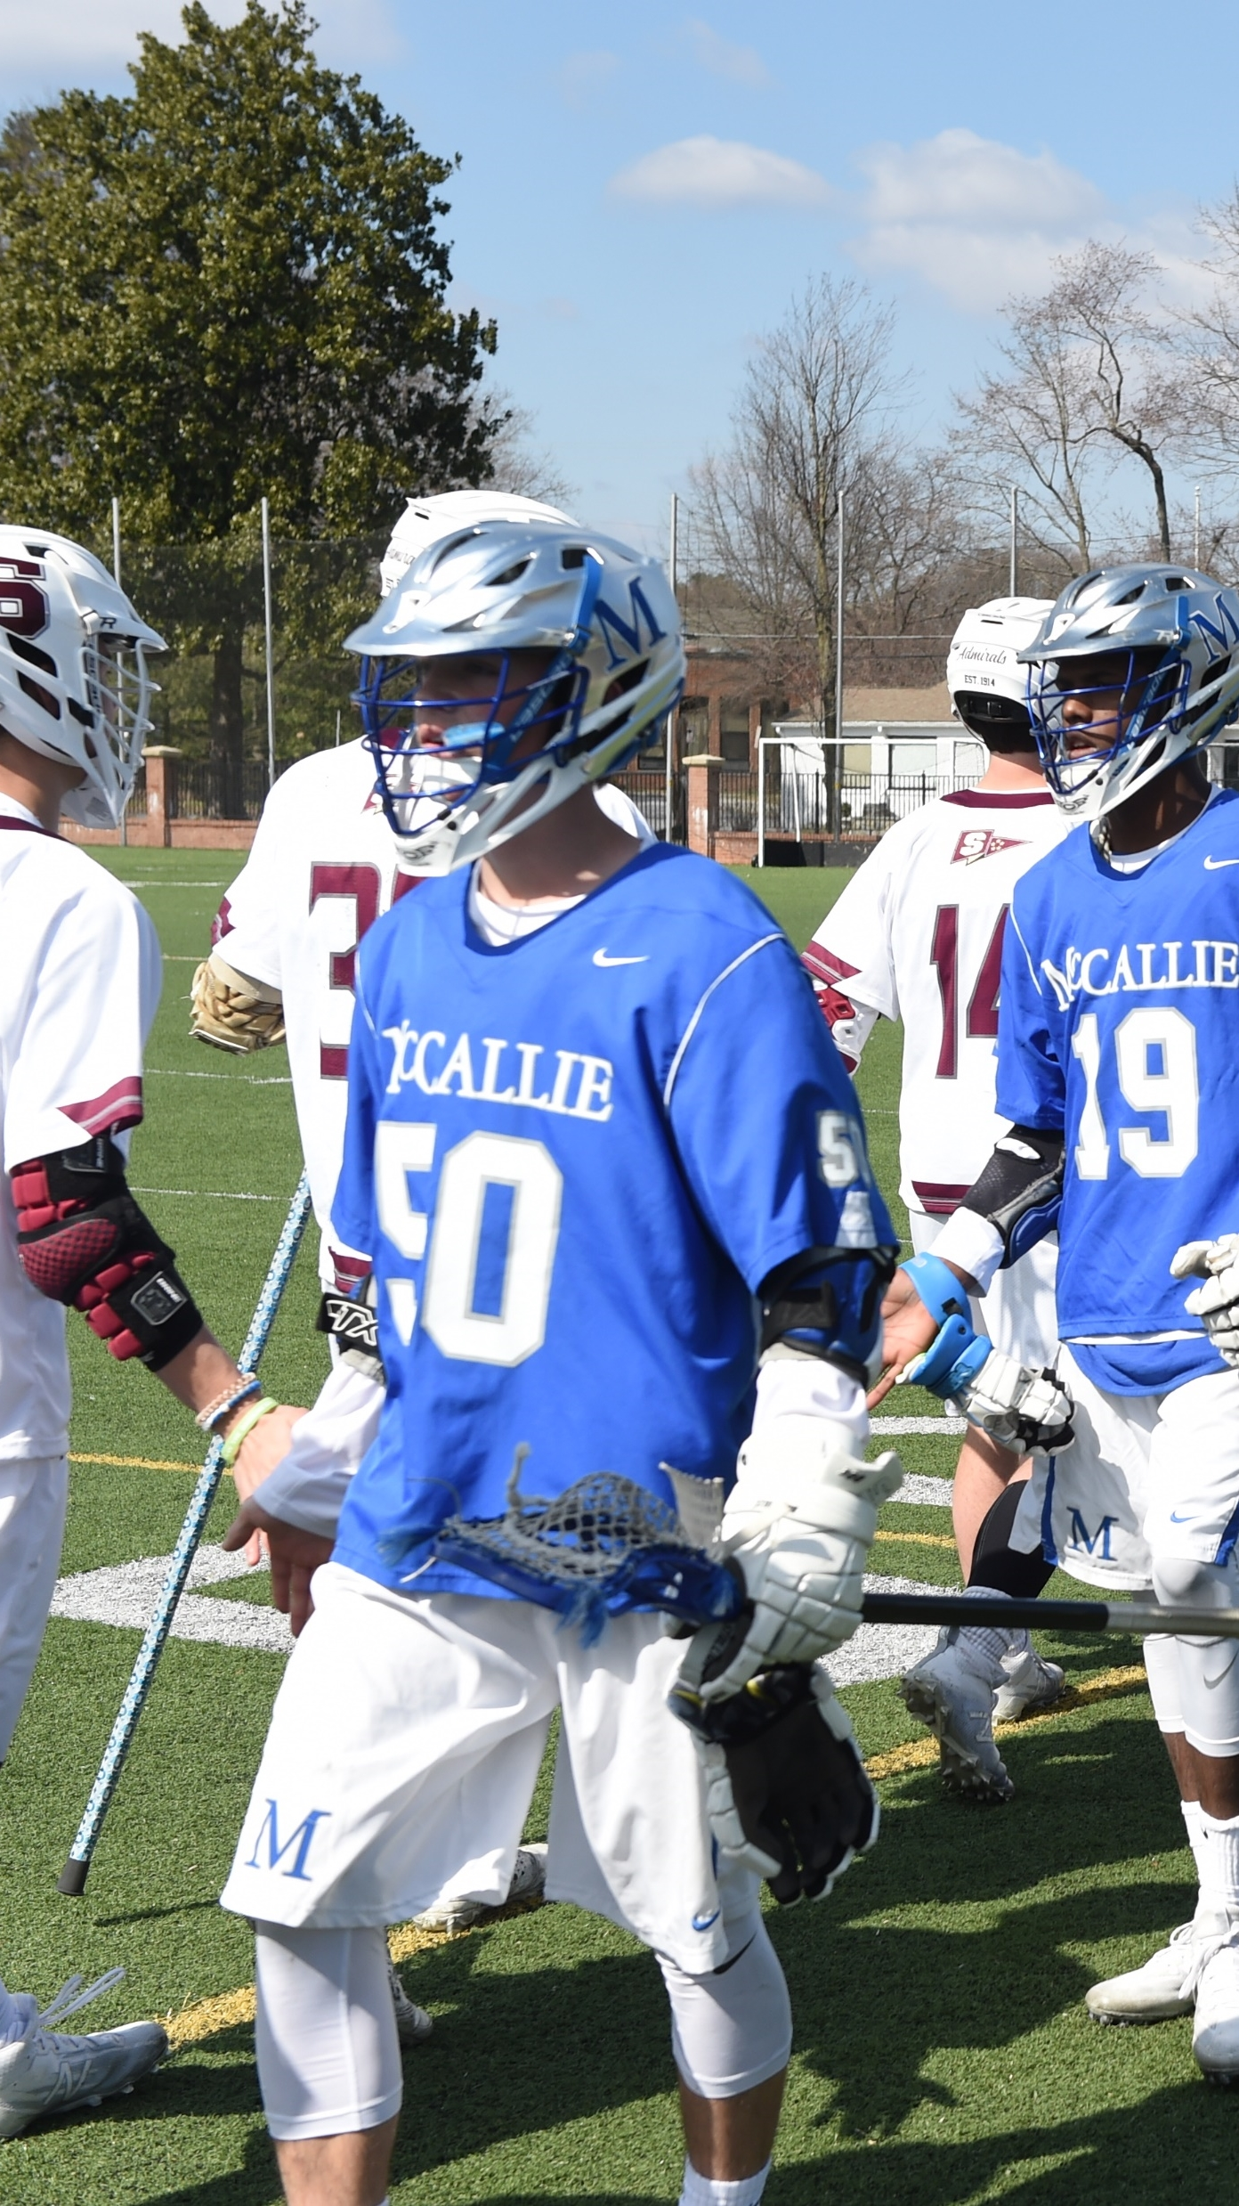
POINTS OF EMPHASIS
SPORTSMANSHIP
Good sporting behavior is one of the fundamental ingredients to the continued success and enjoyment of education-based high school sports and activities.
Sportsmanship, or good sporting behavior, is about treating one another respectfully and exhibiting appropriate behavior.
Coaches set the tone at athletic contests with their display of sportsmanship.
Officials should focus on the actions of players, coaches, and other bench/sideline personnel
A positive, open line of communication between officials and coaches ultimately results in a better contest for everyone involved.
3

Slide 4
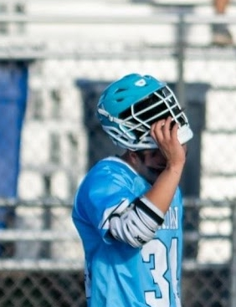
POINTS OF EMPHASIS
PLAYER SAFETY
Continued emphasis is needed regarding player safety rules particularly wearing the helmet securely.
A. The helmet should fit properly.
B. The chin strap should be worn and safely secured as designed by the manufacturer.
4

Slide 5
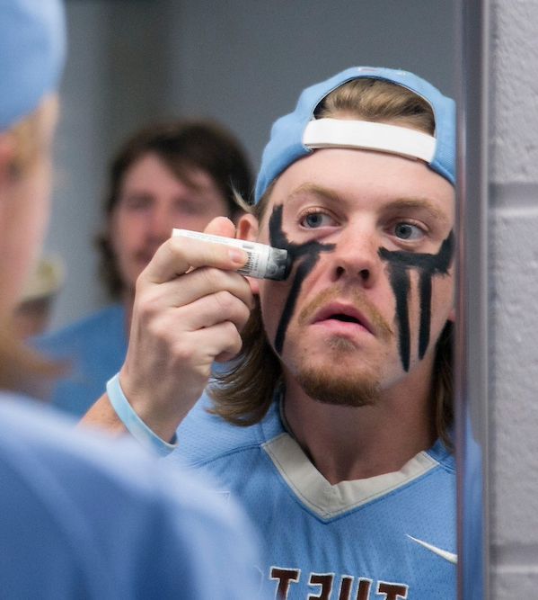
POINTS OF EMPHASIS
EYESHADE
The NFHS Boys Lacrosse Rules Committee has aligned with other sports to standardize the use of eyeshade. Eyeshade (grease or non-glare strips or stickers) shall be a solid stroke and may not include words, numbers, logos or other symbols.
5

Slide 6
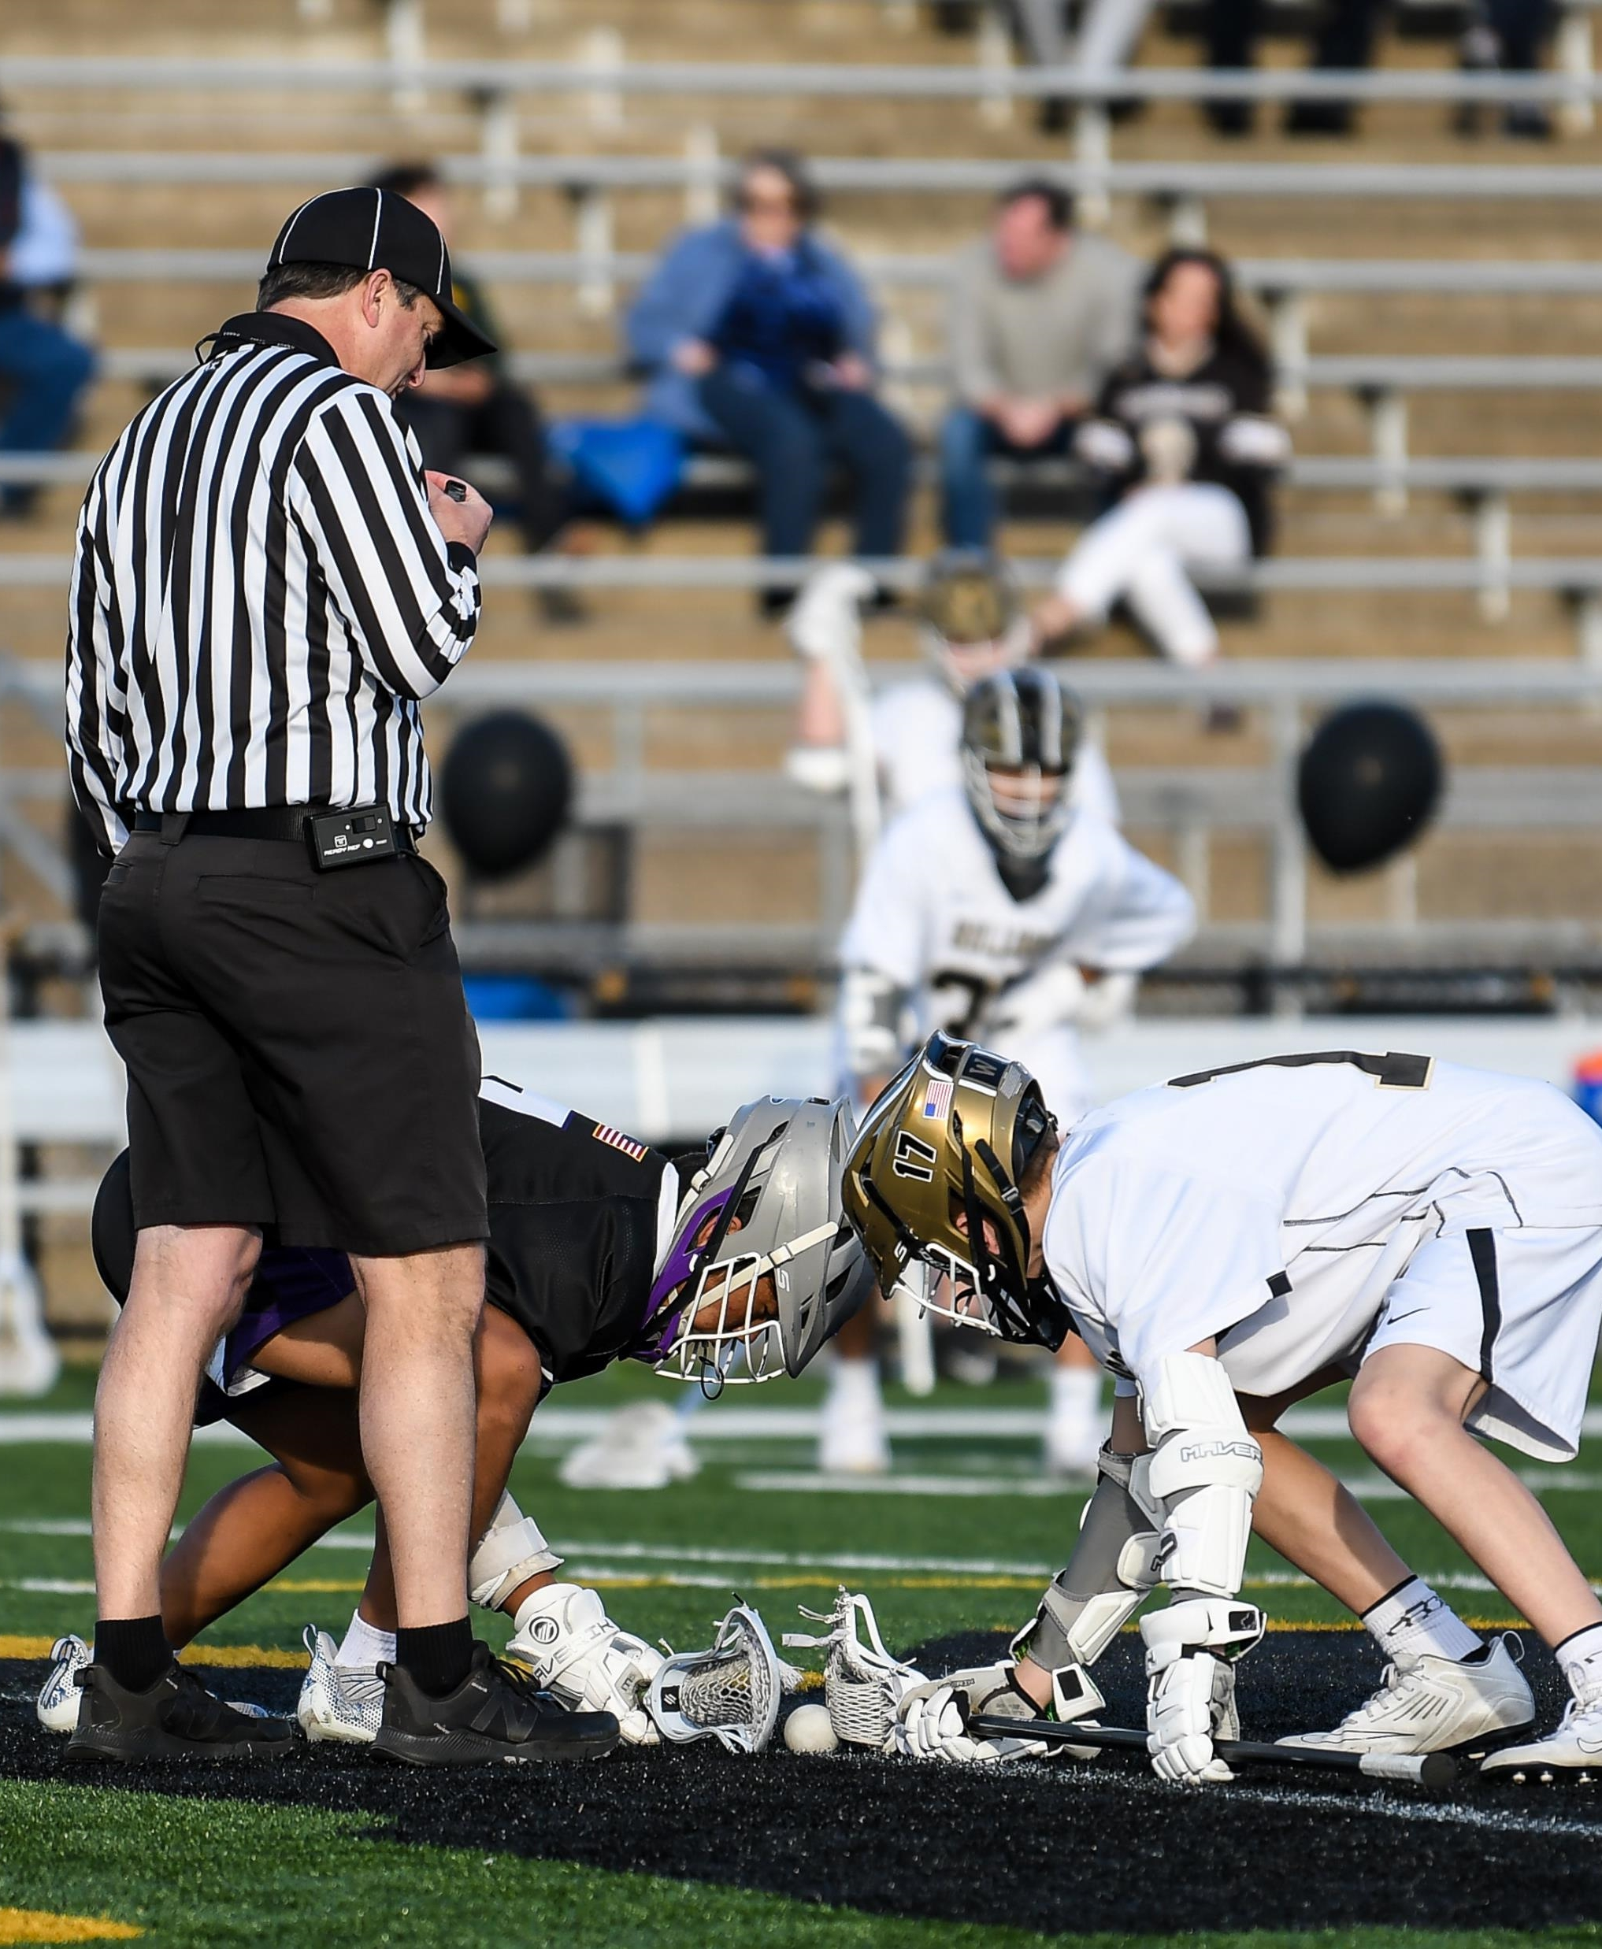
POINTS OF EMPHASIS
FACEOFFS
Upon the whistle starting play, each player must attempt to play the ball first.
A. A player may clamp the ball with the back of the stick, but it must be moved, raked or
directed immediately.
B. A player may not lie on the ball or trap it with the crosse longer than necessary to control the ball and pick it up with one continuous motion.
6

Slide 7
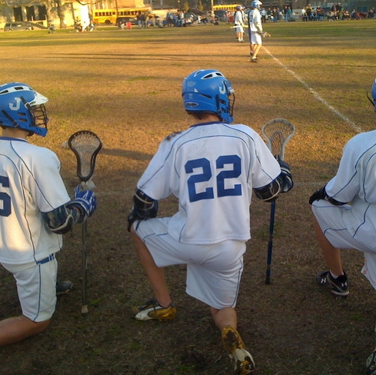
POINTS OF EMPHASIS
RUNNING CLOCK PENALTIES
Under a running clock when a penalty expires during a faceoff period, the player may not reenter the game until the faceoff is completed.
7

Slide 8
MAJOR RULES CHANGES AND CLARIFICATIONS

Slide 9
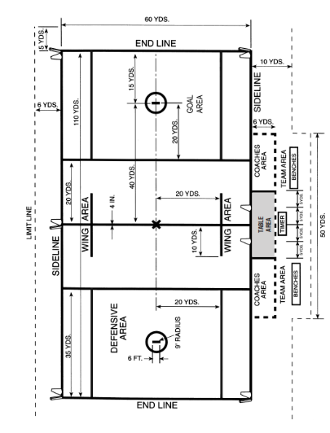
MAJOR RULES CHANGES AND CLARIFICATIONS
RULE 1-2-1 CONTINUOUS SIDELINES AND END LINE
PENALTY: Failure to have a clearly marked center line that runs the entire width of the field, and continuous sidelines and end lines is an illegal procedure assessed against the home team.
RESULT: No faceoff and the away team take the first possession.
9

Slide 10
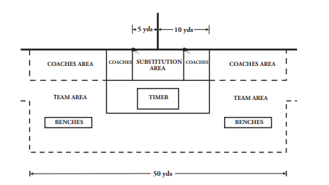
RULE CHANGE
RULE 1-2-7&8 THE SUBSTITUTION AREA AND COACHES BOX
10
Notes:
ART. 7 . . . Where physically possible, the scorer's table should be placed at least 6 yards from the sideline at the center line. Two lines shall be drawn on either side of the center line 5 yards from the center line and extending past the scorer’s table. The area bounded by the sideline, the two lines perpendicular to the sideline and the scorer's table shall be referred to as the table area. Only players serving penalty time, players ready to substitute on the fly, the chief bench official, and official scorers and timers are allowed in the table area.
ART. 8 . . . The coaches' areas shall be located on either side of the table area. Each coaches' area shall extend from the table area 20 yards parallel to the sideline. It shall be bounded by the sideline, the table area, a dotted line 6 yards from and parallel to the sideline, and a dotted line extending from the sideline, parallel to and 20 yards from the table-area line.

Slide 11
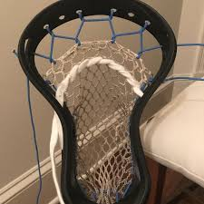
RULE CHANGE
RULE 1-7-1 UPDATES TO POCKET REQUIREMENTS
The pocket/net shall be completely attached to the head and the side walls, leaving no gaps larger than 1.68 inches in diameter (i.e., an American golf ball).
11

Slide 12
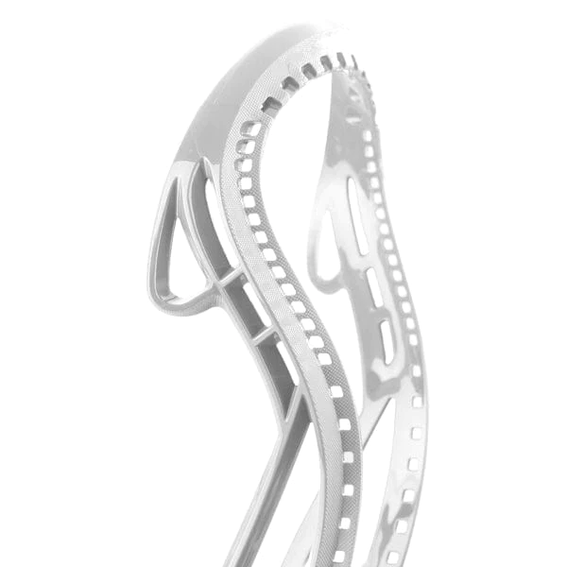
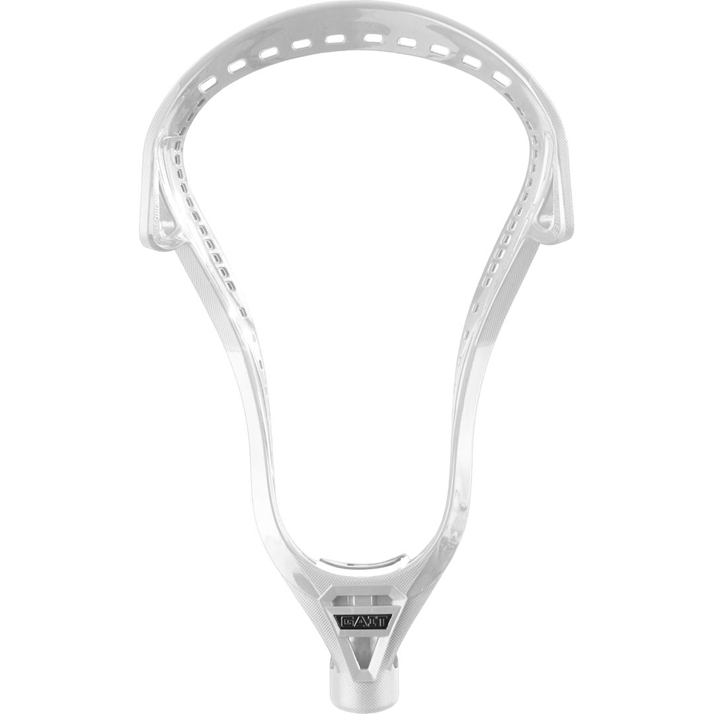
RULE CHANGE
RULE 1-8-1 PROHIBITED CROSSE PROTRUSIONS
The crosse shall not have protrusions or sharp edges.
Protrusions - The crosse shall not be able to hook on any part of the player’s body, equipment, or helmet. The crosse shall not penetrate the lacrosse helmet face protector that has been certified to meet the NOCSAE standard at the time of manufacture.
The NCAA, NFHS, and USA Lacrosse have adopted this definition of a protrusion.
Standard Neutral Grip
Moto Grip
12

Slide 13
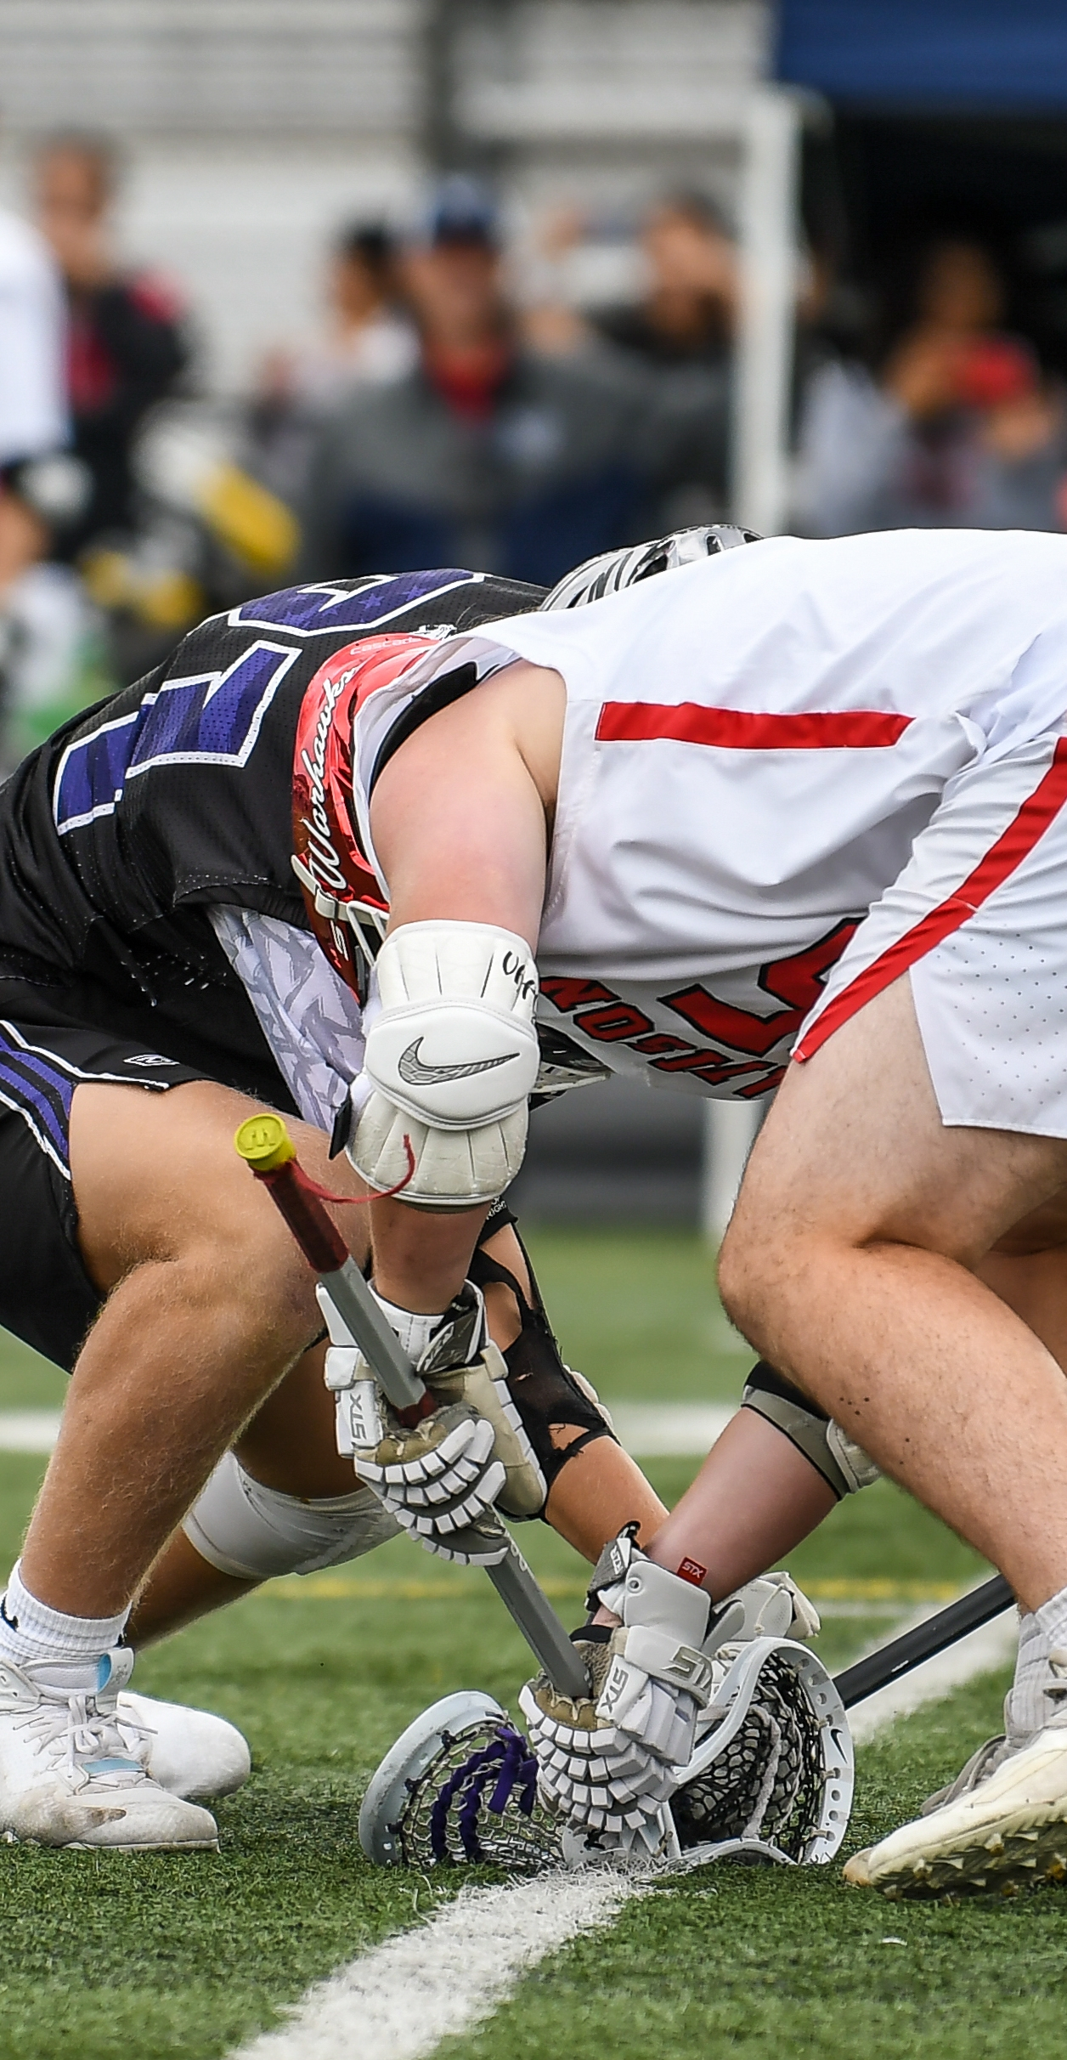
CLARIFICATION
RULE 4-3-1 CLARIFICATION OF FACEOFF EXCEPTIONS
ART. 1 . . . Play shall be started at the beginning of each period and after each goal by facing the ball at the Center.
EXCEPTIONS:
  Player-advantage or a flag down, creating a player advantage.
  Player or team commits a foul before any faceoff.
  Player at any faceoff delays resumption of play.
  Player moves the crosse or body after “set” is said, gaining an advantage.
Review New Situations K – N for Clarification on where play restarts.
13

Slide 14
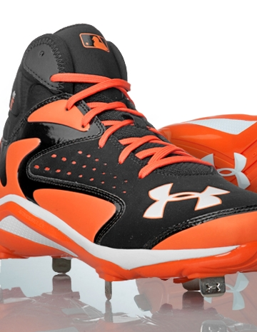
CLARIFICATION
RULE 1-9-1 FOOTWEAR
Shoes shall be worn which are designed for the sport of lacrosse. Metal spikes are not permitted.
1.9.1 SITUATION C: Once the game has begun, A1 is discovered wearing non-conforming shoes with metal spikes. RULING: One-minute, non-releasable penalty on A1.
Moto Grip
14

Slide 15
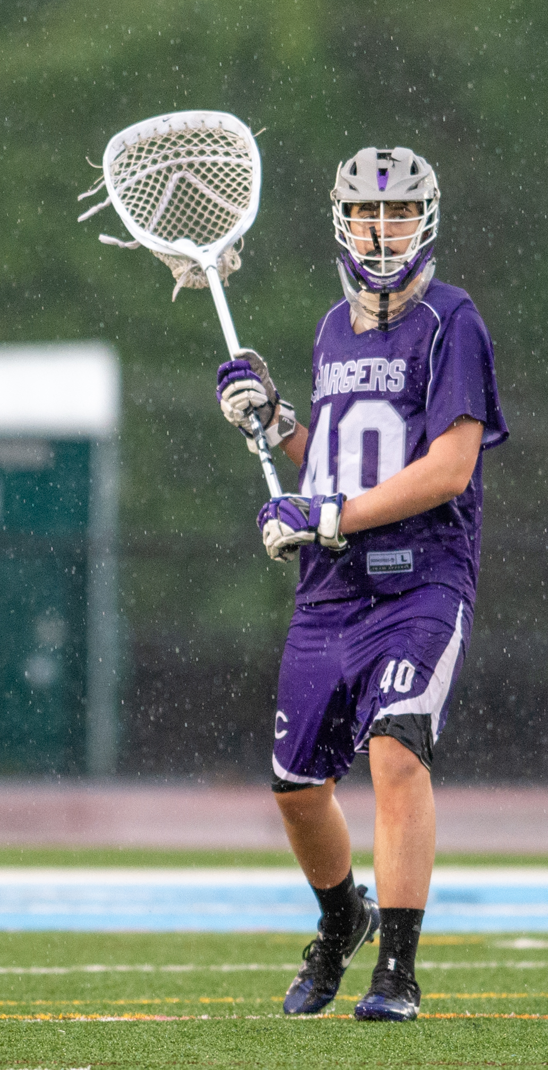
MAJOR RULES CHANGES AND CLARIFICATIONS
4.24.1 GOALIES OUTSIDE OF THE CREASE
ART. 1 . . . An official may suspend play at the official's discretion. If a player loses any mandatory personal equipment in a scrimmage area or a player is apparently injured, play shall be suspended immediately. A goalkeeper, when outside the crease, is treated like a field player. If the official discovers a player who is apparently bleeding, has an open wound, or has any blood on the uniform, such player shall be considered an injured player.
ART. 8 . . . Play shall be suspended immediately if the goalkeeper's stick or any other mandatory goalkeeper's equipment becomes broken in the crease.
15

Slide 16
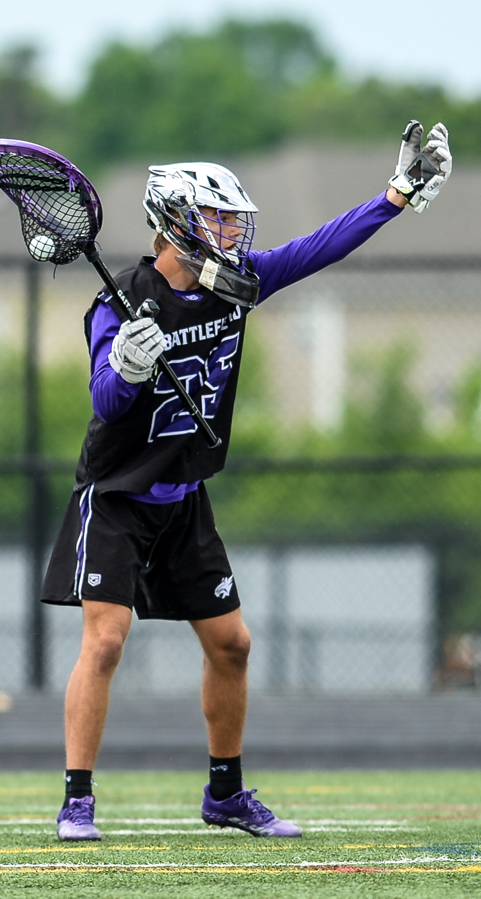
MAJOR RULES CHANGES AND CLARIFICATIONS
RULE 4.24.1 GOALIES OUTSIDE OF THE CREASE
4.22.3 SITUATION C: A1 shoots at the goal and misses, and the ball goes out of bounds on the end line. A2 is on the end line near where the ball went out of bounds. Goalkeeper B1 leaves Team B's crease solely in an attempt to delay the restart by five seconds to allow Team B defense to regroup. Should the official allow B1 a maximum of five seconds to resume position? RULING: No. The goalkeeper is given a maximum of five seconds to resume position only when the goalkeeper leaves the crease for a legitimate purpose.
16

Slide 17
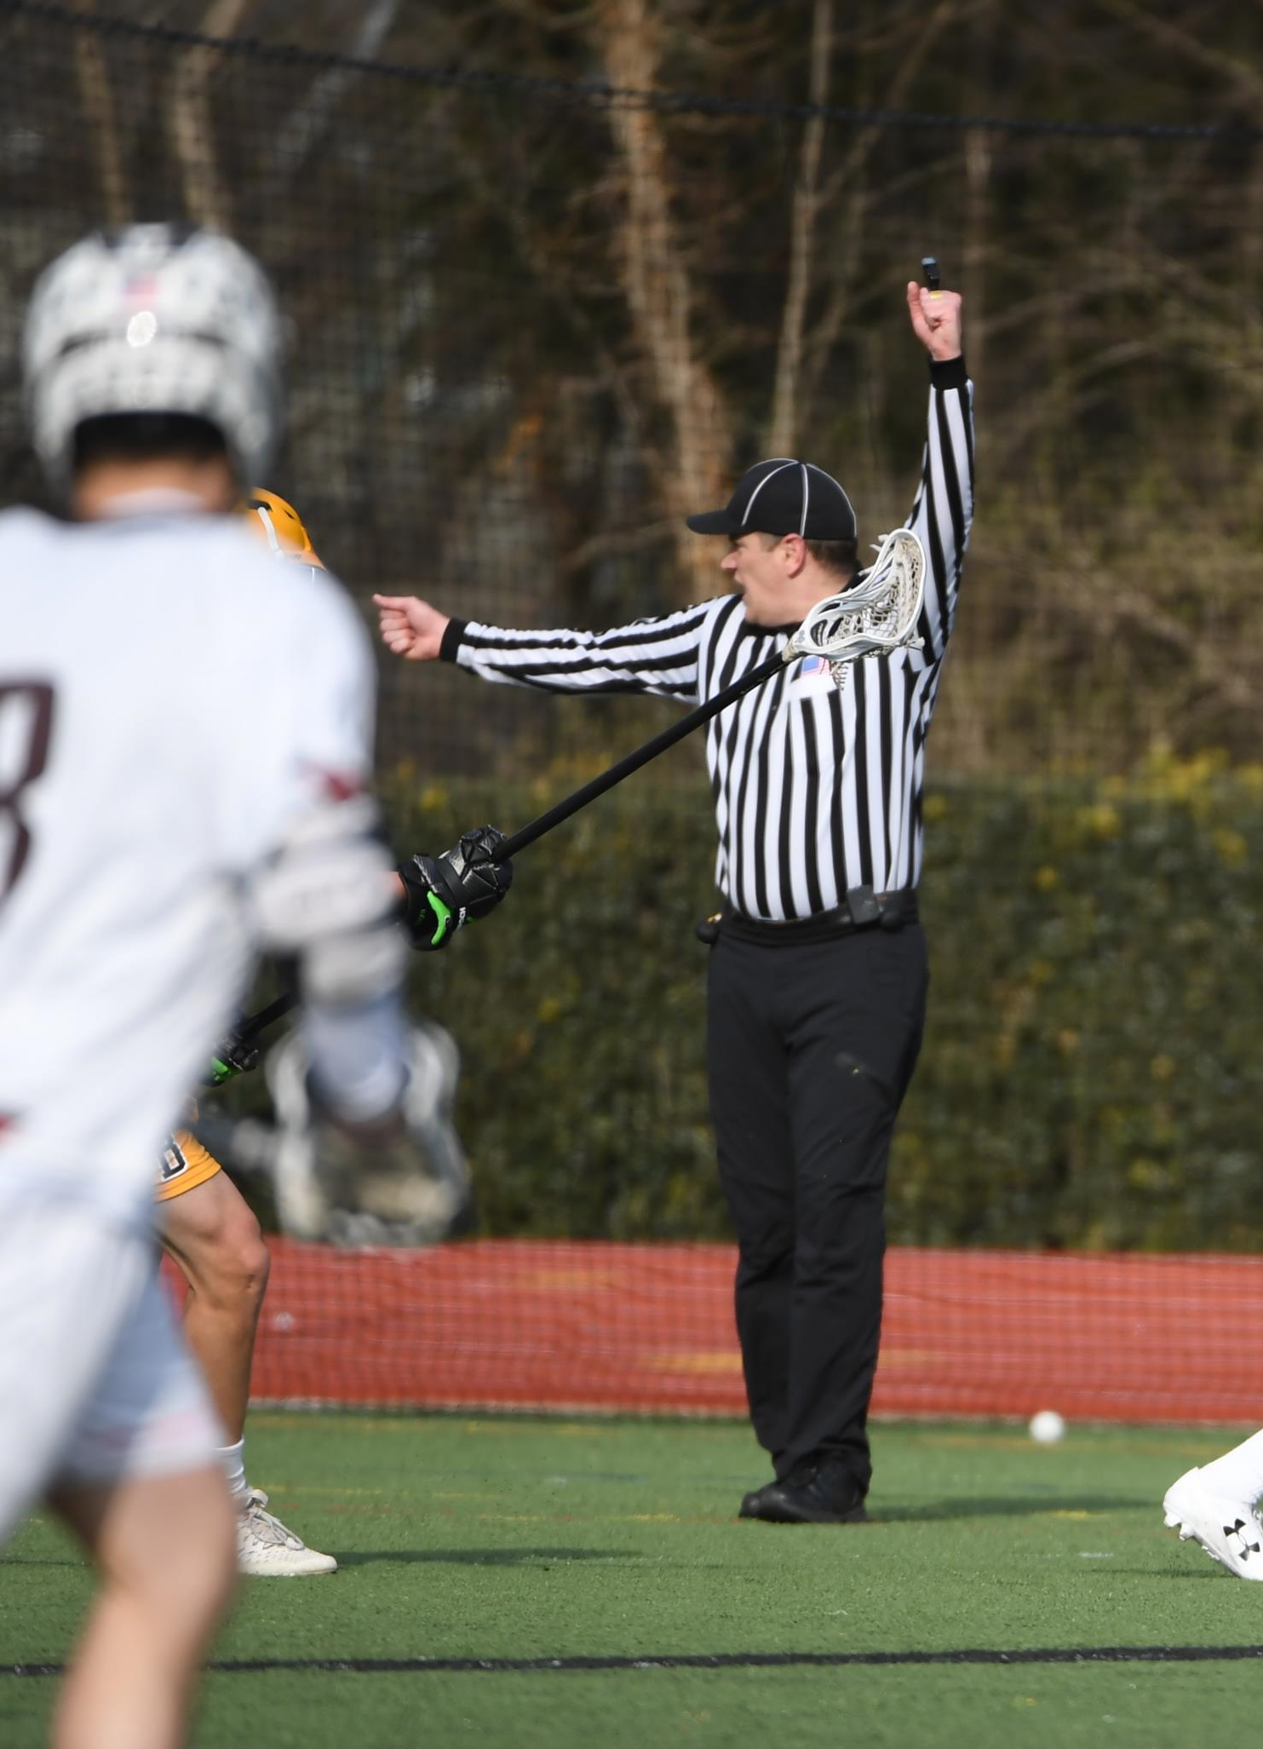
CLARIFICATION
RULE 6-10-3 NEW STALLING SITUATION
6.10.3 SITUATION E: Team A, ahead by four goals or less, fulfills the initial 10-second count with under two minutes to play. A1 shoots on goal and the ball deflects off of the goal pipe and comes to rest within the goal area. A2 causes the ball to leave the goal area before gaining possession.
RULING: Stalling. Award ball to Team B.
17

Slide 18
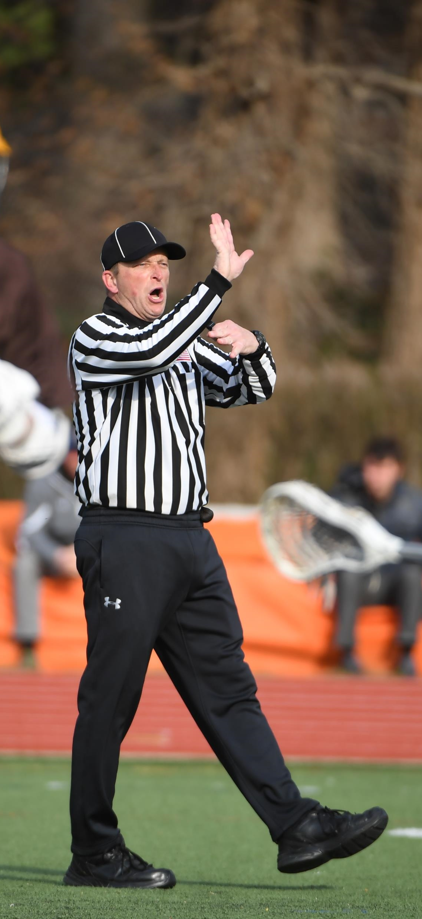
MAJOR RULES CHANGES AND CLARIFICATIONS
RULE 7-2H RELEASE OF PENALTIES DURING A RUNNING CLOCK
H. During running time, penalty time will start with the whistle resuming play after the penalty is administered. If there is time remaining on a non-releasable penalty when a goal is scored, the earliest the penalty will when the ensuing faceoff has been completed.
18

Slide 19
THANK YOU TO THE MEMBERS OF THE
2023 MENS OFFICIAL’S EDUCATION DEVELOPMENT TEAM

