Slide 1
RETURNING OFFICIALS – SESSION 2
MENS OFFICIALS DEVELOPMENT | 2023 SEASON
Notes:
RETURNING OFFICIALS
The purpose of this curriculum is to give the trainer “talking points” for virtual and/or in-person meetings
Each session is designed to be 45-60m.
Returning officials generally benefit more from discussion rather than rule-by-rule lessons
Use the material as you see fit and use your “style” to make it work for your officials

Slide 2
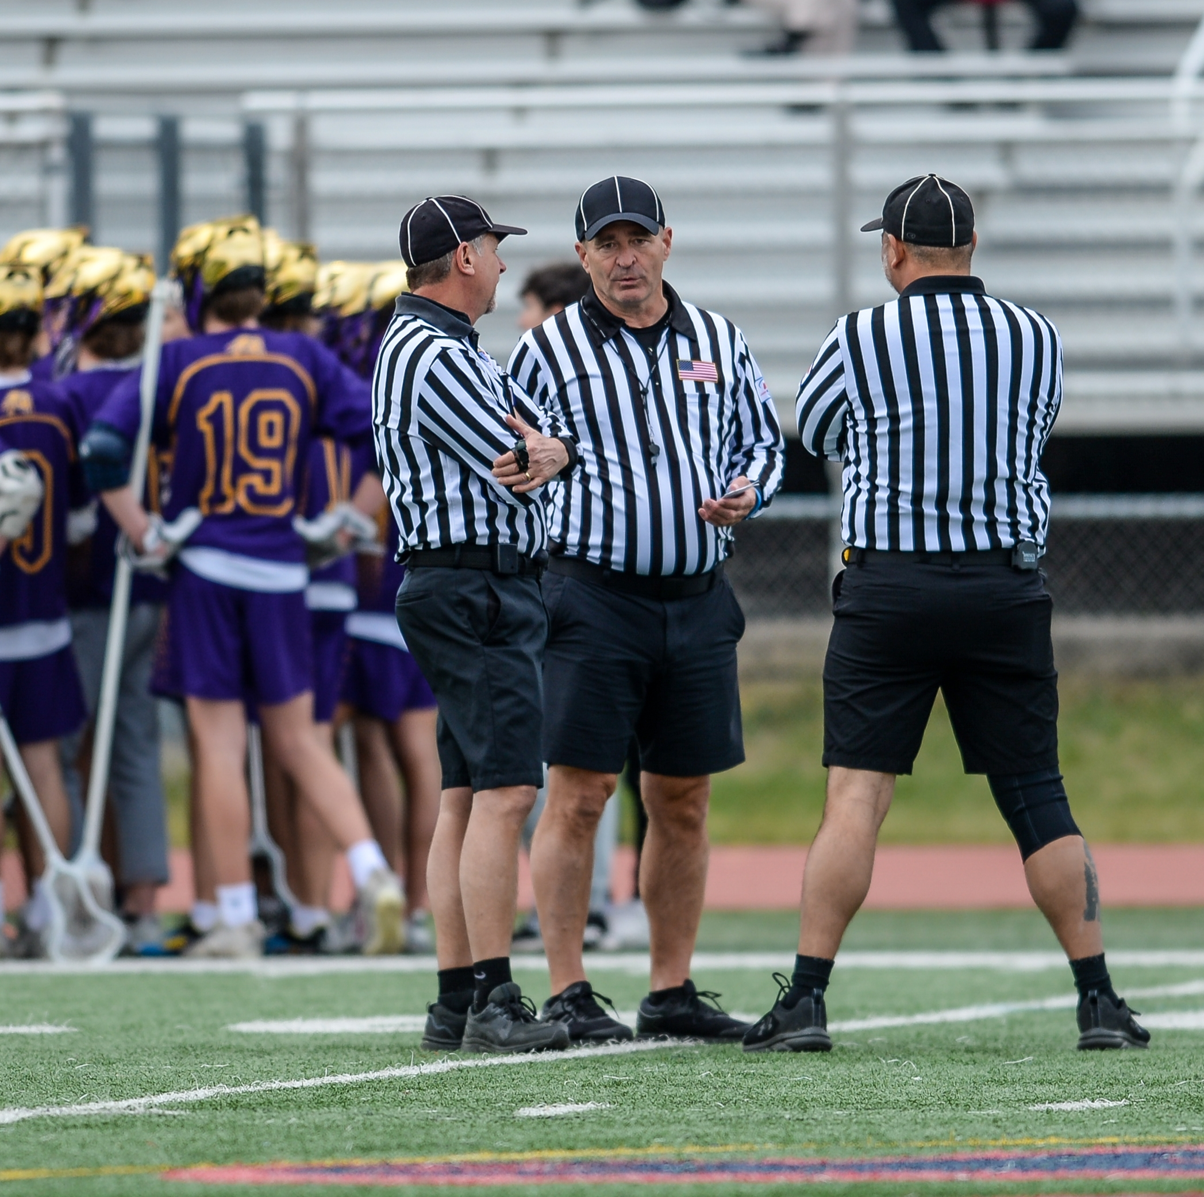
WHAT WILL BE COVERED
Advanced Positioning
Transition Tips
Restarts
Notes:
WHAT WILL BE COVERED
Advanced Positioning
Transition Tips
Restarts

Slide 3
MECHANICS & POSITIONING
Notes:
ADVANCED POSITIONING

Slide 4
2-PERSON - REFINE YOUR STANDARD POSITION
T
T
L
L
Notes:
2-PERSON - REFINE YOUR STANDARD POSITION
2-Person Mechanics are hard on field coverage
Learn to anticipate so you can be in position
Lead - Stay at or just above GLE
Trail – Move inside if the wingline to help the lead on any crease calls

Slide 5
LEAD RESPONSIBILITIES
Time to crash the crease!
THE GOAL IS PRIMARY
L
Notes:
GOAL ATTEMPT AWARENESS – LEAD OFFICIAL
Learn to understand the player in each game
You can start to see tendencies in offensive sets, body language, “go-to” players, etc.
Learn the defensive slide system and you may be able to see potential fouls
Don’t be afraid to get in there BUT…
You need to be able to get out.
Know your limitations

Slide 6
THE GOAL NEEDS COVERAGE
Move to improve, Get to GLE.
RECOVER FROM BEHIND
L
Notes:
THE GOAL NEEDS COVERAGE
Lead needs to always be thinking of goal coverage
When chasing a CONTESTED endline shot, remember to recover as the ball is whistled back in.
Don’t stay behind GLE, a goal can’t be scored from behind

Slide 7
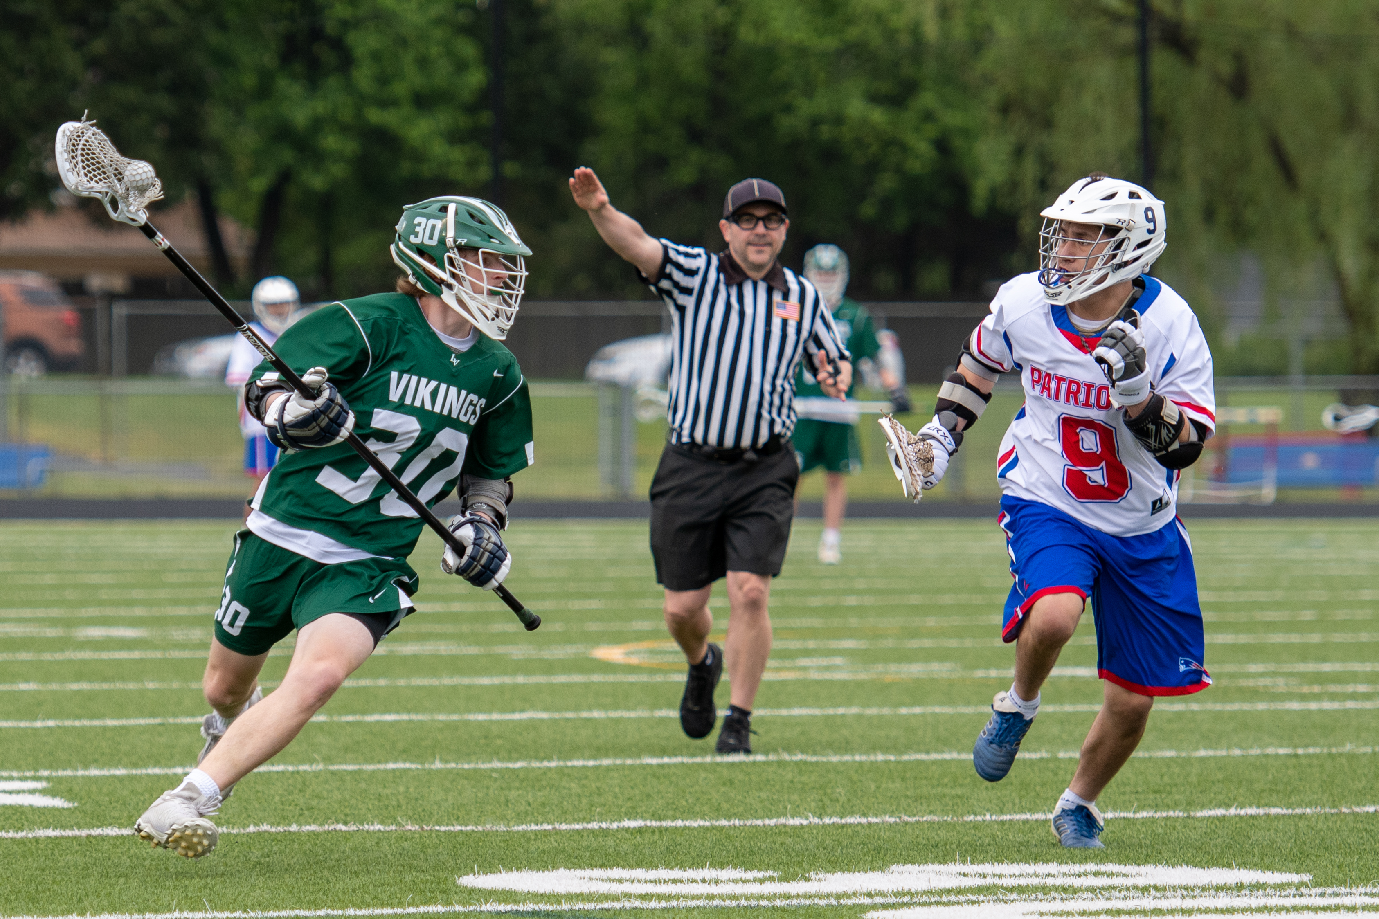
SINGLE RESPONSIBILITIES
All Counts
Offside
Shooter
Goal Coverage
SEE THE BIG PICTURE
S
Notes:
SINGLE RESPONSIBILITIES
Remember to get to the cone in transition
DO NOT block the cone, stand OFF of the field
Let the ball pass and follow it in
Get the early offside, the trail will get any delayed offside
Always count FORWARD twice!

Slide 8
TRAIL RESPONSIBILITIES
Far Goal
Over and Back
Shooter
My Sideline
DON’T KILL GRASS
T
Notes:
TRAIL RESPONSIBILITIES
Be in best position for YOU to get to far goal
Call over and back and let single restart
Always help with shooter

Slide 9
TEAMWORK
Step above GLE, get a good angle.
LEAD & SINGLE
L
Shooter, watch the back.
S
Notes:
TEAMWORK
Yo-Yo in and out with each other
Single covers GLE when Lead is out
Look for help on close calls.
Crease Calls
If you see the back, watch for the push
If you see the front, watch the feet

Slide 10
3-PERSON, REFINE YOUR SETTLED POSITION
DYNAMIC POSITIONING
T
T
S
S
L
L
Notes:
3-PERSON, REFINE YOUR STANDARD POSITION
Dynamic Position – Adjust to the situation
Lead
Within 1y of GLE
Don’t hang out behind but move to improve angle if needed
Single
GLE when Lead not there
5y above when Lead is on GLE
Trail
End of wingline is target
Move around to improve view
Be close enough to sideline to cover OOB

Slide 11
TRANSITION TIPS
Notes:
TRANSITION TIPS

Slide 12
2-PERSON MECHANICS
T
ANTICIPATION IS KEY
T
L
L
T
Notes:
2-PERSON MECHANICS
Trail has to know his limitations
Stay as deep as needed to cover far goal
Some offsdes will be missed
Lead to New Trail needs to see the whole field
Stay wide in high-transition games

Slide 13
STAY FOCUSED WHILE RUNNING
Okay, they’re still clearing.
Get to GLE.
HEAD ON A SWIVEL
L
Notes:
STAY FOCUSED WHILE RUNNING
Sprint on dead balls
Run with head on a swivel on live balls
Know where the players and coaches are
As single, try and get to the cone BEFORE the restart whistle

Slide 14
TRAIL JOGS, LEAD RUNS
Jog; eyes on the passer.
SEE THE BIG PICTURE
T
Notes:
TRAIL JOGS, LEAD RUNS
Trail goes with the ball and a little behind
Lead gets to the goal and lets ball come to him

Slide 15
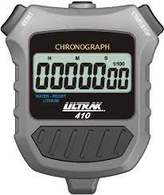
3-PERSON MECHANICS
S
Single starts 20s timer
KNOW YOUR JOB
S
S
L
L
T
T
Notes:
3-PERSON MECHANICS (covered in same detail on the next few slides)
Old Trail to New Lead
Get 2 lines ahead of ball
Run, then turn and backpedal to minimize time not looking
Signal when ball is in box
Watch subs
GLE is final spot
Single
Get to the cone and be OFF the field, players need to see the cone
Start the 20s timer on possession or restart
Let ball come to you at cone and follow in
Look for trail attackman touching line for offsides
Settle in somewhere between GLE and 5y.
Lower level, high transition game, create a higher and wider triangle with Trail
Old Lead to New Trail
Crease counts
Stay with ball or just behind to cover a turnover
Watch subs
Check for delayed offsides
Stay on defensive half of field until you are reasonable sure of a maintained possession
Be ready to cover Over-and-Back – Know when ball has been touched and OOB is ON
End of wingline is final spot

Slide 16
TRAIL TO NEW LEAD
Fast break! Count is good, not stopping at the cone!
TAKE A WIDE VIEW
S
Notes:
Trail to New Lead
Get 2 lines ahead of ball
Run, then turn and backpedal to minimize time not looking
Signal when ball is in box
Watch subs
GLE is final spot

Slide 17
SINGLE SIDE
TAKE A WIDE VIEW
I can see everything from here!
S
Notes:
SINGLE SIDE
Get to the cone and be OFF the field, players need to see the cone
Start the 20s timer on possession or restart
Let ball come to you at cone and follow in
Look for trail attackman touching line for offsides
Settle in somewhere between GLE and 5y.
Lower level, high transition game, create a higher and wider triangle with Trail

Slide 18
LEAD TO NEW TRAIL
WHERE TO FOCUS
Got the crease count; partners are breaking upfield.
Notes:
LEAD TO NEW TRAIL
Crease counts
Interference w/goalie
Stay with ball or just behind to cover a turnover
Watch subs
Check for delayed offsides
Stay on defensive half of field until you are reasonable sure of a maintained possession
Be ready to cover Over-and-Back – Know when ball has been touched and OOB is ON
End of wingline is final spot

Slide 19
WORK HARD TO GET WHERE YOU WILL BE NEEDED
ARE YOU AHEAD OF THE GAME OR BEHIND?
Get to GLE, let the play come to me.
L
Notes:
WORK HARD TO GET WHERE YOU WILL BE NEEDED
Are you in shape?
No substitute for hustle
This is what separates playoff officials from regular season officials

Slide 20
RESTARTS

Slide 21
2-PERSON
BALL STAYS WITH OFFENSE
L
B
T
Notes:
2-PERSON - BALL STAYS WITH OFFENSE
Trail has sideline
Lead has endline and sideline
Communication is key, especially after penalties

Slide 22
2-PERSON
BALL GOES TO DEFENSE
T
L
B
Notes:
2-PERSON - BALL STAYS WITH OFFENSE
Trail has sideline
Lead had endline and sideline
Communication is key, especially after penalties

Slide 23
NON-VERBAL COMMUNICATION
DON’T RUN RED LIGHTS!
Notes:
NON-VERBAL COMMUNICATION
Restart official after a dead ball, check with your partners for the go signal
Remember, some restarts do not require waiting
Shots to either team
Turnover in-bounds
Other live ball restarts

Slide 24
NON-VERBAL COMMUNIATION
WAIT FOR GREEN LIGHTS
Notes:
NON-VERBAL COMMUNICATION
Check the field
Be quick, but don’t rush

Slide 25
3-PERSON
S
L
T
Notes:
3-PERSON - BALL STAYS WITH OFFENSE
Trail has near sideline
Lead has endline
Single has far sideline
Communication is key, especially after penalties

Slide 26
3-PERSON DEEP RESTART
S
L
T
Notes:
3-PERSON - BALL GOES TO DEFENSE
Lead has endline and area from winglines back to endline
Single has far sideline
Communication is key, especially after penalties

Slide 27
SPEED UP PLAY
Players aren’t going to wait on me today.
WHISTLE READY
Notes:
SPEED UP PLAY
We expect the players to be ready, are we ready?
Talk the players in-bounds and to be ready
Give verbal cues before whistle
“Here we go”
“On the hop”
“lets go blue”

Slide 28
USE DEAD BALL TIME EFFICIENTLY
HUSTLE BUT REGROUP
Partner has the restart. Get into position!
Notes:
USE DEAD BALL TIME EFFICIENTLY
Get to your spot and rest
Scan the field
Look for red light/green light from partners
Expect the unexpected

Slide 29
SELL YOUR CALLS
Notes:
SELL YOUR CALLS
Fake it till you make it
If you believe it, they will too!

Slide 30
POOR SALESMANSHIP
Notes:
POOR SALESMANSHIP
How long was it before you saw the call?
What was the call? Can you even tell?

Slide 31
EXCELLENT SALESMANSHIP
Notes:
EXCELLENT SALESMANSHIP
Any question on this call?
Look at #3. Can’t believe the call! But he goes with it and starts to get back on defense

Slide 32
THANK YOU TO THE MEMBERS OF THE
2023 MENS OFFICIAL’S EDUCATION DEVELOPMENT TEAM

