Slide 1
RETURNING OFFICIALS – SESSION 3
MENS OFFICIALS DEVELOPMENT | 2023 SEASON
Notes:
RETURNING OFFICIALS
The purpose of this curriculum is to give the trainer “talking points” for virtual and/or in-person meetings
Each session is designed to be 45-60m.
Returning officials generally benefit more from discussion rather than rule-by-rule lessons
Use the material as you see fit and use your “style” to make it work for your officials

Slide 2
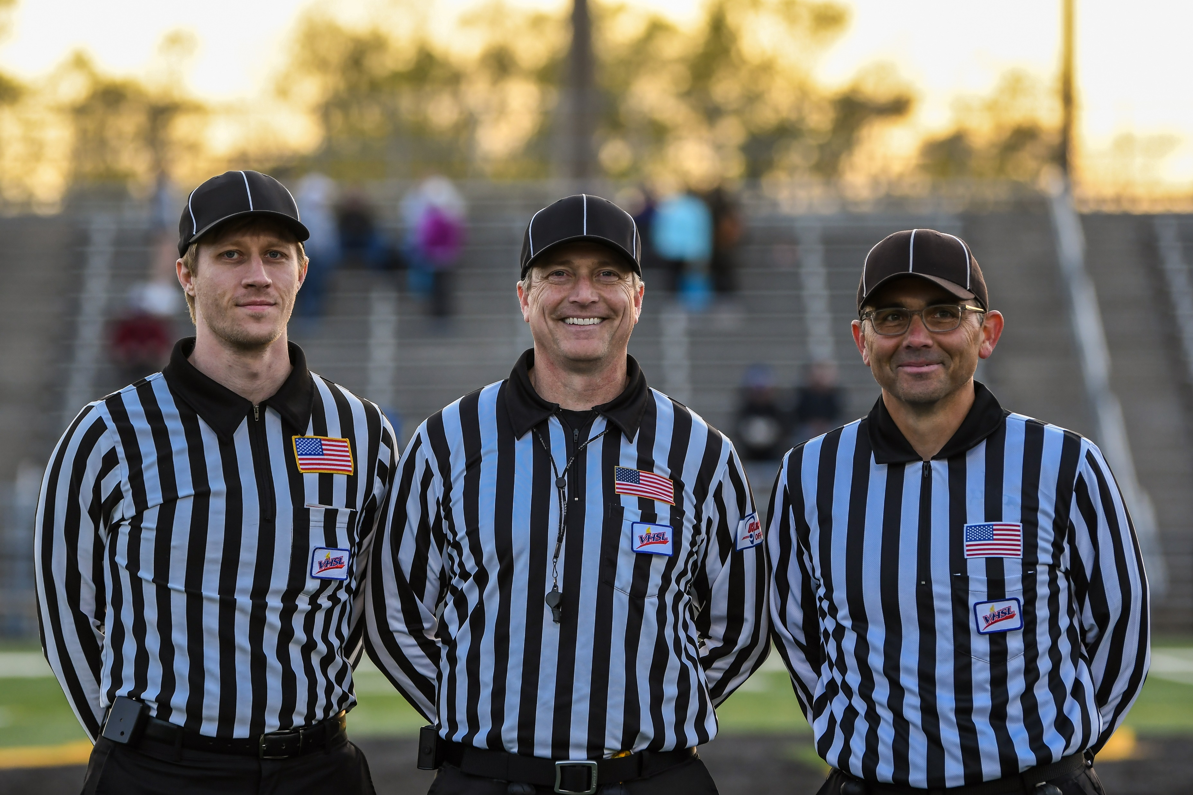
WHAT WILL BE COVERED
Dead-Ball Officiating
Faceoffs
Communication

Slide 3
DEAD BALL OFFICIATING
When the ball is dead, we become alive.

Slide 4
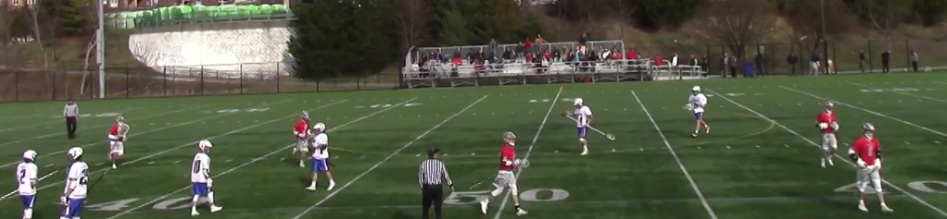
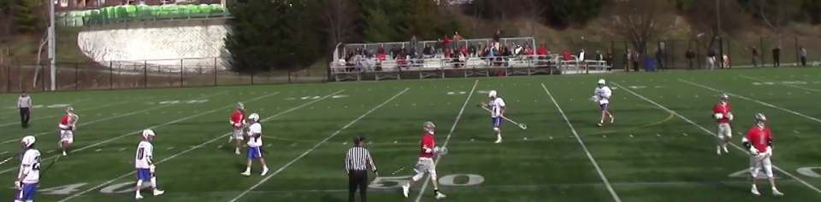
PAY ATTENTION!
Far side official maintains wide view of entire field.
Closest official “shows stripes” with position near the midline.

Slide 5
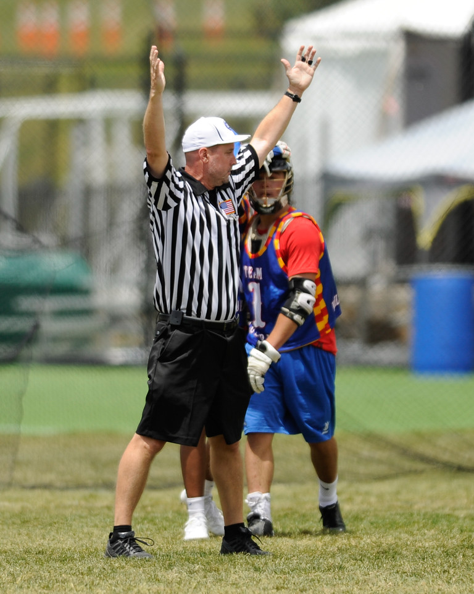
AFTER GOALS
Eyes on the players.
Danger Zone!
One team is happy.
One team is not.

Slide 6
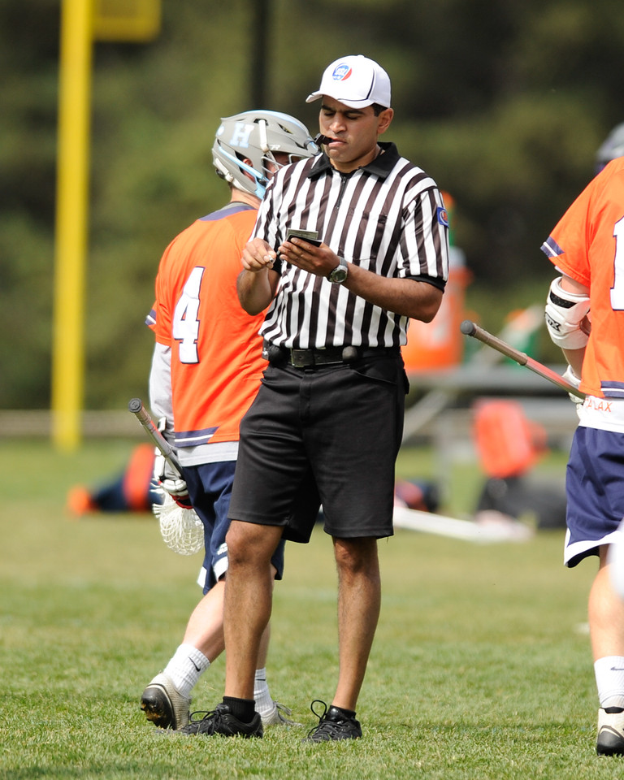
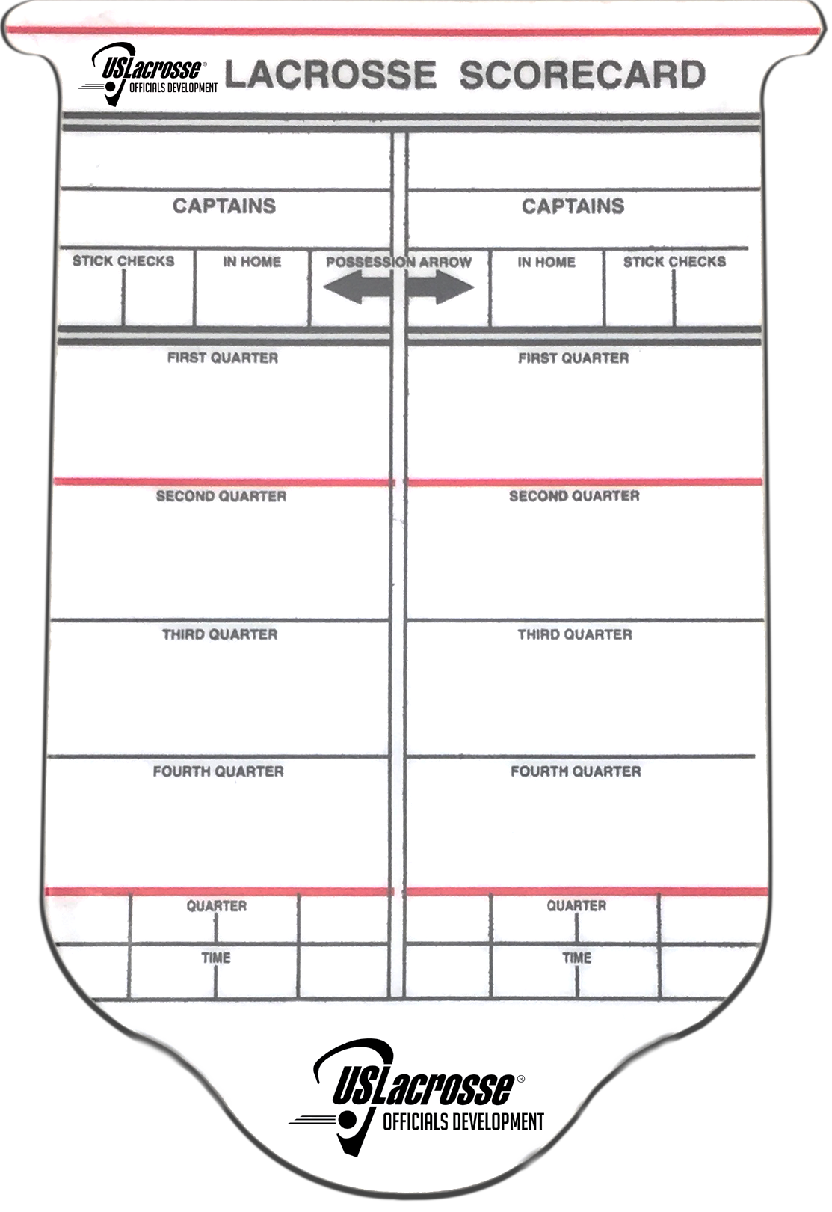
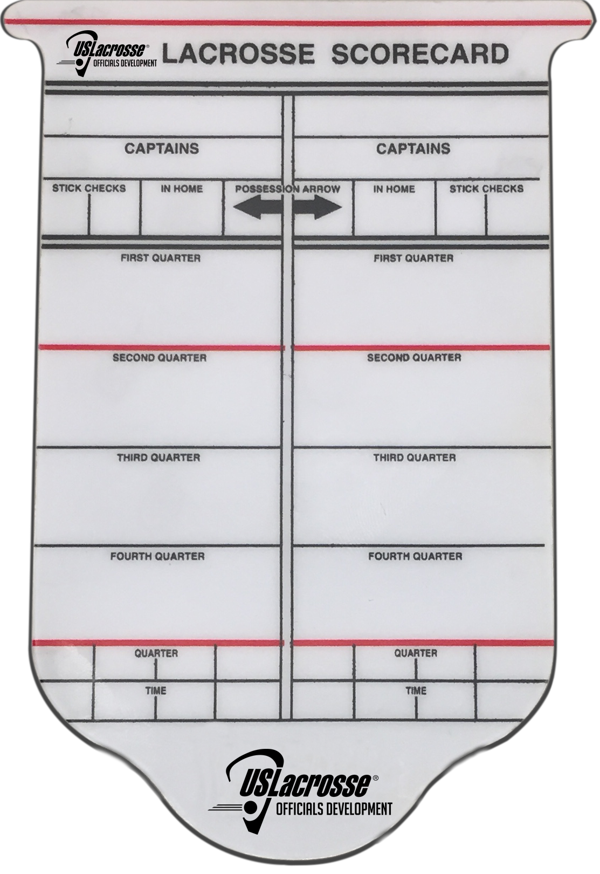

THE SCORECARD CAN ALWAYS WAIT

Slide 7
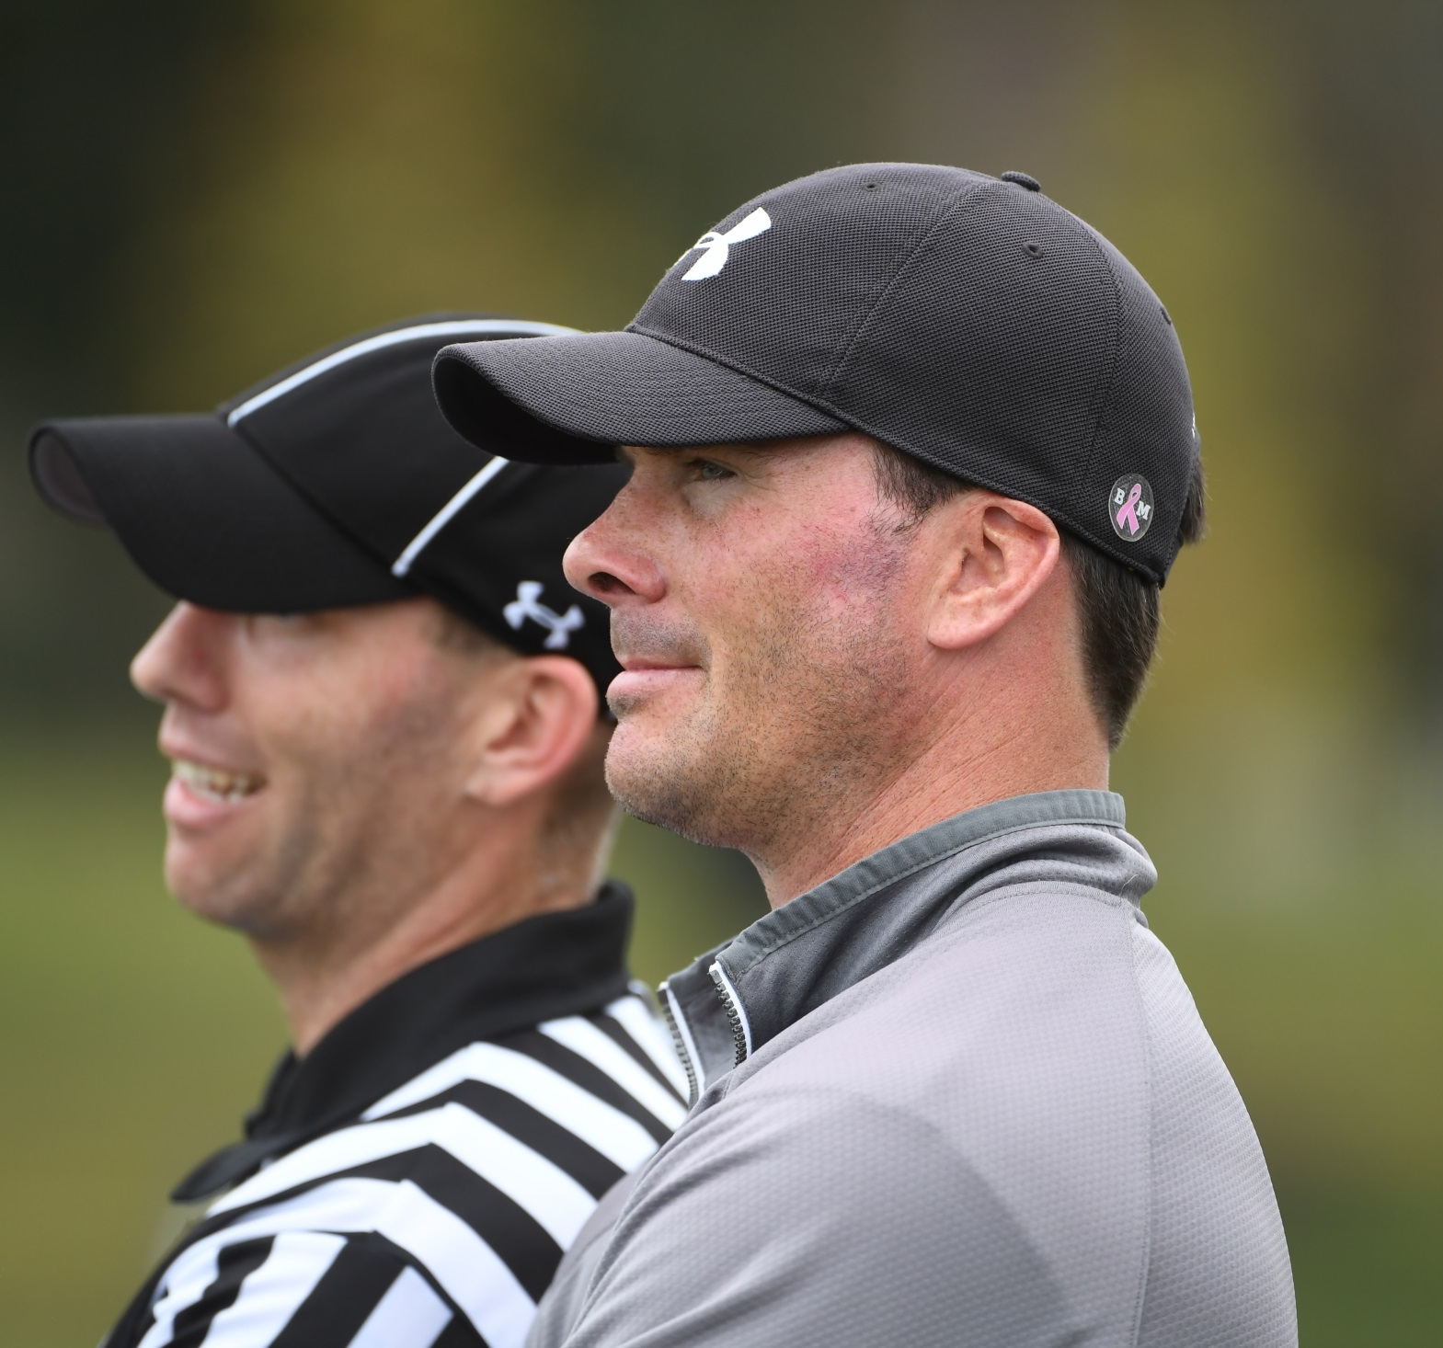
WHEN SPEAKING WITH COACHES
Face the field and keep your eyes on the players.
Effective responses:
Ok
I hear you
I’ll find out for you
It was close

Slide 8
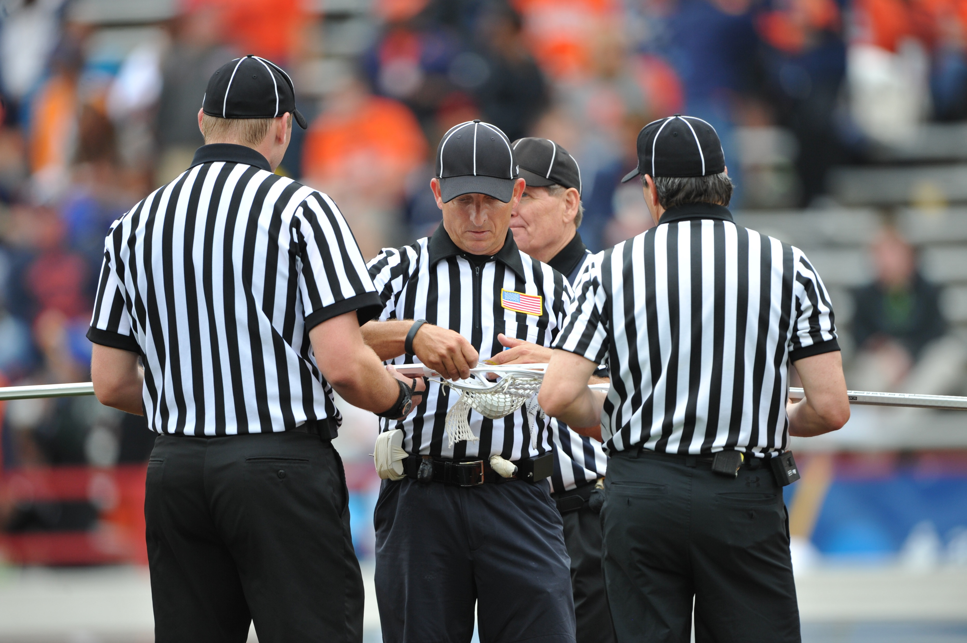
USE DEAD BALL TIME TO CONVERSE
Anything on your radar?

Slide 9
FACEOFFS
Top to Stop

Slide 10
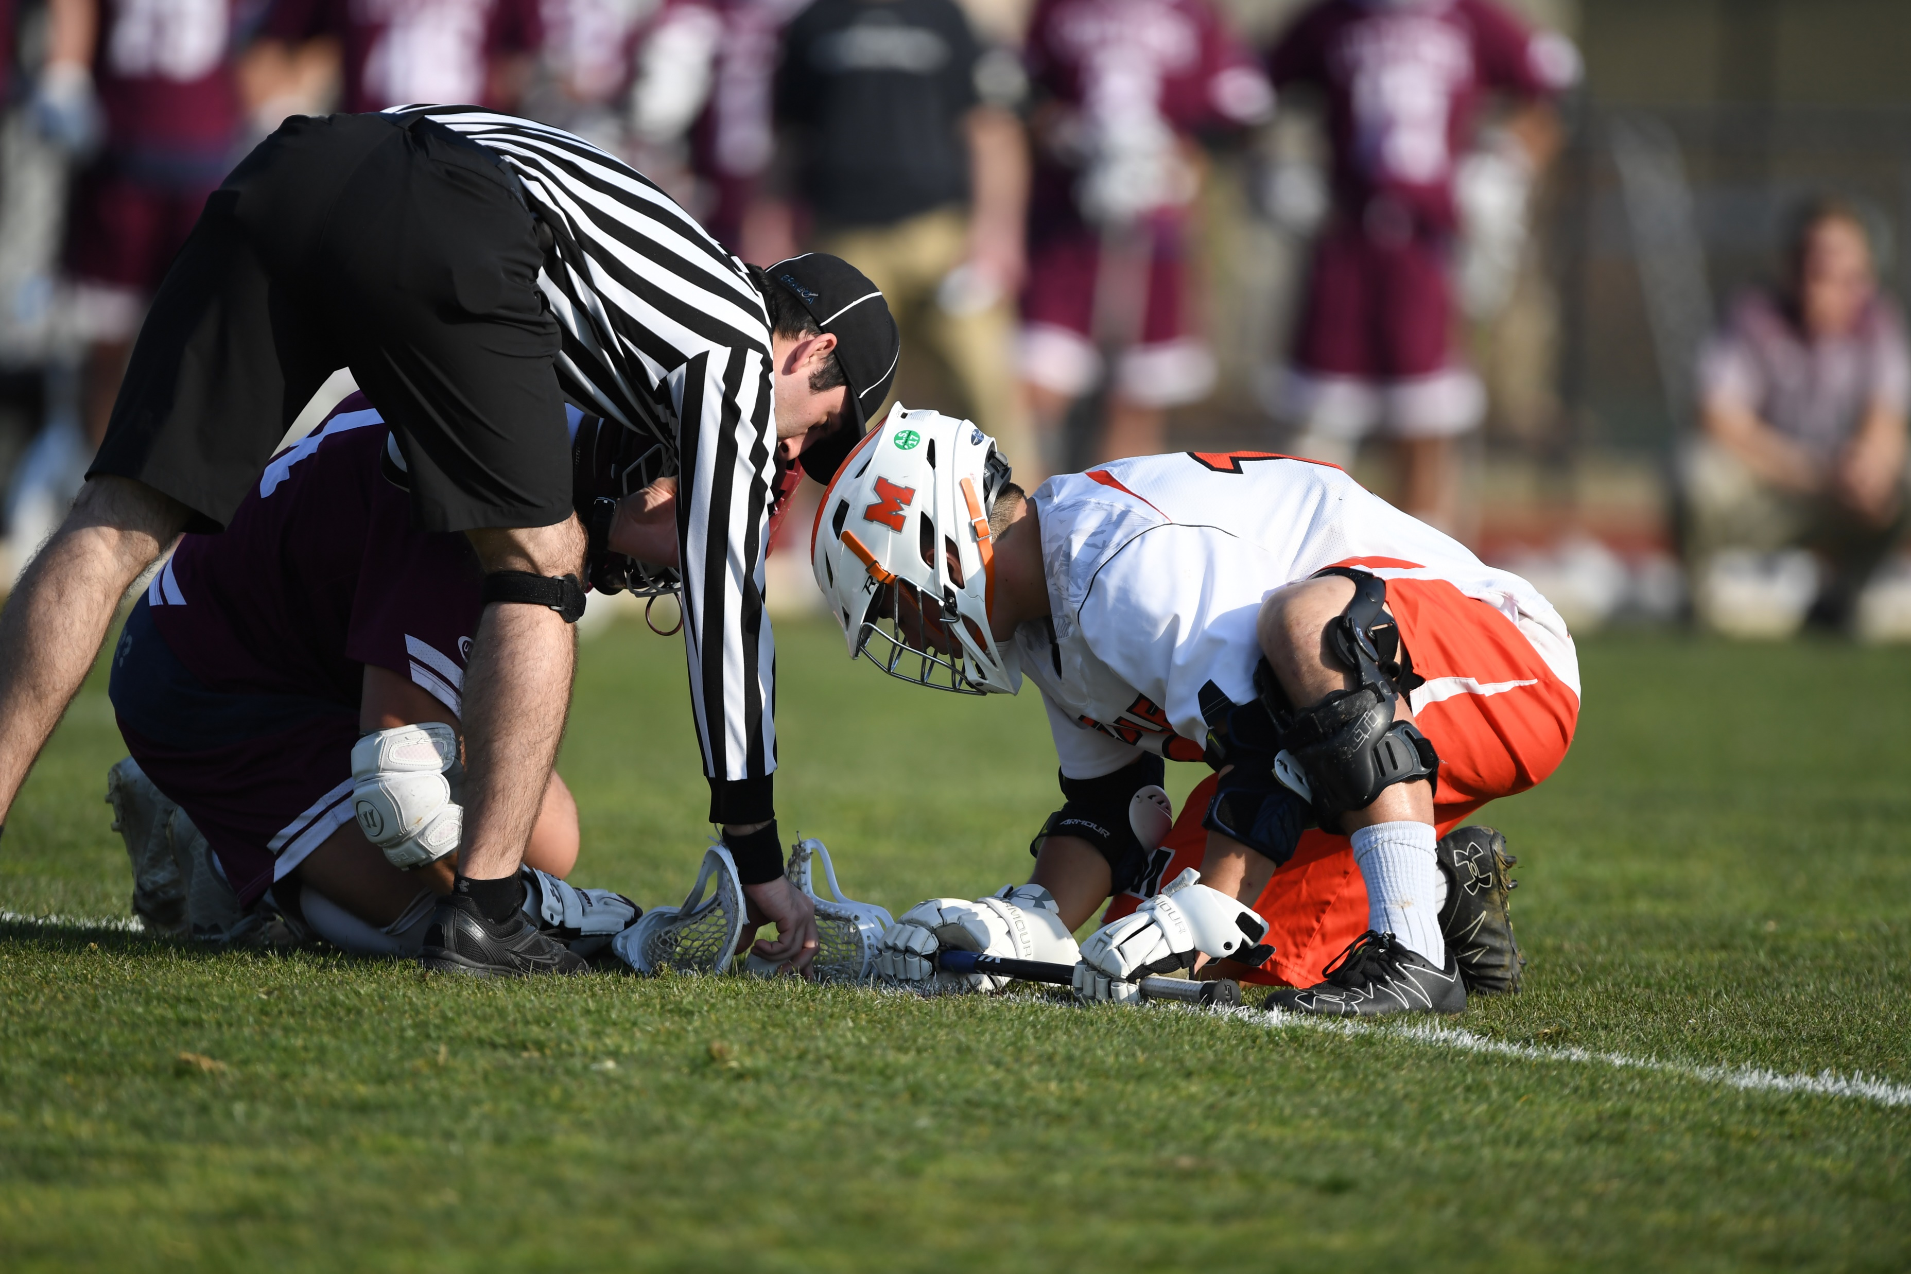
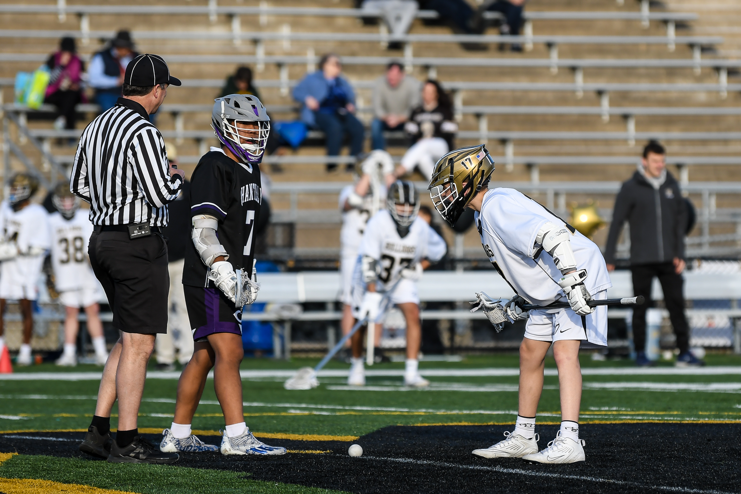
PLACE THE BALL

Slide 11
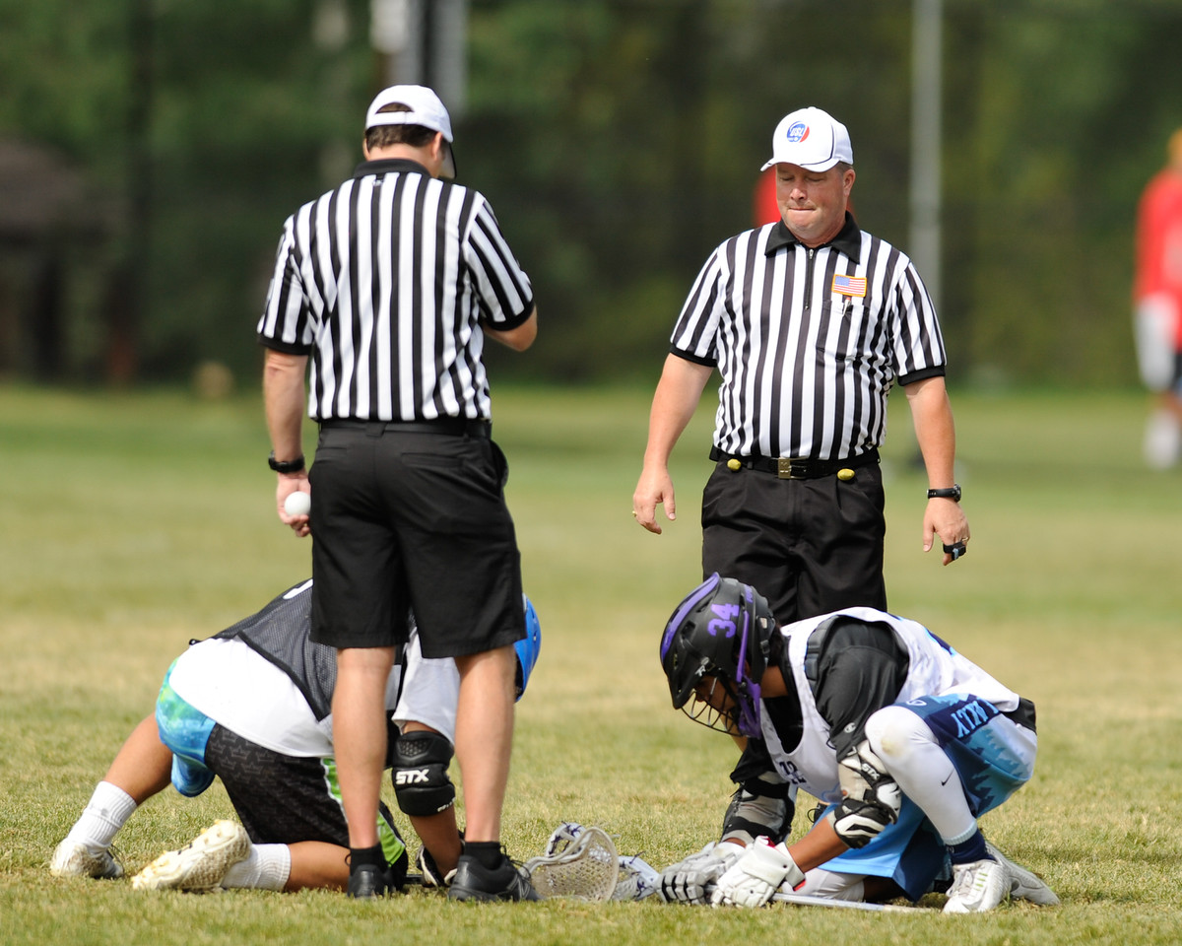
ONE OFFICIAL TALKS AT A TIME
Hands off the plastic
Move left
Does he mean me?

Slide 12
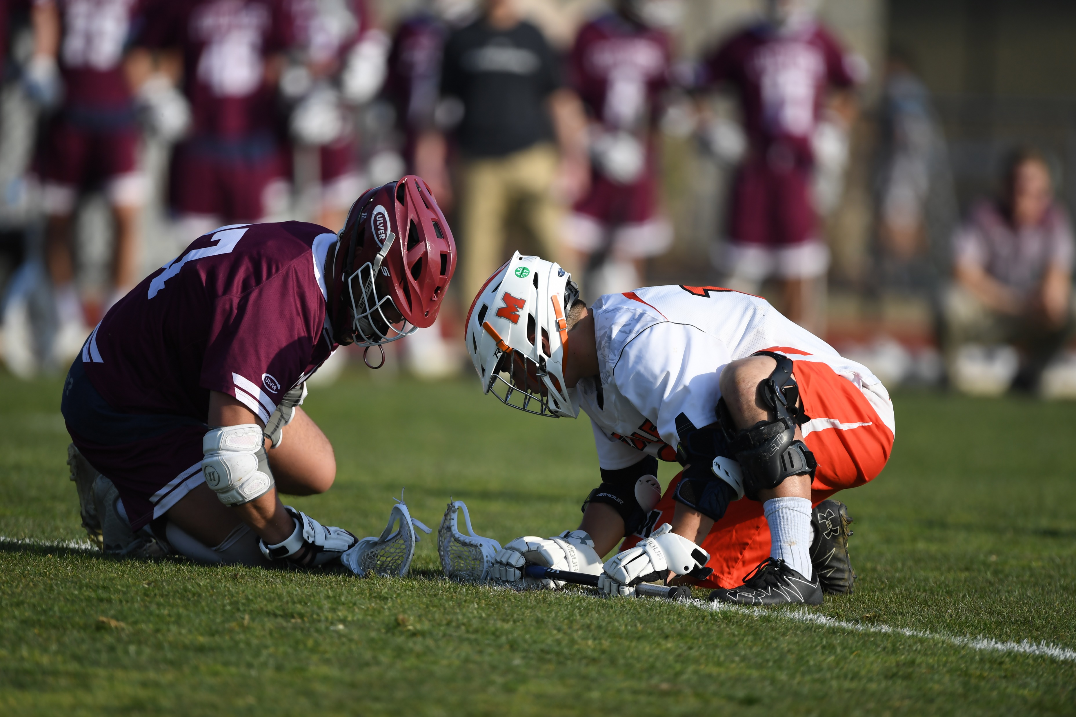
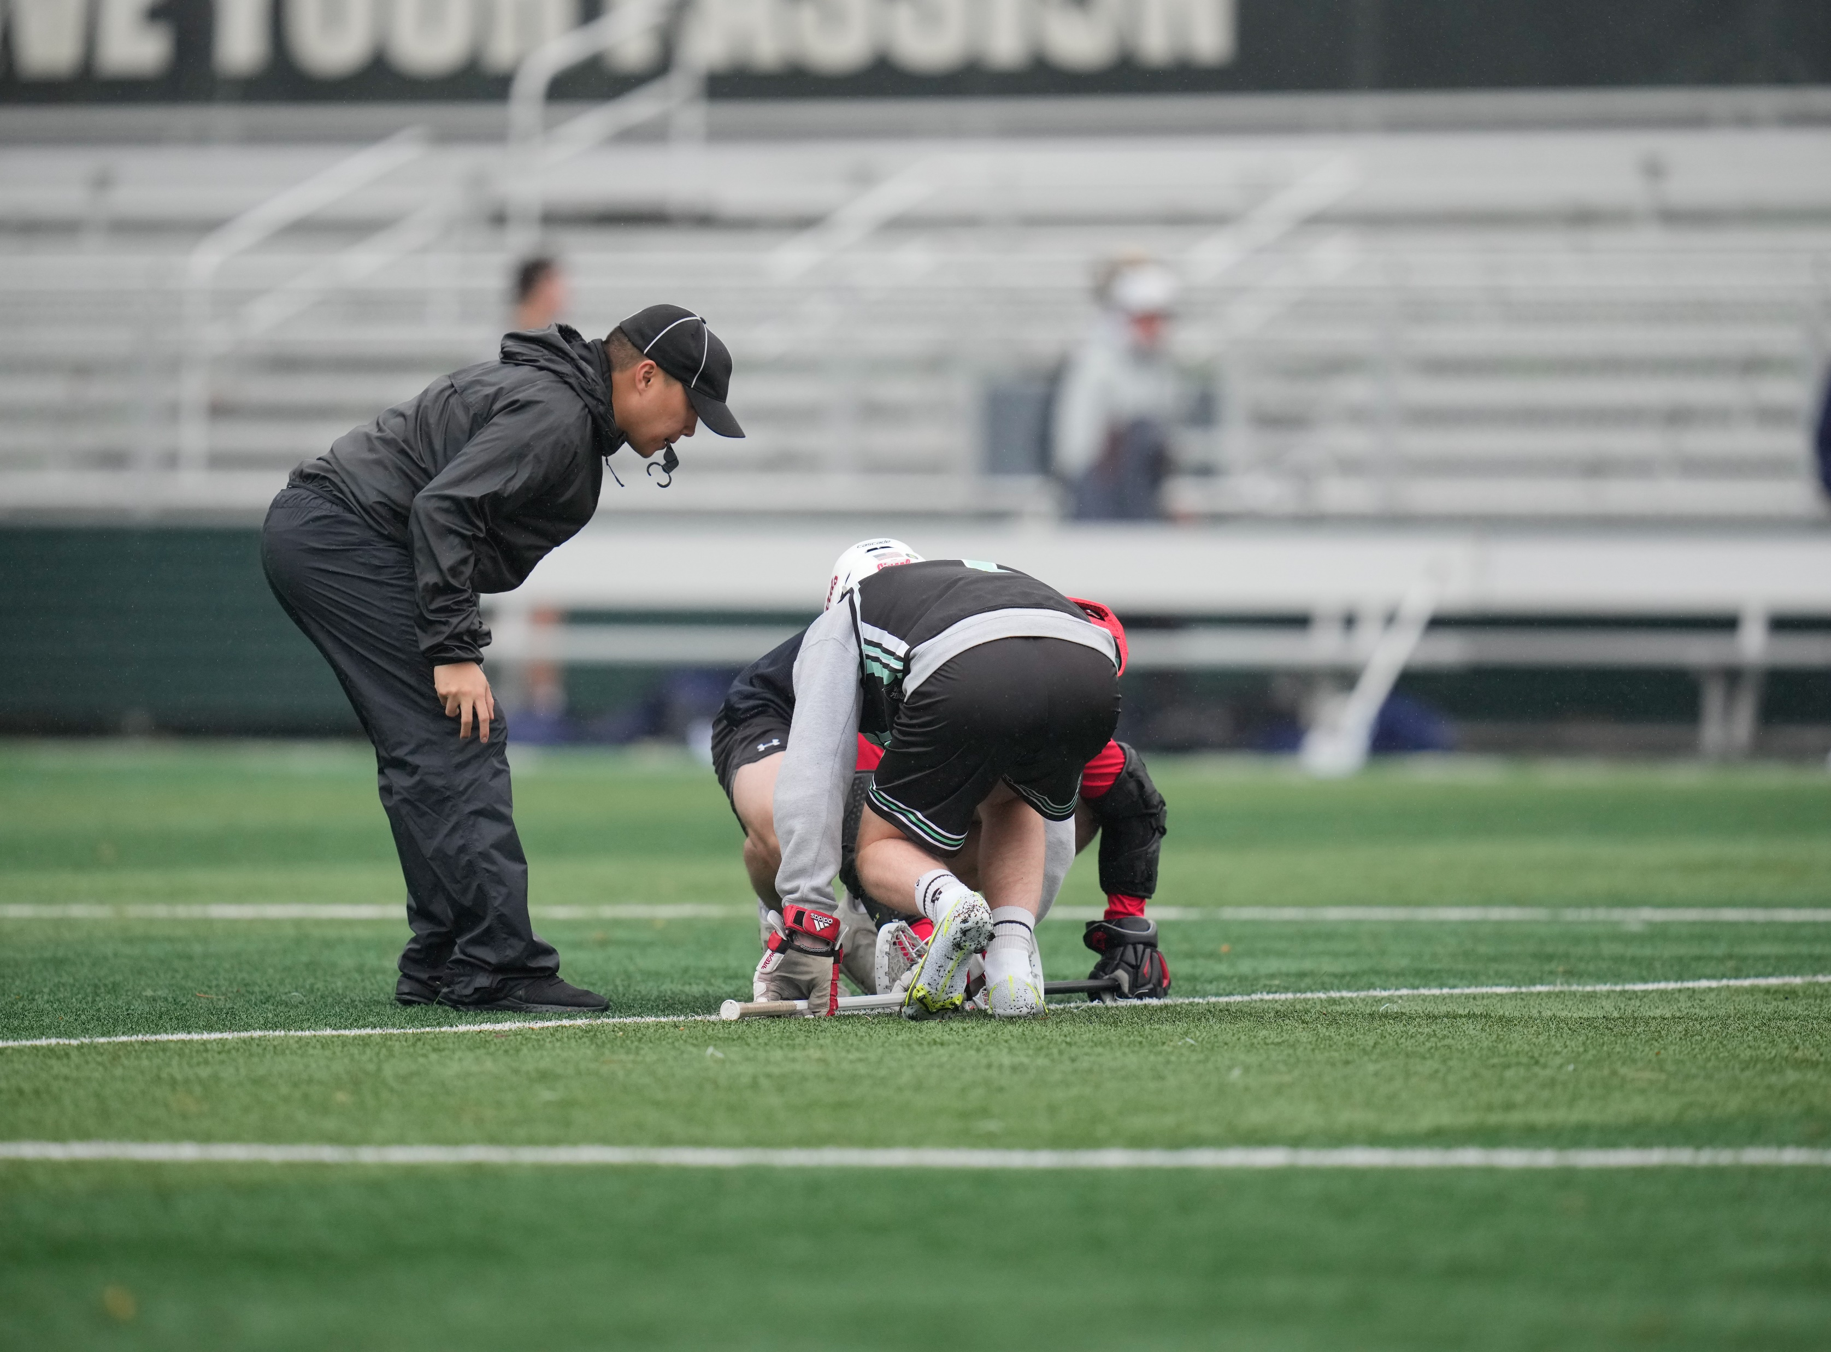
DOWN
Move left.

Slide 13
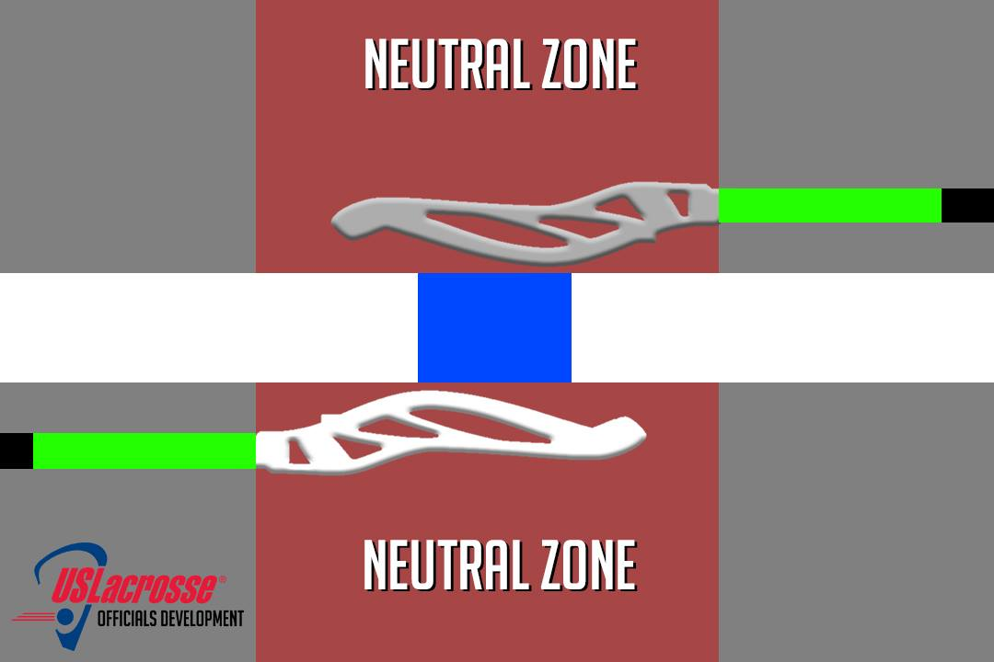
TOP VIEW

Slide 14
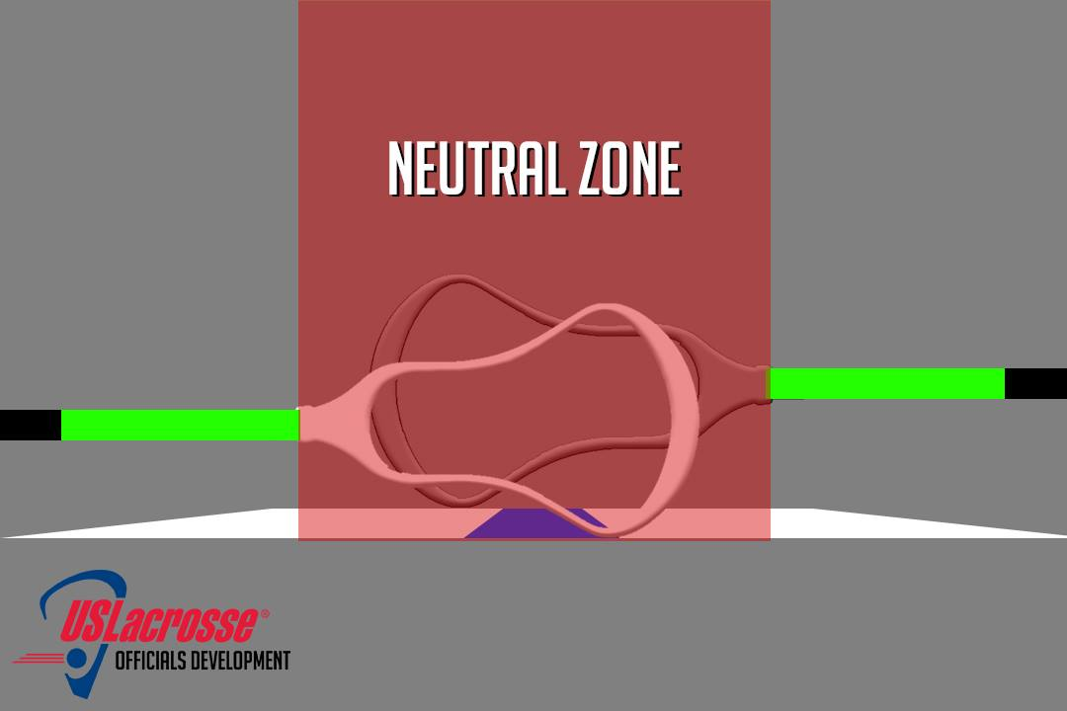
SIDE VIEW

Slide 15
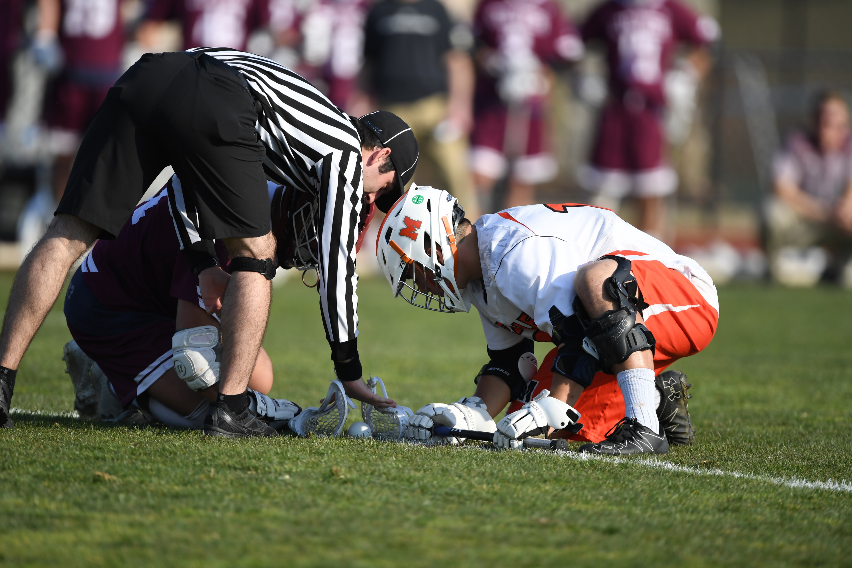
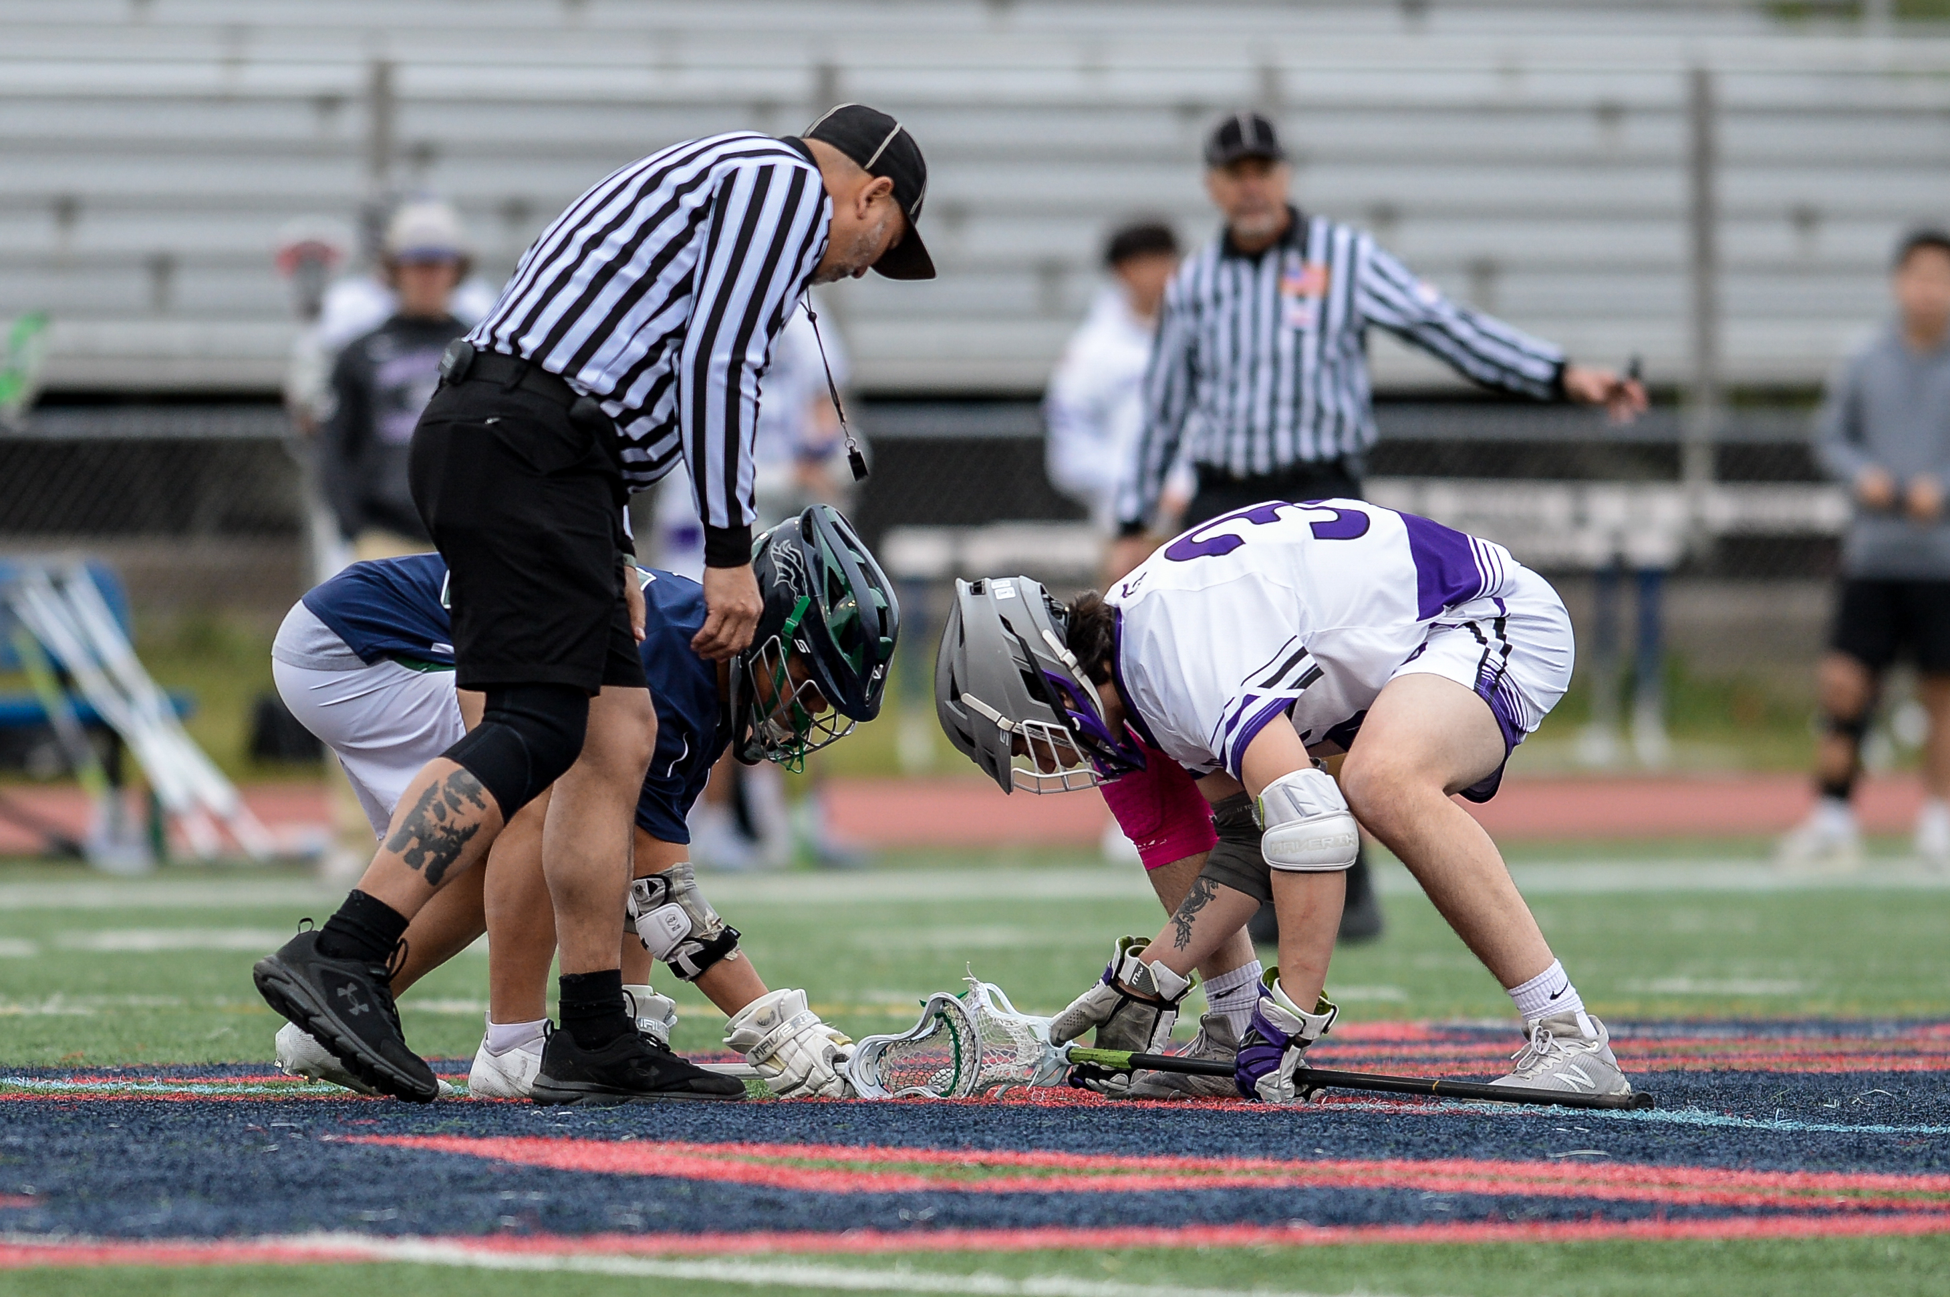
SET
Set

Slide 16
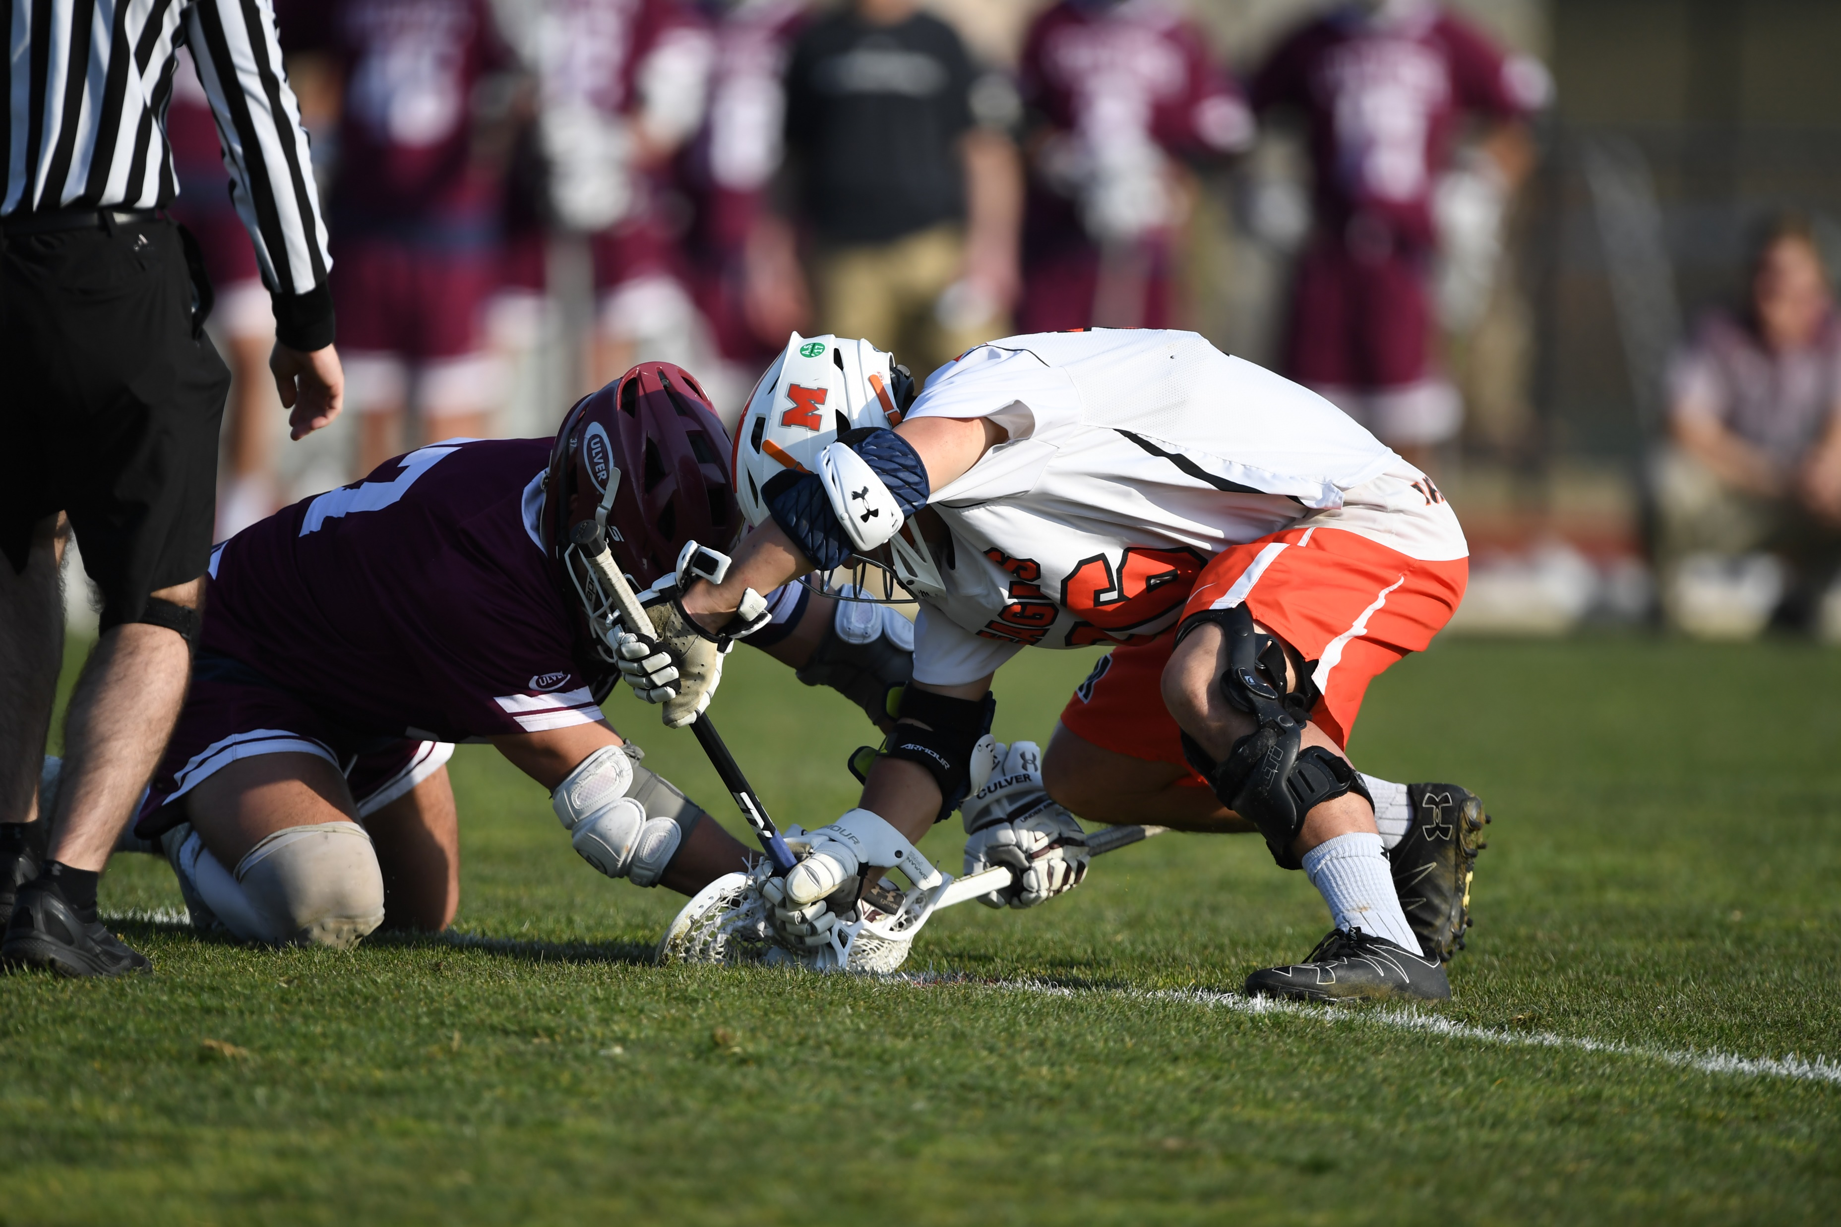
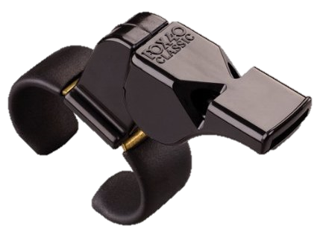
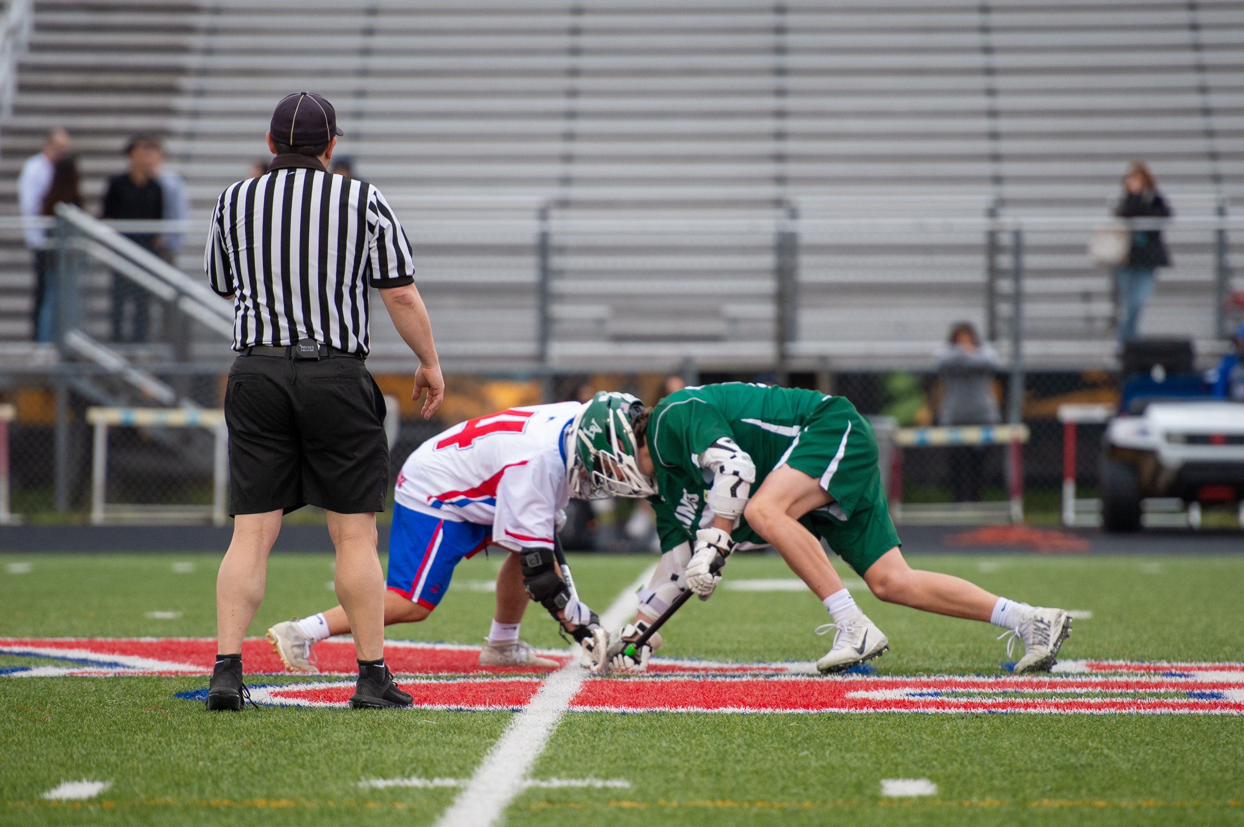
WHISTLE (VARIED CADENCE)

Slide 17
COMMUNICATION
If one official is confused, the entire crew is confused.

Slide 18
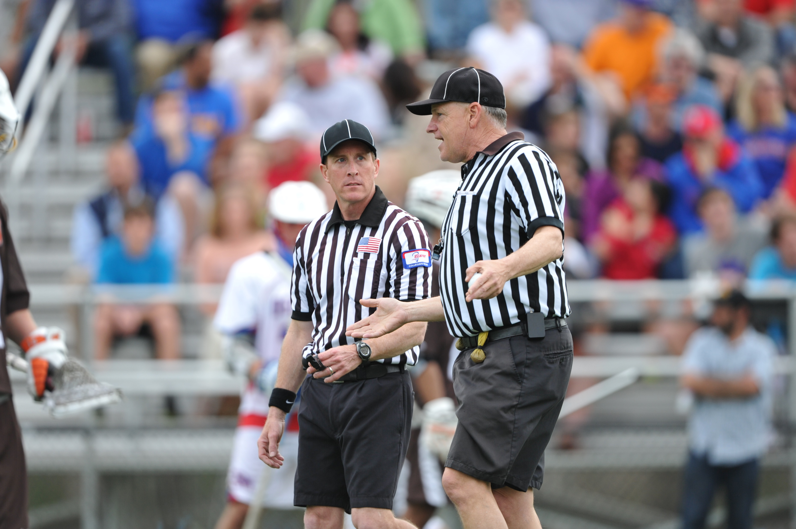
TELL YOUR PARTNER ABOUT ANY WARNINGS YOU ISSUE
I told the head coach that if his assistant kept making comments…we’re going to turn the ball over.

Slide 19
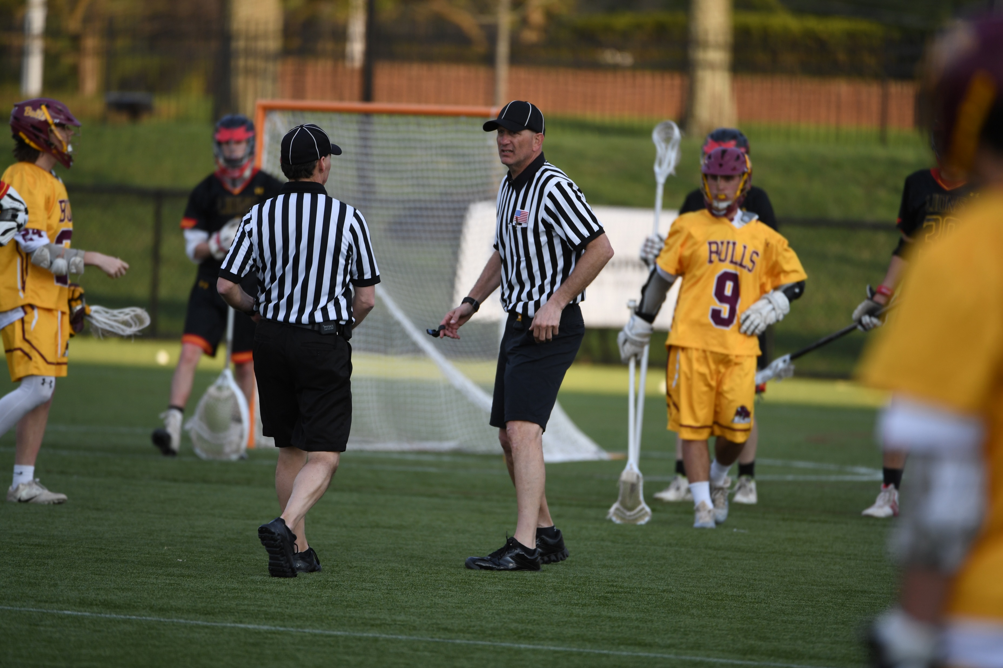
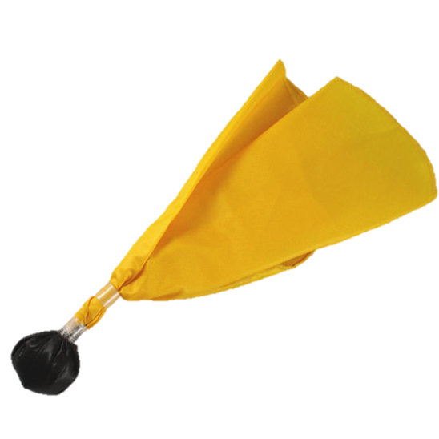
TWO FLAGS = TALK!
Did we throw for the same thing?

Slide 20
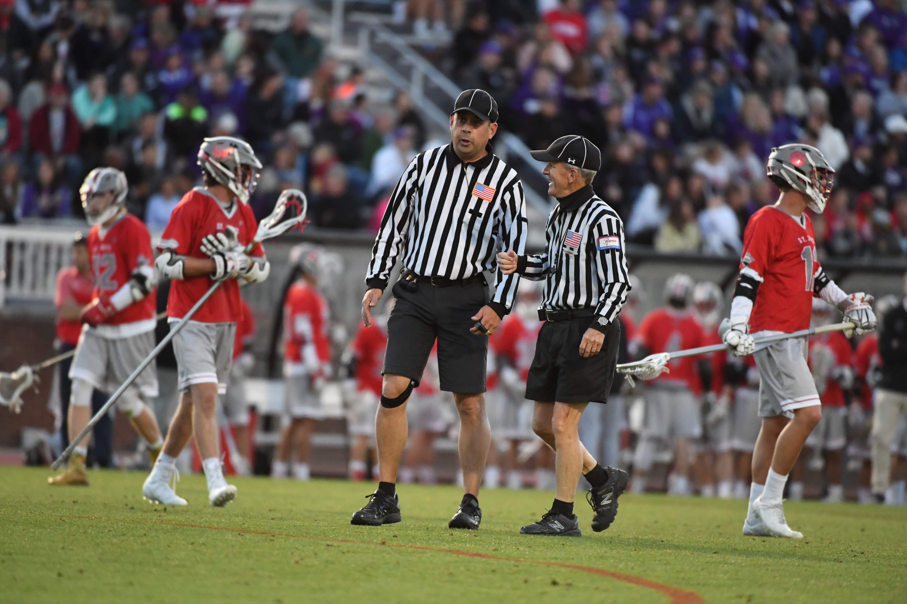
GATHER THE FACTS, BREAK ON THE SAME PAGE
What did you have?
I have Red, 4, with a push too.
Okay, so Red will be two men down.

Slide 21
PENALTY REPORTING
Color
Number
Offense
Time
Explanation
Red
55
Slash
1-minute
If needed

Slide 22
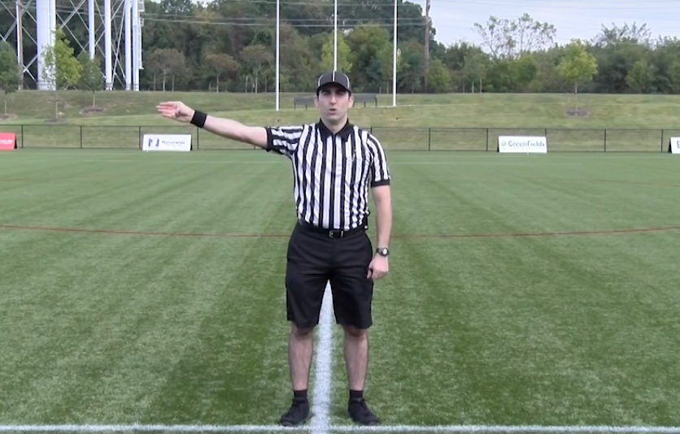
PENALTY REPORTING
Red
Color
Number
Offense
Time
Explanation

Slide 23
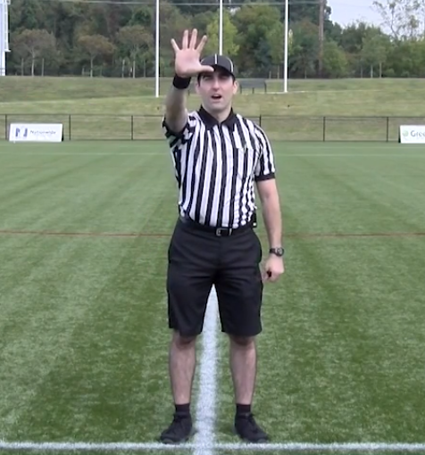
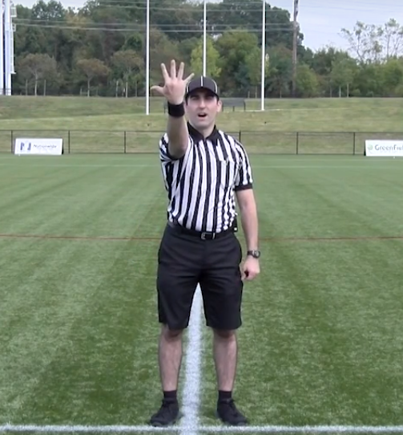
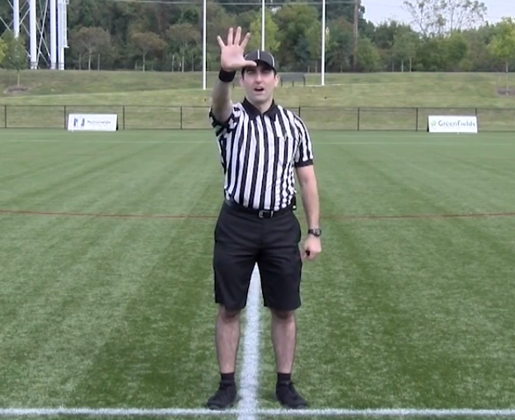
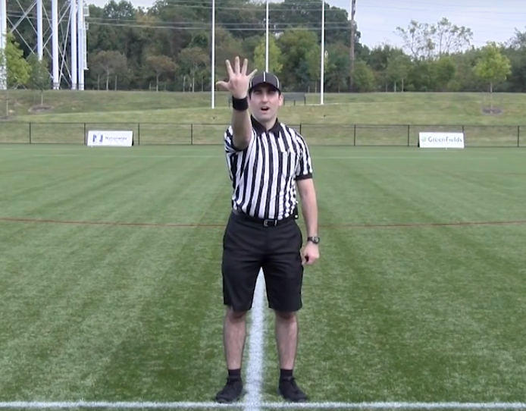
PENALTY REPORTING
Five,
Five
Color
Number
Offense
Time
Explanation

Slide 24
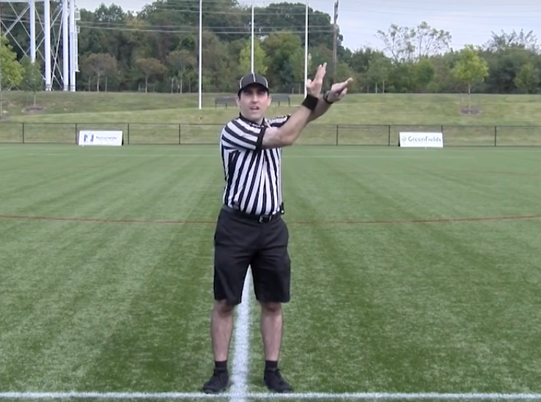
PENALTY REPORTING
Slashing
Color
Number
Offense
Time
Explanation

Slide 25
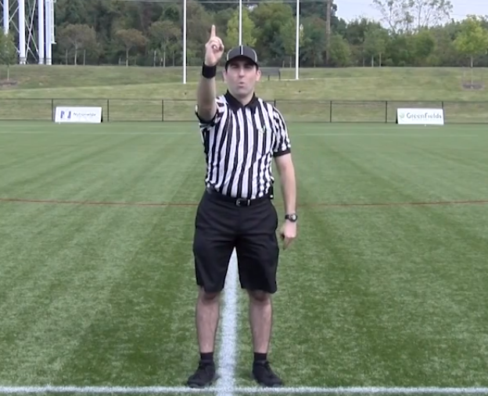
PENALTY REPORTING
1-minute
Color
Number
Offense
Time
Explanation

Slide 26
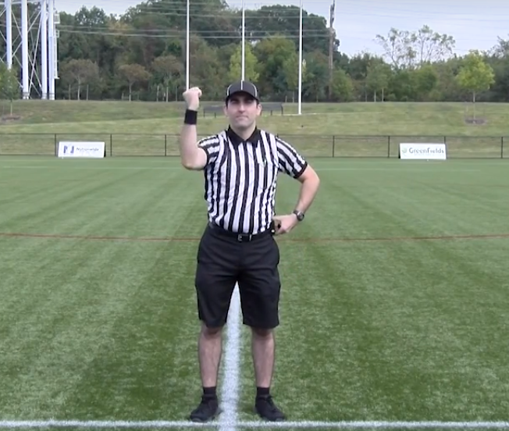
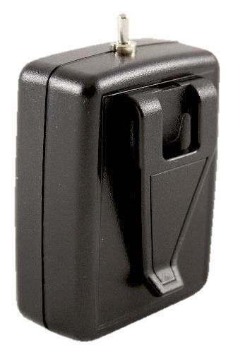
PENALTY REPORTING
20-Second Timer
Color
Number
Offense
Time
Explanation

Slide 27
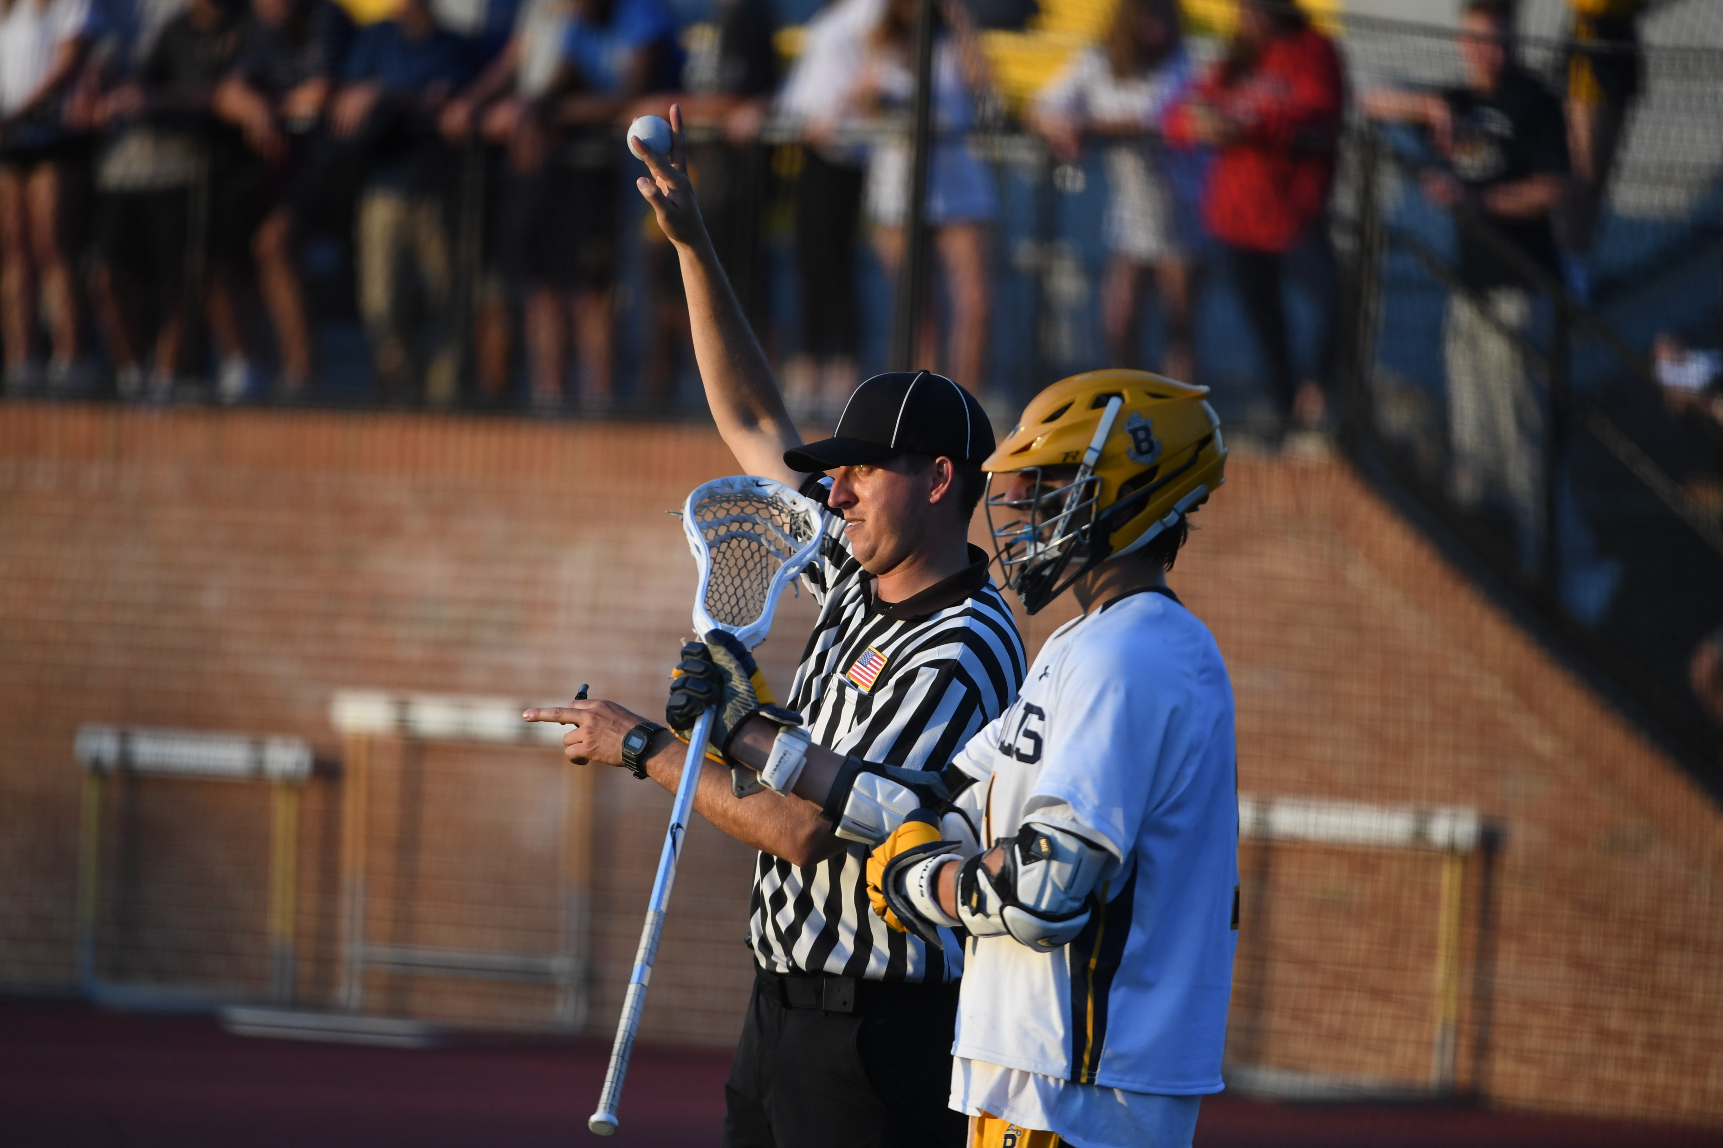
SET THE FIELD WHILE PARTNER REPORTS FOUL
Goalie! Ball is side right!

Slide 28
TIPS
Impressions matter.

Slide 29
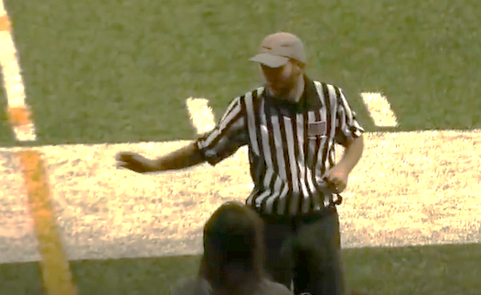
POOR PRESENCE
Sloppy and rushed signal.
Too close to the table. Set your feet at the wing line.

Slide 30
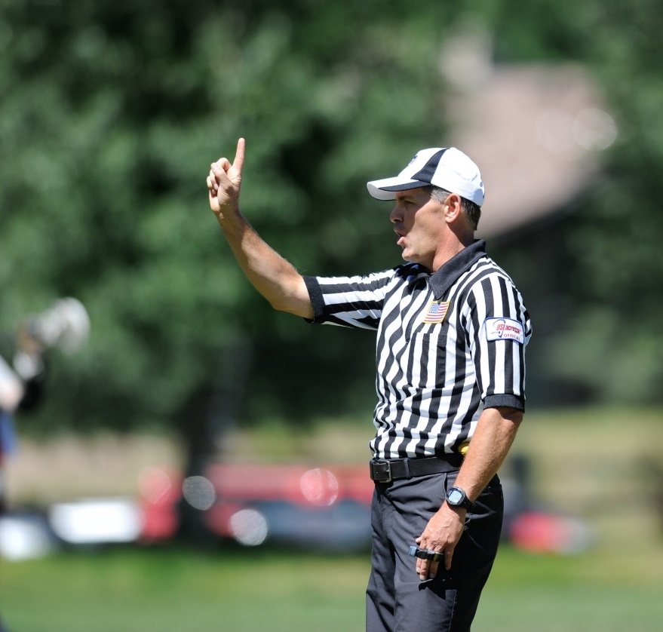
GREAT PRESENCE
Stand with excellent posture to make the best impression.
Show clear and obvious signals so everyone understands the call.

Slide 31
THANK YOU TO THE MEMBERS OF THE
2023 MENS OFFICIAL’S EDUCATION DEVELOPMENT TEAM

