Slide 1
RETURNING OFFICIALS – SESSION 5
MENS OFFICIALS DEVELOPMENT | 2023 SEASON
Notes:
RETURNING OFFICIALS
The purpose of this curriculum is to give the trainer “talking points” for virtual and/or in-person meetings
Each session is designed to be 45-60m.
Returning officials generally benefit more from discussion rather than rule-by-rule lessons
Use the material as you see fit and use your “style” to make it work for your officials

Slide 2
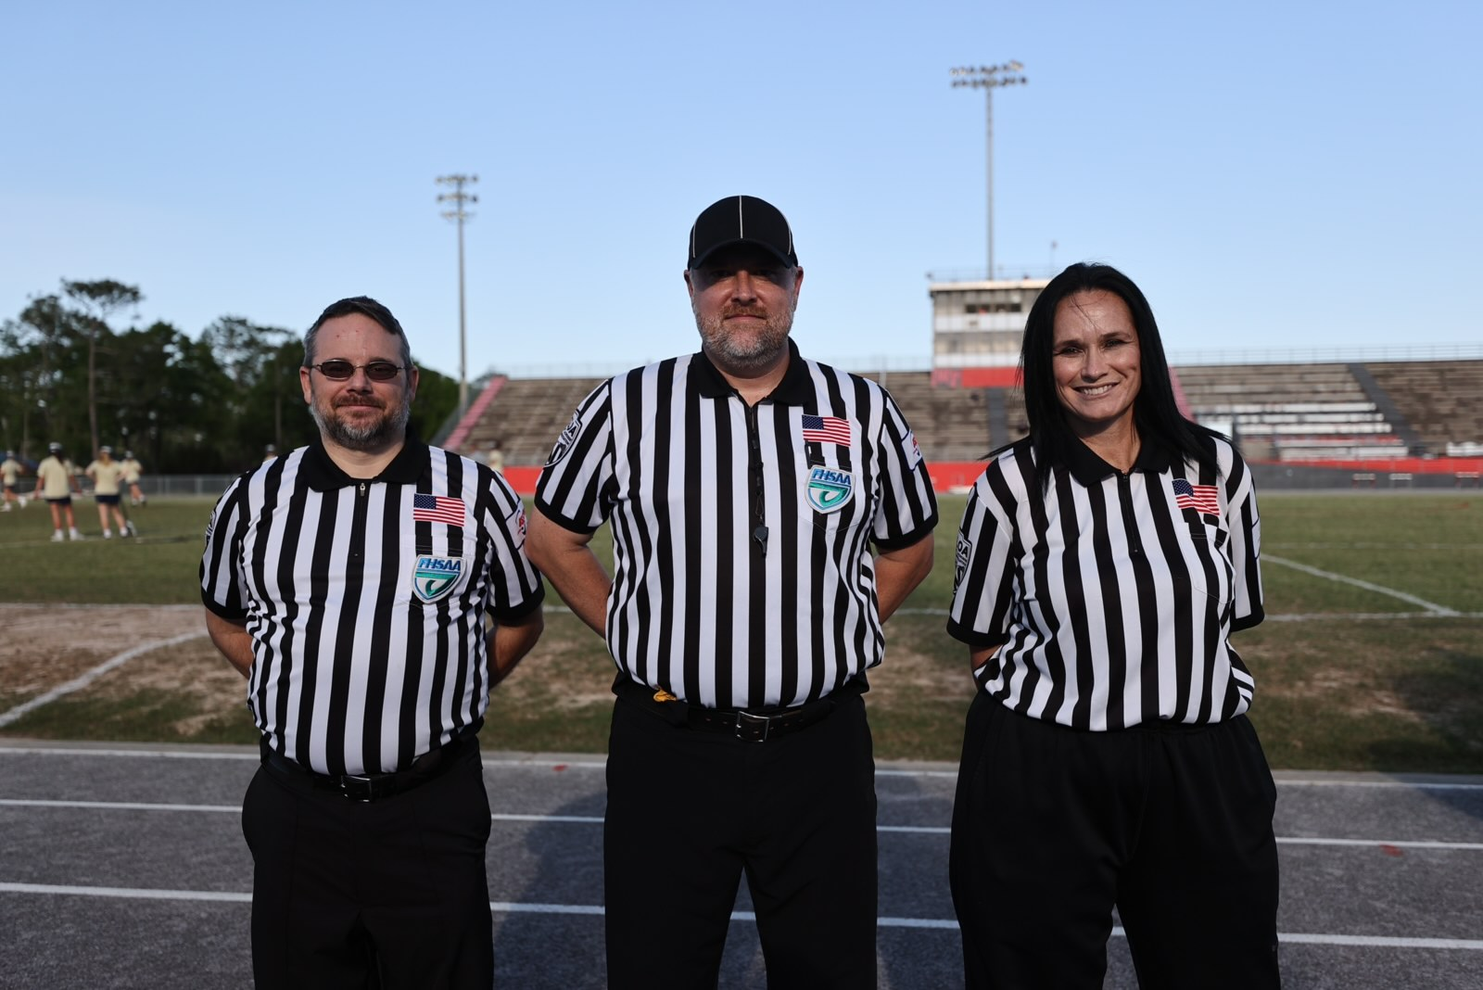
WHAT YOU WILL LEARN
Game Management
The Ramp
Mental Agility

Slide 3
GAME MANAGEMENT
Set the Tone…

Slide 4
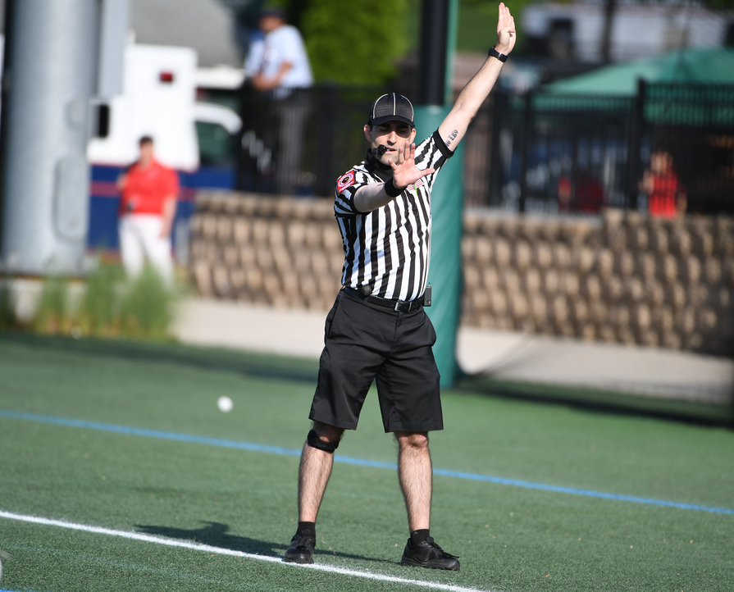

WHAT IS YOUR THRESHOLD?
Write down three game comments or questions that:
  Bother you
  Upset you
  Distract you

Slide 5
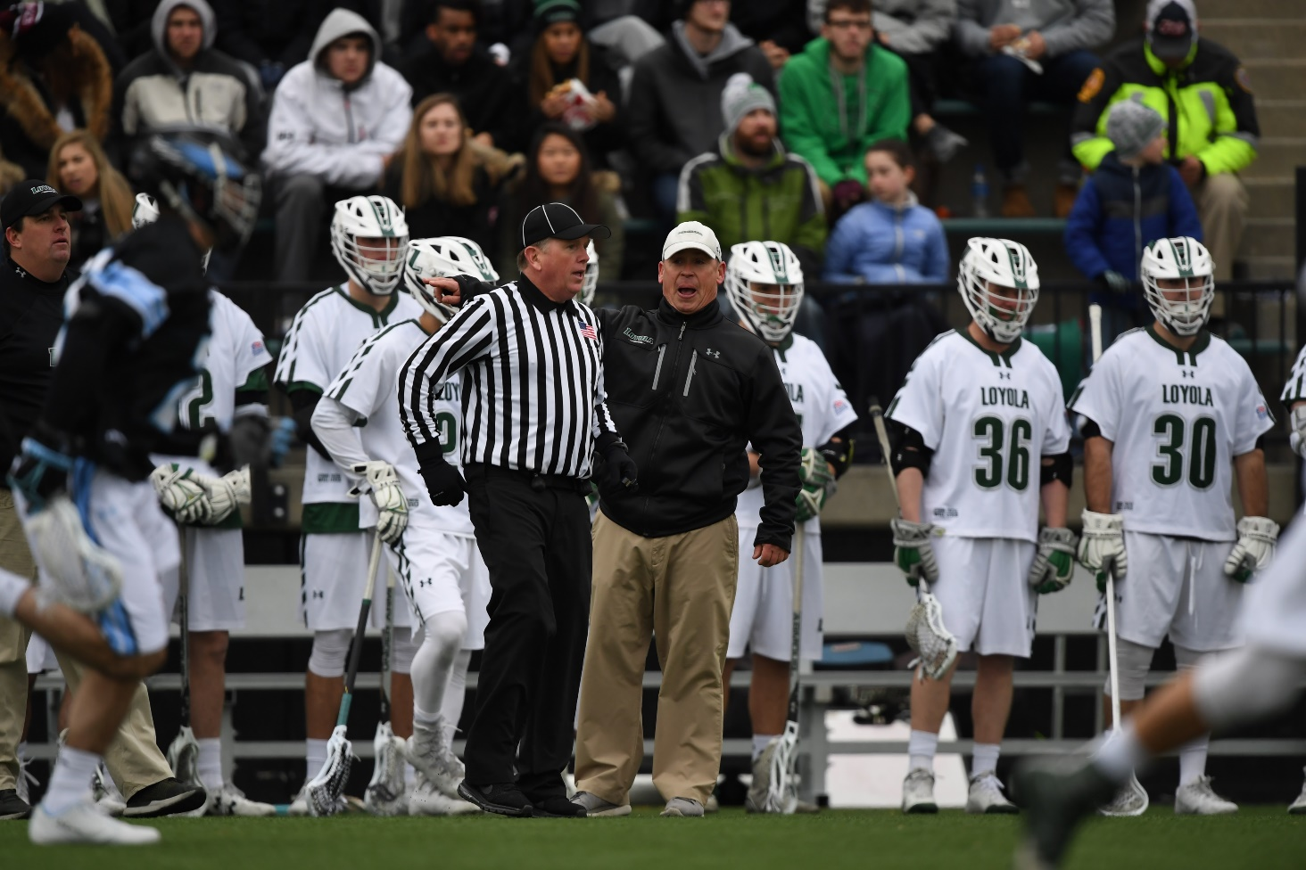
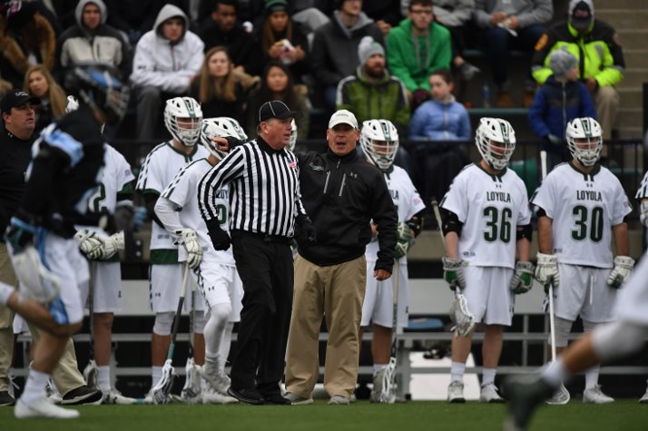
STATEMENTS DO NOT REQUIRE ANSWERS
That call was awful!

Slide 6
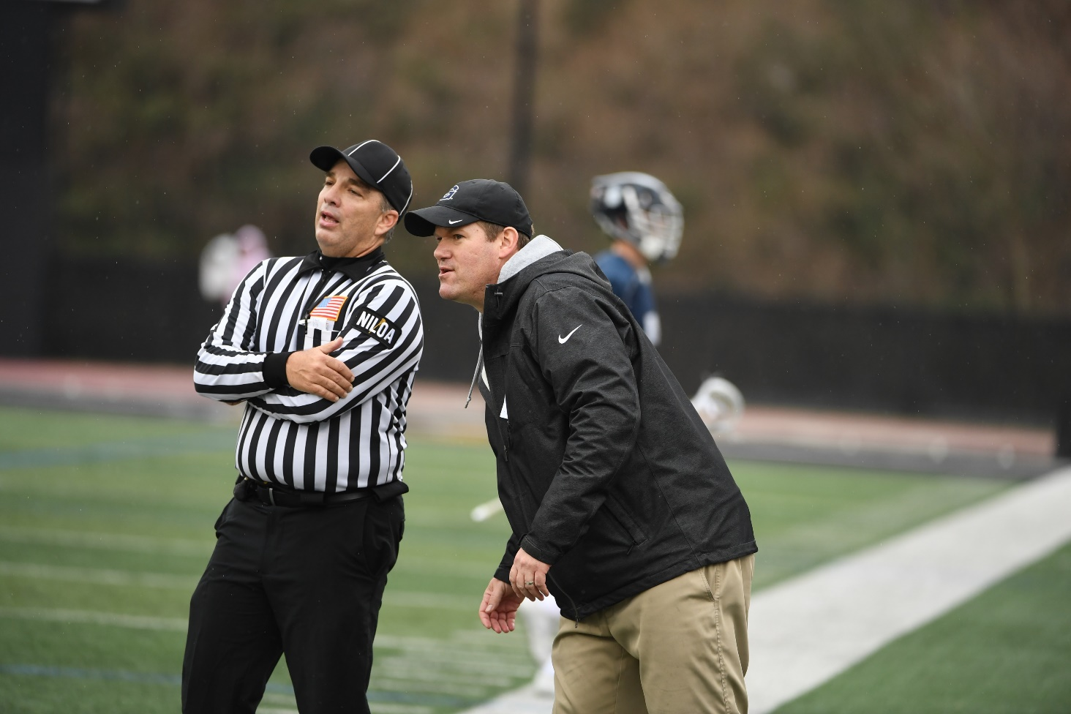

ANSWER QUESTIONS IN RESPECTFUL TERMS
What did he call?
I’m not sure, and I’ll find out for you.

Slide 7
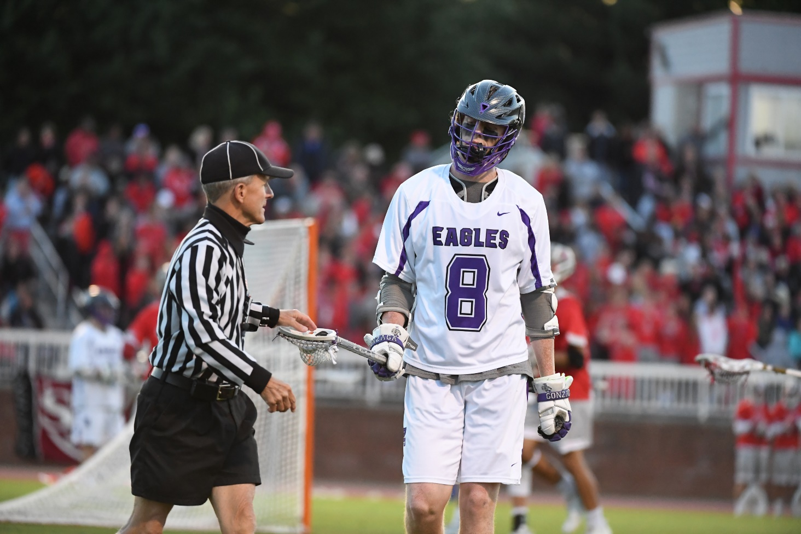

Use Professional Language
Here’s the ball kid.
Here’s the ball sir.

Slide 8
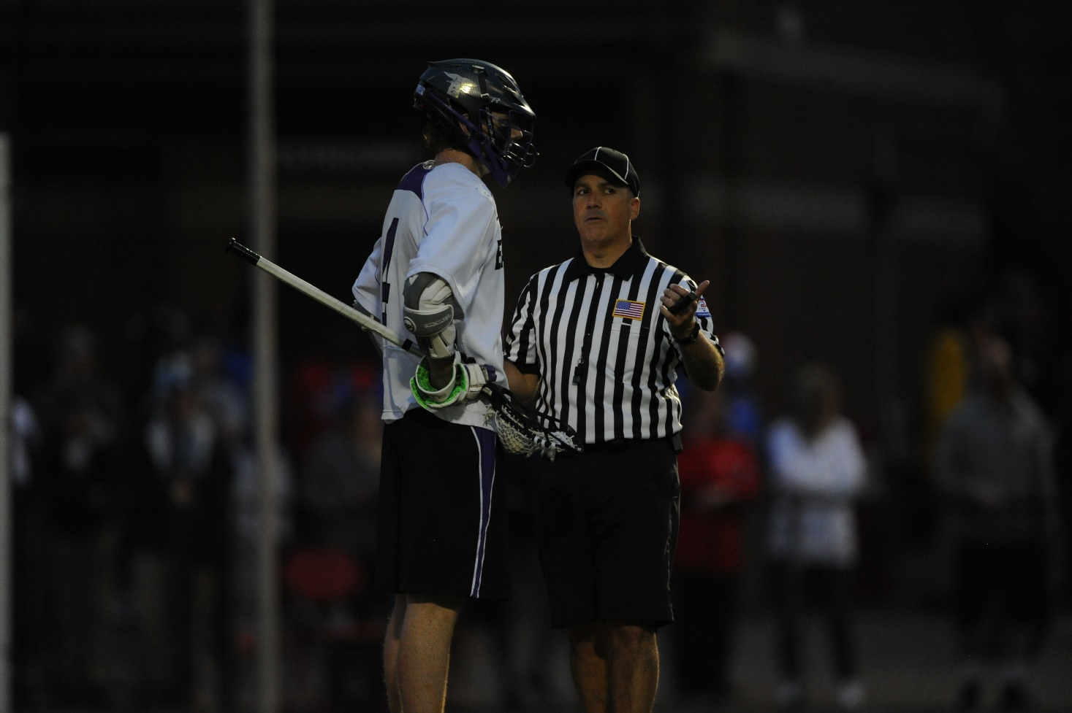
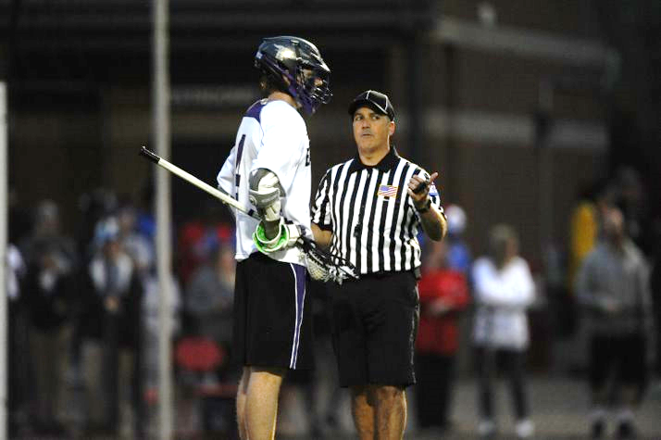
CREATE ALLIES
I want to work together. Help me get #27 under control.

Slide 9
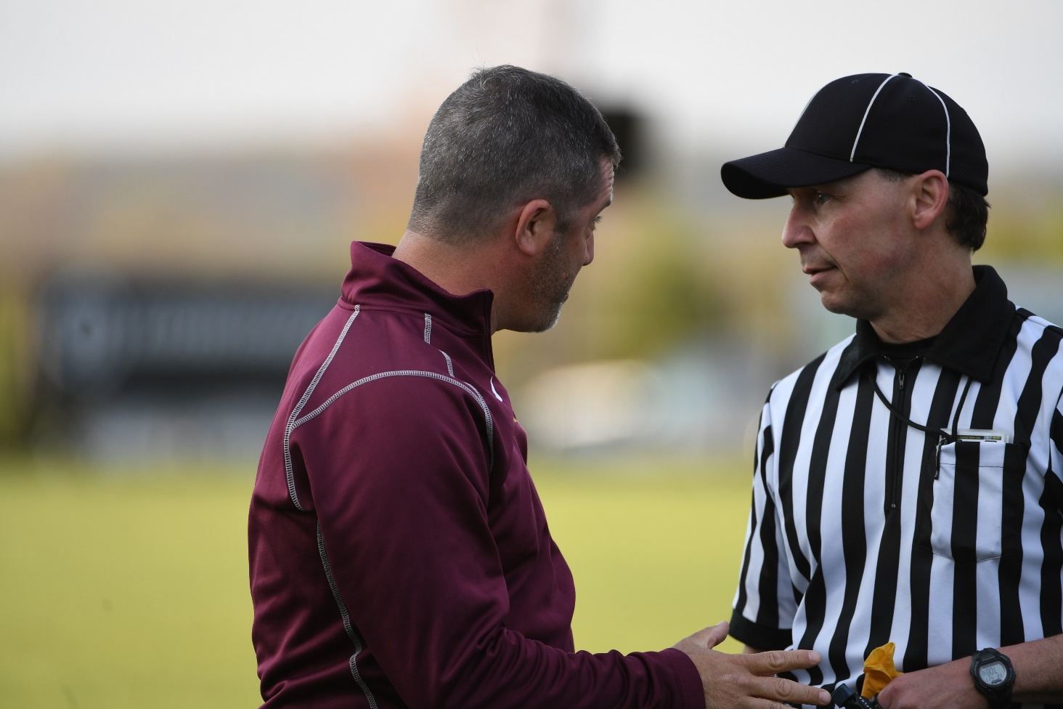

YOU GET WHAT YOU ALLOW
Coach, you made your point and we’re moving on.

Slide 10
THE RAMP
Actions have consequences…

Slide 11
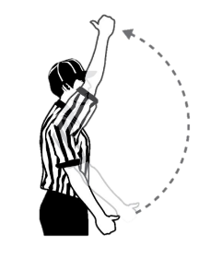

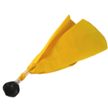


THE RAMP – NFHS
Ejection
USC
1-minute
NR
Conduct foul with opponent possession
30-seconds
Conduct foul with possession
Verbal Warning
Notes:
Answer polite questions from coaches
Use the conduct foul “ladder” to manage the benches
Opportunities
Coach leaves coach's area to confront you
Head coach is impolite / unprofessional
Assistant coach tries to influence you
Maligning comment from bench area

Slide 12
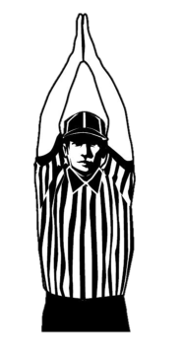
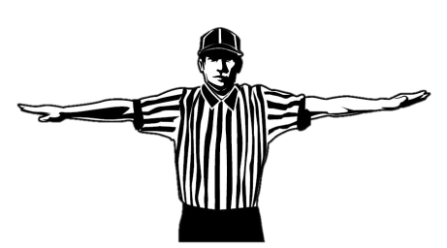
MAGIC WORDS
Attacks against integrity
F-Bombs
Ejection
USC
1-minute
NR

Slide 13
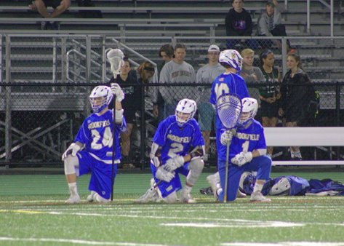
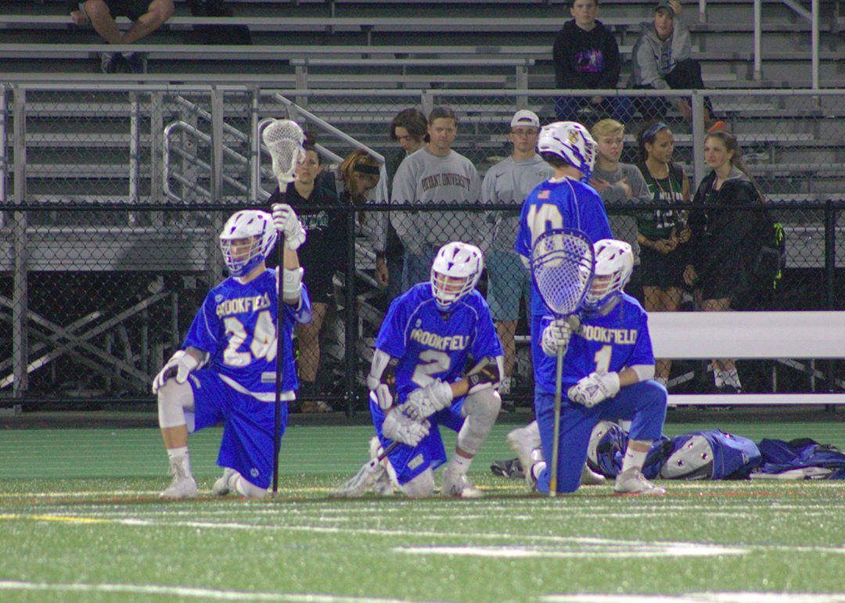
PLAYER EJECTION PROCEDURE
May leave if supervised by a parent/guardian
Confined to the end of the bench without equipment if no supervision is available
Mandatory 3-minute nonreleasable unsportsmanlike conduct (USC)

Slide 14
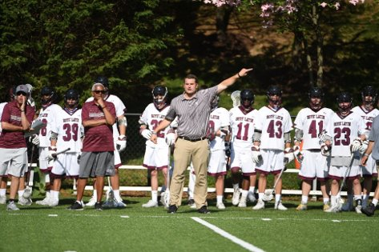
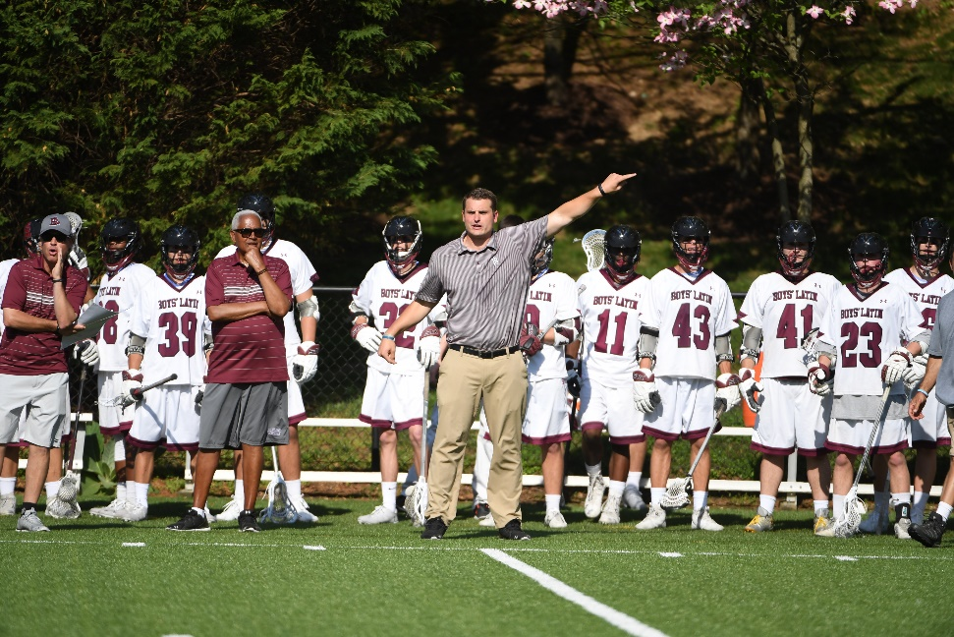
COACH EJECTION PROCEDURES
Coach must leave the premises
In-home serves 1-minute nonreleasable USC based on official’s judgment

Slide 15
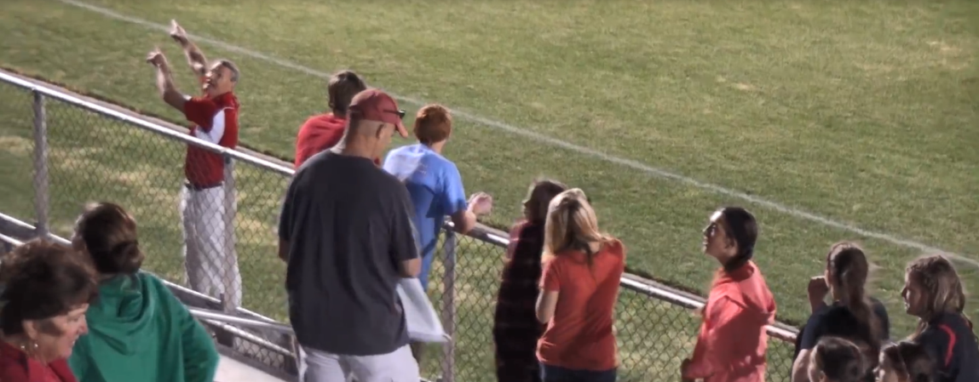
CROWD EJECTIONS
The referee informed me that the game will not continue until everyone has left.
Notes:
CROWD EJECTIONS
Officials have no authority to penalize either team
Officials may stop the game and refuse to continue until the problem is solved
Identify the Game Manager on duty prior to the start of the game

Slide 16
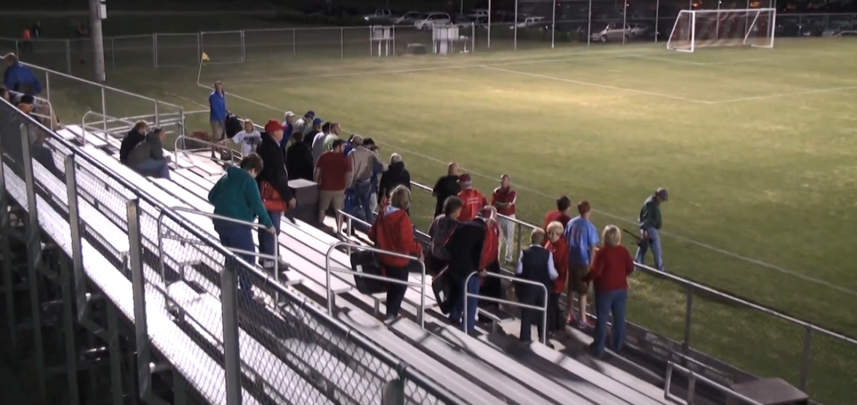

Crowd Removal
Notes:
This is the nuclear option, and we want to avoid this if possible.
Use the head coach of the teams and the site administrator to address fans if they become a problem.
Eject the individuals most responsible for the abusive comments or actions
When all else fails, have the site administrator send everyone out of the venue.

Slide 17
MENTAL AGILITY
How to stay calm and centered in any situation…

Slide 18

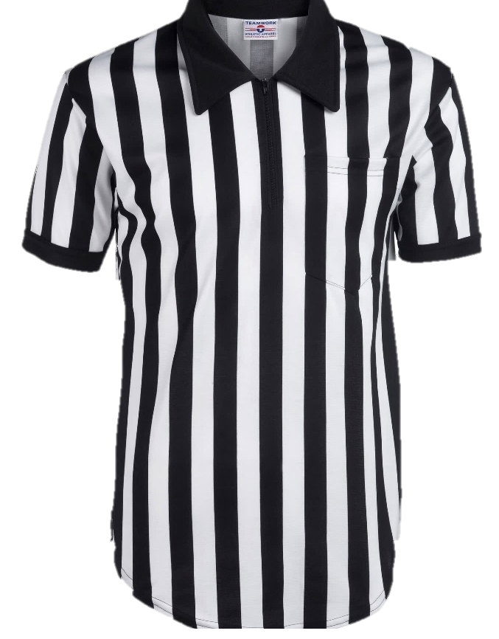

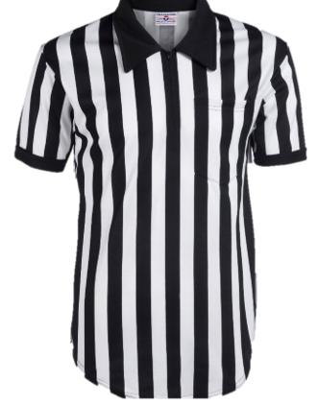
YOUR STRIPES ARE POWERFUL!

Slide 19
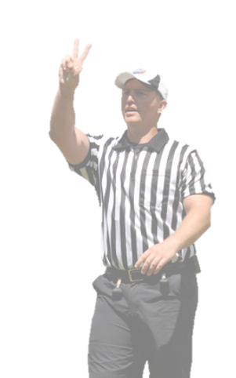
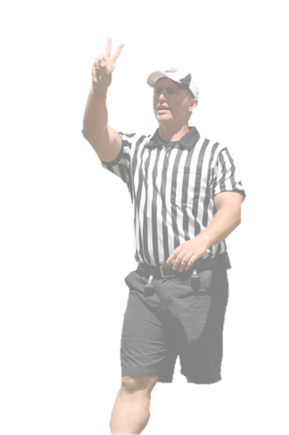
GHOSTING
Review the statements you wrote down earlier.
Circle worst one.
  The one that you WILL NOT allow to be said without consequence.
Allow the other comments to pass through you.
You are terrible!
Horrible call!
Awful, just awful!
Notes:
Imagine the words passing through you.
Only the ones that merit a response and the ones you respond to.

Slide 20
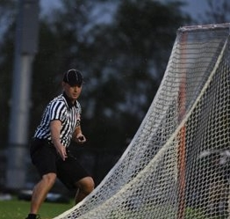
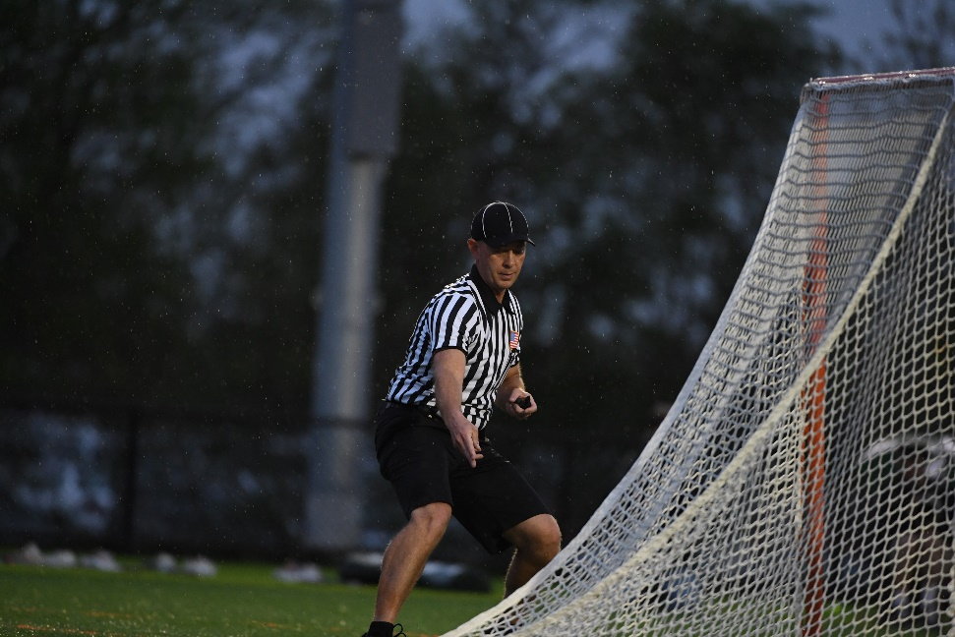
VISUALIZATION
Before you find yourself making a call
  Imagine yourself in a tie game,
  Cross-town rivalry,
  Packed stadium,
  Under the lights!
    You get the call right!

Slide 21
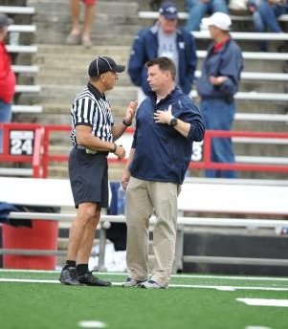
PHRASES FOR YOUR BACK POCKET
I hear you coach.
From my angle, I did not see that.
I’ll find out and get back to you.
Remind me at the next timeout.
Coach, I need your help.
Notes:
Yelling at my partner is not going to make him better today – yell at me not at him.

Slide 22
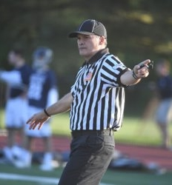
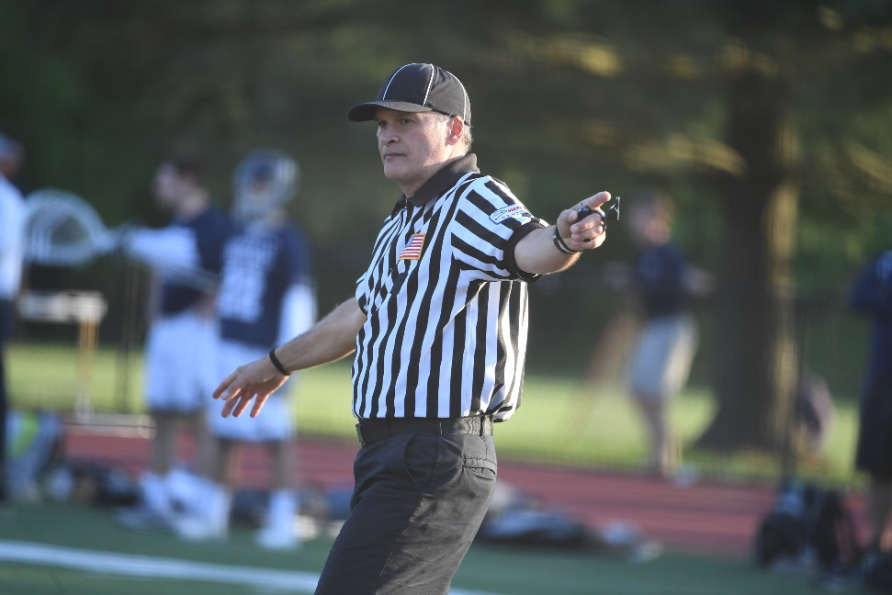
Phrases to Avoid
Coach, it’s only club ball.
Do you want to ref?
Next time I’m flagging you.
Shut up!
Calm down.
Notes:
There are ample studies that show pointing fingers raises antagonistic and angry feelings at the person you are pointing at.
If you want greater success persuading someone of your point, use an open palm instead.

Slide 23

SILENCE CANNOT BE MISQUOTED

Slide 24
THANK YOU TO THE MEMBERS OF THE
2023 MENS OFFICIAL’S EDUCATION DEVELOPMENT TEAM

