Slide 1
RULE 7.6 - SIMULTANEOUS FOULS
Notes:
UNIT LENGTH: 60M
MATERIALS NEEDED
Acquire and test A/V equipment
“Rule 1-3” PowerPoint presentation
Whiteboard
Markers
Lacrosse Ball
Tape measure(s)
Long and short crosses
Whistle(s)
Timer
Scorecard

Slide 2
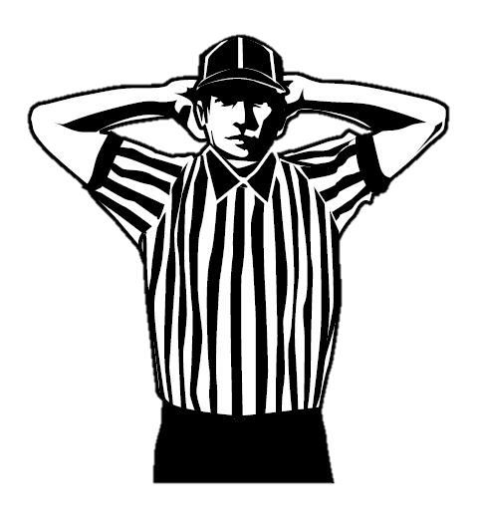
WHAT ARE SIMULTANEOUS FOULS?
THE MOST CONFUSING RULE
What the rulebook says
Rule 7-6. Art.1… Simultaneous fouls are fouls called on players of opposing teams during:
a. a live ball; or
b. a dead ball when sequence cannot be determined (We apply this when we don’t know order)
Most live-ball simultaneous fouls do not actually occur at the exact same time but occur between two whistles
SIMULTANEOUS = CONCURRENT
2
Notes:
WHAT ARE SIMULTANEOUS FOULS?
When you read this rule, you can see how difficult this rule can be to enforce correctly
The next steps you will learn will help you better understand these fouls and how to manage them.

Slide 3
DEFINITIONS
UNDERSTAND THE DIFFERENT TERMS
Simultaneous Fouls
Fouls called on players of opposing teams
Live Ball Fouls
Fouls that occur between two whistles
Do not have to occur at the same exact moment
Dead Ball Fouls
Occur when clock is stopped, or after action requiring a whistle to stop play
Multiple Fouls
Called on the same player or on several players on the same team
Class Discussion Questions
3
Notes:
DEFINITIONS
Simultaneous Fouls
Live Ball Fouls
Dead Ball Fouls
Multiple Fouls
Class Discussion:
Why are simultaneous fouls called simultaneous when it doesn’t mean at the same time?
This is confusing for many new officials, and there isn’t a good answer. The best way to think about simultaneous fouls is that fouls that occur during the time from a whistle to start play and a whistle to end play.

Slide 4
LIVE BALL SIMULTANEOUS FOUL TREE
Class Discussion Questions
During Live Play…
A1 commits…
Technical
Personal
B1 Commits Loose Ball Push
“Play-On”
A1 commits…
Whistle
Whistle + Flag
B1 Commits Personal Foul
Flag Down
Technical
Personal
Whistle
Whistle + Flag
B1 Serves, A1 Does Not
B1 + A1 BOTH Serve
No time served
B1 & A1 BOTH Serve
A Ball
A ball if penalty time is equal or A serves less time, B ball if B penalty time is less than A's penalty time.
A Ball
B Ball
LEARN THE PROGRESSION
4
Notes:
LIVE BALL SIMULTANEOUS FOUL TREE
If there is no play-on or flag down and all fouls are technical, the fouls cancel
If the team in possession (or entitled to) commits:
Only technical = no penalty for team in possession
Any personal foul = all players serve including all technical and personal fouls by either team
Releasing players:
Shortest penalty time is non-releasable for all penalties
Goal scored during NR time does not release penalties
Goal scored after NR time is up releases all remaining penalties
Class Discussion
If a player receives a non-releasable penalty and a releasable penalty, which type of foul is served first?
Non-releasable foul time is always served first regardless of the sequence of fouls for that player.

Slide 5
DEAD BALL SIMULTANEOUS FOULS
TECHNICALLY, THEY ARE NOT SIMULTANEOUS
Enforced in the sequence in which they occur
These are not simultaneous fouls.
When sequence cannot be determined:
Ex. Equipment violations on both teams
Enforce as simultaneous
Releasing players:
Shortest penalty time is non-releasable for all penalties, goal scored during NR time does not release penalties.
Goal scored after NR time is up releases all remaining penalties
Class Discussion Questions
5
Notes:
DEAD BALL SIMULTANEOUS FOULS
Enforced in the sequence in which they occur, these are not simultaneous fouls.
When sequence cannot be determined:
Ex. Equipment violations on both teams
Enforce as simultaneous
Releasing players:
Shortest penalty time is non-releasable for all penalties, goal scored during NR time does not release penalties.
Goal scored after NR time is up releases all remaining penalties
Class Question
What do you do if you can’t determine the sequence of fouls?
Use alternate possession.

Slide 6
DEAD BALL FOUL TREE
Class Discussion Questions
KNOW THE PROCESS
Dead Ball
B1 Slashes
A1 Slashes
A1 Conduct Foul
B1 Conduct Foul
A1 Delays the Game
B1 + A1 serve
No foul time
B1 serves
A1 does not
Team B awarded ball because of order of fouls
Team B awarded ball because of order of fouls
Team B awarded ball because of order of fouls
A1 Slashes in retaliation
A1 serves, B1 does not
Team B awarded ball because of order of fouls
Random Equipment Inspection
Both teams w/ deep pockets
Each players serves 2m NR
Ball awarded by AP
6
Notes:
DEAD BALL FOUL TREE
Class Discussion
What does “enforce as simultaneous” mean when these are dead ball fouls and not simultaneous fouls?
This is because the penalty enforcement for foul time is the same.
The least common amount of penalty time is treated as non-releasable for both dead ball fouls and simultaneous fouls.
The difference is where the restart will be, which will be covered later.

Slide 7
SIMULTANEOUS FOULS
Class Discussion Questions
GENERAL RULES
Less Foul Time = Possession
30 Seconds
2 Minutes
Equal Foul Time
Got ball? Keep Ball
Getting Ball? Keep Ball
No Clue? AP
1 Minute
1 Minute
7
Notes:
GENERAL RULES
The team with less total penalty time receives the ball
When penalties times are equal or all fouls cancel:
Team in possession at time of flag or whistle retains possession
If neither team has possession ball is awarded by alternate possession
Exception – if faceoff is pending then administer faceoff
The ball is restarted where the ball was at the time the whistle was blown
Class Discussion
Why is there an exception for if a faceoff is pending and the foul time is equal?
AP was created because in the early days of lacrosse in order to determine who got the ball in situations like this the officials would conduct a faceoff.
AP is only used when there is no faceoff pending because the crew needs a way to quickly restart play.

Slide 8
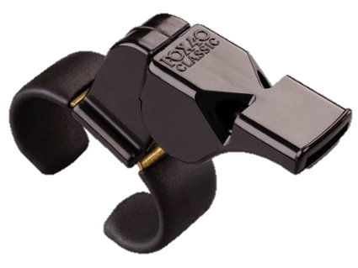
RESTART LOCATION
Class Discussion Questions
WHEN DID THE FOUL OCCUR?
Live Ball
Leave It
Dead Ball
Dead Center
8
Notes:
RESTART LOCATION
The ball is restarted in team’s offensive end where the ball was when the whistle was blown, if free clear – closest adjacent point to where foul occurred.
Live Ball – Leave It
Dead Ball – Dead Center
One step over midline
Class Discussion
Team B fouls Team A during a dead ball, where is the restart?
Center X one step over the midline.

Slide 9
PENALTY TIME AND RESTARTS
BASIC POINTS TO REMEMBER
Players who start together, stay together, for the shortest of the two penalty times.
Both players penalty time is Non-releasable for the shorter penalties to be served.
Team with the shorter penalty time will restart with the ball.
When penalty times are equal then the team entitled to the ball will start in the same relative position on the field.
If neither team had possession, then the alternate possession rule with determine the team to restart with the ball.
When penalty time is equal, remember that “Play on” or “Flag down” denotes possession in the subsequent award of the ball after simultaneous fouls are enforced.
9
Notes:
PENALTY TIME AND RESTARTS
Remember these basic points and you will generally be OK

Slide 10
LOOSE BALL SIMULTANEOUS FOULS
THESE TAKE PRACTICE
B1 on defense commits a loose ball technical foul (Push) followed by a technical foul by A1.
The foul by A1 on offense ends the play and since the ball was loose A1 restarts with possession.
The technical fouls cancel.
B1 on defense commits a loose ball technical foul followed by A1 committing a personal foul while on offense.
Both teams have a player serving penalties.
B1 serves 30 seconds and A1 serves a minute.
B1 is entitled to the restart since they have less penalty time, and the ball will restart in the same relative possession on the field (LEAVE IT concept).
B1 illegal body checks A1 (flag down) who does not lose possession of the ball however A1 turns around and emphatically throws the ball attempting to hit B1 with the throw (second flag and immediate whistle).
Both players serve one-minute non-releasable penalties.
Ball awarded according to alternate possession since it was loose at the time of the flag.
10
Notes:
LOOSE BALL SIMULTANEOUS FOULS
Sometimes serve and sometimes do not
Work through these

Slide 11
NON-RELEASABLE
COMMON TIME SERVES
If simultaneous personal foul times are equal…
If fouls times are different…
1-munte + 1-minute
Full-time served for all
The lesser common time is non-releasable for both
1-minute + 30-second
30-second NR
If simultaneous technical foul times are equal…
30-second + 30-second
No time serves
All even
11
Notes:
NON-RELEASABLE
If the foul times match, they will serve the whole penalty time,
If the foul times on both teams are different, the smallest common foul time will be non-releasable, the remainder of the longer penalty time will be releasable
New Live Ball Example (where penalty time is the same)
A1 has the ball and gets pushed by B1 but maintains possession (flag down, slow whistle)
A2 interferes with goalie B2 (whistle ending play)
B1 Penalty Time: :30 (push with possession)
A1 Penalty Time: :30 (interference)
Non-Releasable Time: :30 (for both)
Previous Dead Ball Example (where penalty times are not equal)
A1 has the ball and gets pushed by B1 but maintains possession (flag down, slow whistle)
A1 gets up, passes the ball and then slashes B1 (whistle ending play)
As both players are heading to the box, B1 throws the f-bomb at A1 and shoves him to the ground
B1 Penalty Time: 1:30 (push with possession & USC)
A1 Penalty Time: 1:00 (slash)
Non-Releasable Time: 1:00 (for both)

Slide 12
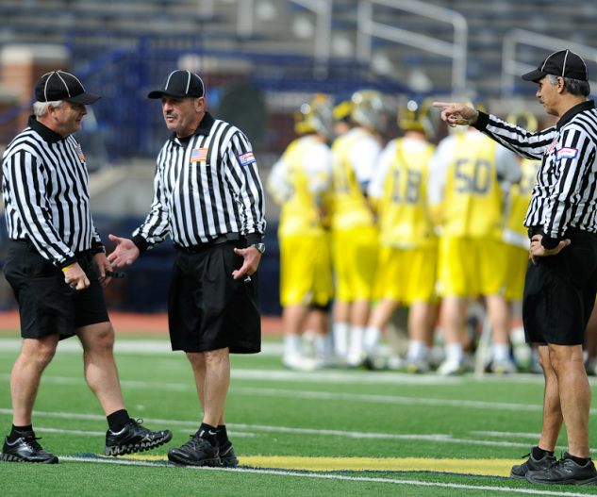
COMMUNICATION
TALK TO YOUR PARTNERS
Watch the players!
Take your time
Think it through
Discuss after the game
Learn from it
Share the story at your next pregame!
Class Discussion Questions
Notes:
COMMUNICATION
Make sure table personnel are fully aware of all penalty and when they release.
Clock is not running and situation is complicated.
Take an extra moment to get it right.
Make sure the play is completed, including any dead ball action
If multiple flags talk to your partner
Same foul?
Different fouls?
Who gets the ball?
Where is the restart?
Class Discussion:
If we are going to get together as a crew to discuss a series of penalties to get the sequence and enforcement correct where should we stand?
Away from the players and coaches.
If 2-person, both officials should stand side by side with full view of the benches so they can keep their eyes on dead ball action.
If 3-person the official not involved in the flags watches the teams while the other two officials determine what must be done.

Slide 13
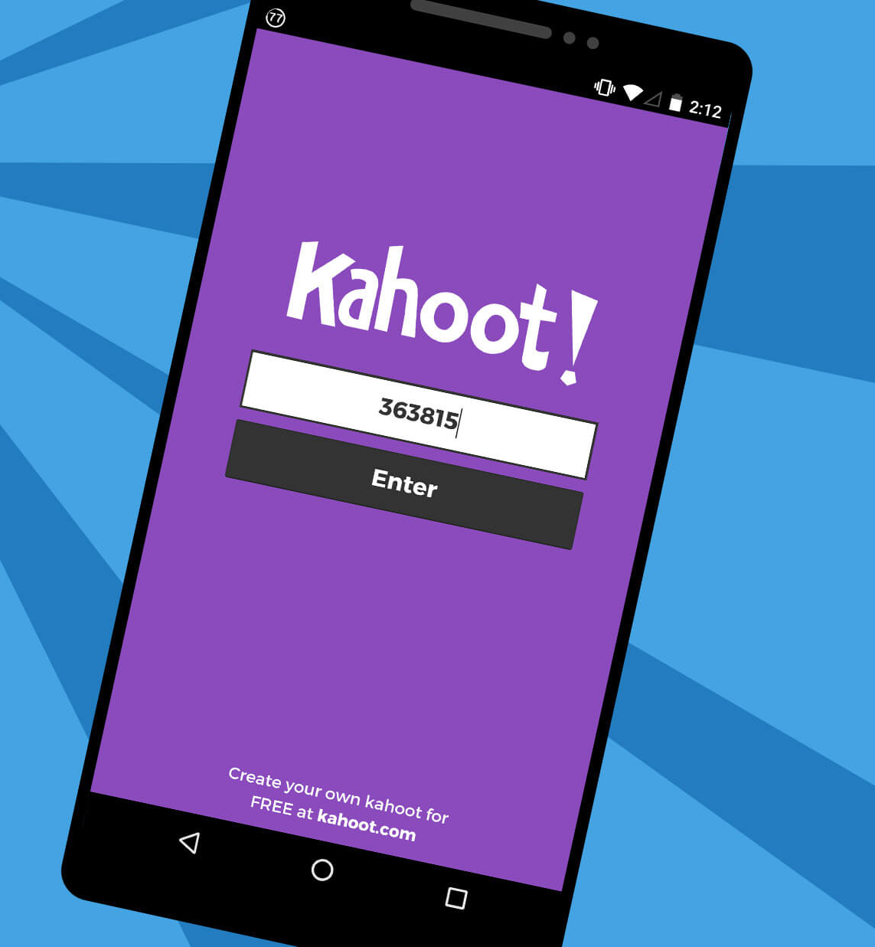
KAHOOT
GAME-STYLE LEARNING
Kahoot! is a digital learning platform that uses quiz-style games to help students learn by making the information engaging in a fun way.
As one of the biggest names in quiz-based learning, it's impressive that Kahoot! still offers a free-to-use platform, which makes it highly accessible for teachers and students alike. It's also a helpful tool for a hybrid class that uses both digital and classroom-based learning.
The cloud-based service will work on most devices via a web browser. That means this is accessible for students in class or at home using laptops, tablets and smartphones.
Notes:
KAHOOT (You need to be connected to the internet to Play Kahoot!)
Practice this before the class starts
Open the link and have it sitting in a browser window waiting
No app or login is required

Slide 14
KAHOOT INSTRUCTIONS
PLAYERS
On your smartphone, tablet or laptop, go to www.kahoot.it
Wait for the instructor to give you the Game Pin
Enter your first name and last initial ONLY
INSTRUCTORS
A Kahoot account can keep track of results, otherwise, you can play without an account
https://create.kahoot.it/auth/login
Create a free BASIC account (up to 50 users) or paid PRO account (up to 100 users)
Click on the link below
Game will open in an internet browser window
USA Lacrosse Officials Development Program - SIMULTANEOUS FOULS
Notes:
You need to be connected to the internet to Play Kahoot!

Slide 15
THANK YOU TO THE MEMBERS OF THE
2023 MENS OFFICIAL’S EDUCATION DEVELOPMENT TEAM

