Slide 1

Game Management

Slide 2
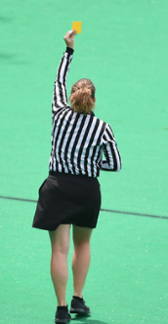
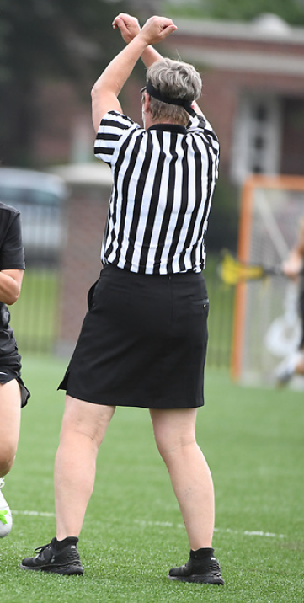
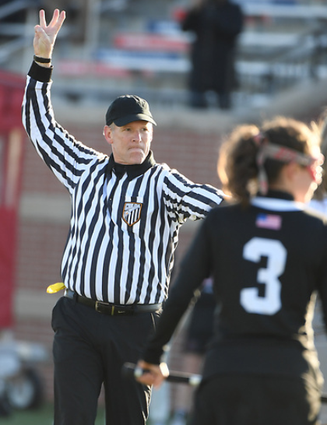
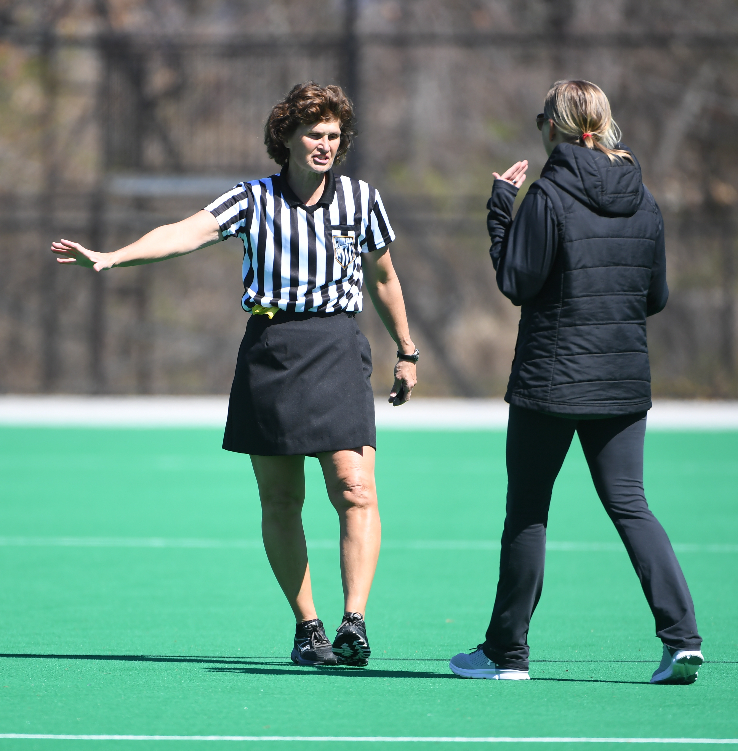
WHAT IS GAME MANAGEMENT?
Notes:
Management is defined as the process of dealing with or controlling things or people
Effective game management means we control the situation, keep it safe and fair, and do NOT make ourselves the focus of the game.
Game management is a skill that typically develops over time with experience. As you grow as an official, listening and learning from more experienced officials is a great way to develop your own game management style.

Slide 3
WHAT IS GAME MANAGEMENT?
Managing the clock
Recognizing and handling fouls
Setting the tone of the game
Handling Unsportsmanlike Behavior
Responding appropriately to players, coaches and spectators
Management is a skill that can be learned
Notes:
To effectively manage a game these are some areas to work on as you develop. Your officiaiting skills.
Do you know when the clock should be stopped and take a glance at the clock at those times? If the clock does not stop when it should for example when giving a card or after a goal, and you know the time when it should have stopped. Take the time to go to the table and correct this.
Are you recognizing fouls and calling appropriately? This includes gving clear concise signals.
Be sure you set the tone of the game early, you may whistle more fouls so the athletes know what is acceptable and what is not. It is easier to start calling a game tight and loosening up as the game moves along than trying to tighten up late in a game.
When you see or hear unsportsmanlike behavior, know what your course of action in and take that action. These situations can be challenging and emotional. Know the language of the rules to manage these situations as well as the steps to take as per the rulebook.
Finally, when communicating to players, coaches and game personnel, do so respectfully and without anger or frustration. We are there to administer penalties not reprimand players for their illegal actions.

Slide 4
TIME MANAGEMENT
Know your timer and clock operator
Check in with them when carding, during TOs, before overtime
Give clear TO signals
Be aware of the time on the clock
Start the game on time!
Notes:
Know the timer: What is there name, most people react to their name before they would “Hey timer”, Ask them if they have done this job before? Find out What can they tell you about the clock and horn.
Spend time with them explaining their duties and ask them to tell you what they know about the role. Remember to bring up coach requested time outs.
Be sure one of the crew goes over to the table when a card is given, have them write down the player, time and release time. If a team takes a timeout, just quick check in with them and review who has how many time outs left. If there is overtime, review this with them as well.
Big, clear time out signals will help your timer know what is expected
Off-Ball official should check the visible clock each time the game is stopped and started. Keep a back up clock when you can.
Managing the clock also means starting the game on time!

Slide 5
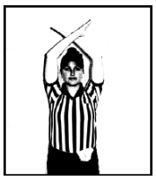
Managing the Clock
TIME MANAGEMENT
Listen closely for coaches or players to call a T/O -- especially in close games.
The table may signal a coach’s request for a timeout with two blasts of the horn.
Time outs are two minutes long
1. Sound the whistle at 1:45
2. Start play at 2:00
3. Penalize teams that are not
ready
When a T/O is called during live play:
1. Position players in a penalty administration for restart,
2. Dismiss players to benches.
Notes:
In addition to timeouts, make sure halftime is the agreed upon length and teams are on the field and ready to start on time.
Remind the timer to time the team time-outs, but it is always a good idea to keep that time yourself.
Keep track of how many time-outs each team has remaining in the game . When you hear a coach calling for a time out be sure their team has the ball and note where the ball is at the time. Also know if a penalty is being administered, or if in live ball who may take the restart

Slide 6
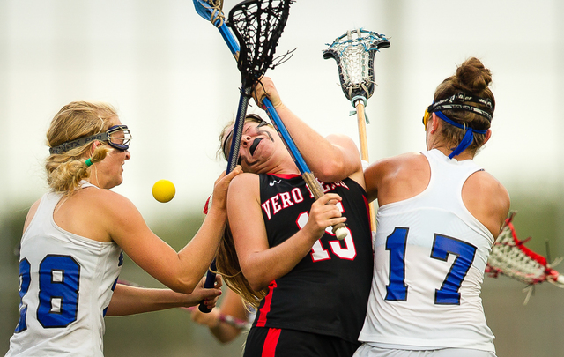
RECOGNIZING AND HANDLING FOULS
Card dangerous play. Keep the game safe!
Notes:
Identifying and reacting quickly to dangerous play not only sets the tone early in a game, but shows all participants that those actions and behaviors will not be tolerated.
Review the cardable fouls and those that are not required cards but can be carded if excessive or repeated.

Slide 7
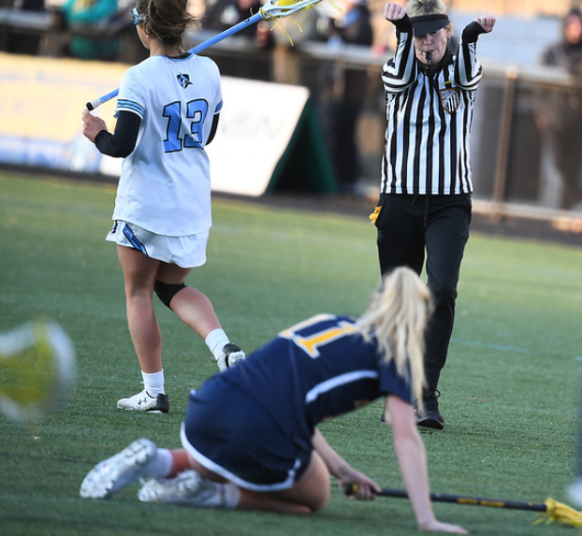
UNSPORTSMANLIKE BEHAVIOR
2022 and 2023 Point of Emphasis
... Good sportsmanship brings integrity to the game by showing respect; building self-confidence, self-discipline, teamwork and focus. Whether a team is winning or losing, the focus should be on supporting the athletes and the game by respecting one another.
The passion for interscholastic competition may create an emotional response and officials must provide effective communication and game management to help deter acts of unsportsmanlike conduct. When such methods are not enough to manage behavior, those in violation should be held accountable with the administration of cards.
Notes:
Directly from 2022 Rulebook
Address unsportsmanlike behavior IMMEDIATELY!

Slide 8
THE TONE OF THE GAME
Be prepared for anything as soon as the game starts
Allow the game to dictate how you call it
Make the calls in the midfield rather than hold for advantage
Address the Coaches' Questions
Notes:
Assess the tone of the game early. Is it a very physical game? Maybe the officiating team needs to discuss tightening up calls. Is it a lopsided contest? The officials should make sure they are calling fouls to keep the less-skilled players safe.
Making calls in the midfield cleans up many games. If you hold for advantage, you are telling players you will allow a certain level of play. Is that what you are intending? Discuss with your partner to make sure you are on the same page.
Addressing the coaches’ questions may mean that you tell them you will answer later, not immediately.
Have the ability to end the conversation in a respectful way, "Coach, we can further discuss this at a time out, halftime or after the game?"

Slide 9
SETTING THE TONE OF THE GAME
Clear and quick foul communications so self-starts are not impacted
Move players off lines on draws, 8m arc
Address failure to move away from self-start early in the game
Penalize when needed: use your GREEN card
Notes:
Here are some steps you can take to set the tone early in your games in regards to starting and restarting play after a foul has been called

Slide 10

COMMUNICATION
VERBAL VS. NON-VERBAL
NON –VERBAL COMMUNICATION
SPEAKS LOUDLY
ACTIVITY:
"Non-Verbal Communication"
Body language SPEAKS volumes!
Notes:
Whether intentional or not, many of our actions speak louder than our words. Be aware of things such as how you stand when you are off ball, during a time-out or quarter break when you discuss play with your partner are you mimicking fouls you have seen , During these breaks we don’t always talk about the game, so regardless of what your conversation is about be aware of body language and how it might be misunderstood from a distance. For example you may be laughing about something not related to your game, but this might be misunderstood for miocking a team or player.

Slide 11
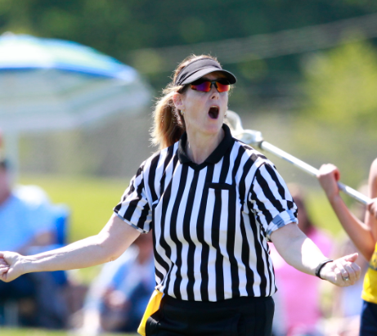
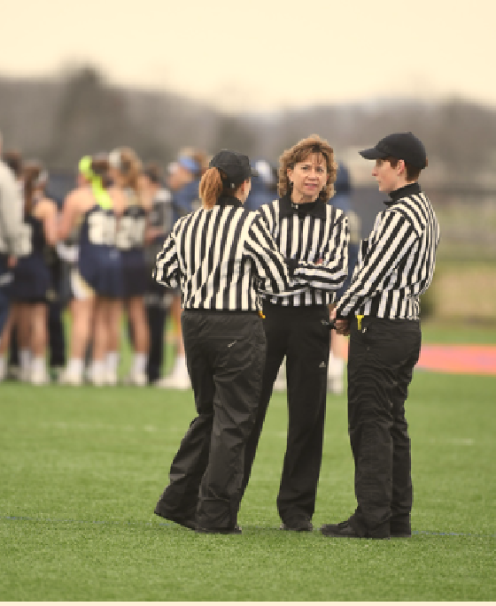
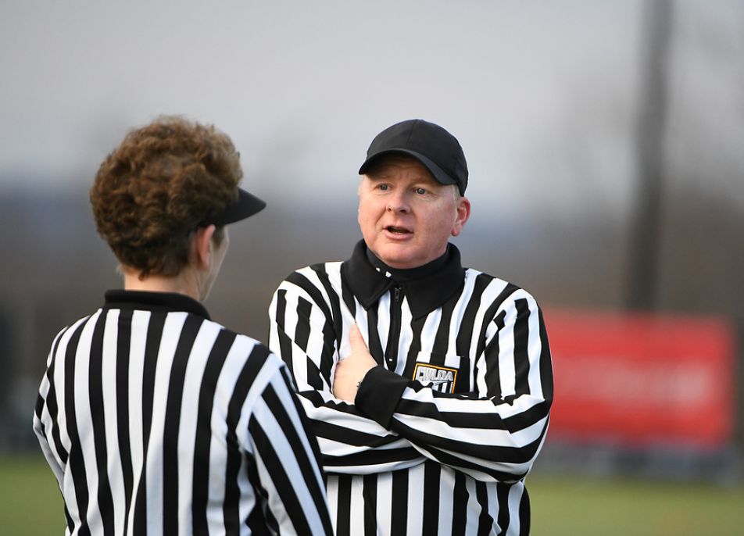
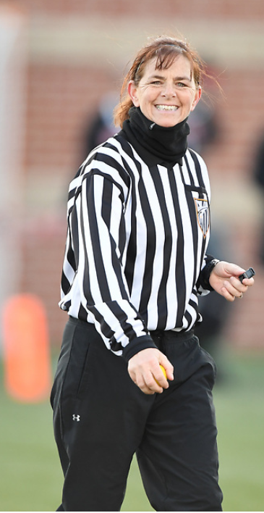
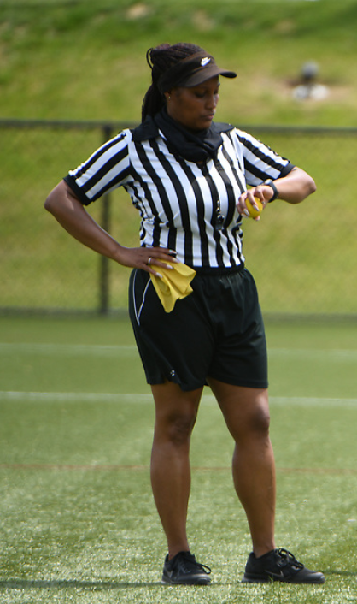
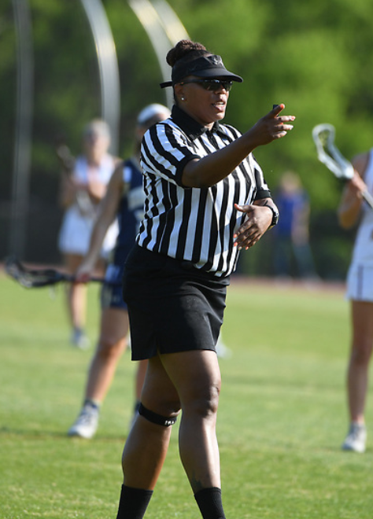
What comes to mind when you see this communication?

Slide 12

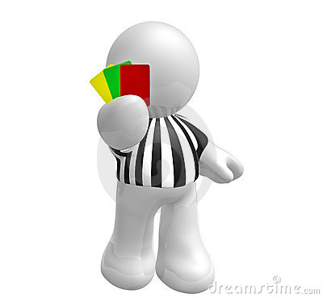

NON-VERBAL COMMUNICATION
ACTVITY:
"How to Blow A Whistle"
WHISTLE TALK
Loud and bold for BIG fouls
Short and sweet for restarts, boundaries
CARDS
Use them!
BIG whistle to stop clock
efficient mechanics
SIGNALS
Show signal/direction every time
“Stadium signals”

Slide 13
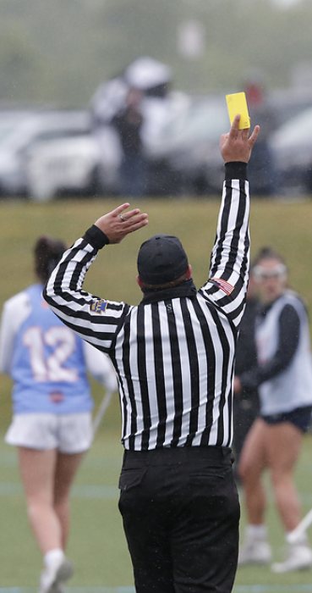
MECHANICS
Our form of communication with Players, Coaches, Partners and Fans
Consistent, Clear and Concise
Directional Signal followed by Foul Signal
Bigger is Better!
Use the signals we have, refrain from creativity
Sell Your Call

Slide 14
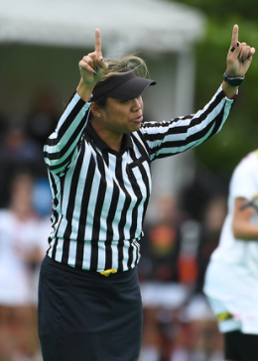
NON-VERBAL COMMUNICATION
COMPORTMENT- WHAT IS THAT, ANYWAY?!?
Affirmative, supportive body language
Calm, pleasant demeanor
Assertive, not aggressive, energy
Confidence & competence
Non-reactive behavior
Positive attitude
Attentive
Notes:
Another form of non-verbal communication is this concept of comportment – what exactly is that?
Discuss definition of comportment, then roll slide

Slide 15
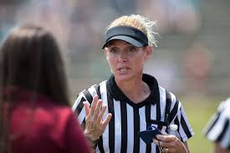
COMMUNICATION WITH COACHES
Listen
Keep interaction professional and concise
Read and know the rules book
Use the language of the rules to answer questions
ACTIVITY:
Coach Interaction
Notes:
Practice and know the “language” of the rules…give an example of things you have heard that do not speak the language of the rules (moving pick, etc)
Look up and read ‘slash’ and ‘empty stick check’.
Make sure what you say is what you are calling. A dangerous shot is a major foul while a dangerous propel is a major foul that also has to be a yellow card.
Checking towards the head is different than check to the head. (major foul vs. cardable major foul)

Slide 16
COMMUNICATION WITH PLAYERS
Dos
Answer questions
Don’ts
Yell at players
Coach players
Diffuse volatile situations
Escalate negative emotions
Respect players
Emphasize safety
Be clear and concise
Threaten with cards
Notes:
On the field, keep your verbal communication to a minimum.
Give foul called, what color & number will get the ball, what color & number needs to move for the penalty and what direction everybody else should be moving away.
Tone of voice - ask your partner what you sound like when giving directions. Does it sound like you are yelling? Barking at the players? Are you too quiet? Are you too “wordy”?
Don’t respond to spectators during a game - resist that urge!

Slide 17
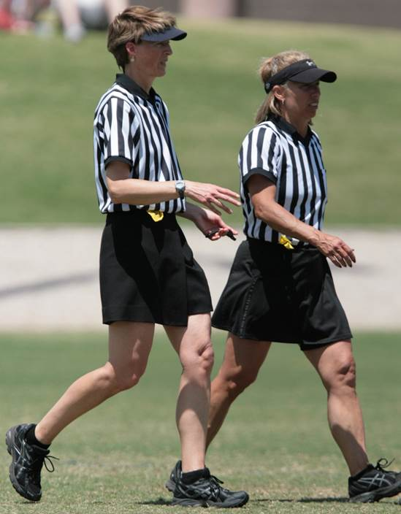
TEAMWORK
Pre-Game Discussion
Areas of Coverage
Free Position Set Ups
Off Ball Responsibilities
Communication/Teamwork
Unusual situations?
Game procedures
A thorough pre-game discussion is essential!
DISCUSSION:
Two-Person
Pre-game
Notes:
There are so many important topics to cover in the pre-game. Whether it is a partner you have never met, or a seasoned official you have worked with for years, a good pregame discussion is essential!
Use the Two-Person Pre-Game Discussion Topics sheet to discuss.

Slide 18
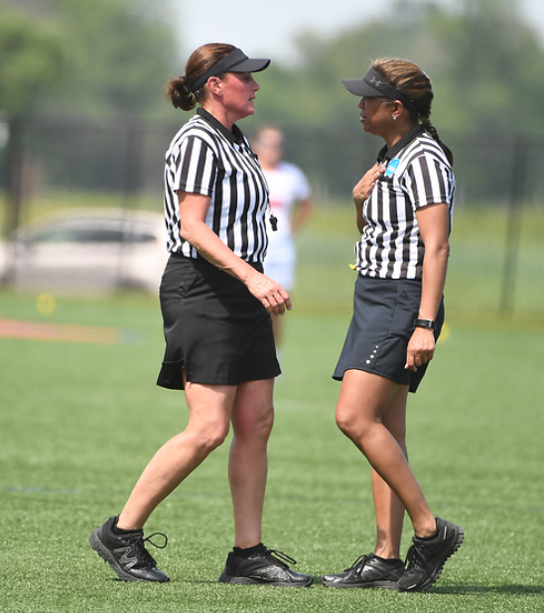
TEAMWORK
During the Game
Support your partner!
Check in with partner often
Make eye contact, use directional signals
Talk through unusual incidents (when the clock is stopped)
Make sure you are “on the same page!”
Don’t challenge them in front of others
Trust them to make calls
Be supportive and positive
Notes:
Note: AFTER the game, or at appropriate time, always ASK first “what did you see?”
Validate/understand partners’ perception before you determine they were wrong…. Maybe YOU missed something!

Slide 19
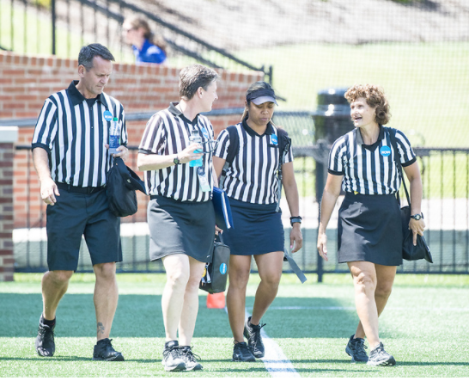
TEAMWORK
Post-Game
Leave the field together!
Post-game discussion:
talk through unusual incidents
what could you (as a team) have done better?
what could you personally have done better?

