Slide 1

Game and Timing Procedures

Slide 2

Time Factors
Playing Time
48 minutes, divided into four 12-minute quarters.
Halftime and Quarter Breaks
Halftime is up to 10 minutes; may be less if agreed upon by the coaches prior to the game.
There is a 2-minute break between Quarter 1 and 2 & Quarter 3 and 4. Players must change ends to begin each quarter.
Clock Stops
When official signals timeout
After each goal signal
On every whistle in the CSA: during the last two minutes of The 2nd and 4th Quarter (unless there is a 10-goal differential)
During overtime
Notes:
In 2024, the duration of a game will change to 48 minutes divided into four 12 minute quarters.
This allows coaches to provide instruction more frequently
Halftime is decided at the captain & coaches meeting and can be up to 10 minutes, but can also be less if agreed upon
The clock will stop on official's timeout signal and after each goal signal.
It will also stop on every whistle inside the Critical Scoring Area (CSA) during the last two minutes of each half. So only in Quarter 2 and Quarter 4 (unless there is a 10-goal differential).
and also stop on every whistle inside the CSA during all of overtime
Be sure to share timing notes, half time, etc. with the game timer so they are aware of the parameters of the game.
Sub-varsity games may have different playing times.

Slide 3
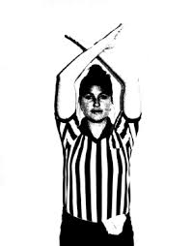
Team Time Outs
2 per team; they do not carry into overtime.
(1 per team during overtime.)
Head coach or any player on the field may request a time out to the on-field official or to the table.
Allowed after a goal is scored or when requesting team has clear possession of the ball.
Interference
Notes:
Teams can call time-outs
Each team is allowed two timeout per game, these do not carry over into overtime. If a game goes into overtime each team is allowed one timeout for entirety of overtime
Coaches or players may notify the officials or the official timer to request a timeout.
If a request for a timeout is made to the official timer, the official timer will assess play on the field to determine if
the team requesting a timeout is in clear possession of the ball and then shall immediately sound the horn twice to
indicate the timeout request, and both the clock and play shall stop on the sound of the horn. The on-field officials will
have the ultimate authority to grant the timeout.
Once they have signaled the timeout and released the
players from the field, the clock will start to begin the two-minute timeout.

Slide 4
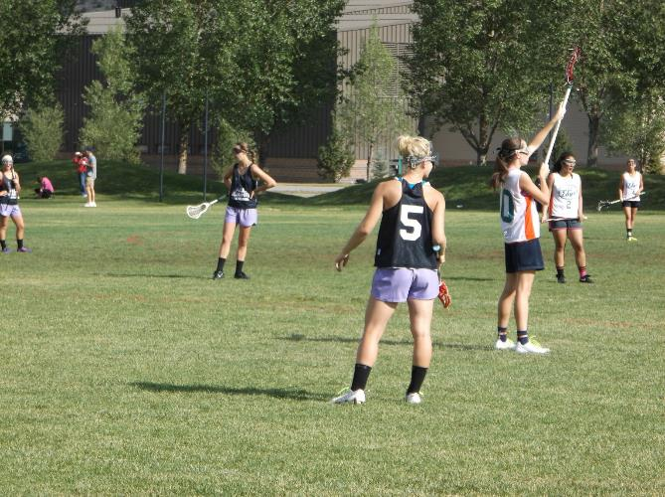
Restarting Play after a Team Time Out
Restart with a whistle
If a foul has occurred, administer the penalty.
  The player that was fouled and the offender will return for the free position restart, substitutions for other players may occur.
If no foul was involved, any player may take the restart
  If the ball was in the CSA, play will start at the dot.
  If goalie was in possession inside the circle, play will restart with ball inside the circle
If the the time out was called when a team/GK had possession of the ball in the Goal Circle, play will be resumed in the Goal Circle and the count will resume from the point of interruption
Notes:
If a foul has occurred, play resumes with a free position at the spot of the foul.
If there is no foul (broken stick, animal on the field, lost ball), the player who was in possession or nearest to the ball
when play was stopped will have the ball. If two players are equidistant from the ball, the Alternate Possession (AP)
procedure will be used to determine which team will have possession of the ball for the restart of play.
If a possession timeout is called, play will restart at the spot of the ball or, if the ball is in the critical scoring area, play
will restart on the closest dot.
If a possession timeout is called and the goalie is in possession of the ball inside the circle, play will restart with the ball
inside the circle. The goal circle 10-count will resume at the point of interruption.
What if the team has no substitute for the injured player and you are setting up a FP? (take the closest player on the same team)
What if they have no other ‘dressed GK’ and the player injured is GK? (GK may stay. Give her time to make sure she is ok)

Slide 5
Official’s Time Outs During Play
Officials must stop the clock for:
Foul in the CSA during the last 2 minutes of each half
Redraw
Offside
Alternate possession
Inadvertent whistle
Illegal Substitute
UNLESS THERE IS A 10 GOAL DIFFERENTIAL
REGARDLESS OF THE SCORE…A Time-Out must be called for:
Illness, Accident or Injury
Issuance of a card
Team Timeout
Interference
Notes:
Officials will call time out during play. As the official you will stop the clock on fouls in the CSA at both ends of the field in the last two minutes of each half, in other words the last two minutes of the second and fourth quarters
Call TO for any redraw
If an offside foul is called
Any time you have an alternate possession or inadvertant whistle, or if there is an illegal sub.
If there is a 10 goal differential you will not call time out for any of these things however
REgardless of the score a time out must be taken for injury, issuing a card and a team timeout.

Slide 6

Stopping the Clock for Unusual Situations
Unsafe Weather Situation
Issues with the Clock
Animal, Spectator, or other non-player comes onto the field
Any other situation that is unsafe or could cause delay to the game
Notes:
Here are a few examples of other times during a game that the official will call timeout:
If there is unsafe weather, that may be thunder and lightening, or heavy snow, extreme rain. If you feel the playing field is becoming unsafe.
If the clock is having issues, such as not stopping when you are calling time out, the clock looks to be malfunctioning or something else you want addressed.
When an animal, spectator, or anyone that is a non-player comes onto the field.
finally there can be other times that may seem unsafe or something could cause a delay in the game. Sometimes a ball will go very far out of bounds and there is not another to pick up the players may have to run very far, or the ball is not retriveable, you should call time out.

Slide 7
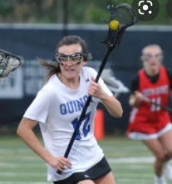
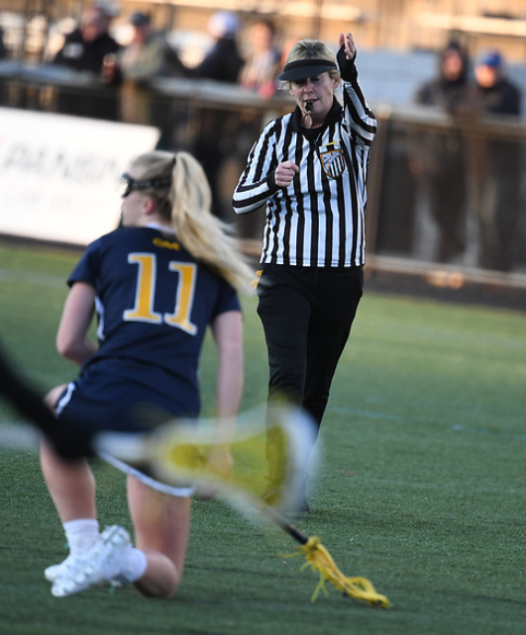
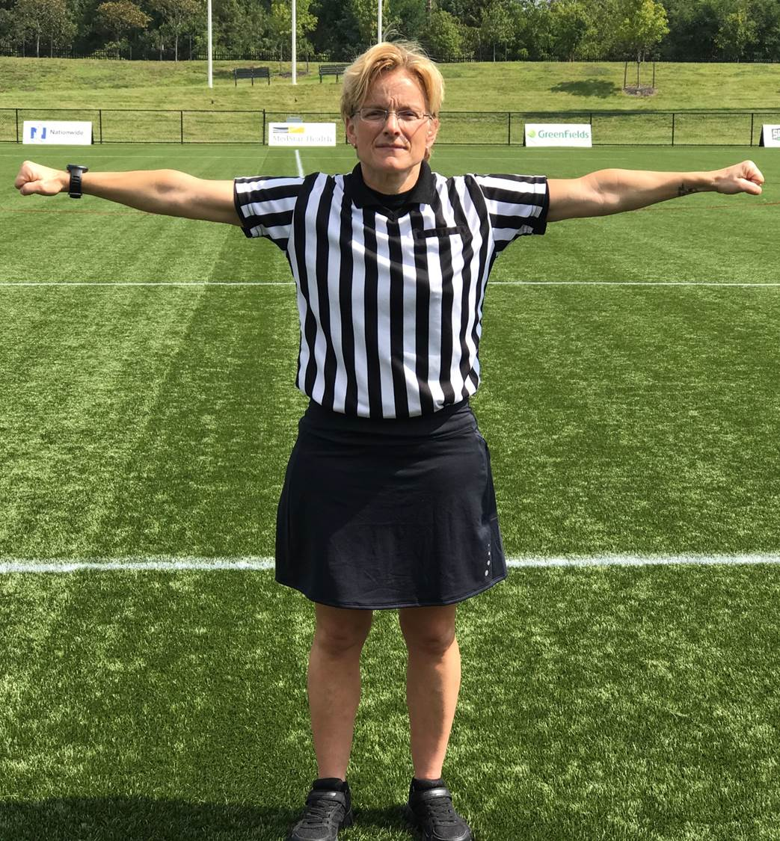
Restarting Play in Unusual Situations
Restart with a whistle
If a foul has occurred, administer the penalty.
Restart with a whistle
If no foul was involved:
Give the ball to the player in possession of the ball or closest to the ball at the time of the stoppage
If 2 players are equidistance from the ball ALTERNATE POSSESSION is awarded
Notes:
If a foul has occurred, play resumes with a free position at the spot of the foul.
If there is no foul (broken stick, animal on the field, lost ball), the player who was in possession or nearest to the ball
when play was stopped will have the ball. If two players are equidistant from the ball, the Alternate Possession (AP)
procedure will be used to determine which team will have possession of the ball for the restart of play.
If a possession timeout is called, play will restart at the spot of the ball or, if the ball is in the critical scoring area, play
will restart on the closest dot.
If a possession timeout is called and the goalie is in possession of the ball inside the circle, play will restart with the ball
inside the circle. The goal circle 10-count will resume at the point of interruption.
What if the team has no substitute for the injured player and you are setting up a FP? (take the closest player on the same team)
What if they have no other ‘dressed GK’ and the player injured is GK? (GK may stay. Give her time to make sure she is ok)

Slide 8
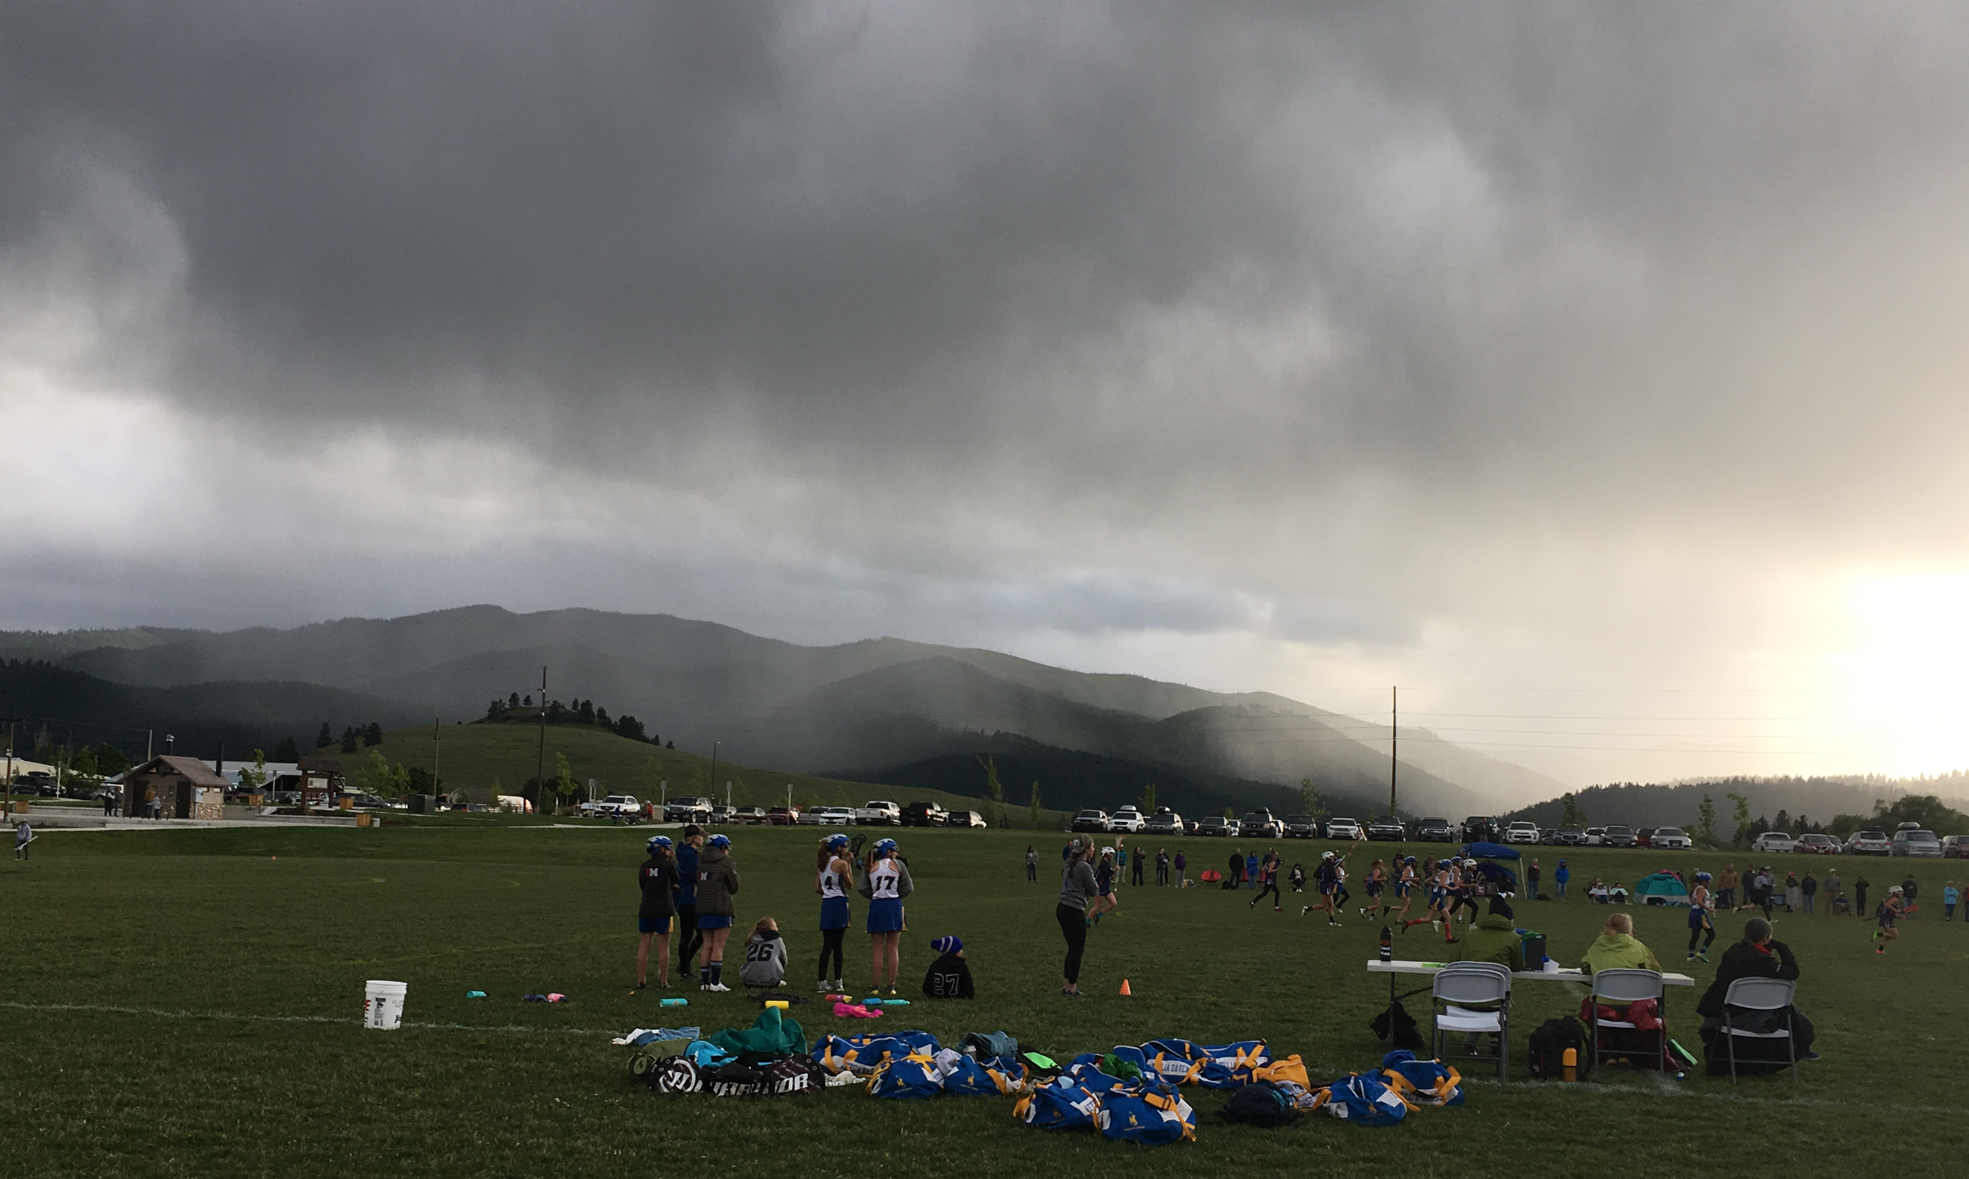
Suspended or Interrupted Game
A game is considered legal and complete when 75% of playing time has elapsed.
Whether a game is interrupted and continues the same day
OR
a game is suspended and continues another day,
the game restarts at the point of interruption.
Notes:
Once play begins, the officials shall have the authority to interrupt or suspend the game due to dangerous weather or
field conditions. The official’s decision is final.
The officials may consult
with the coaches, athletic trainer, or other school officials to determine their lightning policy. State association
guidelines governing waiting time will take precedence.
A game is considered legal and complete if 75 percent of the playing time has elapsed. If the total playing time is
48 minutes (12-minute quarters,) the game is considered legal after the third quarter.
A suspended game to be restarted on the same day or another day will start at “the point of interruption.” To restart
play from “the point of interruption,” the officials will need the following information:
• score,
• time on clock
• team [player] in possession of the ball
• location of the ball on the field
• players in close proximity to the ball
• card information (player #s with a card, time remaining on any penalties being served.)
If the player/ball field location information is not available to the officials for the restart of a suspended game on another
day, play would be started with a center draw (if there was no possession at the time of the suspension) or with possession
at the center circle by the team in possession at the time of the suspension.

Slide 9
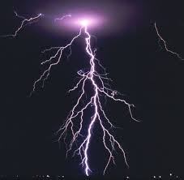
Suspension for Thunder and Lightening
Each time thunder is heard or lightning is seen, the
30-minute clock is reset.
After the last thunder is heard or strike of lightning is seen teams may return to the field
When thunder is heard
or lightning is seen, suspend play and take shelter immediately!
Notes:
Read through slide
(first and last box come up automatically with animation)
This is a RULE, not a guideline. Officials MAY NOT reduce the 30-minute wait time. (click)
Check your individual state rules for further clarification.

Slide 10
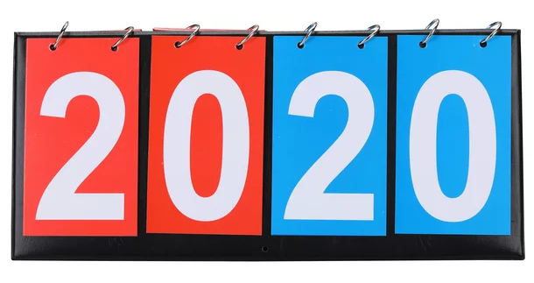
Overtime Procedures
  After end of regulation play
      5-minute rest
      Coin toss (visiting captain calls) for choice of ends
      AP continues from regulation
      Winner decided by “Sudden Victory”
  Two 3-minute Overtime Periods
  Clock stops for all fouls in the CSA.
  If no score, clock stopped at 3 minutes for teams to change ends.
  No delay for coaching.
  The second 3-minute period restarts with draw.
  If no goal is scored, teams get a 3-minute rest.
  **This procedure repeats until a winning goal is scored.**
  (Individual state guidelines take precedence and may vary.)
Notes:
Click through slide to review Overtime Period procedures (8 clicks total)
When the score is tied at the end of regular playing time, a sudden victory overtime will be played.
1. Both teams will have a five-minute rest period.
2. A coin toss (visiting captain calls) will determine choice of ends.
3. The winner will be decided by “sudden victory”. The team scoring the first goal wins.
Overtime is a 6 minutes (A three-minute period will be played, if neither team scores a goal, another three-minute period will be played. (click)
Clock will stop on all whistles in the CSA (click)
At the end of the first 3 minute period, teams shall change ends, (click) with no coaching. (click)
A draw will start each 3 minute period (click)
4. If no winner is determined after the completion of the six minutes of playing time, the teams will have a three-minute
rest period (substitutions are allowed at this time) and change ends. (click)
Game will be restarted with a center draw for the next six-minute overtime (two 3-minute periods with a change of ends after three minutes.) (click)
This will continue until
there is a winner.
5. Each team will have one timeout for the entire duration of the overtime.
6. The Alternate Possession (AP) procedure will be continuous from the game (not reestablished at the coin toss).
7. Individual state association guidelines may alter overtime procedures.

Slide 11
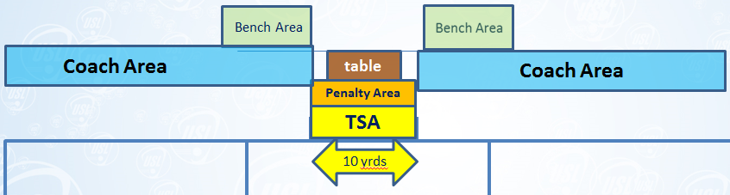
Substitutions
Players may sub freely throughout the game during play or after a goal
ALL Subbing must take place in the Team Substitution Area (TSA)
Players subbing in during play must wait until their teammate is completely in the TSA
Substitutions during a Free Position: Offended player and offender may not substitute.
Notes:
Use Rule 4, section 7 in the USL rulebook for review.
1. If substituting during play, the player going into the game may not enter the team’s substitution area until the arrival of the player
she is replacing is imminent. Note: a player in the act of running to the substitution area is considered imminent.
2. If substituting after a goal has been scored (no time out,) the substitution must be through the substitution area.
3. A substitution may not take place after the official’s hand is in contact with both centers’ sticks at the draw.
4. During a team possession timeout, substitutions are allowed, with exception to the player being awarded the ball and
the offender if the possession time out was called following the whistle for a foul.
5. During an injury timeout, the player substituting for the injured player taking a free position must assume the spot
vacated by the injured player who is leaving the field. Other players may substitute.
6. In the event of an injured goalkeeper, if the backup goalkeeper is in the game as a field player, the new goalkeeper
will be permitted the time to put on the goalkeeper equipment and replace the injured goalkeeper. A player from the
bench may replace the field player.
7. Substitutions are permitted during redraws.
Coaches must remain within their own coaching area except when entering the substitution area to exchange a crosse with a player on the field

Slide 12
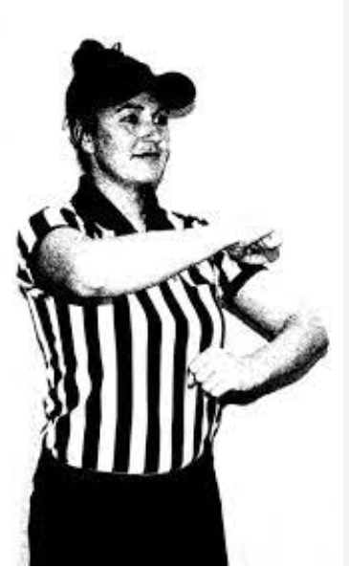
Illegal Substitution
An extra player on the field
A player not listed or incorrectly listed on the roster or in the scorebook at the start of the game
A player who enters without going through the substitution area
A player who enters prior to the teammate leaving the field
Procedure for Minor Foul: Illegal Substitution
The official calls a timeout
Removes the illegal substitute
Awards a free position for the opposing team
Exception
When a Suspended or Ejected player returns to the game, a misconduct card (yellow) shall be given to the coach.
Notes:
Use Rule 4, section 7 in the USL rulebook for review.
Read through the 5 blue boxes
Penalty for Illegal Substitute is a free position for the opposing team at the spot where play was to resume before the foul occurred. If the spot cannot be determined, play will resume at the spot where the ball was when the foul was discovered.
Read yellow and red boxes
Penalty for these Illegal Substitution is coach misconduct

Slide 13
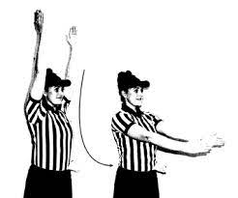
Scoring
A goal is scored when:
The whole ball passes completely over the goal line, between the goal posts
The ball has been shot with the legal crosse of an attack player
The ball goes off the crosse or body of a defender
The ball is released from the crosse before time expires
Notes:
A goal is scored when the ball passes wholly over the goal line into the goal, propelled by an attacking player’s stick or by the
stick or person of the defending team (including the defensive goalkeeper).
A goal scored with a non-NOCSAE “approved” ball will stand. The ball will be replaced with an approved ball prior to the
ensuing draw.
As a Lead Official, after a shot from close to the goal circle, watch the player’s follow through and body movement, and
if the ball goes into the goal cage. If the ball does enter the goal legally, hold the whistle a little longer to watch for any
goal circle violations.
Make eye contact with your partner(s) to be sure no other fouls have occurred that may cause
the goal to be disallowed.

Slide 14
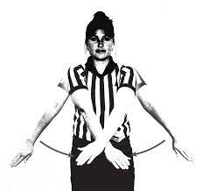
Scoring
A goal is NOT scored when:
The ball is put through the goal by a non-player (official)
The ball comes off the body of an attacker
A foul by the attack occurs on the shot (dangerous follow through, dangerous propel, goal circle violation, offsides, attacking team has an illegal player on the field)
The goal is scored with an illegal crosse
The attack player steps on or over the goal circle
The ball enters the goal from the attacking team’s goalkeeper
Notes:
Read above slide
If the ball goes off the official into the goal, is it a goal? (no)
If the goalie clears the ball from one end of the field and it goes into the other goal, does it count? (no)
What if a team scores and then the official realizes they are offside? (no goal. Ball awarded to the opposing GK in her circle.)

Slide 15
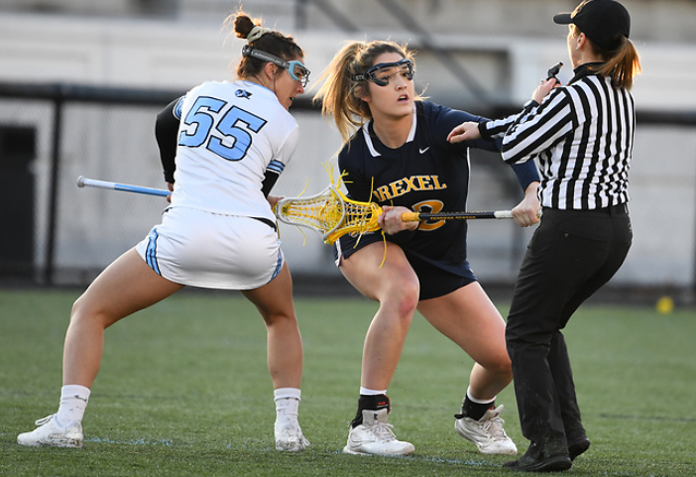
Starting and Restarting Play
The Draw is used to start the game, each quarter and overtime.
The Draw is used to restart play after goals

Slide 16
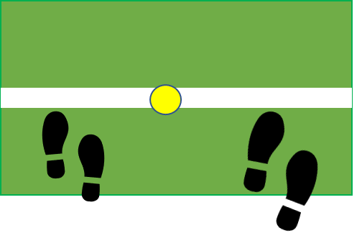
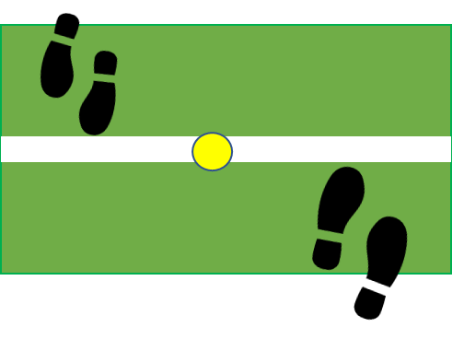
Starting Play: The Draw
Players taking the draw shall be in the center circle and toe the line
All other players must be below the restraining lines
O X
O X
O X
O X
O X
O X
GK
GK
Goalies are not allowed between the restraining lines on a draw
O X
O X
O X
O X
Two other teammates from each team may be between the restraining lines, but outside the center circle
O X
Notes:
Let’s discuss the rules pertaining to the draw. (click)
“Toe the line” – One foot touching the edge of the line. (click) Both feet must be on the same side of the center line behind the player’s crosse. (click)
A maximum of three players from each team may be between the restraining lines during the draw until the restraining line is released (click)
All other players must be below either restraining line. “Below Restraining Lines” – on the side of the lines closer to the goals. (click)
Goalies cannot be between the restraining lines, but do not have to be in the goal circle to start.

Slide 17
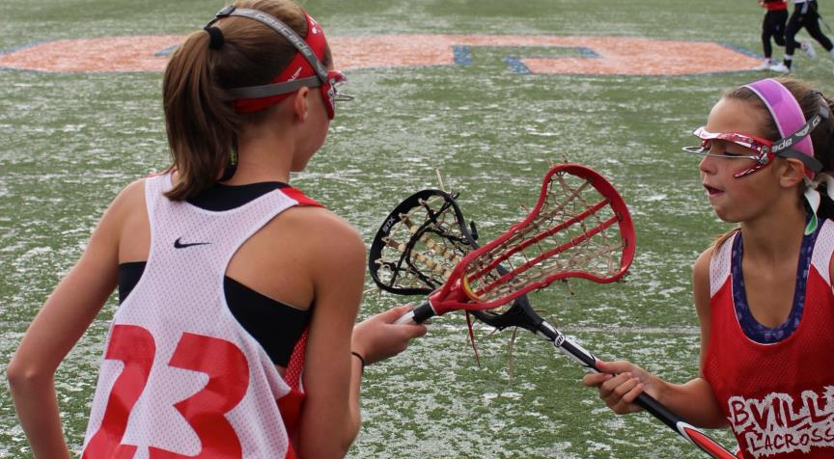
For Both Players on the Draw
Pocket open to player’s goalie
Right side of crosse is down
Notes:
Crosses are held in the air, above each player’s hip level and back to back, so that the players’ crosses are between the ball and the goal they are defending.
The stick (handle and head combined) is held in the air, above hip level. The sticks are aligned
“lower side to lower side” with the entire length of both sticks within the vertical plane over the center line, parallel
to the center line and open to the goal they are defending. The lower side is the wood of a wooden stick and the right
side of the molded head stick pocket when looking at the front of the stick.
2. The players’ sticks are between the ball and the goal they are defending.
3. A player’s top hand may not contact any part of the sidewall or pocket. The throat is not considered part of the
sidewall.
4. The official rests the sides of the sticks lightly on the palm of her hand. Prior to placing the ball between the sticks, the
official must verify that a NOCSAE ball is in use.
The draw skill will be difficult to just see and read about. This is one skill that will be done with your field training

Slide 18
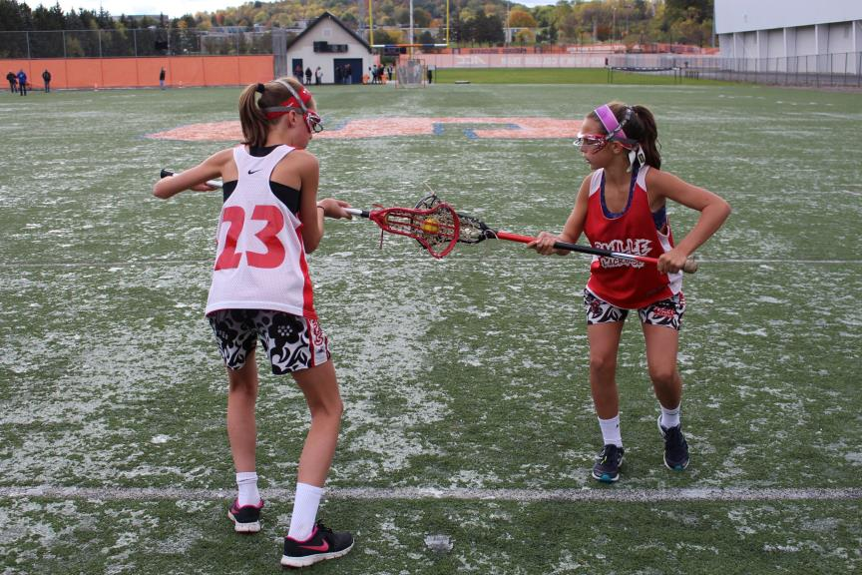
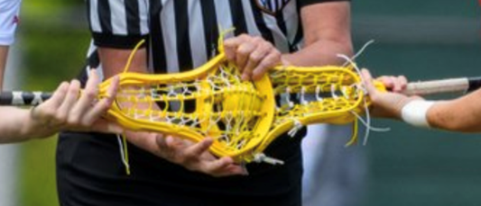
Draw: Both Players Right Hands
Note: Head position of both crosses
Ball is placed in the upper third of each head
Crosses MUST be horizontal and parallel to the line
Notes:
The crosses are held in the air, above each player's hip level with the lower side above the center line and back to back, so that the players crosses are between the ball and the goal the player is defending
Once positioned, the ball is placed between the backsides of the sticks
in the upper third of the head, at the widest part of the head.
When setting up the draw, the official should be aware of possible height differentials between the centers and place
sticks in such a way that neither player gains an advantage.

Slide 19
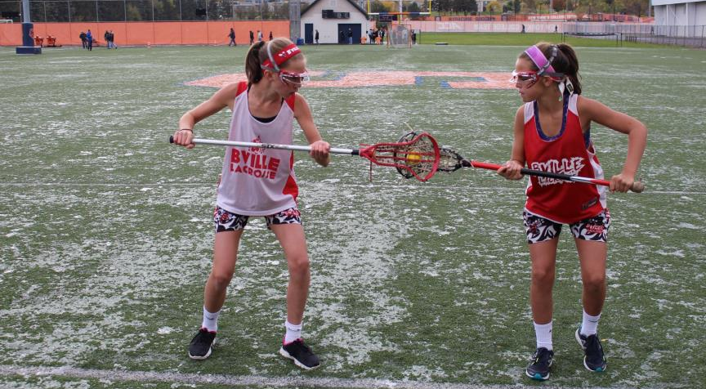
Draw: One Left Hand, One Right Hand
So Red goal keeper would be here
Red pocket facing her goalie
Note: Body moved, but stick/crosse position has not changed
Notes:
Read slide
The lower side of the crosse is defined as the right side of the crosse as the player looks at it with the open pocket facing the player's goal keeper (Click) (Click)

Slide 20
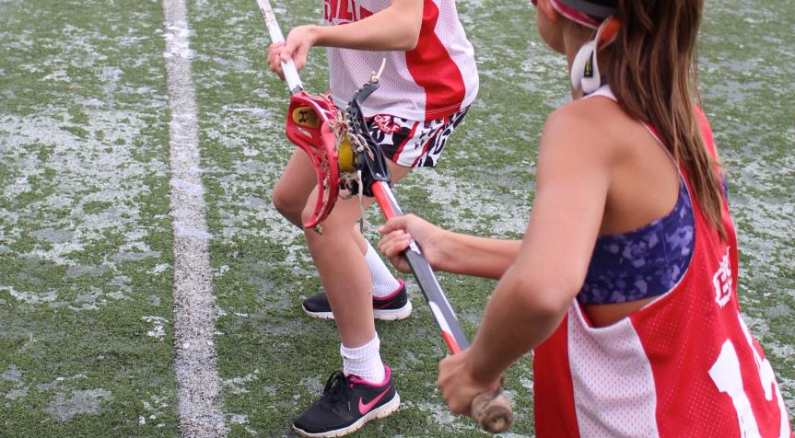
Is this Draw properly Set Up?
Notes:
Does anyone see any issues with this set up?
Problems: Not Toeing line and crosses not over line, ball not in upper third.

Slide 21
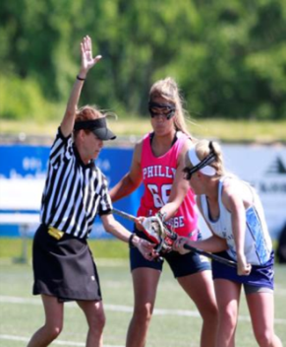
Draw Rules
Players taking the draw must remain motionless, except for head movement, until the whistle after the official says “ready”
No players may step on or over the center circle until the whistle
The first motion of the draw must be UP
No players may step on or over the restraining line before the official signals "possession"
Crosses are held in the air, parallel to and above the center line
Players may reach over the restraining line to play the ball, as long as the player's foot is NOT on or over the line
Notes:
Once the ball has been placed between the sticks, the official makes sure that the players are all set before removing
her hand. The word “ready” followed by the whistle indicates the start of play. The official says “ready” as she begins to
step away from the players, then blows the whistle and lowers her arm while moving backwards.
On “ready” the two centers must remain motionless, except for head movement, until the whistle.
While officials may vary the time interval between the word “ready” and the whistle to avoid anticipation of the signal
to start play, they must also realize that asking the two players to remain motionless for an extended period of time is
unfair.
On the whistle, the players draw up. The official does not have to be outside the circle before blowing the whistle.
Players may not enter the field after the official’s hand is on the sticks for the draw until a player has gained possession of
the ball, the ball goes out of bounds or crosses the restraining line, or a whistle stops play for a foul.
The official administering the draw is the one who calls any illegal draws involving the two centers.
What is an illegal draw? (drawing too soon, not drawing, touching side wall on draw, ball not over their heads, motion of the crosse is not up, player moves after officials says “ready”.)
(For Field Training or in Person Classroom) Demonstrate how to set up a draw.
Activity: Have each participant practice a draw.
Demonstrate the mechanic for a re-draw. Have each participant demonstrate the re-draw mechanic.
Demonstrate the possession signal.

Slide 22

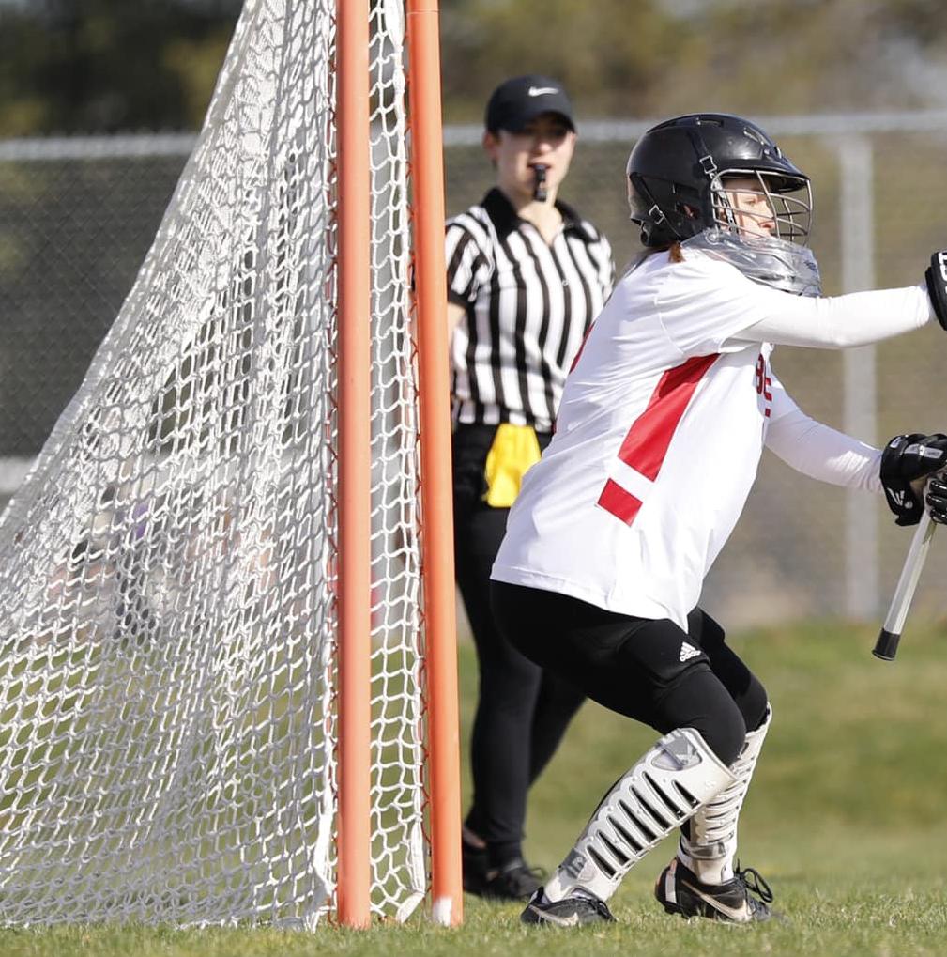
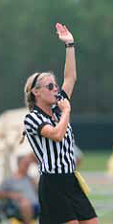
Restarting Play
The whistle is used to stop and start play except for self-starts.​
When starting play, the official will give a visual arm signal by raising the arm above the head.
Notes:
Prepare for starting/restarting play by raising your arm - - starting play occurs when you drop your arm downward and whistle simultaneously.
If you are outside or in a large room, try some “whistle training.” Some of your attendees may have never blown a whistle! Make the sound ‘crisp’ and short.

Slide 23
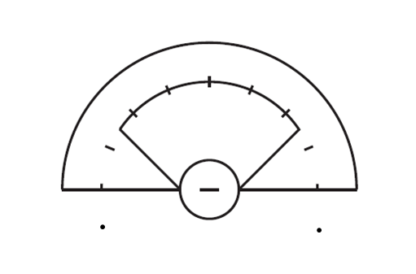
Restarting Play: Free Position (a foul has occurred)
No FP may be taken closer than 8m to the goal circle
(except an attack foul in the CSA!)
The violation of any rule is a foul.​
The penalty for a foul is a Free Position.​
Player committing the foul moves:
4m behind (Major Foul)
4m away (Minor Foul)
All other players must be 4m AWAY
8m
Free positions below the goal line extended in the CSA shall be taken at the closest dot.
Notes:
The penalty for a foul is a free position. The official indicates where the player taking the free position is to restart play.
FPs take place within 4 meters of the spot of the foul, unless specifically directed by rules, or the spot of the foul would disadvantage the non-offending team. When would something like this happen? Push after a pass, for example.
The player committing the foul will be directed either 4m away from the player awarded the free position (in the case of a minor foul), or 4m behind the player awarded the free position (in the case of a major foul).
No players shall be within 4m of the player awarded a free position, except when play commences on a self-start and
the ball carrier chooses to start play prior to all players moving 4m away.(click)
No free position may be taken closer than 4m to the boundary line (different from a simple boundary ball) (click)
FPs for defense fouls in the CSA are 8m from the goal circle (which is, conveniently, exactly how far the hashes (inside and outside) and the dots are from the circle!
(exception: defender being awarded a free position within her defensive critical scoring area, when the clock has not stopped. They can pick up the ball at the spot of the foul and self-start. They do NOT need to move 8m away before they restart play.(click)
Free positions below the goal line extended and in the critical scoring area shall be taken at the closest dot. (click)
FPs awarded to goalie in her circle remain in the circle.

Slide 24
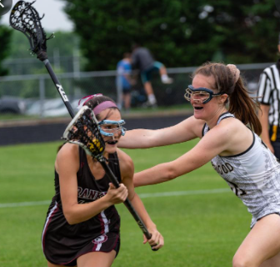
Restarting Play: Self-Start
Following a whistle blown for a foul outside of the critical scoring area, or for an attack foul in the CSA*, the player who is awarded the free position can self-start
*not in the last 2 min of each half
To self-start, a player DOES NOT have to come to a momentary pause before commencing play.
Notes:
Following a whistle blown for a foul outside of the critical scoring area, or for an attack foul in the CSA, the player who is awarded the free position,
may continue the course of play without waiting for an additional whistle
The player fouled must take the free position within 4 meters of the spot of the foul. The offending player shall move 4m from the player taking the
free position as directed by the official. All players must move 4m away from the free position.
How does Self Start work?(click)
X has the ball and O fouls. (click)
Whistle blows and official gives directional and signal. (click)
The player fouled (X) must take the free position within 4 meters of the spot of the foul. The offending player (O) shall move 4m from the player taking the
free position as directed by the official. All players must move 4m away from the free position.
Play will commence once the ball carrier steps or passes. (To self-start, a player DOES NOT have to come to a momentary pause before commencing play).
Once play has commenced, the defenders may engage in play with the ball carrier. A player taking the free position may wait until all players are moved 4m away, and then
play may commence on the officials’ whistle.

Slide 25
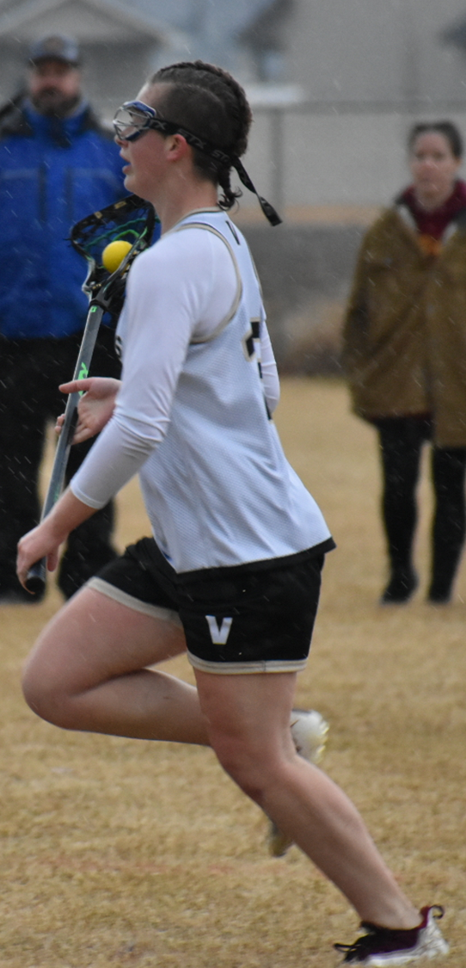
Criteria for Self-Start
Ball is outside of the CSA
An Attack foul in the CSA (not under 2min in Q2 or Q4)
Game clock is running
Ball is within 4 meters of the spot of the foul
Ball more than 4 meters away?
Offensive player initiating self-start may pick up the ball, bring it back to the spot of foul and self-start.
Teammate may also pick up ball and return it to the ball carrier so that the player may self-start from a legal position.
Notes:
We’ve talked about where self starts can happen, and how it happens, but When is a Self-Start allowed?
When the Ball is outside of the CSA
When the Game clock is running
And when the Ball is within 4 meters of the spot of the foul
If a player starts more than 4m away, it is NOT a foul. Whistle to stop play, bring player back to correct spot for restart and allow player to self-start from that location.

Slide 26
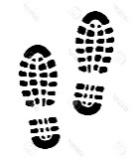
Self-Start when a Foul Occurs
Fouled Player options:
Restart play immediately
Wait for other players to move 4m away
Wait for whistle
Play will commence once the ball carrier steps
or passes
Repeatedly self-starting beyond 4m of the spot of the foul
may result in a warning and/or Delay of Game penalty.
Note: Proactive officiating may prevent need for whistle!
Notes:
The ball carrier may start immediately, may start from a settled stance or may wait until all other players are 4m away. If ball carrier does not commence play, official should state “you may start.” If player still does not go, official may blow whistle.
Once the ball carrier steps or passes, the defenders may engage with the ball carrier.
Repeatedly self-starting beyond 4m of the spot of the foul
may result in a warning and/or Delay of Game penalty.
Note: Proactive officiating may prevent need for whistle!

Slide 27
Self-Start- Offender and Defenders Responsibilities
After foul is called, defenders must initiate movement 4m behind or away, as directed by official.
Defenders may not engage ball carrier until play has commenced.
These motions do NOT commence play:
Pivoting or rocking motions
Cradling the ball
Pumping the crosse
Repeated failure to move away from the free position or move behind the ball carrier may result in a warning and/or Delay of Game penalty.
Notes:
[click to display each segment]
The ball carrier is the one who restarts play first. Defenders, except for the player who fouled and those within 4m of the ball, may not move until the ball carrier either takes a step or passes the ball.
Cradling the ball or rocking back and forth does NOT commence play.
Once the ball carrier steps or passes, the defenders may engage with the ball carrier.

Slide 28

When is Self-Start NOT an Option?
When the game clock is stopped
Defensive foul in the CSA
A goal is scored
Offside*
Alternate Possession*
Inadvertent Whistles*
In the last two minutes of each half and all of overtime, all fouls (attack and defense) in the CSA require a whistle start.*
Notes:
Self-start is not an option when:
a. The game clock is stopped
b. There is a defensive foul in the critical scoring area
c. A goal is scored
d. There is an offside foul, alternative possession or an inadvertent whistle
NOTE: *these are self-starts if there is a 10-goal differential
Proactive officiating is using commands PRIOR to the start/restart of play to prevent a player from making a foul.
For example, you stop the clock to issue a yellow card. Before you give the ball to the opposing team, you state “On my whistle,” loudly and clearly so the players know they have to wait for a whistle to restart.
For fouls in the 8m, state “center hash and it is on my whistle” to the fouled player.
Reminder: Defense can self start after an attack foul in the CSA – unless the game clock is stopped! The game clock stops in the last two minutes of each half and on every whistle in overtime.

Slide 29
Alternate Possession
The first AP of the game is determined at the captain’s meeting
Off-setting fouls occur
A shot or deflected shot goes out of bounds, and two opposing players are equidistant from the ball
Don’t know which team caused the ball to go out of bounds
Ball lodges in the clothing of a field player/official
A “score” off a non-player
Play is stopped, no player had possession and opposing players are equidistant from the ball
AP in the CSA (above or below GLE) is awarded at the nearest DOT!
AP designation is continuous through any overtime period
Notes:
When do you call an Alternate Possession? There are six scenarios where AP is called. [click through the scenarios]
Ball goes into the goal off a non-player
The ball goes out of bounds as the result of a shot or deflected shot and two opposing players are equally near the ball
It cannot be determined which team caused the ball to go out of bounds
The ball lodges in the clothing of a field player or official
Off-setting fouls occur
Play is stopped, no player had possession and opposing players are equidistant from the ball
Who gets the first possession when you rule ‘Alternate Possession”? (decided at captain’s meeting.) Where is the possession restarted? spot of ball or (click)…
After any of the events listed
Who might the “non-player” be? Most likely an official!
Any AP in the CSA (above OR below the GLE) goes to the nearest DOT.
AP is continuous through any overtime period (not reestablished at the coin toss that takes place prior to the first
overtime period).

Slide 30
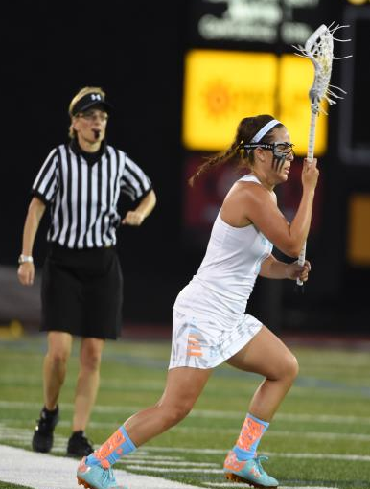
Boundaries
The ball is out of bounds when a player carrying the ball…
A player steps on or over the boundary line
A player’s body or crosse touches the ground on or outside the line
A loose ball touches the ground on or outside the line
Notes:
1. The ball is out of bounds when:
• A player has possession of the ball and steps on or over the boundary line.
• Any part of her body or stick touches the ground on or outside the boundary while she is in possession of the ball.
• A loose ball touches the boundary line or ground outside the line.
WHO WINS/GETS THE BALL? You need to know
2. The player/team that last touched the ball before it went out of bounds will lose possession of it unless it was a shot or
a deflected shot on goal. The opponent will be awarded the ball when the play resumes.
3. A player in possession of the ball may hold her stick outside the boundary as long as her foot/feet are not on or over
the boundary line
Options for field training or classroom: On a field or using the vinyl field, set up a variety of out of bounds situations and demonstrate how to administer the restart. Next, set up an out of bounds situation then ask participants to set-up the restart.

Slide 31
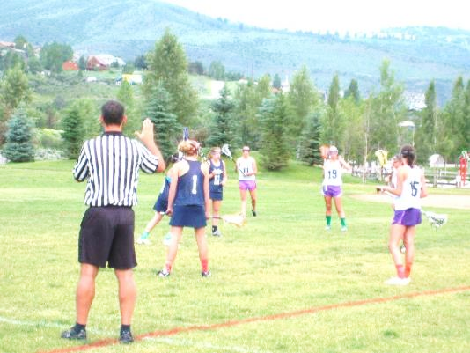
Boundary Situations
If an in-bounds opponent legally checks a ball-carrier’s stick, causing the ball to fall to the ground, out of bounds, possession will be awarded to the opponent.
If foot/feet are out of bounds, you may not take an active part in the game. Penalty = minor foul.
Players may not run out of bounds and re-enter to a more advantageous position. Penalty = minor foul.
If a player deliberately pushes /flicks/bats the ball into an opponent’s feet/body to cause the ball to go out of bounds; penalty = major foul.
If an opponent illegally causes a ball carrier to go out of bounds, ball carrier will maintain possession of the ball when play resumes. The opponent’s penalty = major foul.
Notes:
1. If an opponent who is in-bounds legally checks a player’s stick causing the ball to fall to the ground out of bounds,
possession will be awarded to the opponent when play resumes. (Think about who touched it last: the ball carrier, so the opponent wins that boundary ball).
2. When an opponent illegally causes a player in possession of the ball to go out of bounds, the ball carrier will maintain
possession of the ball when play resumes. The opponent will be penalized for a major foul.
3. If a player deliberately pushes, flicks, or bats the ball into an opponent’s feet or body in order to cause the ball to go
out of bounds, it will be penalized as a major foul.
4. When a player’s foot/feet are out of bounds, she may not take an active part in the game. This will be penalized as a
minor foul.
5. Players may not run out of bounds and re-enter to a more advantageous position. This will be penalized as a minor
foul.

Slide 32
Boundary Restarts
2m
X
Play may not start with a pass from out of bounds!
O
Opponents must give the player with the ball at least 2 meters of free space
Any player from the team awarded possession may run onto the field with the ball to restart play.
X
If the goalkeeper, while within the goal circle, is the nearest to the ball when it crosses the boundary, any player
from that team (including the goalie) may retrieve the ball and play will commence with a self-start relative
to where the ball went out of bounds.
Notes:
1. To resume play when the ball has gone out of bounds:
Let's say X is passing to teammate, teammate misses it and it goes out of bounds. (click)
Any player from the team awarded the ball will place the ball in the crosse and will commence play with a self-Start. (click)
Play may not commence with a pass out of bounds! Opponents must give the player with the ball at least 2 meters of free space (stick and feet).
Play begins when the player with the ball steps inbounds relative to the spot where the ball went out of bounds. (click)
If the goalkeeper, while within the goal circle, is the nearest to the ball when it crosses the boundary, any player
from that team (including the goalie) may retrieve the ball and play will commence with a self-start relative
to where the ball went out of bounds.

Slide 33
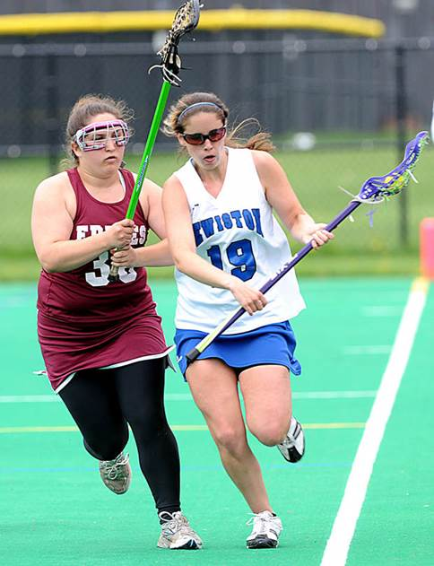
Restarting Play when a foul occurs near the boundary
If the ball goes out of bounds as the result of a foul. The fouled player is positioned, with the ball, at the spot of the foul, 4m from the boundary.
The player being awarded the ball may self-start just inside the boundary if she chooses to
Notes:
If a player gets fouled (click) and the ball goes out of bounds, the fouled player is awarded the Free Position (click)
The FP is set up at the spot of the foul, at least 4m in from the sideline. The player who fouled must go 4 m behind (or away)
The fouled player may commence play with a self-start.

Slide 34
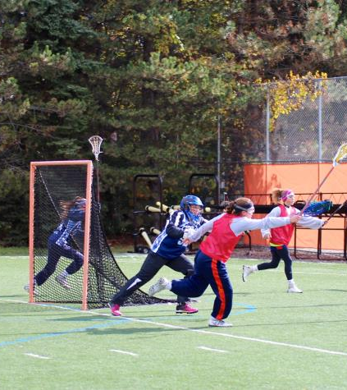
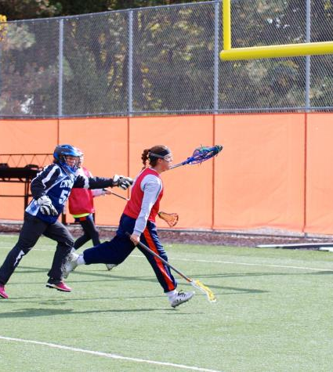
Restarting Play after a shot
Player/crosse closest to ball (and in bounds) where ball crosses line determines possession!
Notes:
2. To resume play when the ball has gone out of bounds on a shot or deflected shot:
a. The team of the player whose body or crosse that is both inbounds and nearest to the ball (stick or body) when
it crosses the boundary will gain possession of the ball.
Any player from the team awarded the ball will commence play with a self-start.
c. If the goalkeeper, while within the goal circle, is the nearest to the ball when it crosses the boundary, any player
from that team (including the goalie) may retrieve the ball and self-start
3. If two opposing players are equidistant from the ball (stick or body) when it goes out of bounds, alternate possession
will be awarded.
Use the vinyl field or white board to demonstrate shot scenarios:
goalie closest
closest to line vs closest to line where the ball went out
where to restart

Slide 35
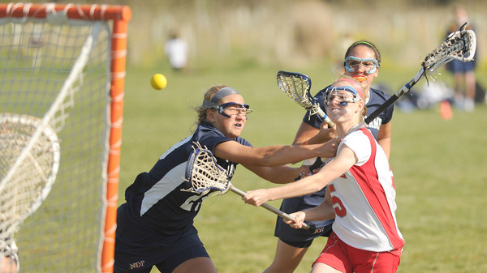
When is a Shot over?
A shot or deflected shot remains a shot until:
the ball goes out of bounds
the ball comes to rest on the field of play
a player gains possession of the ball
or a player otherwise causes the ball to go out of bounds
Note: A shot is considered deflected until it is controlled by a player on either team. Merely touching the ball does not
constitute “control.”
Notes:
4. A shot or deflected shot remains a shot until the ball goes out of bounds, the ball comes to rest on the field of play, a
player gains possession of the ball, or a player otherwise causes the ball to go out of bounds.
5. It is the Lead Official’s responsibility to determine if there is a shot or a pass, a
Note: A shot is considered deflected until it is controlled by a player on either team. Merely touching the ball does not
constitute “control.”

