Slide 1
Major Fouls
Notes:
Rule 10 covers the major fouls of women’s lacrosse.
As we go through these major fouls, reference the rules sheet, rule book, and signals in the rule book.
Instructor: after each foul – demonstrate the foul signal for each.( back pages of the rule book)

Slide 2
Major Fouls
Jeopardize the safety of the game or threaten the “Spirit of the Game”
Major Fouls
Misconduct/
Suspension Fouls
Notes:
This slide illustrates 4 areas of major fouls covered in this lesson. Review the slide
Have the students look at the rule book definitions of some of the fouls (Rule 10) with the class, ( they should be able to locate the definitions of each of the common major fouls covered in this lesson.) As you look at the definitions, mention the “language of the rule” and read a few from the rule book..

Slide 3
Major Fouls by the Defense
Foul With the Crosse
Dangerous Check
Check to the Head
Crosse in/through the Sphere
Crosscheck/Illegal contact
Slash
Dangerous Contact
Foul With the Body
Block
Shooting Space
Three Seconds
Hold/Push
Notes:
Handout and use the rule reference sheet to help with the definition and type of fouls (or the rule book.)
Note the mandatory yellow card fouls indicated on the slide and explain what that means.
The following slides will illustrate some of the fouls (not all). Ask the class if they have an understanding of each and if you need to demo or explain in more detail.

Slide 4
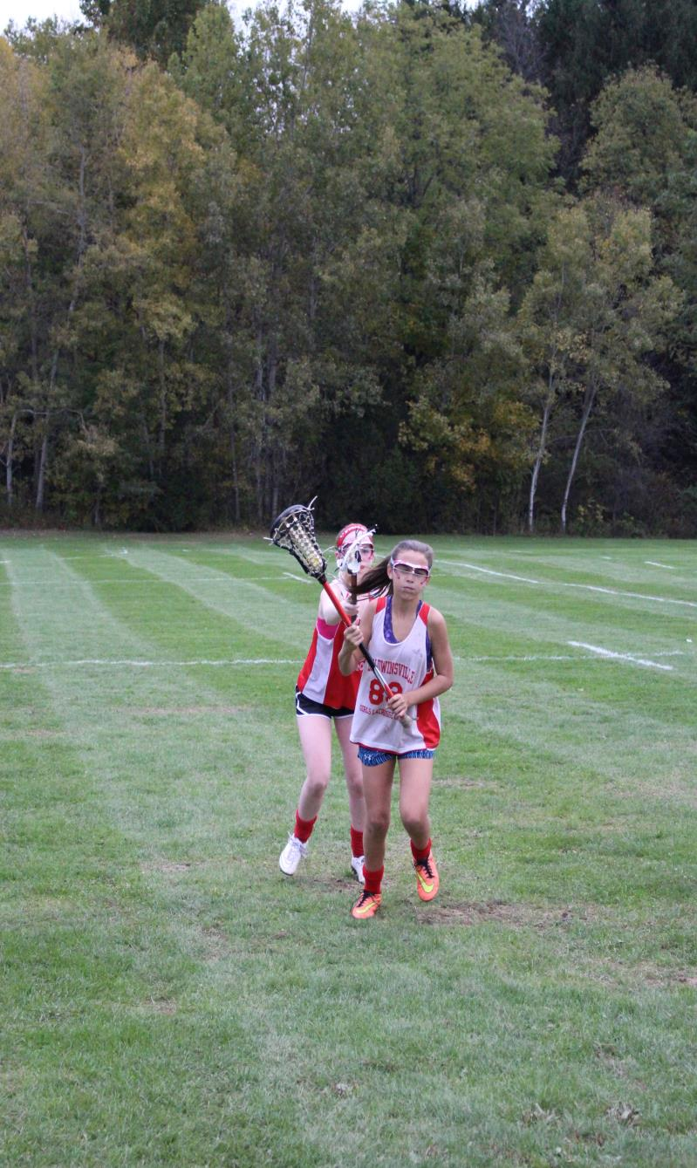
Check Through the Sphere
A player may not reach into or through the sphere or hold her crosse around the throat of her opponent (nor poke or wave in the face.)
Notes:
Explain the sphere (the width of thumb to the end of little finger), all the way around the head. Demo poking and or waving.
Signal? Review the signal.
In relation to the ‘waving and poking,” discuss what is acceptable defense vs. your opponent, and what elevates the defende’rs behavior to unacceptable defense/intimidation?

Slide 5
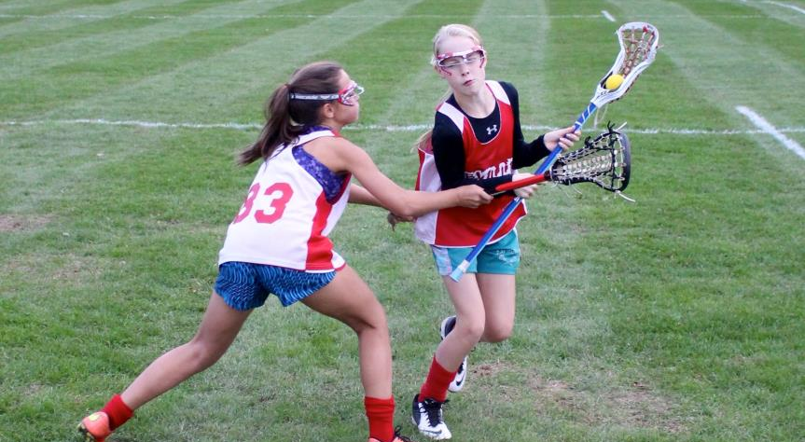
Illegal Stick to Body Contact
Using the shaft of the stick to hit, push or displace the opponent
Notes:
This foul includes a crosscheck and the “horizontal stick” call. Explain the difference.
Signal? Refer to rule book

Slide 6
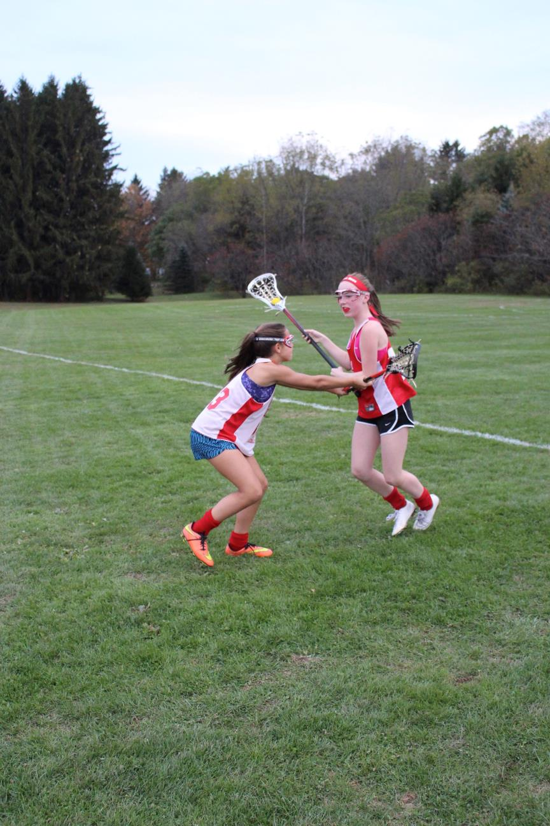
Illegal Stick to Body Contact
Defender drops head of stick to a horizontal position and makes contact with an opponent’s body
Notes:
This slide demonstrates the ‘horizontal stick”. The extension would be a ‘cross check’ foul by rule but the position of the stick ((below the “10 and 2” of the arms of a clock) and making contact with the body also meets the definition of a (horizontal) Illegal contact foul.
Signal?
Talk about consistency in officiating with this call. Talk about cleaning things up early vs “letting it go”, then attempting to change behaviors on the field.

Slide 7

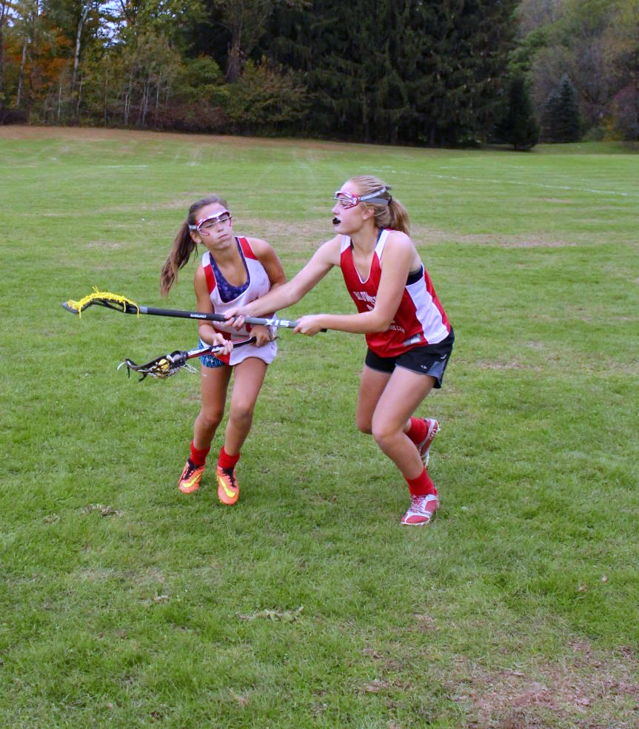
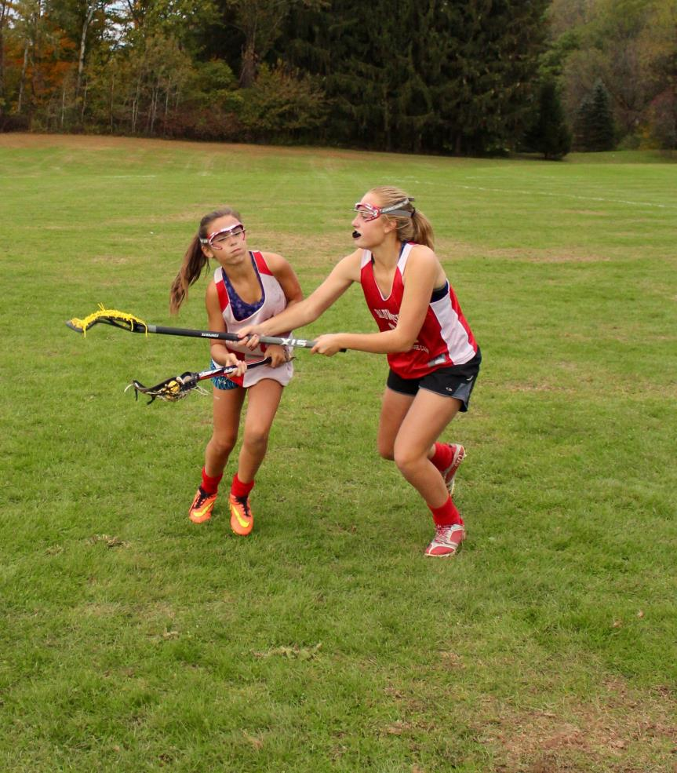
Holding
Defender uses her crosse to prevent player from
continuing on her established path
Notes:
Used to be called “Detaining” May be a hold using the crosse (as shown)
Also includes grabbing the uniform Demonstrate a ‘hold’ with the body (or body part-leg, arm), or clothing.
Signal?

Slide 8
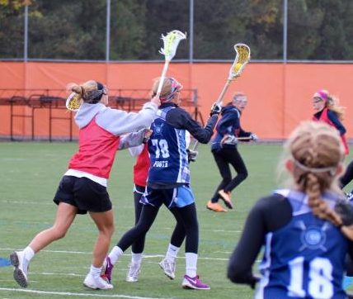
Check to the Head
MANDATORY
CARD
No player’s crosse may hit or cause an opponent’s crosse to hit the opponent’s head or neck.
Notes:
The “Check to the Head” foul is “cardable” (offender will receive a yellow card) -- Mandatory Yellow Cards because of the degree of danger to the opposing player.
Mandatory cards are not optional (officials MUST give the card).
How do you recognize this? Must there be contact? (yes – for “Check to the Head”, but not for all mandatory yellows!)
Does the contact have to be by the defender’s stick (no) – the action of the defender might cause the stick of attacker to hit her own head. Demo this.

Slide 9
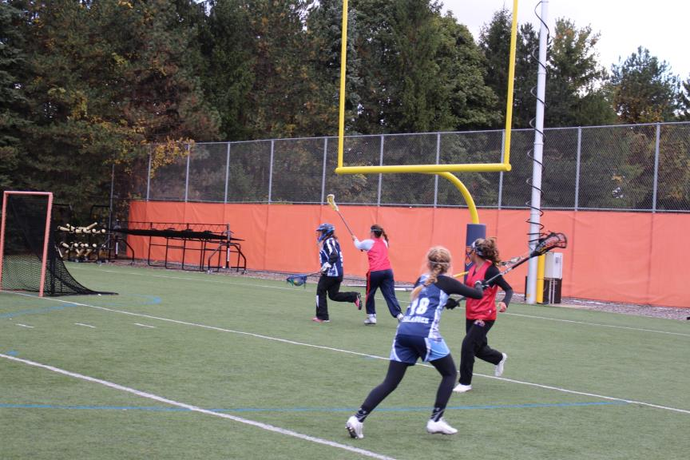
Slash
Defender out of position for a legal check; hands together on bottom of stick
Reckless or dangerous swing of the crosse at an opponent’s crosse or body (contact is not necessary)
MANDATORY
CARD
Notes:
Look for:
-Hands moved down to the end of the stick,
-A defender that is off balance in the attempt to check (therefore loss of control),
-Swings of the stick that are large and forceful and are going to, or almost to, the ground.
Think about a skilled check, vs an unskilled, dangerous attempt to check.
Does contact have to happen? (no).

Slide 10
Three Seconds Foul
A1 D1
No defender may remain in the arc for more than 3 seconds unless she is marking an opponent within a stick’s length
Count begins when the ball crosses the restraining line into the attacking end of the field
D2
A2
Being part of a double team does NOT exempt the defender from Three Seconds Violation*
*Unless double team is on the ball carrier!
Notes:
Animation starts automatically
Define a stick's length. Demonstrate: butt of the stick in contact with your body and the opponent at or inside the length of that stick – IT DOES NOT INCLUDE THE EXTENSION OF ONE or both ARM(s) HOLDING THE STICK.
Where must the ball be for this call to be made? (Across the Restraining Line)
Define a ‘double team’ and why one of them may be called for 3 seconds (3 second count continues against the original non-marking defender within the arc, unless there is again only one defender on that player)
Discuss why we have this rule and what might happen if we did not.

Slide 11
Exemption From Three Seconds Foul
A1
D2
D1
A2
Exempt from Three Seconds – NOT from Shooting Space!
Notes:
A defensive player, who is marking an unmarked opponent who is standing directly behind the goal circle is exempt from the three-second rule,

Slide 12
Three Seconds Foul Administration
Closest point to spot of the foul
A1
A1
Closest point to spot of the ball
A1
D1
D1
D1
D1
A1
Notes:
(Four clicks for animation)
Foul for Three Seconds ALWAYS occurs in the 8m arc.
Penalty Administration depends on spot of the ball:
(click)
Ball in the 8m Arc – FP on the nearest hash
(click)
Ball in the CSA, above GLE – FP on a spot on the 12m fan closest to the spot of the FOUL
(click)
Ball in the CSA, below GLE – FP on the nearest dot
(click)
NEW FOR 2023! Ball outside the CSA – FP on a spot on the 12m fan closest to the spot of the BALL

Slide 13
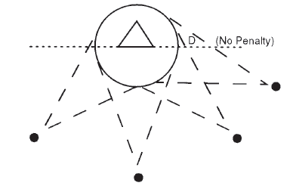
Shooting Space
While outside the goal circle, a player cannot guard the goal by obstructing the free space to goal, between the ball and the goal circle, and deny the attack the opportunity to shoot safely.
Notes:
The shooting space ”cone” is from the BALL to both sides of the goal circle.

Slide 14
Exemption From Shooting Space Foul
A1
D2
Defenders are Double Teaming and within a stick’s length
A2
D1
D3
Exempt from Shooting Space – NOT Three Seconds!
Notes:
Defensive players who are double or multiple teaming a player without the ball and are within a stick’s length are exempt from the obstruction of free space to goal.

Slide 15
Major Fouls by the Attack
Foul With the Crosse
Dangerous Follow-Through
Dangerous Propel
Forcing Through
Illegal Cradle
Foul With the Body
Charge
Illegal Pick
Notes:
Attack fouls need to be recognized and called.
There is an emphasis on attack fouls at the start of each season.
Here we also have yellow (mandatory) fouls.

Slide 16
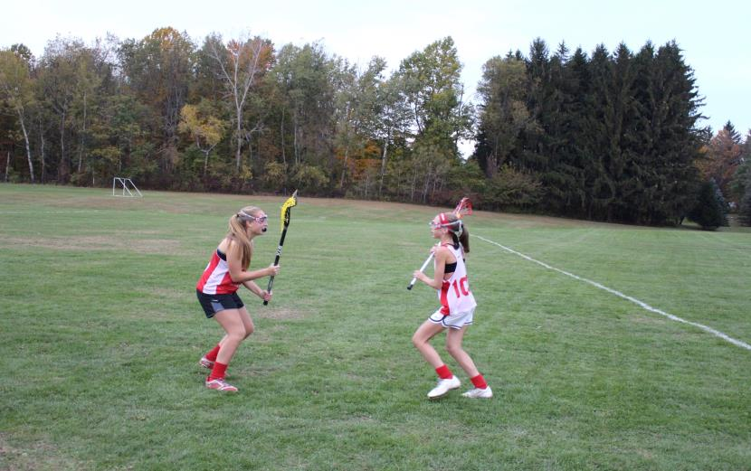
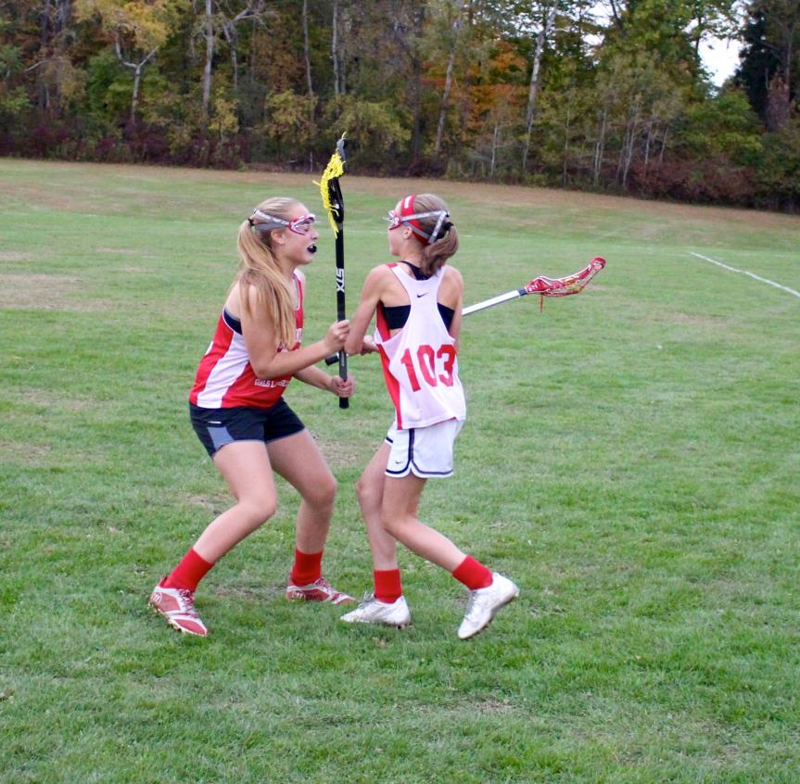
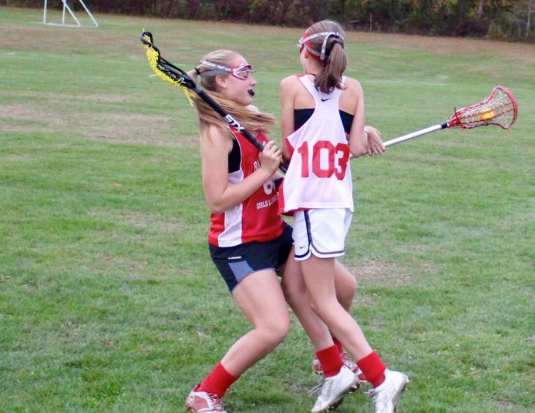
Charge
Defense established
Defender maintained space
CHARGE!
Offense has space to change direction
Offensive player went into her space
Notes:
Here is a good illustration of ‘time and distance’. The defender must give attack player the space to change direction and time to do it (slower players need more time/distance.). If attacker chooses not to change direction, and then she creates the contact, it is a charge.
With all fouls, consider “Who created the contact?”
The defender established her position and stayed there.
The offensive player moved into the defenders established space, therefore, the offensive player “created the contact”, and fouled.
Signal?

Slide 17
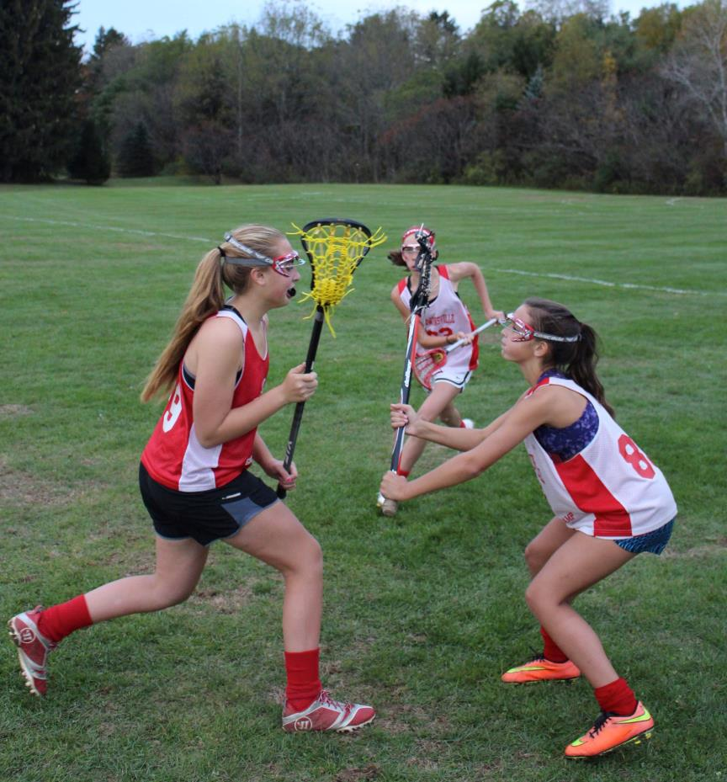
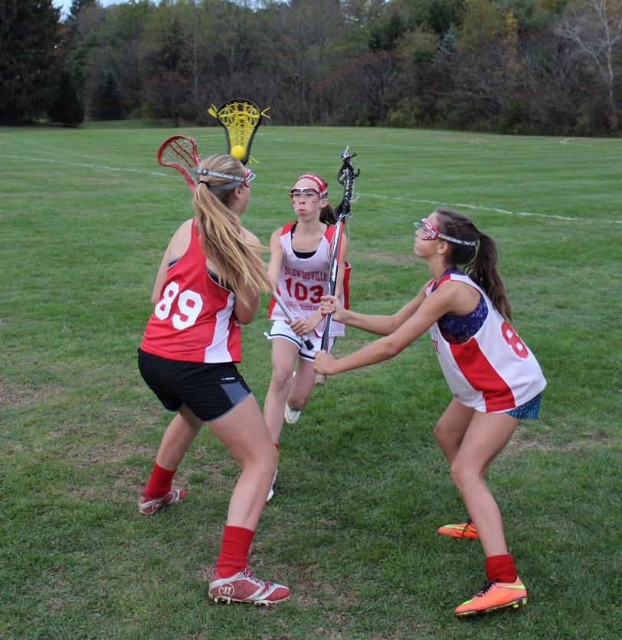
Illegal Cradle
ILLEGAL CRADLE!
Legal defensive positions
Player pulls crosse into her own sphere
Notes:
2 defenders
1 offensive player
Under pressure, the offensive player “tucks” the ball into her sphere, therefore not allowing a defender the opportunity to legally check the ball.
What legal move could the attacker make to avoid these defenders’ check? (turn her body and take the stick away from the defenders, move in another direction)

Slide 18
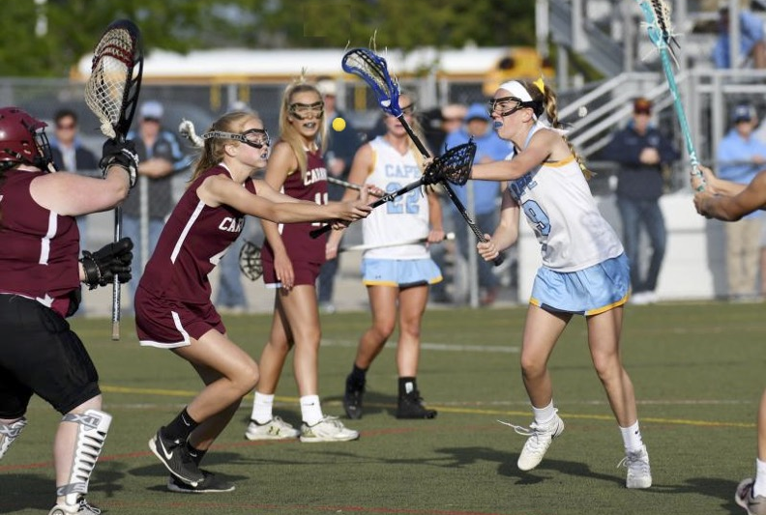
Dangerous Propel
MANDATORY
CARD
Propel the ball with the crosse in a
dangerous or uncontrolled manner at any time.
Notes:
A shot, throw, bat or flick of the ball without regard to the positioning of a field player is dangerous propelling
It disregards/jeopardizes player safety

Slide 19
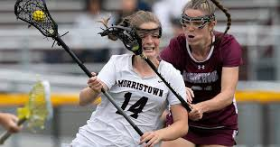
Holding
Detaining, restraining, tagging or pressing/pushing against the opponent’s body, clothing or crosse with an arm, leg, body or crosse
Notes:
Doesn’t have to be with the stick! Any action that prevents an opponent (with or without the ball) from continuing on their path
-Grabbing the jersey
-Holding them back with the stick
-Preventing them from moving through the CSA (path has to be established)
If defender is in place and opponent tries to push through to get where they want to be, could be forcing through (with crosse) or charge (with body)

Slide 20
Illegal Pick
Set a moving or stationary pick out of the visual field of an opposing player which does not allow
time or space to stop or change direction and contact occurs.
Notes:
NOTE: This video is the same as the ”block” video. Focus on the illegal pick here.
What is “The visual field”? (The area that can be seen when an eye is fixed straight at a point)
Was the pick in the visual field? If the player did NOT see the pick, could she have? Should she have? If the pick was in the visual field and she was not “aware”, that is NOT the same as being out of the visual field. If she could have/should have seen the pick and had time and space – it’s legal!

Slide 21
Penalty Administration

Slide 22
Outside the CSA
A1 D1
D1 A1
A
Attack Direction
Spot of the foul
Notes:
4 Clicks
Our illustrations will involve penalty administration based on the location of the ball at the time of the foul.
Outside the CSA
Inside the CSA but outside the 8m arc and above the GLE
Inside the CSA but below the GLE.
(click)
Before you begin with the animation, review the CSA, GLE and Dots on the field with the class.
If they have not covered “BOO” penalty administration, this should also be introduced, or reviewed.
Activity - Demonstrate the penalty administration steps in a whistle start situation. Demonstrate the penalty administration in a self start situation.
B.O.O.: ball, offender, others
The rule reference sheet has the penalty administration by location on the its backside.
This slide has 4 clicks.
Take it slow and explain what has happened on each click. Pause to ask the class for their signal, and penalty administration of this foul, based on location.
You can redo the slide by hitting the up arrow on keyboard (4x)and repeat the movement so the class can repeat the administration and foul signal a few times.
(Self start allowed)

Slide 23
Penalty Administration – Defense Fouls

Slide 24
In the CSA, Below GLE
A
A1 D1
A1 D1
Closest dot
Notes:
Push Foul on D1
(click)
Whistle to call the foul
Give a direction for possession
Give the signal for the foul
A1 moves to the Dot
D1 moves 4m behind, in line with the goal
Whistle the restart (no self start allowed)
Note location is “closest Dot” and angle of the 4m behind, keeping the ball between the goal circle and the offender.

Slide 25
In the CSA, Above the GLE, Outside the 8m
A
Clear a “Lane”
4m to each side of the ball and along imaginary parallel lines that extend from the width of the goal circle
A1 D1
D1 A1
Free position for a defensive foul between the 8m arc and 12m fan will be administered on the 12m fan
The “Lane” does not extend below the GLE
Notes:
Hold on D1
(click)
Whistle to call the foul
Give a direction for possession
Give the signal for the foul
A1 moves to a spot on the 12m fan closest to the spot of the foul
D1 moves 4m behind, in line with the goal
Whistle the restart (no self start allowed)
Let participants know how to get assistance from the trail/C on ‘lane clearing’

Slide 26
In the the 8m Arc
A
Free position at the 8m hash nearest to the spot of the MAJOR foul
A1 D1
D1 A1
Clear the Penalty Zone
Notes:
Push on D1
(click)
Whistle to call the foul
Give a direction for possession
Give the signal for the foul
A1 moves to the 8m hash closest to the spot of the foul
D1 moves 4m behind, in line with the goal
Whistle the restart (no self start allowed)
The following slide will illustrate the Zone and what is to be cleared.

Slide 27
Penalty Zone Clearing
Note the two different areas:
1. The penalty zone
2. The critical scoring area
All players must clear the Penalty Zone
End line
Players MAY position themselves between the PZ and the endline for 8m Free Positions
Notes:
Penalty Zone is different from the CSA boundaries (discuss these imaginary lines and the parts they cover)

Slide 28
Penalty Zone Clearing
D1
A1
D3
D4
Defensive players are entitled to the hash marks adjacent to the ball carrier
A2
D2
Notes:
Both attack and defense have cleared the Penalty Zone as instructed.
Defense gets the adjacent hashes to the ball carrier. Any defender can take them
Doesn’t have to be closest player
Doesn’t have to be player in the 8m arc/CSA

Slide 29
Penalty Administration – Three Seconds
Ball Inside the 8m arc? Restart at nearest hash
A1
Ball outside the CSA?
Restart at a spot on the 12m fan nearest to the BALL
A1
D1
D1
A1
D1
Ball between the 8m and 12m?
Restart at a spot on the 12m fan nearest to the BALL
Penalty administration for any Three Seconds Foul is determined by the spot of the ball when the foul is called
Notes:
Three Seconds foul always occurs in the 8m arc.
Penalty administration depends on the spot of the ball, NOT the spot of the foul.
Ball inside the 8m – restart at nearest hash
(cick)
Ball between 8 and 12m – restart at nearest spot on 12m
(cick)
Ball outside CSA – restart brought up to nearest spot on 12m

Slide 30
Major Fouls By Defensive Goalie
If the goalkeeper commits the foul, they must go behind.
If the goalkeeper is out of the Goal Circle when defensive foul called and did NOT commit the foul, she may go back into the Goal Circle.

Slide 31
Penalty Administration – Offense Fouls

Slide 32
Attack Fouls in 8m Arc
A1
D1
When the attack fouls in the 8m arc, the player fouled will take the free position at the spot of the foul and may self-start.
Notes:
New for 2023!
The defensive player is given the ball, moves 8m from the goal circle, and may self-start
Officials still direct the offender “away” or “behind”… but the defender may self-start immediately.

Slide 33
Attack Fouls in CSA Below the GLE
A1
D1
When the attack fouls in the CSA but below the GLE, the player fouled will take the free position at the spot of the foul and may self-start.
Notes:
New for 2023!
The defensive player is given the ball, moves to the closest dot, and may self-start
Officials still direct the offender “away” or “behind”… but the defender may self-start immediately.

Slide 34
Attack Fouls in CSA, Outside the 8m Arc
A1
D1
When the attack fouls in the CSA, between the 8m arc and 12 m fan, the player fouled will take the free position at the spot of the foul and may self-start.
Notes:
And when the attack fouls in the CSA above the GLE and not in the 8m ARC, (between the 8m and the 12m), the restart is at the spot of the foul.
We DO NOT clear the Penalty Zone.

Slide 35
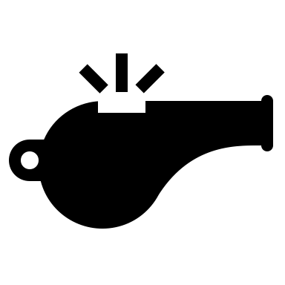
Attack Fouls in the CSA
01:56
D1
A1
During last two minutes of Q2 and Q4 if a defender in the CSA restarts when a whistle start is required, reset the play and whistle start.
Notes:
During the last two (2) minutes of each quarter, ALL fouls in CSA require a whistle restart – including when defense gets the ball!

Slide 36
Major Fouls on Scoring Play –
Flag

Slide 37
Flag
A held whistle is in effect when an attack player in the critical scoring area is on a scoring play and a defender commits a Major foul but the ball carrier retains possession of the ball
and continues their effort towards goal.
OR
An attack player in the critical scoring area is on a scoring play and a Major foul is committed against an attack teammate without the ball.
In both instances, the official will raise a YELLOW FLAG to acknowledge the foul but let play continue . (Rule 11 art. 1)
Notes:
What is Advantage? Where else can we use it?

Slide 38
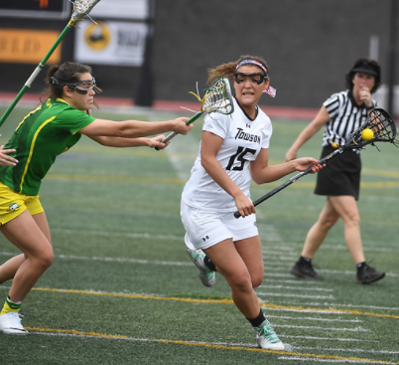
Scoring Play
A scoring play is a continuous effort by the attacking team within the critical scoring area (CSA) to move the ball toward the goal and to take a shot on goal.
Notes:
Give some examples of something that is not a “scoring play” (passing around the arc and player is fouled, cutting through and is fouled, etc.)
Going below the GLE does not ALWAYS mean a scoring play is over. It depends if the ball continues in movement toward goal – or not.

Slide 39
Flag
If Criteria Met :
Pull Yellow Flag
(shows recognition of foul)
Hold up until:
-Scoring play ends
-Attack team loses
possession
-Attack shoots
Ball Is In the Critical Scoring Area?
Attack On a Scoring Play?
Major Foul by Defense?
Notes:
Relate the ‘held whistle’ to the advantage arm on a midfield ‘held’ ( “I see the foul but you’re doing ok so I’m not going to call it”)
The Major foul need not be on the attacker with the ball but any major foul on any attacking player on this scoring play.
Could the flag be raised by the Trail official? (yes) In what scenarios could the Trail raise the flag? (to demonstrate a held whistle on an off-ball foul the Trail sees)
Discussion on the “scoring Play” . What is it?

Slide 41
Held Whistle
True or False?
1. The held whistle allows the attack to continue to ‘go to goal’.
2. The foul against the attacking player must be a major foul.
3. If the movement to goal stops, the official blows the whistle and administers the penalty for the (held) foul
Notes:
We are looking for BASIC understand of the slow whistle.
True
True
True

